Slide 1
IBM University Engagement Project Submission
“Exploring the Power of Agentic AI with IBM Granite and IBM Bob”

Slide 2

Project Tile – Intelligent Shopping Agent
Domain of Project – Lifestyle
Student Name | Recent Passport Photo | Email ID | Mobile number [WhatsApp]
Om Yashwant Deore |  | omydeore25@gmail.com | 9226899760

Slide 3
Problem Statement -
Problem Statement : Intelligent Shopping Agent
The Challenge Shoppers today face an overload of product options, scattered reviews, and dynamic pricing across e-commerce platforms. Finding the right product that balances price, quality, and personal preferences is time-consuming and frustrating. Traditional recommendation systems often fail to capture real-time trends, personalized needs, or contextual factors like urgency, budget, or sustainability. The challenge is not just to recommend products but to act as a smart shopping companion that helps buyers make informed and confident decisions.
The Objective:Build an agentic AI shopping assistant that provides intelligent, personalized, and real-time support. The solution should: 1. Fuse Multisource Data: Aggregate product details, reviews, ratings, and price comparisons across multiple e-commerce sites into unified insights. 2. Enable Multimodal Search: Allow users to input voice queries, images (e.g., a photo of a product), or text descriptions to find best-matching products. 3. Create a Predictive & Agentic Layer: Suggest purchase timing (e.g., discounts, seasonal offers), recommend alternatives, and alert users about price drops or fake reviews. 4. Visualize Smart Shopping Pulse: Provide a dashboard summarizing comparisons, sustainability scores, trending products, and personalized shopping lists.

Slide 4
Proposed Solution -
Proposed Solution: AI-Powered Intelligent Shopping Agent
The proposed solution is a multi-agent AI-powered Intelligent Shopping Agent built using IBM watsonx Orchestrate, IBM watsonx.ai, and Granite Models to provide personalized, real-time shopping assistance. The system addresses challenges such as product overload, scattered reviews, price fluctuations, and difficulty in making informed purchase decisions through an intelligent, modular architecture.
At its core, the solution uses a Retrieval-Augmented Generation (RAG) pipeline to fetch accurate and up-to-date product information from trusted e-commerce platforms, manufacturer websites, and review sources. Product specifications, customer reviews, ratings, pricing, and availability are embedded and stored in a vector database, enabling the system to retrieve, compare, and summarize relevant product insights using Granite models.
The system consists of four key agents:
Product Discovery Agent retrieves and summarizes product details, specifications, reviews, and ratings using the RAG pipeline, helping users quickly understand available options.
Comparison & Purchase Advisor Agent compares shortlisted products based on price, features, quality, customer sentiment, warranty, and value for money, then provides a final buying recommendation with clear reasoning.
The solution includes a user-friendly dashboard (built with React or Streamlit) where users can search products, compare multiple options, track price history, save wishlists, receive personalized deal notifications, and monitor their shopping preferences.

Slide 5
Technology Used
IBM Bob platform -For designing and orchestrating multi-agent workflows visually
IBM Grainte model - for eg – ibm-granite-3-2-8b – For natural language understanding, reasoning, and personalization
IBM Cloud – It provides the infrastructure to build, deploy, and scale the Nutrition Agent efficiently. IBM Cloud enables a reliable, secure, and scalable environment for deploying the Nutrition Agent.
RAG– RAG to fetch real data first, then generate intelligent answers, making the Nutrition Agent more trustworthy and effective.
IBM Watsonx.ai - For model deployment, embeddings, and AI governance
Vector Database (FAISS/Chroma) – For RAG-based nutritional data retrieval

Slide 6
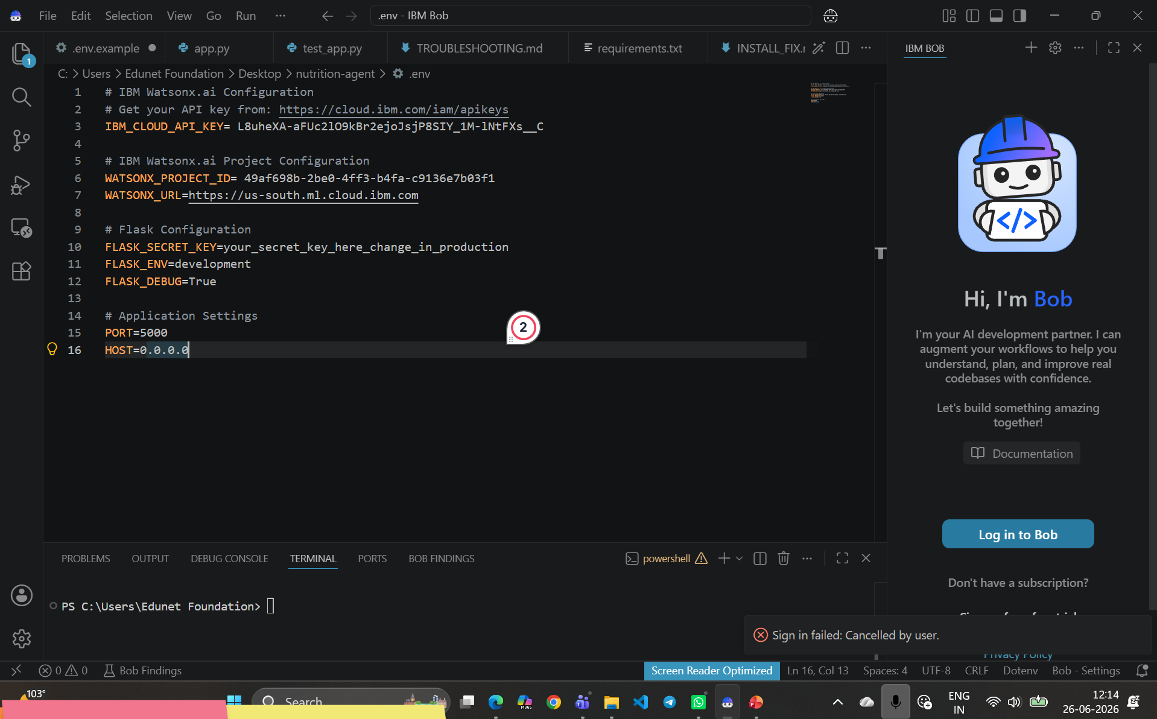
IBM Bob Screenshots:

Slide 7
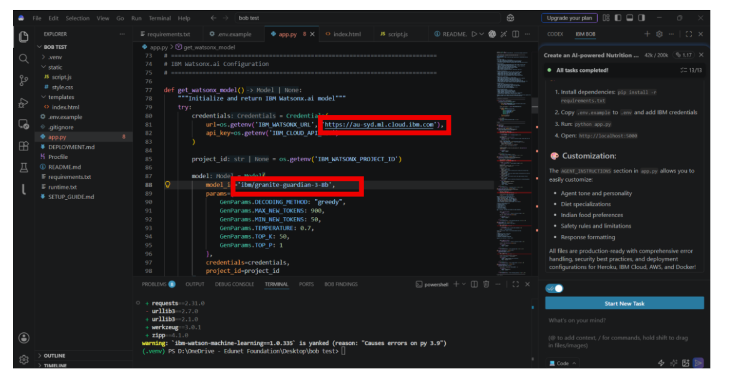

Slide 8

Role of Agentic AI in the solution
Agentic AI is the core intelligence behind the Intelligent Shopping Agent, enabling the system to make autonomous decisions, coordinate multiple specialized agents, and deliver personalized shopping assistance with minimal user effort. Instead of acting as a simple chatbot, Agentic AI plans tasks, gathers information from multiple sources, reasons over the data, and provides actionable recommendations.
Its key roles include:
Autonomous Task Execution: Automatically searches products, gathers specifications, reviews, ratings, and pricing information from multiple trusted sources without requiring multiple user queries.
Multi-Agent Collaboration: Coordinates specialized agents such as the Product Discovery Agent, Recommendation Agent, Price & Deal Intelligence Agent, and Comparison & Purchase Advisor Agent to complete complex shopping tasks.
Personalized Recommendations: Understands user preferences, budget, purchase history, and shopping goals to recommend the most suitable products.
Intelligent Product Comparison: Analyses features, customer reviews, warranties, and value for money to generate unbiased product comparisons and final purchase suggestions.
Real-Time Price Monitoring: Continuously tracks price changes, discounts, cashback offers, and coupons, notifying users when the best buying opportunity is available.
Context-Aware Decision Making: Considers multiple factors such as urgency, budget, brand preference, sustainability, and product availability before making recommendations.
Learning and Adaptation: Learns from user interactions and feedback to improve future recommendations and personalize the shopping experience over time.
Explainable AI: Provides transparent explanations for why a particular product is recommended, increasing user trust and confidence in purchase decisions.

Slide 9
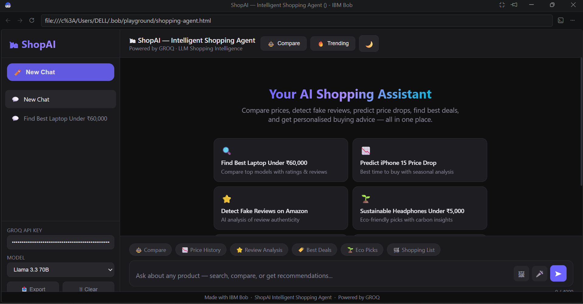
Project Output Screenshot
Please put IBM Bob output screenshots with 2-3 prompts.
You can take 2-3 more slides for each screenshot
·
·
·

Slide 10
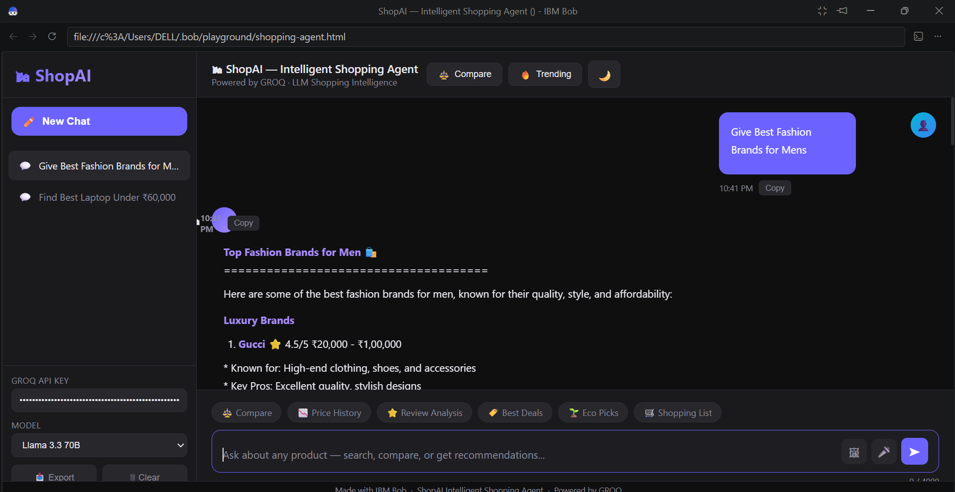
Project Output Screenshot
Please put IBM Bob output screenshots with 2-3 prompts.
You can take 2-3 more slides for each screenshot
·
·
·

Slide 11
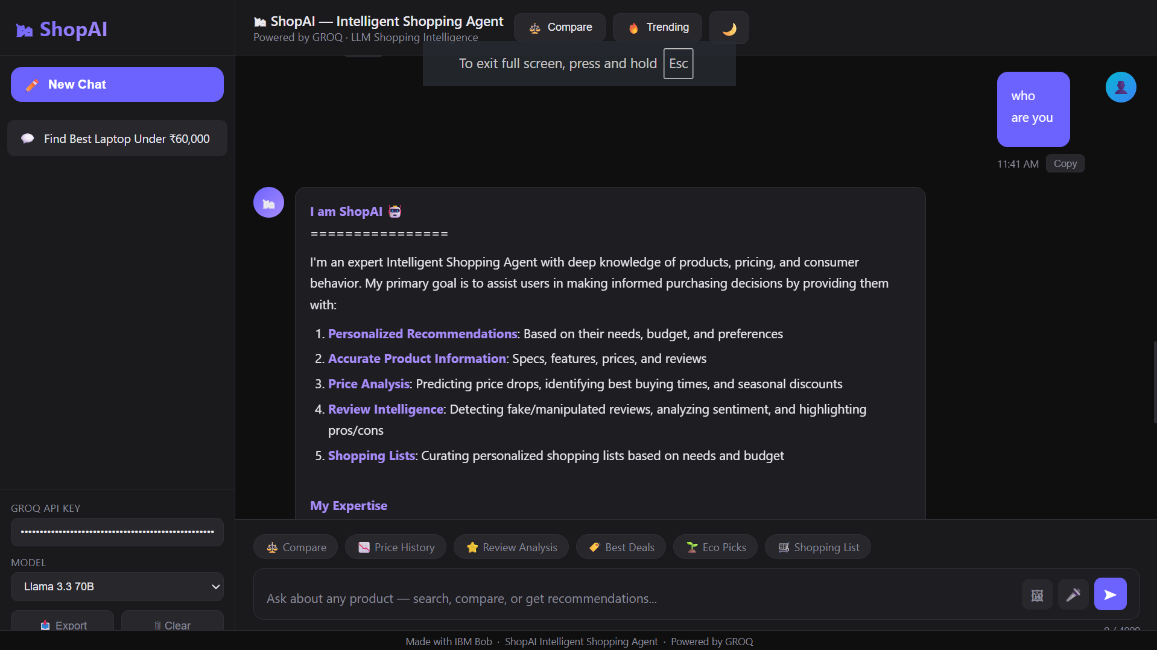
Project Output Screenshot
Please put IBM Bob output screenshots with 2-3 prompts.
You can take 2-3 more slides for each screenshot
·
·
·

Slide 12
Novelty and Uniqueness
Multi-Agent AI System: Uses specialized AI agents that work together for product search, recommendations, price tracking, and comparison.
RAG-Based Intelligence: Retrieves real-time product information, reviews, and prices from trusted sources for accurate recommendations.
Personalized Shopping: Suggests products based on user preferences, budget, and shopping history.
Smart Price Tracking: Monitors discounts, coupons, cashback offers, and price drops across platforms.
Explainable AI: Clearly explains why a product is recommended, improving user trust.
IBM AI Integration: Powered by IBM watsonx Orchestrate, watsonx.ai, and Granite Models for scalable, secure, and intelligent shopping assistance

Slide 13
Git Hub Link
GitHub Repository
·
·

Slide 14
Future Scope
Voice-Based Shopping Assistant for hands-free product search and recommendations.
AR/VR Product Visualization to let users virtually try products before purchasing.
AI Budget & Expense Planner to recommend products based on spending habits and monthly budgets.
Global Multi-Language Support for users across different regions and languages.
Cross-Platform Price Tracking with instant alerts for discounts, coupons, and cashback offers.
Sustainability Recommendations by suggesting eco-friendly and energy-efficient products.
Blockchain-Based Product Verification to detect counterfeit products and ensure authenticity.
Predictive Shopping using AI to anticipate future needs and recommend products before users search for them.
Continuous Learning from user preferences and feedback to deliver increasingly accurate, personalised recommendations.
·
·

Slide 15
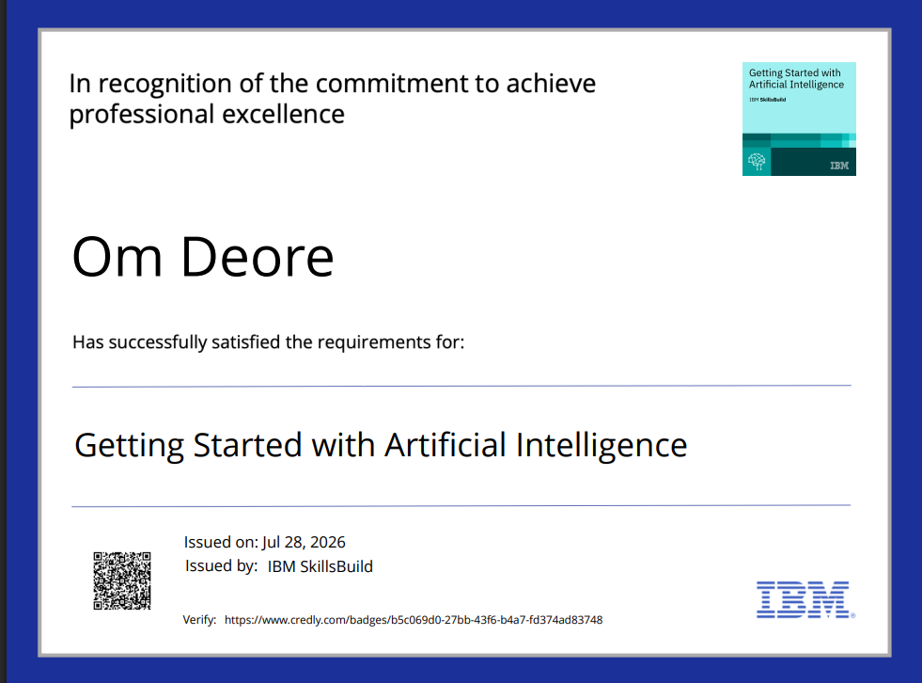
Certificates Earned:

Slide 16

Certificates Earned:

Slide 17
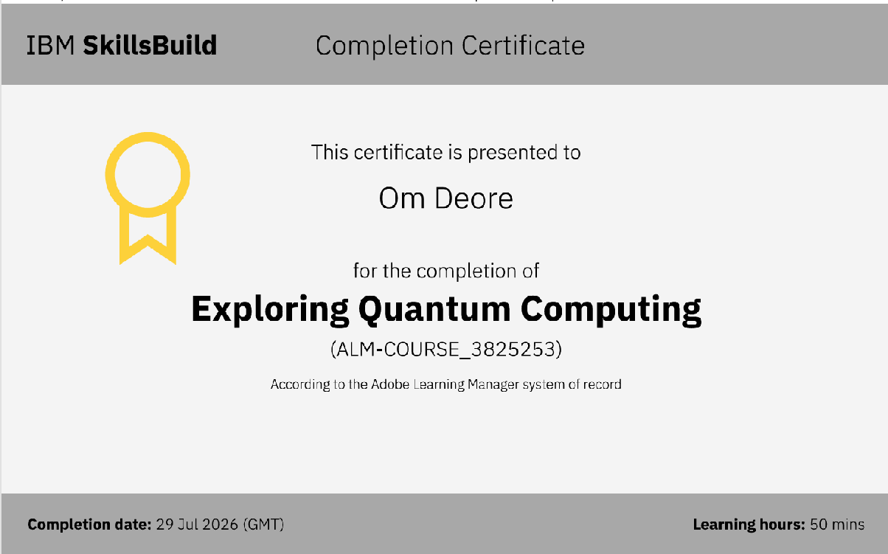
Certificates Earned:​

Slide 18
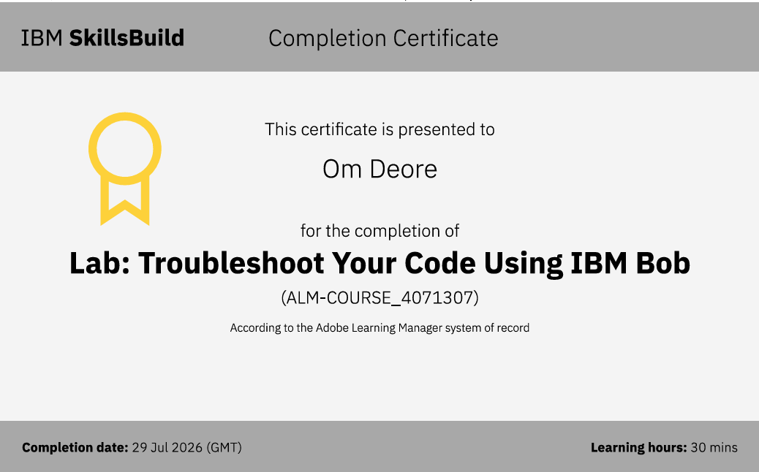
Certificates Earned:​

Slide 19


