Slide 1
UBA Belgian SDR Meetup 3
Kristoff Bonne (ON1ARF)
30/10/2020

Slide 2
BE.SDR Meetup 3: Agenda
20:00
  Question time + Introduce yourself
  Some news about BE.SDR
20:30
  Solution of CTF1 and CTF2
  The elektor SDR receiver shield
  ”Learning SDR hardware: A bare minimum SDR receiver”
21:40
  Open discussion on BE.SDR

Slide 3
BE.SDR Meetup 3: Agenda
20:00
  Question time + Introduce yourself
  Some news about BE.SDR
20:30
  Solution of CTF1 and CTF2
  The elektor SDR receiver shield
  ”Learning SDR hardware: A bare minimum SDR receiver”
21:40
  Open discussion on BE.SDR

Slide 4
Practical Issues
This is a video-conference, so please follow these rules
Use a headset
Best browsers:
  chrome / chromium / …
  Firefox
Mute mic if you have nothing to say
Switch off your camera if you have nothing to show

Slide 5
Practical Issues
This is a video-conference, so please follow these rules
Feel free to give feelback!
  There are three “question time” moments
  You can also use the “chat”
  Feel free to use your own language to ask questions
    I will reply in English

Slide 6
Practical Issues
The video-presentation will be recorded and can be placed online.
Note, that, if you speak, your video (if on) and your name / call will be visible!

Slide 7
Legal
This presenation are distributed under the Creative Commons “BY-SA 4.0” License:
https://creativecommons.org/licenses/by-sa/4.0/
Images used in the presentation may come with their own license.
All care has been taken that all images may be used publicly. If you own the copyright to an image and consider its use in this document improper, please contact the author of this document.

Slide 8
BE.SDR Meetup 3: Agenda
20:00
  Question time + Introduce yourself
  Some news about BE.SDR
20:30
  Solution of CTF1 and CTF2
  The elektor SDR receiver shield
  ”Learning SDR hardware: A bare minimum SDR receiver”
21:40
  Open discussion on BE.SDR

Slide 9
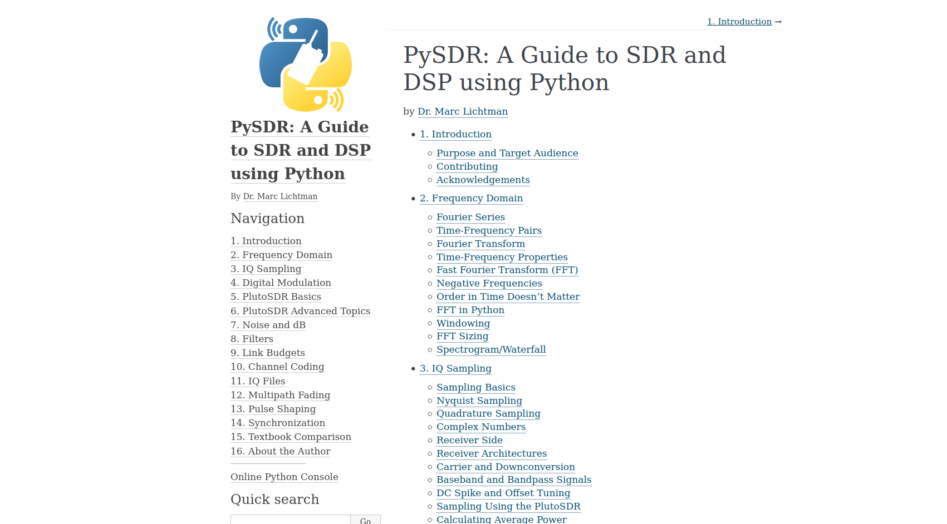
PySDR

Slide 10
PySDR
“SDR explained for Programmers”
  Relative little math
  Very well explained
  Examples using py (scipy, numpy, mathplotlib)

Slide 11
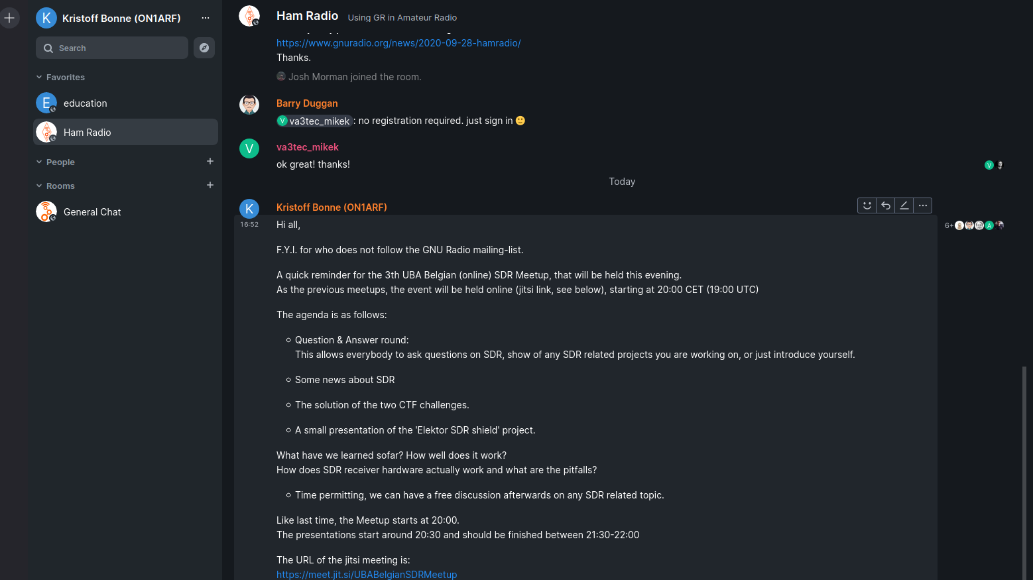
GNU Radio chat
https://chat.gnuradio.org/

Slide 12
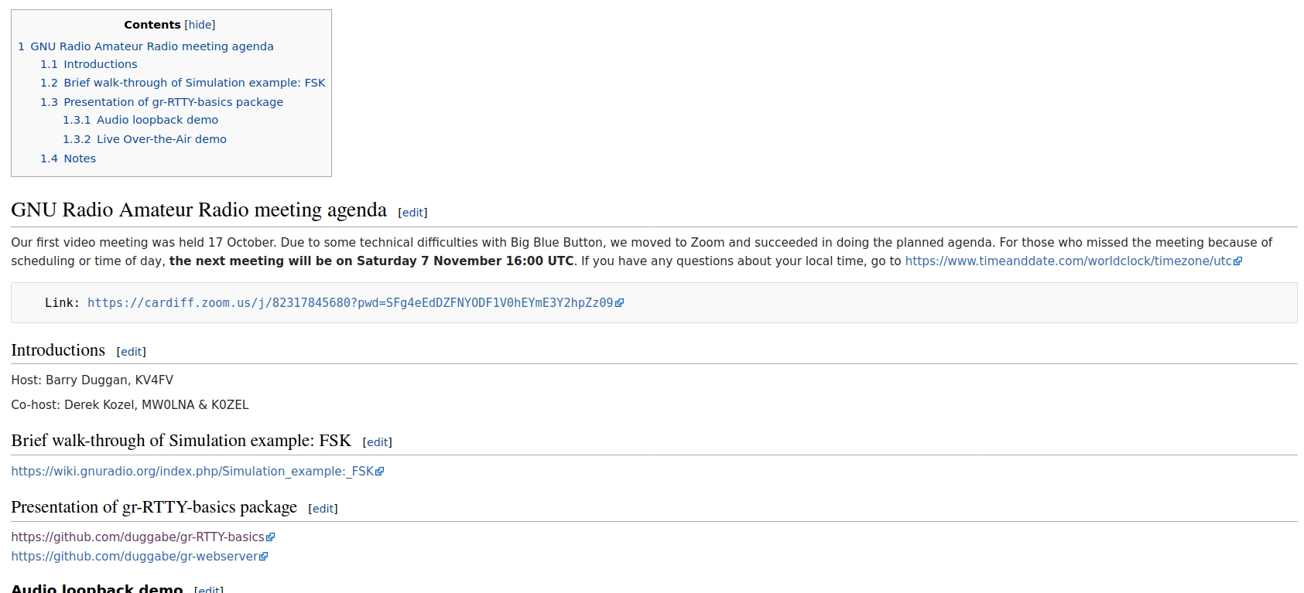
Monthly GNU Radio Amateur Radio Meeting
https://wiki.gnuradio.org/index.php/User:Duggabe

Slide 13
BE.SDR Meetup 3: Agenda
20:00
  Question time + Introduce yourself
  Some news about BE.SDR
20:30
  Solution of CTF1 and CTF2
  The elektor SDR receiver shield
  ”Learning SDR hardware: A bare minimum SDR receiver”
21:40
  Open discussion on BE.SDR

Slide 14
CTF: Capture the Flag
What is a “Capture the flag”
Started out as outdoor game
Later: Cybersecurity events
  2 teams against eachother
  Or CTF against the organisation of the cybersec event: (e.g. find hidden text key in file, disassembler application, …)
RF Cybersecurity:
  Extract hidden message from IQ file

Slide 15
CTF: The GOAL
Learn SDR, GNU Radio and Tools in a fun way
Learn how to demodulate signals
Learn how to decode signals
  Formatting and encoding of data
  Error Detection / Error Correction
  …
Practice your coding skills

Slide 16
CTF1
2 'iq' files:
  20200919_1210Z_490Khz_1200sps
  20200919_1240Z_518Khz_1200sps
Decoder: https://github.com/on1arf/py-navtexdec
Hint: 2nd Belgian SDR Meetup

Slide 17
CTF2
iq file:
  Ctf2_1200bps.iq
The question of this ctf is this:
When (date/time) was this recording made?
Hint: The question of the ctf is a hint by itself.

Slide 18
CTF: Scoreboard
CTF 1:
  Jan ON6LM
CTF 2:
  Laurein ON4CG
  Jan ON6LM

Slide 19
BE.SDR Meetup 3: Agenda
20:00
  Question time + Introduce yourself
  Some news about BE.SDR
20:30
  Solution of CTF1 and CTF2
  The elektor SDR receiver shield
  ”Learning SDR hardware: A bare minimum SDR receiver”
21:40
  Open discussion on BE.SDR

Slide 20
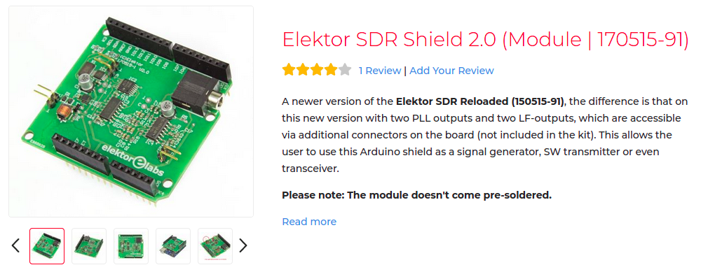
Project: the elektor SDR Shield
Learning SDR Hardware, using a very basic SDR Receiver

Slide 21
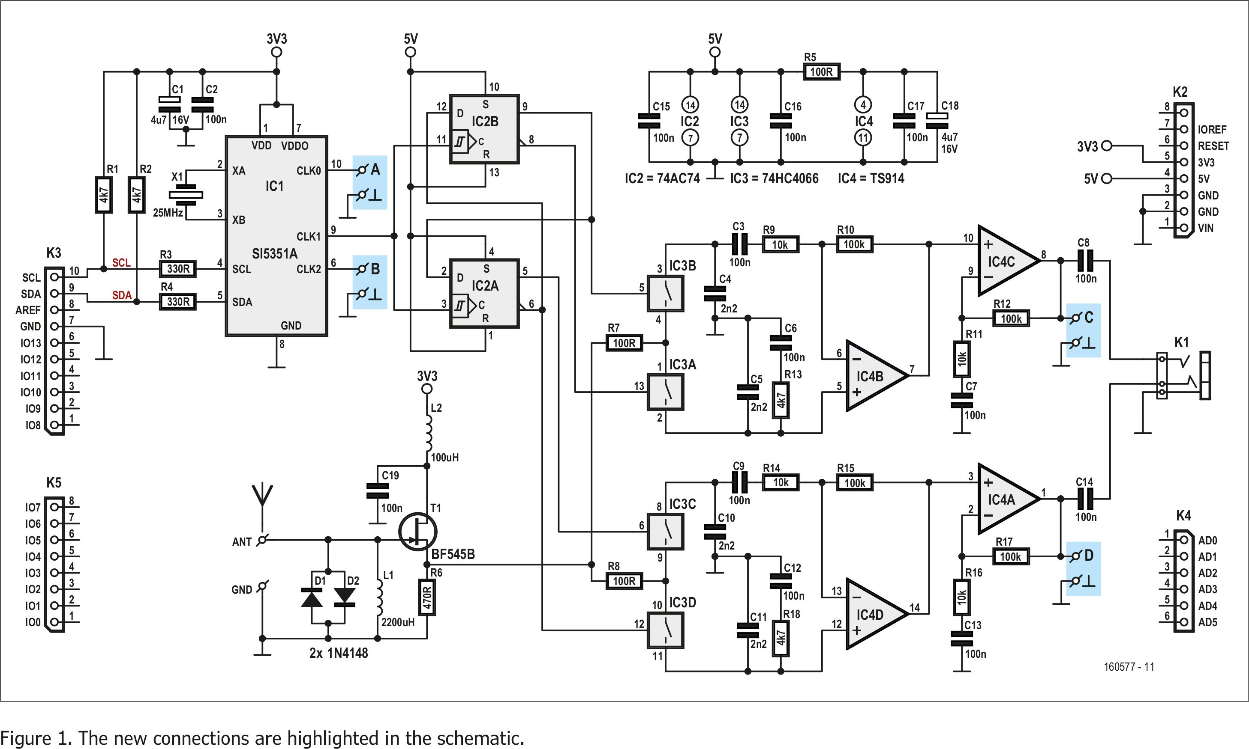
the elektor SDR Shield: Schematics

Slide 22
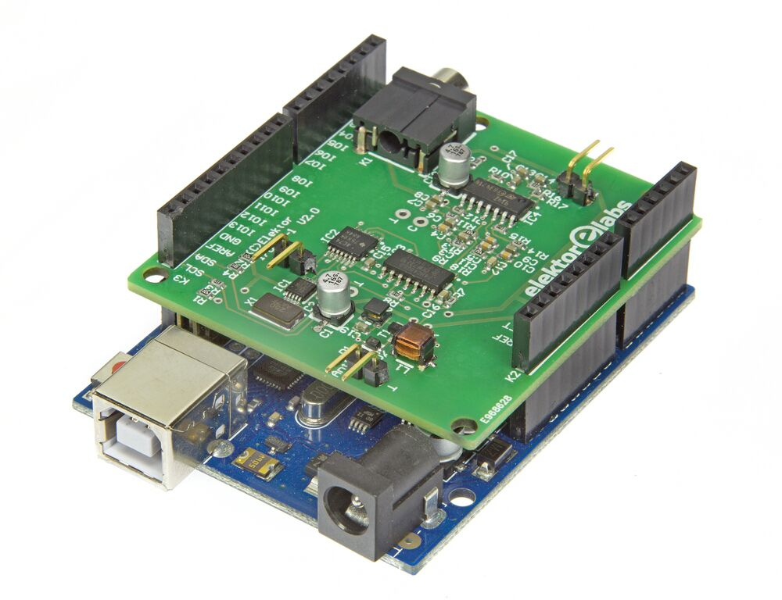
the elektor SDR Shield: On arduino

Slide 23
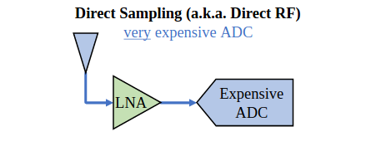
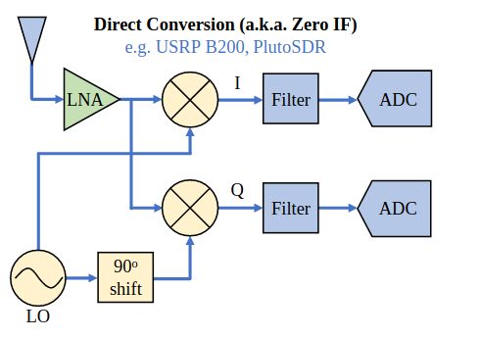
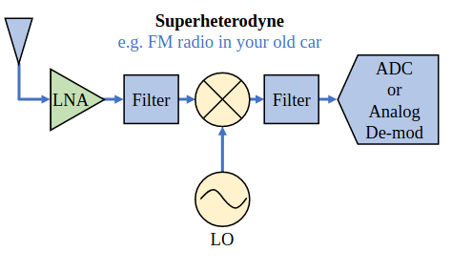
SDR receivers: 3 types
https://pysdr.org/content/sampling.html#receiver-architectures

Slide 24
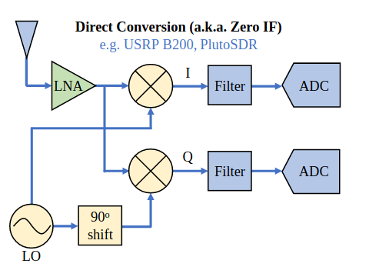
SDR receiver: Direct Conversion

Slide 25
SDR receiver: Direct Conversion (2)
1
4
4
5
3
3
2
2
5
4
1

Slide 26
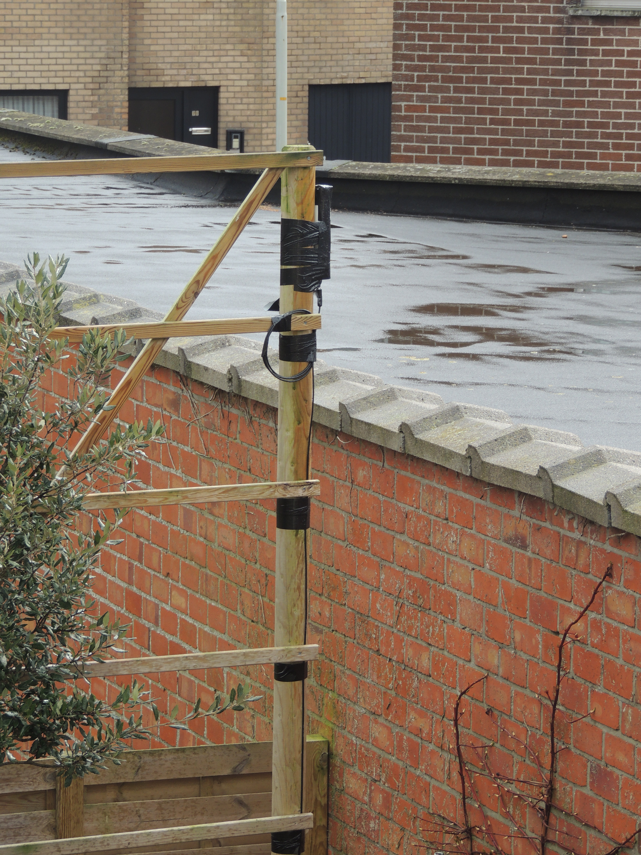
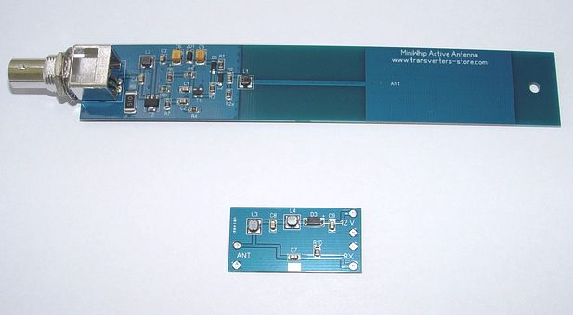
My setup: Antenna
Antenna: active whip-antenna:
http://transverters-store.com/whippcb.htm

Slide 27
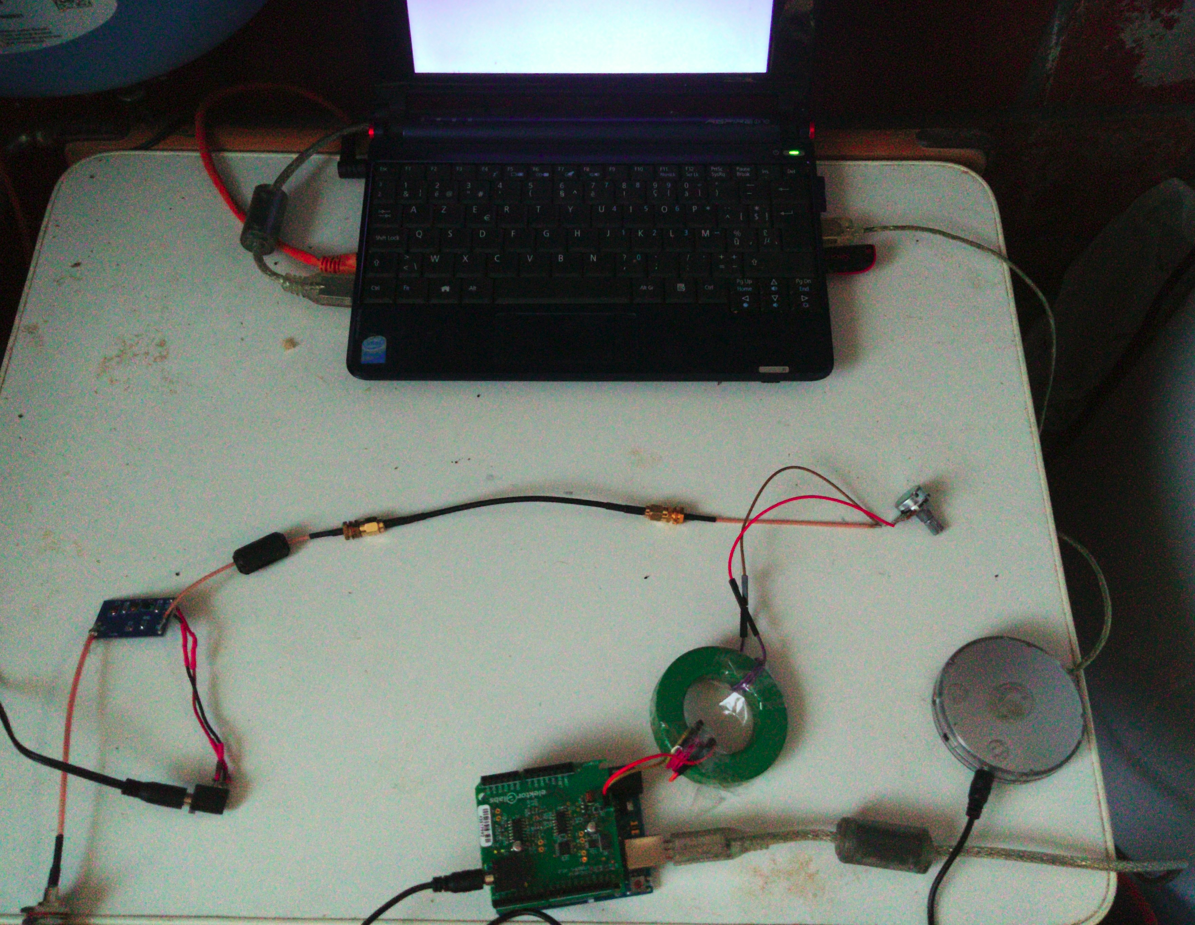
My setup: Receiver hardware
Remote PC
Var. Resistor
Bias-T
Impedance
Matching (1/3)
ADC (Griffin
imic)
SDR Shield
Audio Out
Audio Out
Arduino Serial

Slide 28
My setup: Software
Linux based:
arecord → import audio
  pipe to FIFO (named pipe)
  GQRX
Fldigi
Picocom (control frequency)

Slide 29
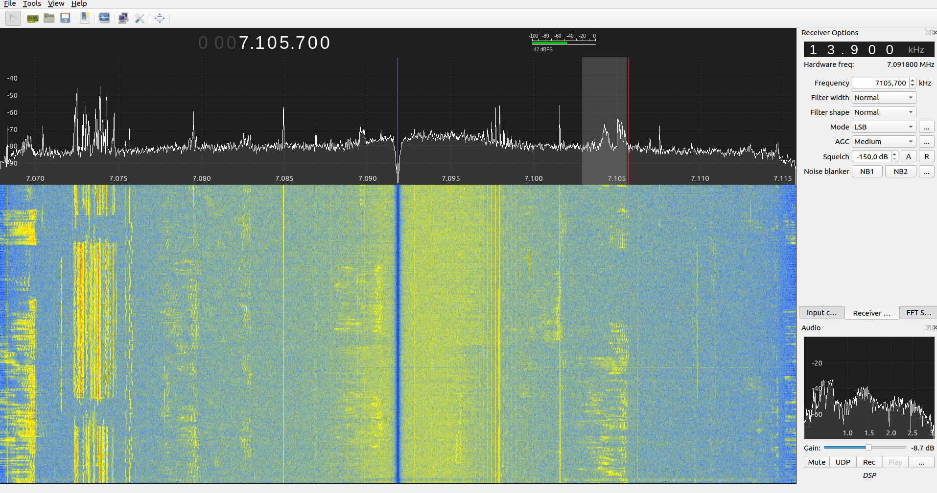
And Does it work?

Slide 30
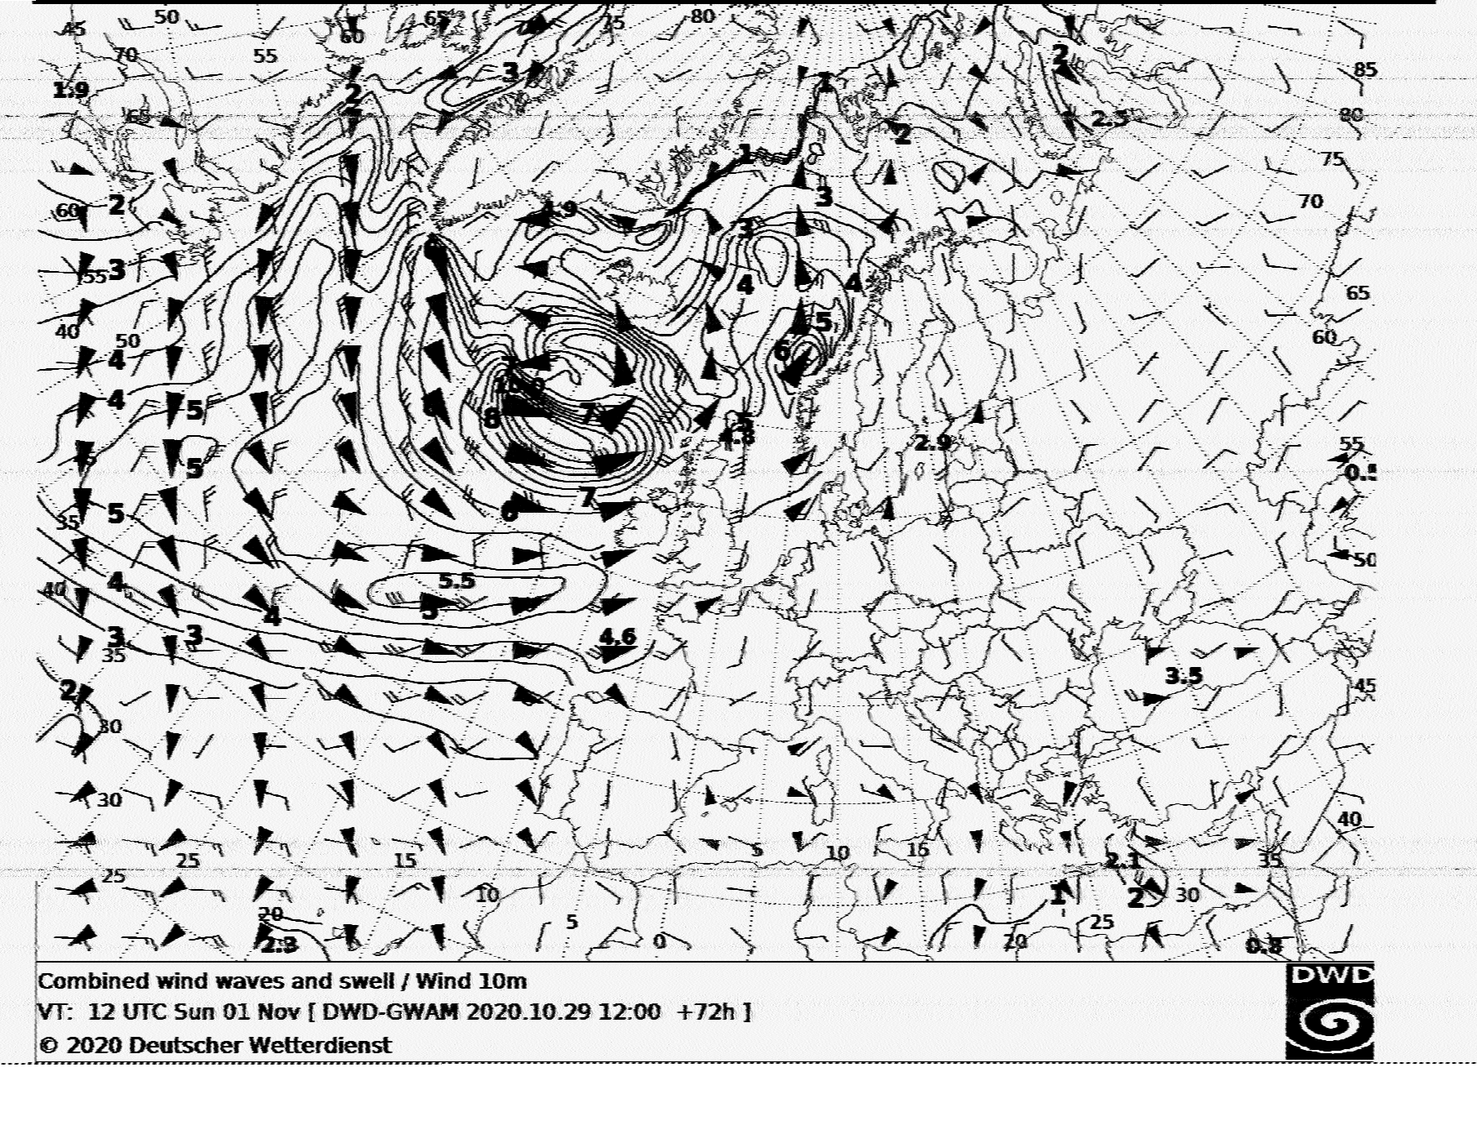
And Does it work? (2)

Slide 31
So all is perfect?
Software:
  Interface is not user-friendly (e.g. frequency-control is not integrated into application)
  Windows / mac
  Integrate into rtl_tcp ?

Slide 32
So all is perfect?
Hardware:
  Filtering in ADC needs to be done in ADC of the PC (very little filtering done on the shield) → make sure you have a good ADC
  No hardware protection on DC overvoltage on the input (bias-T)
  NO RF shielding: noise generated by arduino, by PC
  → Use external AudioDongle (ADC)

Slide 33
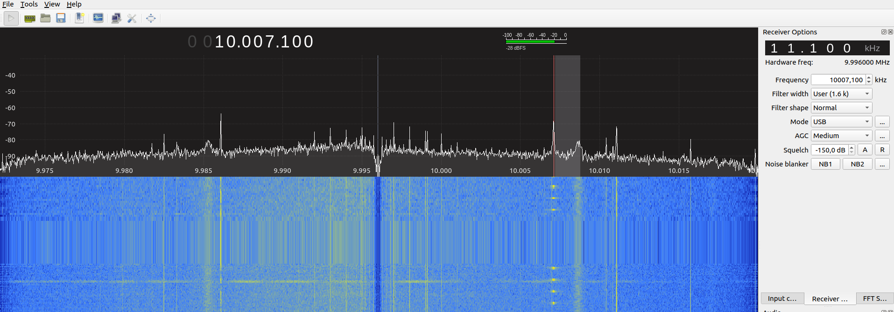
So all is perfect?
Hardware (2):
  Frequency-offset (by > 11 Khz ) → need to be corrected
+11.6 KHz @ 4996 KHz
+11.1 KHz @ 9996 KHz

Slide 34
So all is perfect?
Sampling:
  Sampling at freq. x, will also sample at uneven harmonics of that freq.
Image that the LO oscilator is a square wave

Slide 35
So all is perfect?
Tuned to 1 MHz:
  976 – 1024 KHz
  2976 – 3024 KHz
  4976 – 5024 KHz
  ...

Slide 36
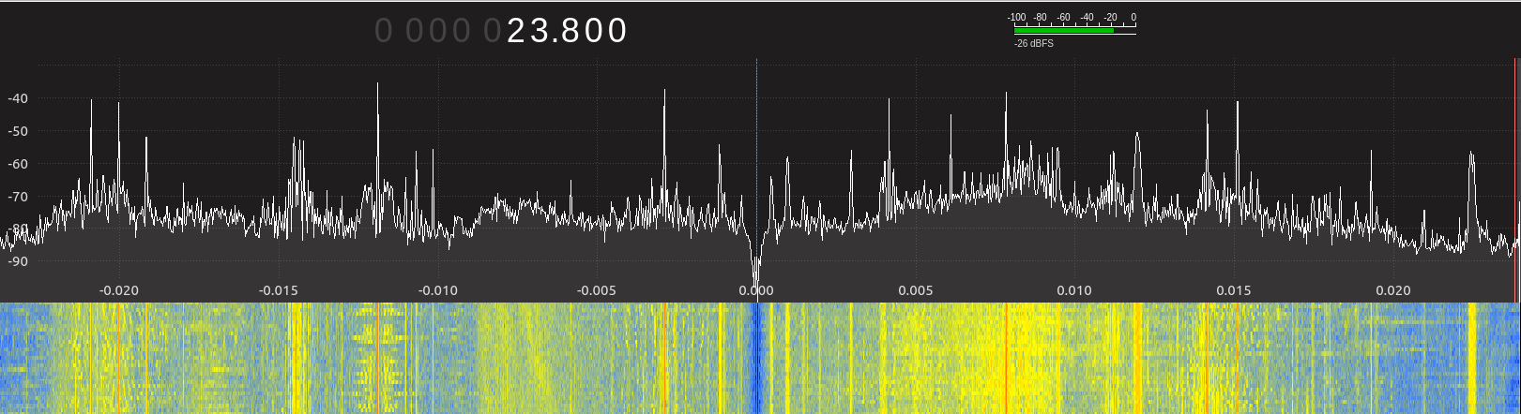
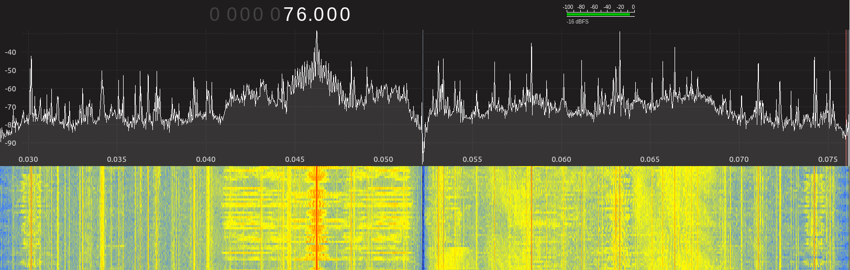
Sampling harmonics
302 KHz
76 KHz

Slide 37
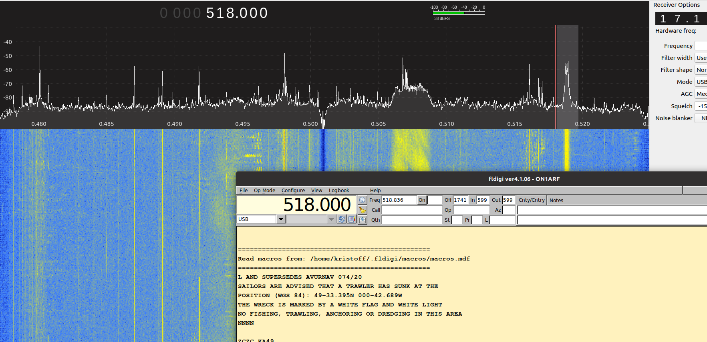
Sampling harmonics (2)
518 Khz (tuned to 512 KHz)

Slide 38
Sampling harmonics (3)
Solutions
(Selectable) Input filters → look lima SDR
Selective Antenna (magnetic loop)
Increase sampling-rate
  e.g. RTL-dongle: 2.4 Msamples/sec (1.2 MHz bandwidth)
  Tune to 1.2 MHz (freq. range: 0 – 2.4 MHz)
  Next harmonic: 3.6 MHz → outside broadcast band + a lot easier to filter

Slide 39
Conclussion of the Elektor SDR Shield (so far)
Interesting learning Experience
Works pretty good for certain applications (e.g. HF)
Can be made better
  Input filters / selective antenna
  RF shielding cases
  DC overvoltage protection
  Better software integration

Slide 40
BE.SDR Meetup 3: Agenda
20:00
  Question time + Introduce yourself
  Some news about BE.SDR
20:30
  Solution of CTF1 and CTF2
  The elektor SDR receiver shield
  ”Learning SDR hardware: A bare minimum SDR receiver”
21:40
  Open discussion on BE.SDR

Slide 41
Other ideas for BE.SDR
Seperate meetings for
Encoding / decoding software (e.g. DGPS decoder, amateur-radio protocols)
  For people with software background
CTFs
  Best way to get started with GNU radio

