Slide 1
UBA Belgian SDR Group
Workshop Getting started with GNU Radio for CTFs
Kristoff Bonne (ON1ARF)
13/11/2020

Slide 2
BE.SDR GR workshop 1
Introduction to GNU Radio
Looking into GRC2 (AM demod - DCF 77)
(If time remaining)
  GRC2 long-dcf77
  GRC1

Slide 3
Introduction to GNU Radio
What is GNU Radio and GNU Radio Companion?
General Overview of GRC
Different types of block
Datatypes
How to get started

Slide 4
Practical Issues
This is a video-conference, so please follow these rules
Use a headset
Best browsers:
  chrome / chromium / …
  Firefox
Use Screen-sharing

Slide 5
Legal
This presenation are distributed under the Creative Commons “BY-SA 4.0” License:
https://creativecommons.org/licenses/by-sa/4.0/
Images used in the presentation may come with their own license.
All care has been taken that all images may be used publicly. If you own the copyright to an image and consider its use in this document improper, please contact the author of this document.

Slide 6
GNU Radio and GRC
GNU Radio (GR)
Framework for signal-processing
Uses python as wrapper around C++ code
Can be used for any kind of signals: RF, AF, DSP, visualisation, …
GNU Radio Companion (GRC)
Graphical Usertool to create GR “flowgraphs”
Creates python or C++ on the backend

Slide 7
GNU Radio .. what it is NOT
Not a “click and play” tool.
You do need to know SDR, DSP and signal-processing
Not an end-user application
  Toolkit!
  You can use it to create applications
    gqrx
    QRadioLink

Slide 8
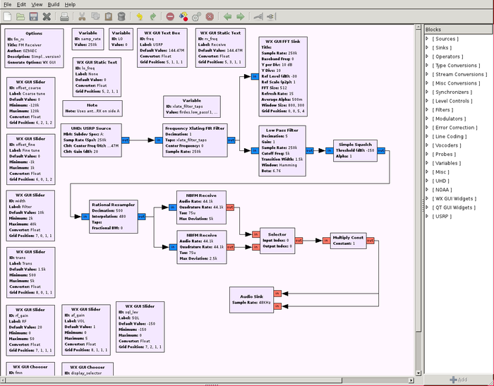
GRC

Slide 9
GRC Getting started
Let’s get started
Start GRC
Different parts
  Menu
  Buttons
  Main screen
  Side Pannel
  Console

Slide 10
GRC Menus
File menu
  Read
  Write / write-as
View
  Block tree
  Console Panel
  Variable editor
  Find

Slide 11
GRC Getting started
Top buttons
  Start / stop
  Show Errors !! (flow-graph errors)
SideBar
  Block tree
Console: Errors!!! (Runtime Errors)
Variable editor (can be part of sidebar)

Slide 12
The GNU Radio blocks
Types of Blocks:
Input / Output
Processing
Math operations
Variables
Instrumentation blocks (probes)
Embedded python blocks
Misc (!)

Slide 13
The GNU Radio blocks (2)
Questions:
What is the correct block to use?
What are the correct parameters of the block?
Note:
I do not know all the blocks neither.

Slide 14
The I/O blocks (1)
Input (read): Source
Output (write): Sink
  Devices: like SDR rx/tx → osmocom block
  Audio interface (mono or stereo)
  Signal-source
    Incl. Noise sources

Slide 15
The I/O blocks (2)
  File block:
    File source / sink (including FIFO)
    Wave source / sink
  Network (UDP, TCP, ZeroMQ)
  Note:
  Type of device determines datatype

Slide 16
The Processing blocks
“Process” (whatever that may be)
DSP/SDR functions:
  Filters
  Modulator / demodulator
  Frequency Mixers
  Channel simulators
Samplerate Conversions
Datatype conversions
Threshhold blocks

Slide 17
Math Operations
Add / subtract / multiply / divide
Abs(), min(), max(), ...
Different uses: (e.g.) Multiply:
  Multiply two streams: mixer
  Multiply with constant: amplifier
  Multiply with -1 (invert)
  Multiply with 0 or 1 (switch on/off)

Slide 18
Variables
Is used as parameter in block
  (e.g. inside I/O block): “frequency”
  Fixed value (“variable” block)
  “Entry” field
  Range (slider)
  Chooser (selection)
Can contain other variable or function
  AudioRate = int(samp_rate / decim)
  Filtertaps = f(AudioRate,maxfreq)

Slide 19
Instrumentation
Visualisation tools
very important to examine signals
(“QT GUI sink”)
Time sink (osciloscoop)
Frequency sink
Waterfall sink...
Histogram sink
Number sink
Constellation sink
...

Slide 20
Instrumentation (2)
“QT GUI Time sink” and “QT GUI Frequency sink”
  Note the “Control Panel” option in the “config” tab

Slide 21
Embedded python blocks
Allows to create your own blocks
Not that difficult
(A lot of examples)

Slide 22
Misc blocks
Throttle block
  VERY IMPORTANT
  Necessairy when no “physical” blocks (no SDR rx/tx, no audio source/sink, …)
Comment blocks

Slide 23
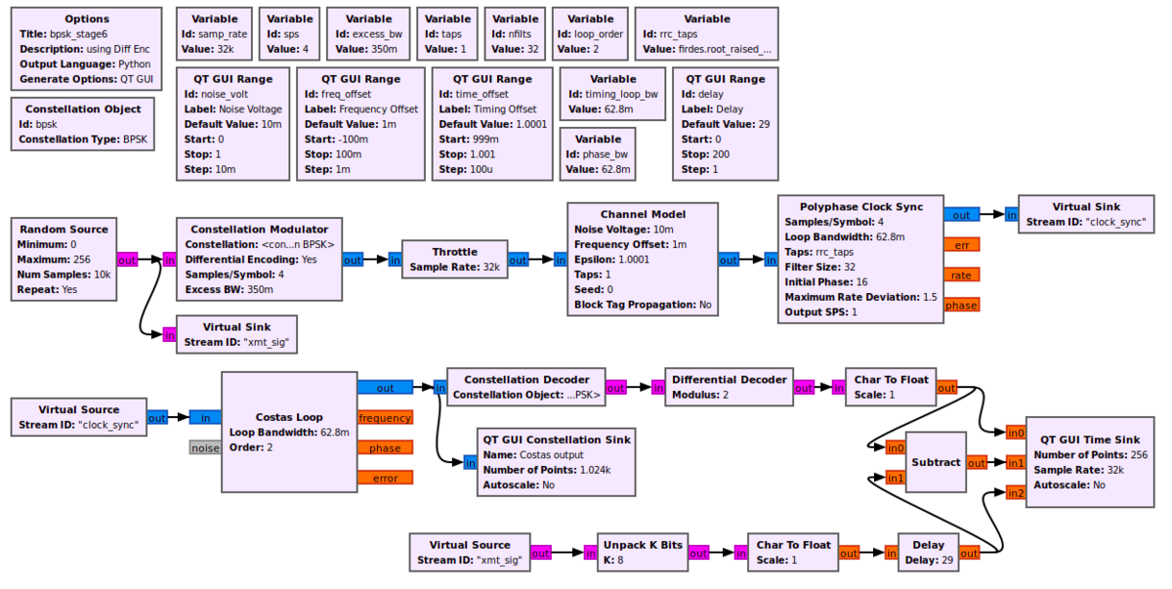
Misc blocks
Virtual Source / sink
  Keeps you flowgraph clean

Slide 24
DataTypes
Byte (8 bit), Short (16 bit), Int (32 bit)
Float (32 bit)
Complex (I/Q samples)
  2 * float
Messages

Slide 25
I/Q signals
* *
* * * *
* * * *
* * * *
--*-----------*-----------*------------*-----------*--
* * * *
* * * *
* * * *
* *
Disclaimer: This is only one of the ways to explain I/Q sampling
(but it’s the one that is most intuitive, and it is how it is used in
most ham-radio SDR receivers)

Slide 26
I/Q signals
What Direction (up/down) does the signal travel at the points ‘X’?
* *
* * * *
* * * *
* * * *
--*-----------X-----------X------------*-----------*--
* * * *
* * * *
* * * *
* *

Slide 27
I/Q signals
What Direction (up/down) does the signal travel at the points ‘X’?
* *
* * * *
* * * *
* * * *
/\
--*-----------X||---------X||----------*-----------*--
\/
* * * *
* * * *
* * * *
* *

Slide 28
I/Q signals
What Direction (up/down) does the signal travel at the points ‘X’?
When you only have the information at point ‘t’?
--*-----------X-----------X------------*-----------*--

Slide 29
I/Q signals
What Direction (up/down) does the signal travel at the points ‘X’?
When you only have the information at point ‘t’?
+
--*-----------X-----------X------------*-----------*--
+
IQ IQ
Solution: for every point “t”, take a 2nd sample, ¼*t later

Slide 30

I/Q signals: negative frequencies
So why is this important?
Positive / Negative frequency
+
--*-----------X-----------X------------*----
+
IQ IQ
+
--*-----------X-----------X------------*---
+
IQ IQ
https://en.wikipedia.org/wiki/Spinning_dancer
https://pixabay.com/illustrations/ball-sphere-shape-spin-spinning-313522/

Slide 31
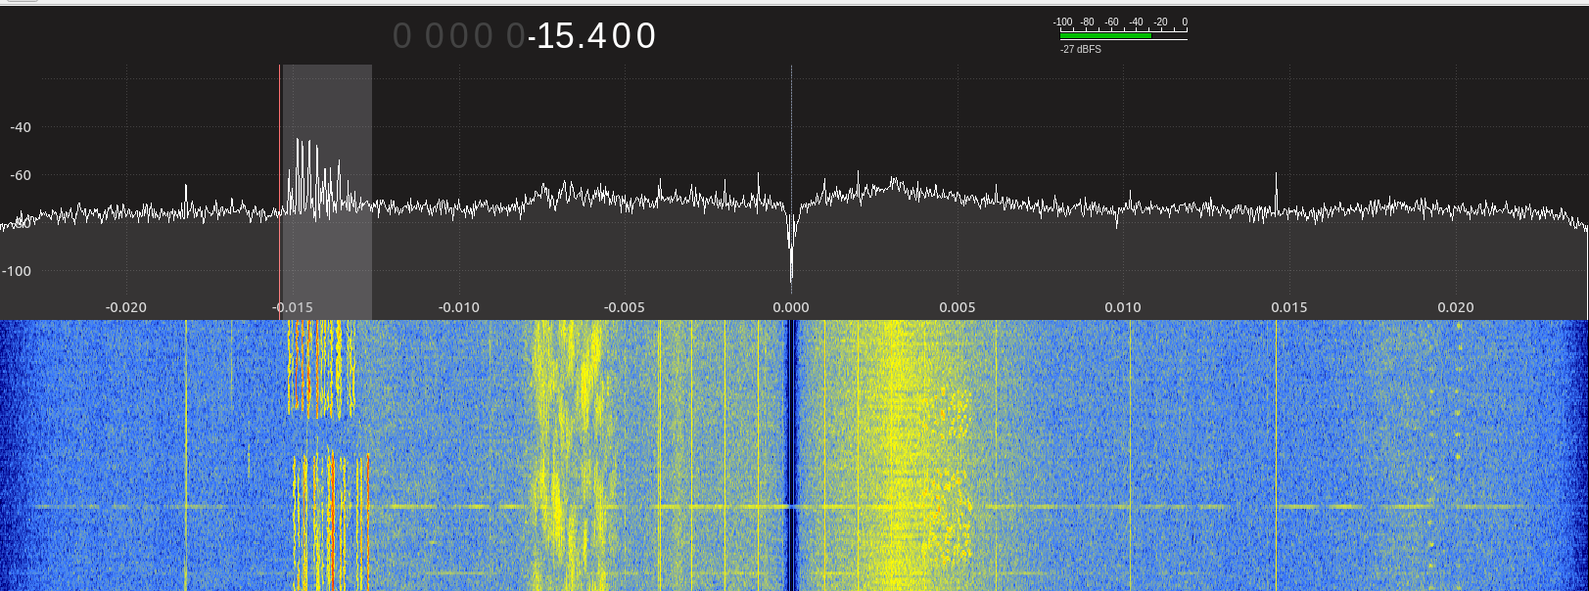
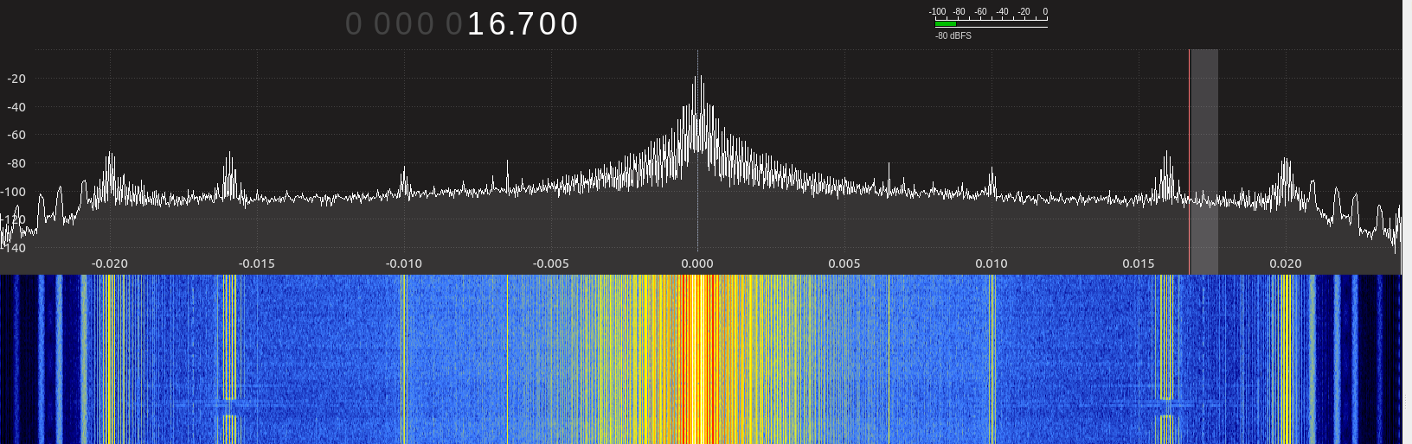
I/Q sampling
For every periode “t”, two sample-actions are done: “I” (In phase) and “Q” (quadrature)
This provides information about the “direction” of a frequency: positive or negative

Slide 32
To do
Still a lot to learn (also for me!)

Slide 33
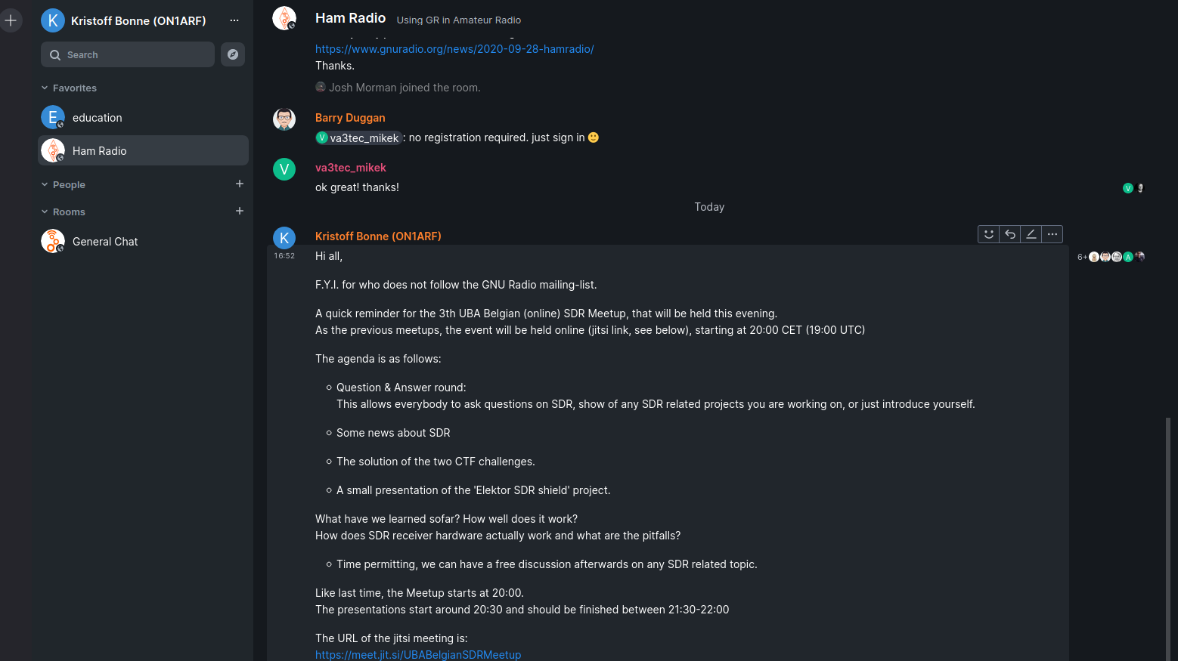
GNU Radio chat
https://chat.gnuradio.org/

Slide 34
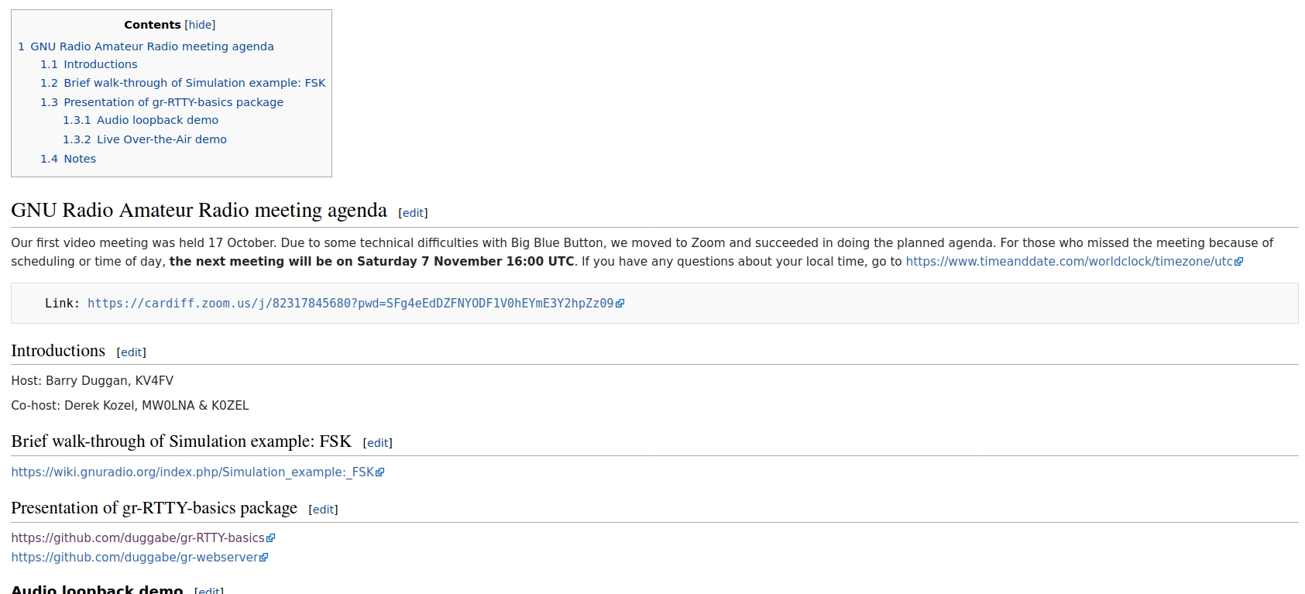
Monthly GNU Radio Amateur Radio Meeting
https://wiki.gnuradio.org/index.php/User:Duggabe

Slide 35
CTF2
iq file:
  Ctf2_1200bps.iq
The question of this ctf is this:
When (date/time) was this recording made?
Hint: The question of the ctf is a hint by itself.

Slide 36
CTF2
File input:
  File source block
  Verify datatype
  Check sample-rate
    → variable “samp_rate”

Slide 37
CTF2
Throttle-block
  If no physical interfaces, insert throttle-block

Slide 38
CTF2
Instrumentation
  Time sink
  Frequency Sink
  Waterfall
  → Let’s run it, but first
    Options block → id
    Save → name
    What kind of signal is it?

Slide 39
CTF2
Instrumentation
  Time sink
  Frequency Sink
  Waterfall
  Zoom in, control-pannel, ...
  What kind of signal is it?

Slide 40
CTF2
AM-signal
  “AM demod” → try : does not work
  Complex_to_amplitude^2
    Add time sink
Once ok, disable other sinks

Slide 41
CTF2
To much noise
  Low-pass filter
    Most easy LPF: moving average filter
    Length → slider
    Scale
  What is effect → time sink, 2 input

Slide 42
CTF2
AGC block ?
  Gain, max. gain, reference ?
    Help !
  → change default values of time sink

Slide 43
CTF2
What signal is this?
  Hint: “the question of the CTF is a hint by itself:
  When (time/date) was this recorded
    Time → dcf77
    https://en.wikipedia.org/wiki/DCF77
      > dcf77 time format

Slide 44
Threshold
Time to use virtual sink (?)
Threshhold block
  Where to set threshhold value?
    Variable “QT enter” block

Slide 45
Threshold
Use virtual sink (?)
Threshhold block
  Where to set threshhold value?
    Variable “QT enter” block

Slide 46
Write to File
Convert to a more easy format (byte)
Write to file
  Fifo ?
  od -t x1 -v fifo.f

Slide 47
Some other things that might be usefull
FM / FSK demod
  Quadrature demodulator
To receive real signals
  Frequency xlat FIR filter
  Sample rate !!!
  filters

