Slide 1
Introduction in SDR and GNUradio project 101
Belgian SDR Meetup
Kristoff Bonne (ON1ARF)
4/9/2020

Slide 2
Agenda
Introduction to SDR
  Question time 1
Project RTTY decode:
  the hardware
  the RTTY-signaal
  Intro GNU Radio + DWD demodulator in GNU Radio
  Question time 2

Slide 3
Agenda (2)
Project RTTY decoder:
  Baudot Decoder
  Everything together
GNU Radio .. summary
Question time 3

Slide 4
Practical Issues
This is a video-conference, so please follow these rules
Use a headset
Best browsers:
  chrome / chromium / …
  Firefox
Mute mic if you have nothing to say
Switch off your camera if you have nothing to show

Slide 5
Practical Issues
This is a video-conference, so please follow these rules
Feel free to give feelback!
  There are three “question time” moments
  You can also use the “chat”
  Feel free to use your own language to ask questions
    I will reply in English

Slide 6
Practical Issues
The video-presentation will be recorded and can be placed online.
Note, that, if you speak, your video (if on) and your name / call will be visible!

Slide 7
Goal
Practicle goal:
  Receive, demodulate and decode RTTY signal
  DWD: always active, very strong
Secundairy goals:
  Starting to learn GNUradio
  Starting to learn decoding
    RTTY: simpel, easy to demodulate (FSK), slow

Slide 8
Legal
This presenation are distributed under the Creative Commons “BY-SA 4.0” License:
https://creativecommons.org/licenses/by-sa/4.0/
Images used in the presentation may come with their own license.
All care has been taken that all images may be used publicly. If you own the copyright to an image and consider its use in this document improper, please contact the author of this document.

Slide 9
What we want to achieve
$telnet pan2.local 5301
Connected to pan2.local.
9579 10018 47998 /3116 10051 21050 40069 52015 700//
22200 10910 70048=
NNNN
ZCZC 993
FQEW57 EDZW 030600
SEEWETTERBERICHT FUER WESTEUROPAEISCHE GEWAESSER HERAUSGEGEBEN VOM SEEWETTERDIENST HAMBURG 03.04.20, 00 UTC:
WETTERLAGE:
STURMTIEF 966 BO ….

Slide 10
SDR: … a very Confusing Name
SDR: Software Defined Radio
Although SDR is based on software, it is not the main element of SDR
A better name should be .. MDR
(more on that later)

Slide 11
Explaining SDR
SDR
My (personal) definition:
The use of DSP techniques and hardware peripherals to simulate a radio receiver and/or transmitter inside a computing-device
So .. what is DSP?

Slide 12
Explaining SDR / DSP
SDR: Software Defined Radio is based on DSP.
DSP: ”Digital Signal Processing”
So … what is a signal?

Slide 13
Explaining SDR / DSP / Signal
Signal: a medium carrying information
Medium: electricity, light, Electromagnetic waves (i.e. radiowaves)
Information: .. audio, video, text, data, …

Slide 14
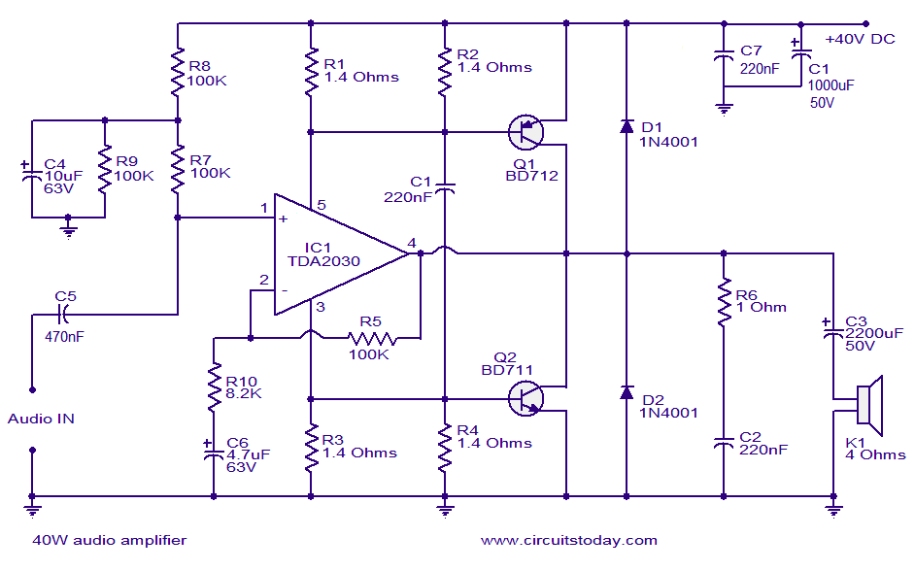
Signal Processing
Analog:
e.g. using analog electronics:
  E.g. Circuits using electronic components (active, passive) or physical characteristics of the components (speaker, PCB trace, …)
https://www.circuitstoday.com/40w-audio-amplifier

Slide 15
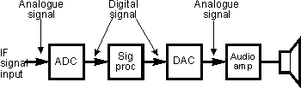
Signal Processing
Digital signal processing:
Processing signal using “digital” components
Note: most signals are in essence analog by nature
  ADC: Analog Digital Convertor
  DAC: Digital Analog Convertor
http://blog.arviups.com/explain-details-digital-signal-processing/

Slide 16
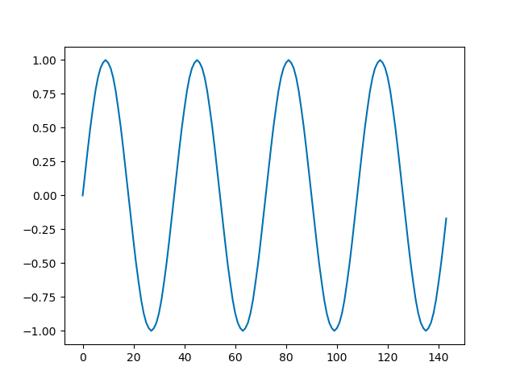
Signal Processing
Analog signal: (sine wave)
a voltage on the input port of an amplifier circuit, as it varies over time
Digital Signal:
A list of values, that
represent an analog
signal (voltage,
current, …), either in
time or Frequency
domain
[0.00, 0.17, 0.34, 0.50, 0.64, 0.77, 0.87, 0.94, 0.98, 1.00, 0.98, 0.94, 0.87, 0.77, 0.64, 0.50, 0.34, 0.17, 0.00, -0.17, -0.34, -0.50, -0.64, -0.77, -0.87, -0.94, -0.98, -1.00, -0.98, -0.94, -0.87, -0.77, -0.64, -0.50, -0.34, -0.17]

Slide 17
But what does this mean?
How do you go from
To

Slide 18
But how does this work?
Some misconceptions:
Well, it’s a computer, and the computer does this, no?
  But how does the computer know how to do this?

Slide 19
But how does this work?
Some misconceptions:
Well, it’s software
  OK, but software is only as good as the person who wrote this.
  So, how does this software work?

Slide 20
But how does this work?
Some misconceptions:
I guess it is .. magic ?
  Not really …

Slide 21
But how does this work?
Some misconceptions:
I guess is it .. magic ?
  Not really … it is MATH!

Slide 22
Mathematical functions
DSP program-code is based on mathematical functions (“algorithms”)
Functional equivalent to the analog circuit.
Examples:
  Amplifier:
  y(t) = A * x(t)
  Every value of the output-stream at time “t”, is the value of the input stream at time “t” multiplied by “A” (amplification value)

Slide 23
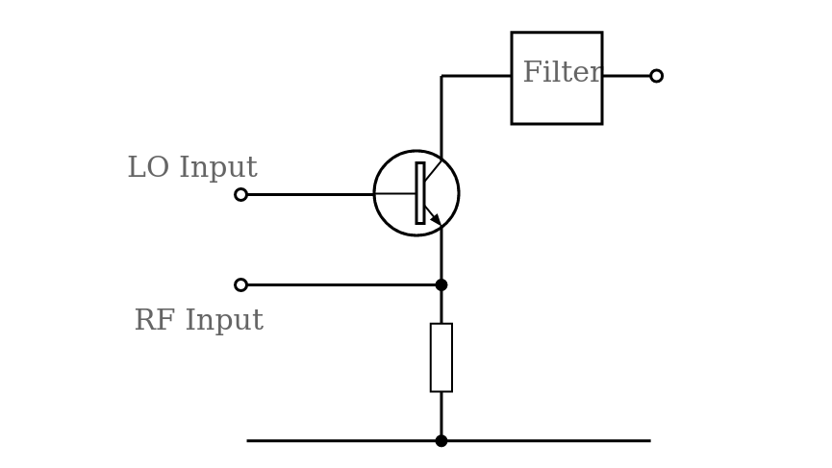
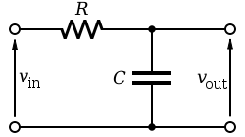
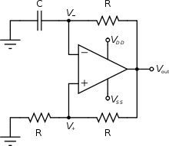
Mathematical functions
Amplifier:
y(t) = A * x(t)
Frequency Mixer:
y(t) = x1(t) * x2(t)
Low-pass Filter:
y(t) = ½ (A1*x(t) + A2*x(t-1))
Oscillator
y(t) = sin(t*(2*pi)/F)
https://www.electronics-notes.com/articles/radio/rf-mixer/bipolar-transistor-mixer.php
https://en.wikipedia.org/wiki/Low-pass_filter
https://en.wikipedia.org/wiki/Electronic_oscillator

Slide 24
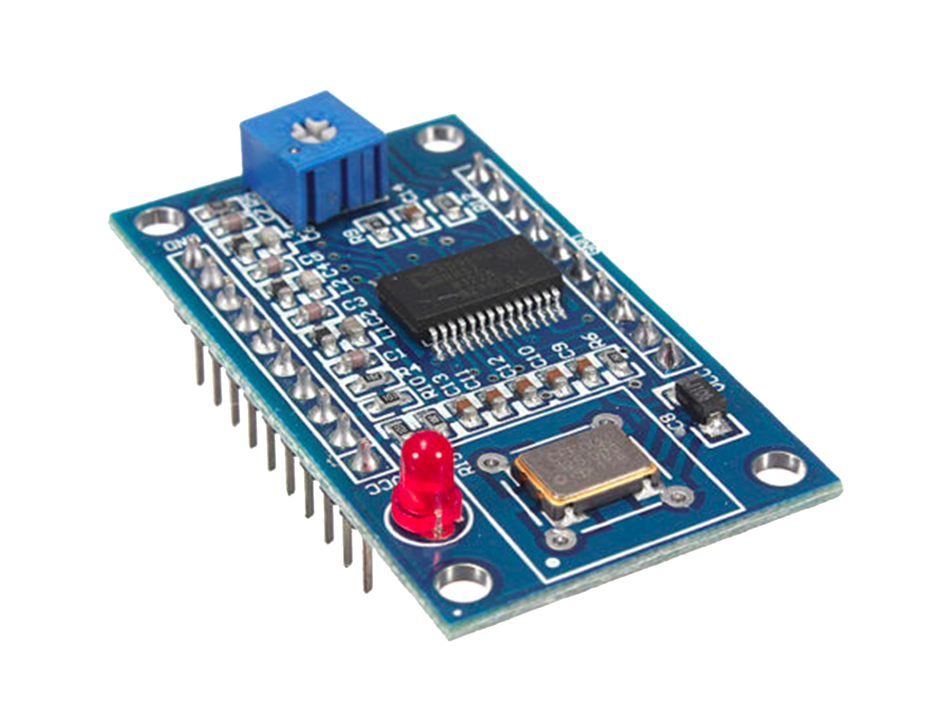
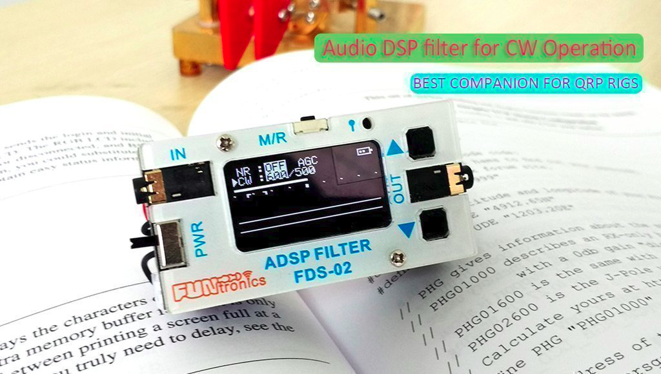
DSP applications
AD9851 Sinewave generator
DSP Filter
https://www.tinytronics.nl/shop/nl/diversen/overige/ad9851-dds-signaal-generator-module-0-70mhz
https://elekitsorparts.com/product/external-audio-dsp-filter-module-for-ssb-cw-ft8x7-dsp-filter

Slide 25
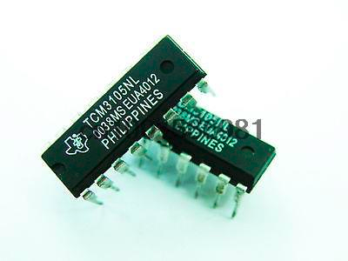
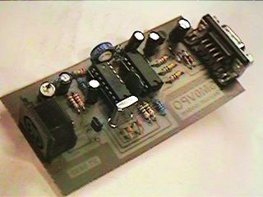
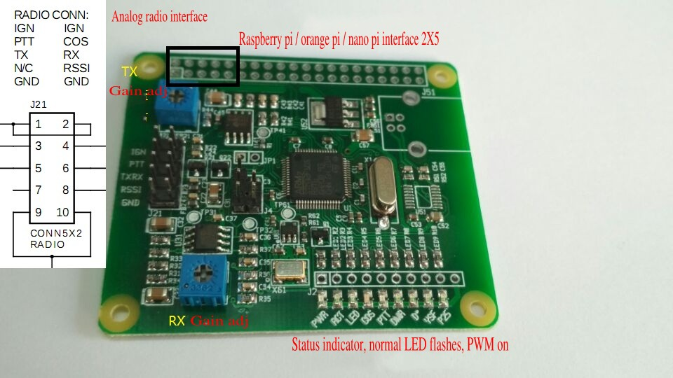
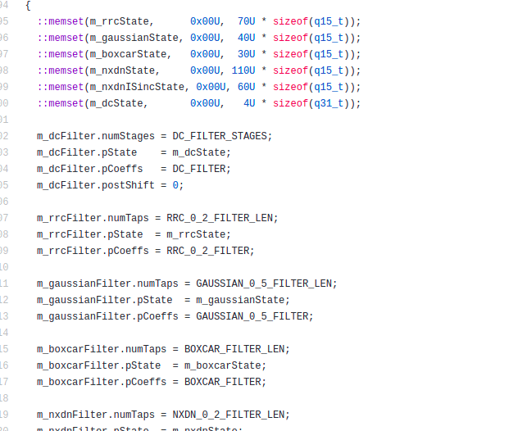
DSP applications
Baycom modem
(packet radio)
TCM3105 tx: SDR
MMDVM
DSP code in MMDVM:
https://github.com/g4klx/MMDVM/blob/master/IO.cpp
http://sm0vpo.altervista.org/use/baycom.htm
https://www.aliexpress.com/item/32322805517.html
https://www.ebay.com/itm/MMDVM-Multi-Mode-Digital-Voice-Modem-for-Raspberry-Pi-Arduino-Orange-Pi-/112744287264

Slide 26
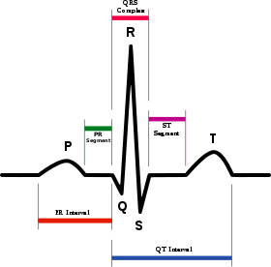
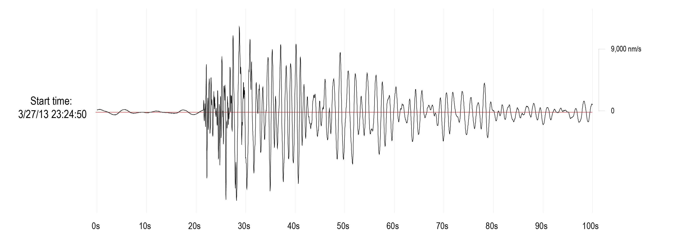
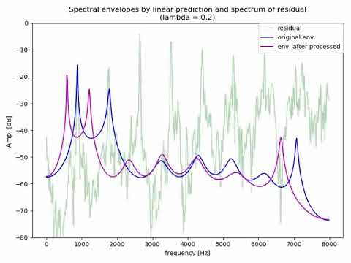
DSP applications
https://www.youtube.com/watch?v=Vjg0fkXzVgM
http://ds.iris.edu/aed2/c/alaska/earthquakes/eq_5.htmlhttps://en.wikipedia.org/wiki/Electrocardiography

Slide 27
SDR: definition (2nd try)
Use of Mathematical functions
to process digital radio signals,
as implemented in software on a digital device (mpu, cpu, gpu) or digital logic (fpga, asic)
Low-pass Filter:
y(t) = ½ (A1*x(t) + A2*x(t-1))

Slide 28
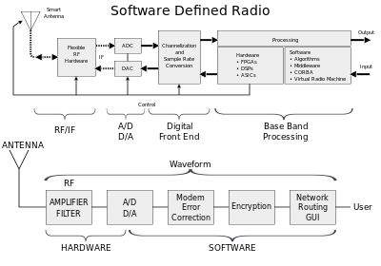
SDR: Overview
https://en.wikipedia.org/wiki/Software-defined_radio

Slide 29
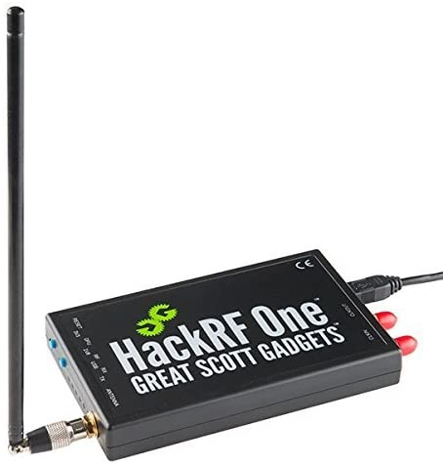
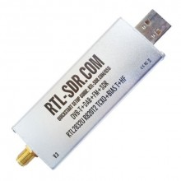
SDR: features (1)
Uses “SDR Peripheral” (receiver / transmitter)
- RTL-SDR, hackRF, PlutoSDR
It’s like a soundcard, only for radio-signals
(M. Ossman)
https://greatscottgadgets.com/sdr/5/
https://www.maes-electr.be/nl/radioamateur-sdr/rtl-sdr/rtl-sdr-v3-usb-dongle/2176/

Slide 30
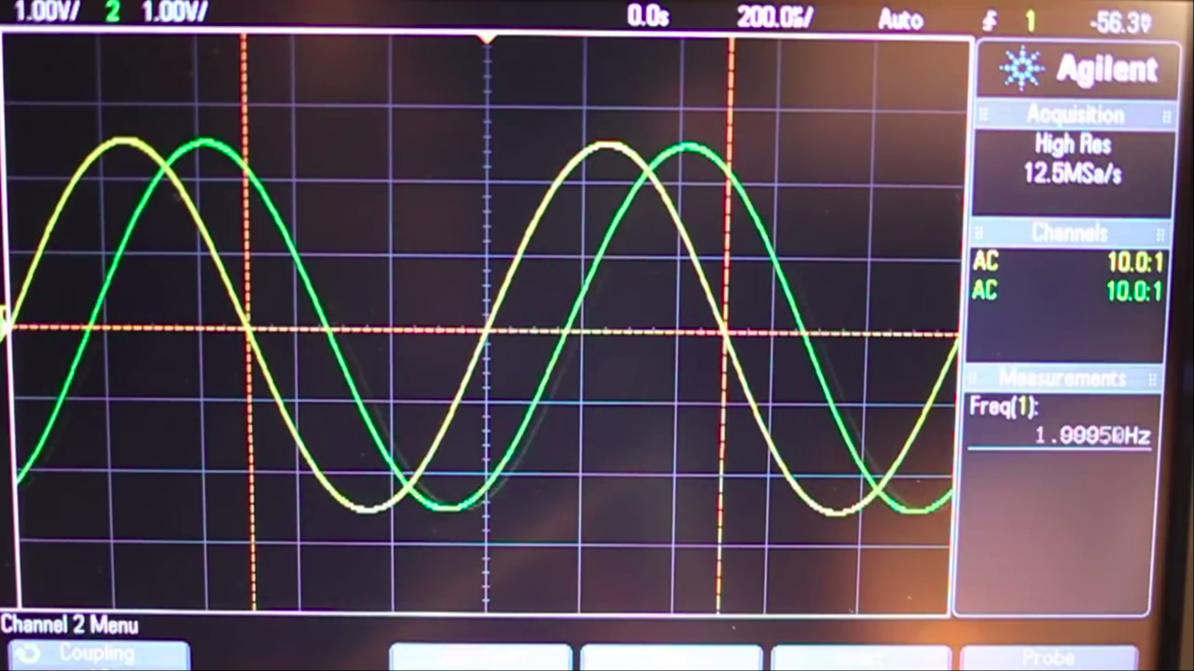
SDR: features (2)
Uses I/Q signals
For every sample, two values are samples, 90 degrees apart.
Adds phase-information to the received signals
https://www.youtube.com/watch?v=JuuKF1RFvBM

Slide 31
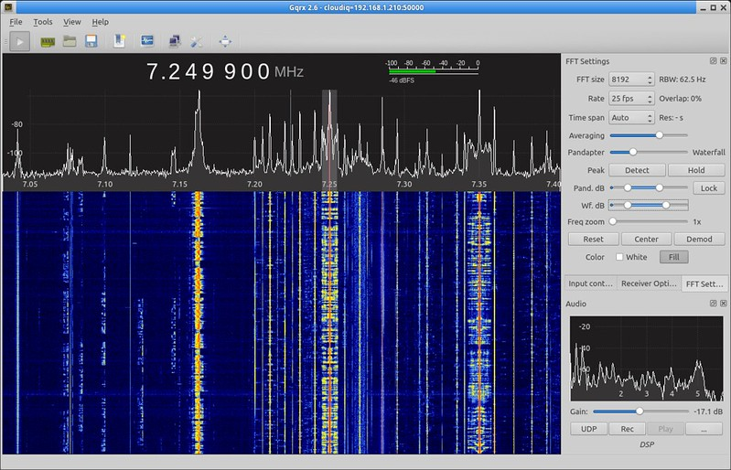
SDR applications
https://gqrx.dk/

Slide 32
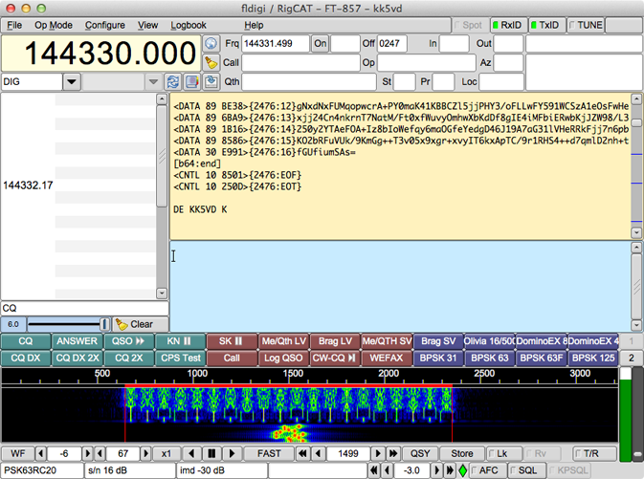
SDR applications
https://sourceforge.net/projects/fldigi/

Slide 33
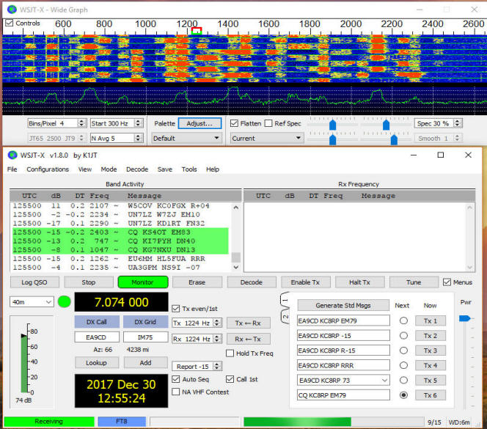
DSP/SDR applications
https://www.pestingers.net/pages-images/ham-stuff/digital-modes/digital-software/wsjt-x/wsjt-x.htm

Slide 34
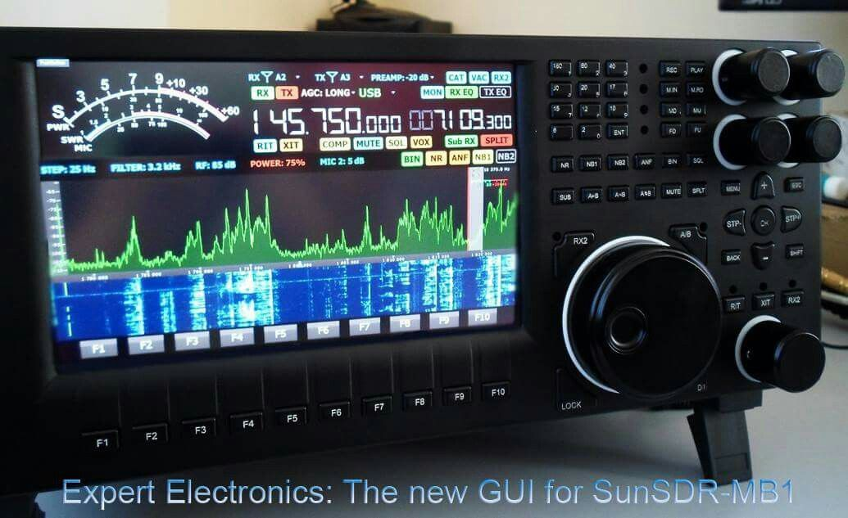
SDR applications
https://www.pinterest.com/pin/659495939160969257/

Slide 35
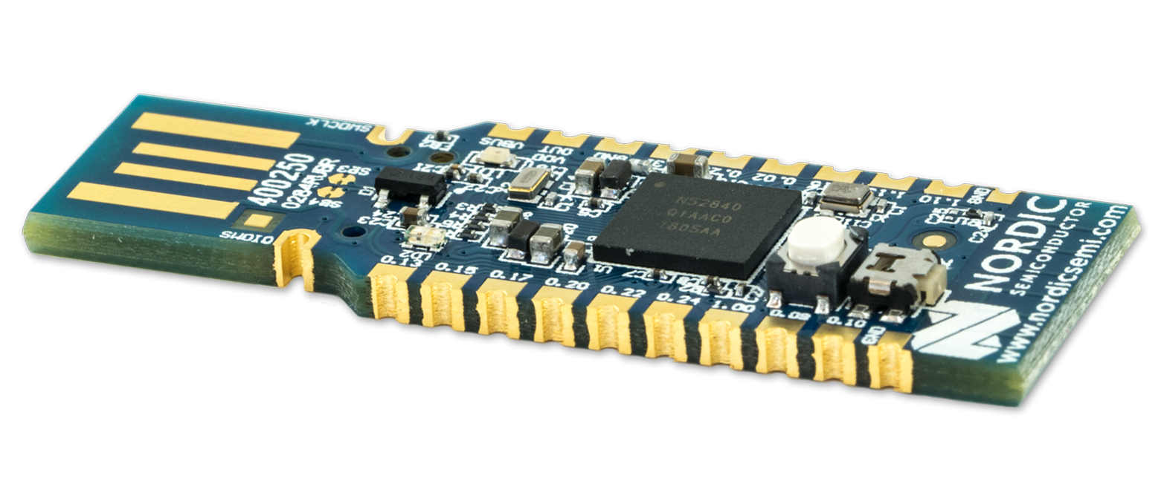
SDR applications
https://www.nordicsemi.com/Software-and-tools/Development-Kits/nRF52840-Dongle

Slide 36
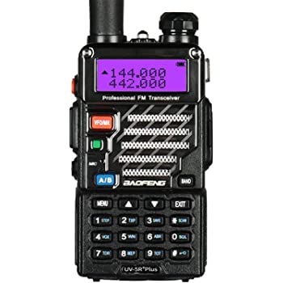
DSP/SDR applications
https://www.amazon.com/BaoFeng-UV-5R-Dual-Band-136-174-400-480/

Slide 37
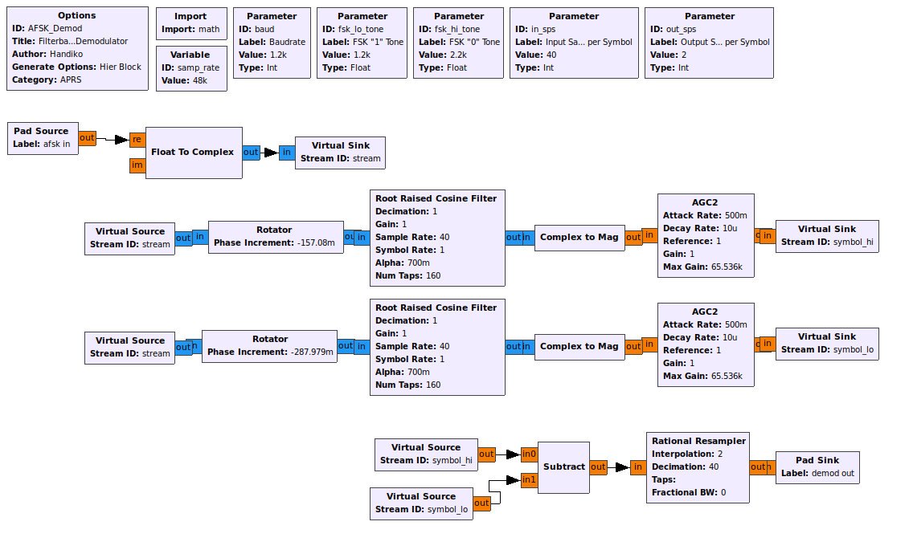
DSP/SDR applications
GNU Radio
https://handiko.github.io/gr-APRS/

Slide 38
Question time (1)
Questions?

Slide 39
SDR project: RTTY receiver project
Goal:
Receive Deutsche Wetter Dienst RTTY (147.3 Khz): 50 baud RTTY
Learn GNU Radio

Slide 40
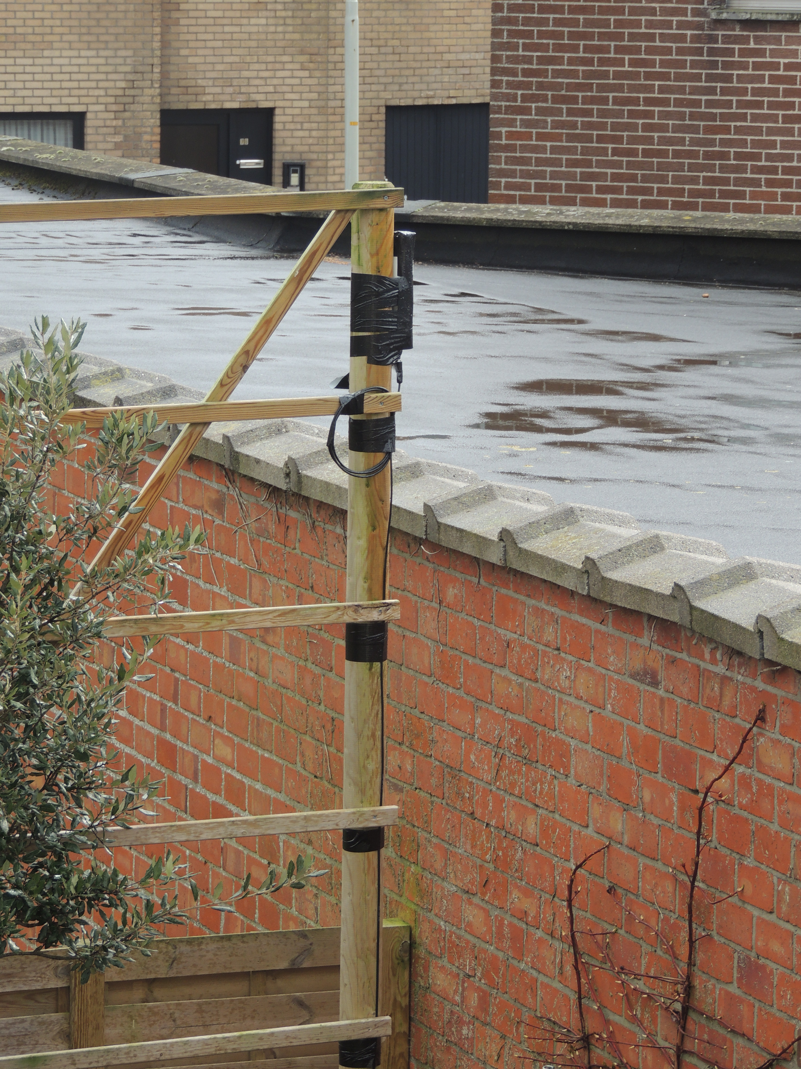
Hardware
The antenna

Slide 41
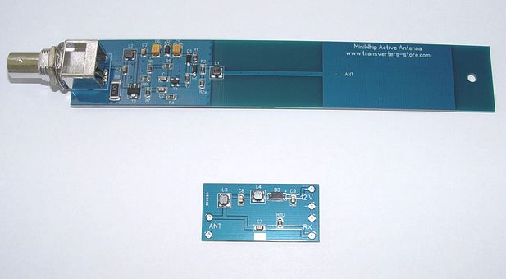
Hardware
Antenna: active whip-antenna:
http://transverters-store.com/whippcb.htm

Slide 42
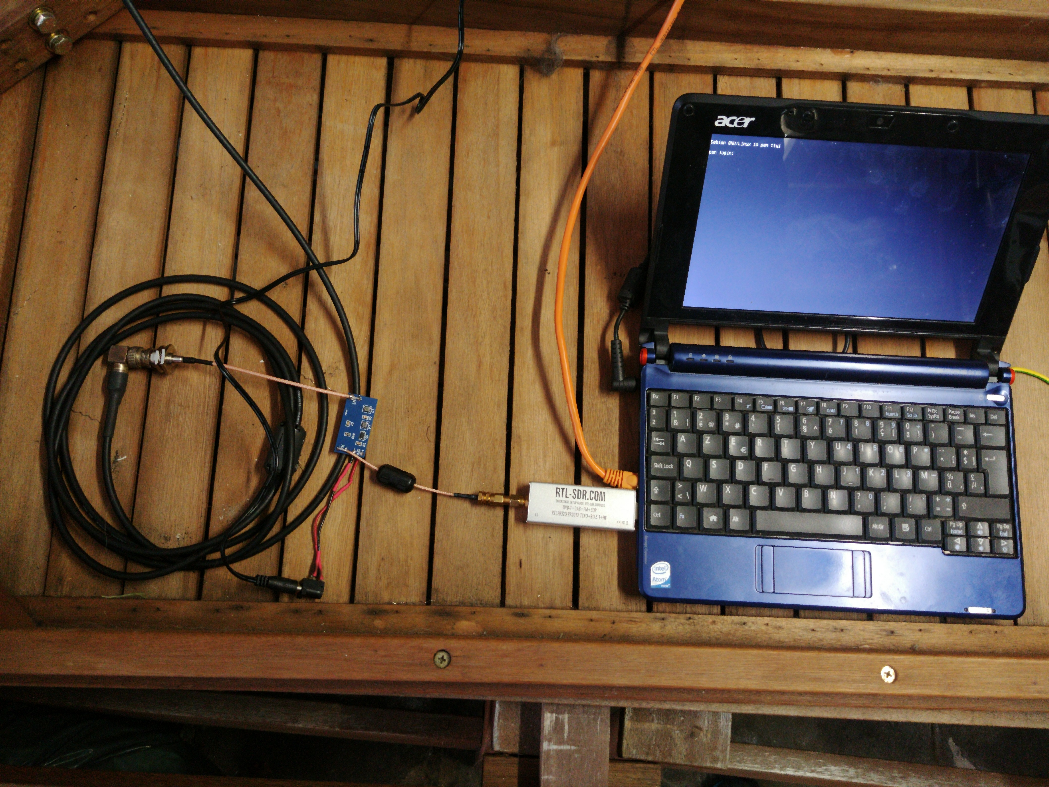
Hardware
RTLSDRv3
in “direct mode”
Bias-T (12 V) for Antenna
Netbook (debian)
  Power Supply (relative ‘clean’)

Slide 43
Software: RTL_TCP (1)
RTL_TCP: Part of the “RTL-SDR” software under linux / MacOS:
Allows you to “listen to” a rtl-sdr dongle at a distance.
(e.g. RPi or other single-board computer + RTL-SDR dongle at the attic / mast / garage …)
- active whip antenne
- QO-100 receiver

Slide 44
Software: RTL_TCP (2)
RTL_TCP: “RTL-SDR” software
Note: you need a special version for the RTL-SDRv3 dongle in “direct mode”
rtl_tcp -p 5300 -a 0.0.0.0 -s 960000 -D 1

Slide 45
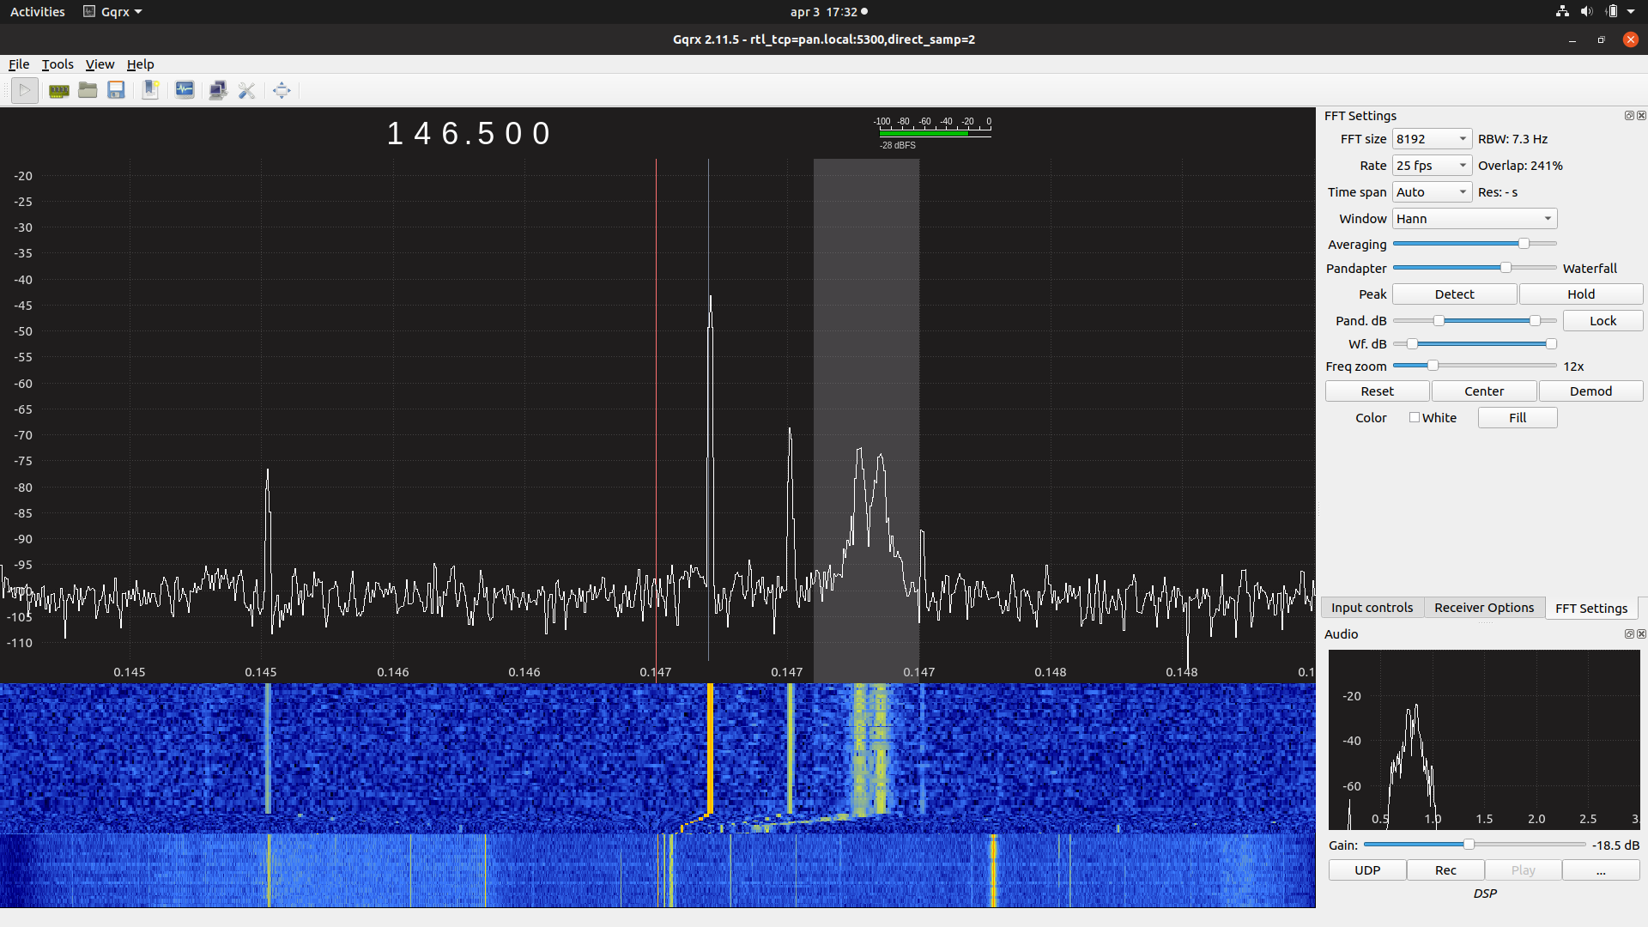
The Signal (1): gqrx

Slide 46
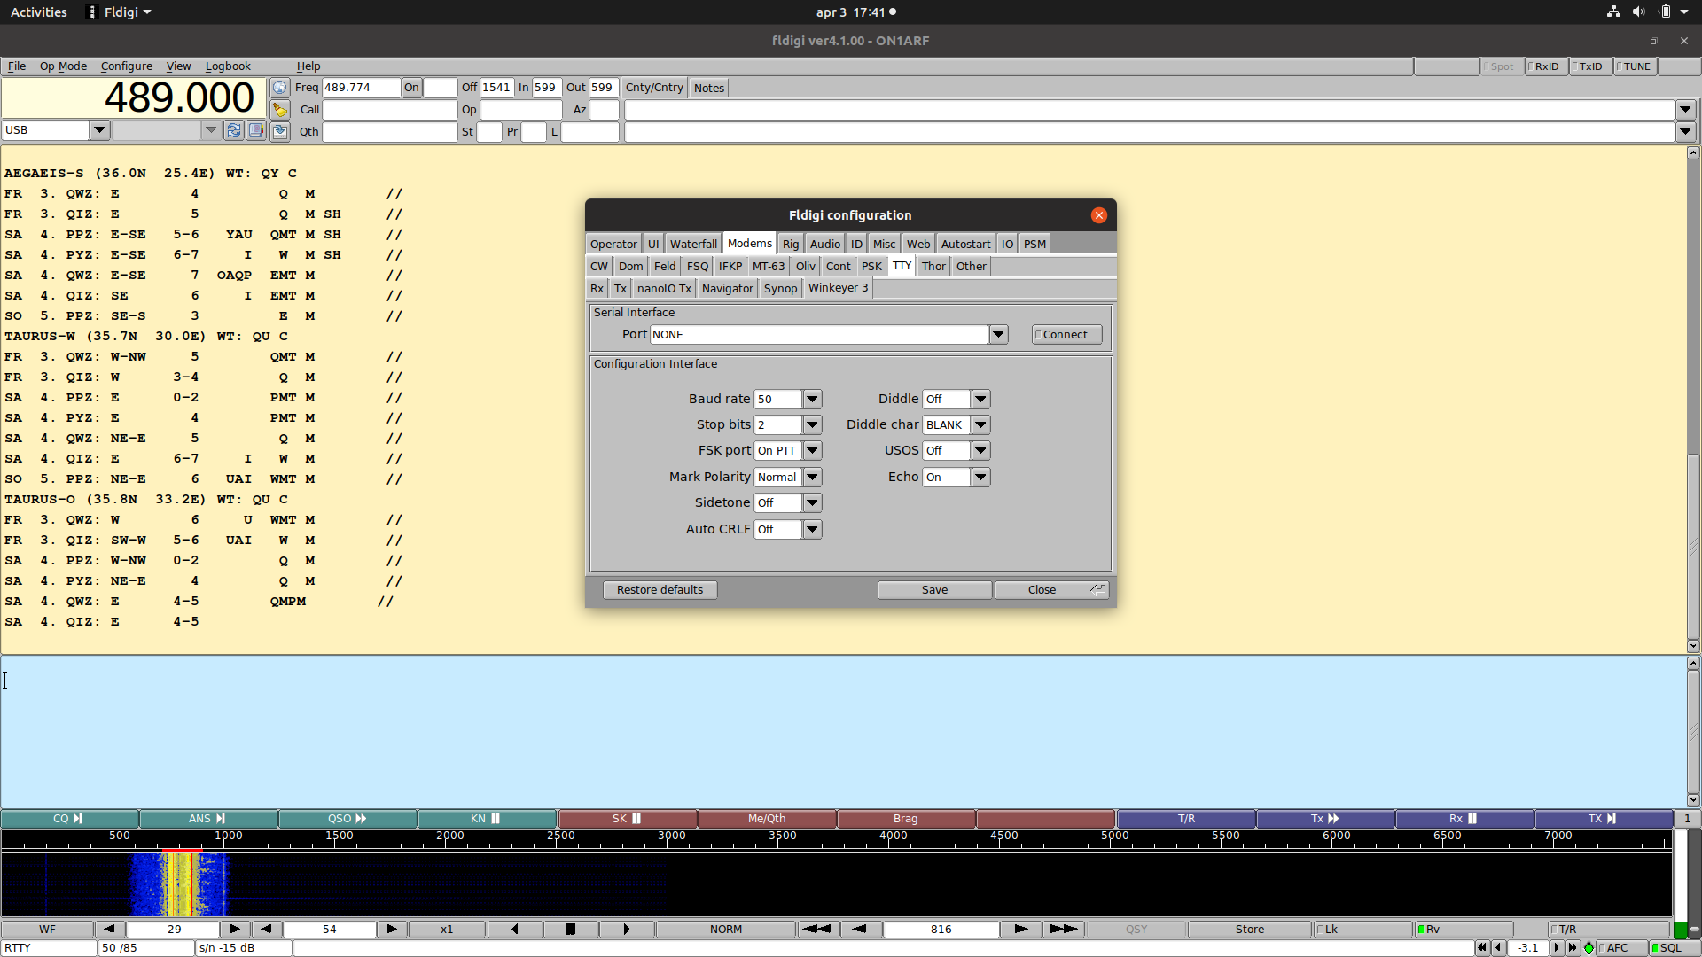
The Signal (2): fldigi

Slide 47
GNU Radio: design your own SDR application
SDR Framework
Create SDR “flowgraphs”
Visual: “GNURadio Companion” (GRC)
Blocks (but: what do they exactly do?, Which one? Parameters?)
Block: implements a SDR or DSP “function”
Note: you do are creating an radio-device, so radio-knowledge IS REQUIRED

Slide 48
How to make a receiver? (analog)
RF
Filter
RF
Amplifier
Mixer
IF
Filter
IF
Amplifier
Demodulator
Audio
Amplifier
Local
Oscillator
Demodulator
Audio
Amplifier

Slide 49
How to make a receiver? (SDR)
RF
Filter
RF
Amplifier
Mixer
IF
Filter
IF
Amplifier
Demodulator
Audio
Amplifier
Local
Oscillator
Demodulator
Audio
Amplifier
Analog Front-end
SDR
RF
Filter
RF
Amplifier
Mixer
BB
Amplifier
Analog – Digital
Convertor
ADC
...
I/Q data
Local
Oscillator

Slide 50
But this is how you must think!
RF
Filter
RF
Amplifier
Mixer
IF
Filter
IF
Amplifier
Demodulator
Audio
Amplifier
Local
Oscillator
Demodulator
Audio
Amplifier

Slide 51
How to make a receiver? (SDR)
What do we need?
Receiver (RTL-SDR dongle + rtl_tcp)
Tuner (down-convertor IF / AF)
Filters + amplifiers
Demodulator
  Audio out (speaker)
  Decoder (RTTY)

Slide 52
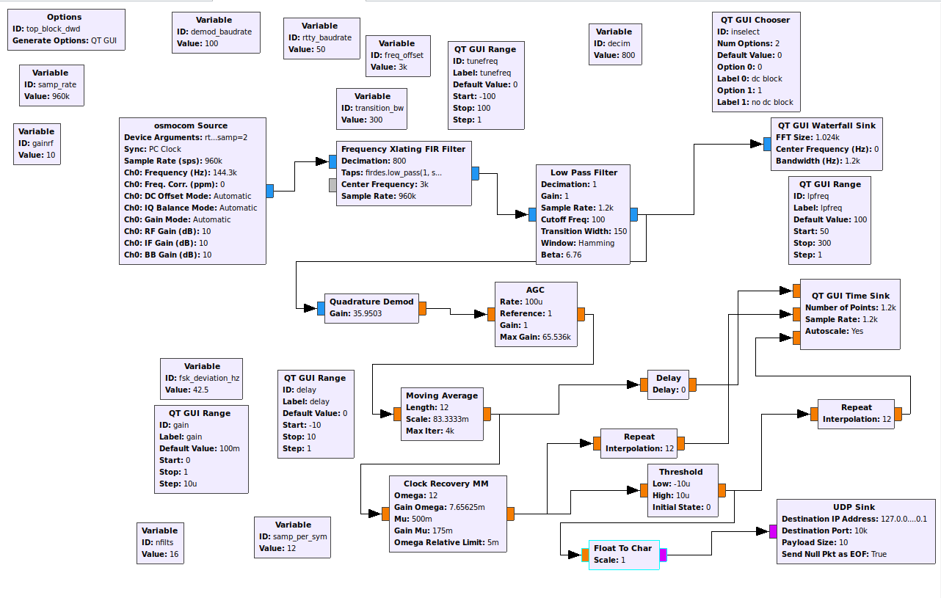
GRC

Slide 53
GRC
Filters
Tuner
FM demod
Amp.
FSK decoder

Slide 54
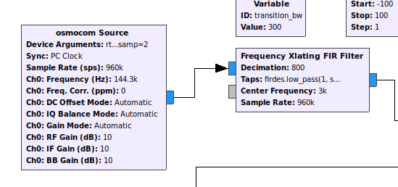
Tuner + reduce bandwidth

Slide 55
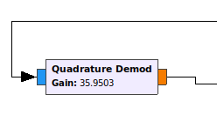
FM demodulator

Slide 56
FM demodulator + filter
Let’s experiment !!!

Slide 57
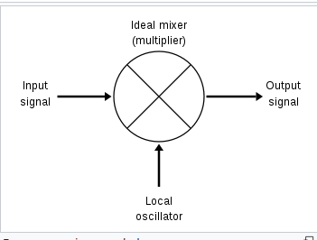
Frequency mixer? (1)
Mixer (analog):
input 1 = f1
input 2 = f2
output: ?
https://en.wikipedia.org/wiki/Frequency_mixer

Slide 58
Frequency Mixer? (2)
Mixer (analog):
input 1 = f1
input 2 = f2
output:
  f1 + f2
  f1 – f2
  So: 1000Hz * 1001 Hz → 1 Hz + 2001 Hz

Slide 59
Frequency Mixer? (3)
Mixer (Digital):
input 1 = f1
input 2 = f2
output IF USING I/Q SIGNALS:
  f1 + f2
  So: 1000Hz * 1001 Hz → 2001 Hz
Frequency Mixer:
y(t) = x1(t) * x2(t)

Slide 60
Negative frequencies? (SDR) (1)
I/Q signal have a ‘direction’ (does ‘I’ preceed ‘Q’ or does ‘Q’ preceed ‘I’?)
    Q Preceeds I: + frequency
    I Preceeds Q: - frequency
    So:
      1000Hz * 1001 Hz → 2001 Hz
      1001 Hz * -1000 Hz → 1 Hz
https://www.khanacademy.org/science/electrical-engineering/ee-circuit-analysis-topic/ee-ac-analysis/v/ee-negative-frequency
https://www.pe0sat.vgnet.nl/sdr/iq-data-explained/

Slide 61
Negative frequencies? (SDR) (2)
      1000Hz * 1001 Hz → 2001 Hz
      1001 Hz * -1000 Hz → 1 Hz
So:
      1001 Hz * -1000 Hz → 1 Hz
      999 Hz * -1000 Hz → -1 Hz
  → Baseband signal

Slide 62
FSK demodulation step 1: hardware tuner
DWD: 147.3 KHz +- 37.5 Hz
Hardware Tuner: 144.3 Khz
  2 tones on output of “tuner”:
  3000 Hz +- 37.5 Hz
  3000 Hz + 37.5 Hz = 3037.5 Hz
  3000 Hz – 37.5 Hz = 2962.5 Hz

Slide 63
FSK demodulation step 2: Freq.Xlating filter
3000 Hz + 37.5 Hz = 3037.5 Hz
3000 Hz – 37.5 Hz = 2962.5 Hz
“freq. Xlating FIR filter”:
Bandpassing filter
Tuner: -3 Khz
  +37.5 Hz
  - 37.5 Hz
Decimation: Reduce bandwith
  960 Khz bw → 1200 Hz

Slide 64
FSK demodulation step 2: Freq.Xlating filter

Slide 65
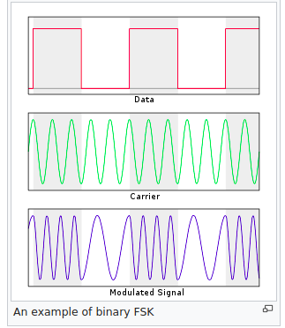
FSK demodulatie:
Step 3: FM demod
Mixer (“freq. Xlating FIR filter): 3 Khz
  +37.5 Hz
  - 37.5 Hz
FM demod (“quadrature demod”):
  +37.5 Hz → positive output
  -37.5 Hz → negative output
https://en.wikipedia.org/wiki/Frequency-shift_keying

Slide 66
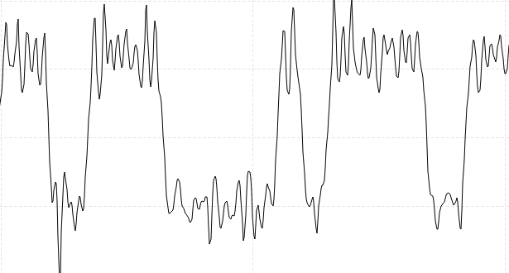
Clock recovery (1)
Sampling-rate (I/Q signal from receiver)
: 1200 samples / sec
Bitrate RTTY = 100 bits / sec.
(why?)
1 bit = 12 samples

Slide 67
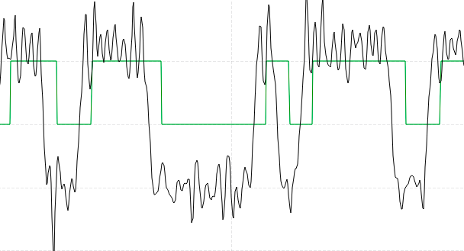
Clock recovery (2)
Sampling-rate (I/Q signal from receiver)
: 1200 samples / sec
Bitrate RTTY = 100 bits / sec.
(why?)
1 bit = 12 samples

Slide 68
Clock recovery (3)
Clock Recovery MM block
Based on a PLL
Requires “peaks” to well synchronize
“dark magic”

Slide 69
Samples to bits
Comparator:
>0 → “1”
<0 → “0”
→ output uit GNURadio → UDP pakket

Slide 70
Outputting the bits (to baudot decoder)
Output from GNURadio to external python script
→ UDP pakket
This can probably also work with GNU Radio “messages”

Slide 71
Bits (dump)
01 01 01 01 01 01 01 00 00 01 01 00 00 00 01 01
01 01 01 01 01 01 00 00 01 01 00 00 00 01 01 01
01 00 00 01 01 01 01 01 01 00 00 00 01 01 01 01
00 00 01 01 01 01 01 01 00 00 00 01 01 00 00 00
00 00 00 00 00 00 00 00 00 00 01 01 00 00 00 00
01 01 01 01 00 00 00 00 00 01 01 00 00 01 01 01
01 01 01 01 01 00 00 00 01 01 00 00 01 01 00 00
01 01 01 01 00 00 00 01 01 01 01 01 01 01 01 01
01 00 00 00 00 00 01 01 01 01 00 00 01 01 01 01
00 00 00 00 00 01 01 00 00 00 00 01 01 00 00 00
00 00 00 00 01 01 01 01 01 01 00 00 00 00 00 00
00 00 00 01 01 00 00 00 00 00 00 00 00 00 00 00
00 00 01 01 00 00 00 00 00 00 00 00 01 01 00 00
00 01 01 01 01 01 01 01 01 00 00 00 00 00 00 00
01 01 01 01 00 00 01 01 00 00 01 01 00 00 00 01
01 00 00 01 01 00 00 01 01 01 01 00 00 00 01 01
00 00 00 00 01 01 00 00 00 00 00 00 00 01 01 00
00 01 01 00 00 00 00 00 00 00 00 00 01 01 00 00
00 00 00 00 00 00 00 00 00 00 00 01 01 00 00 01
01 00 00 01 01 01 01 00 00 00 01 01 01 01 01 01

Slide 72
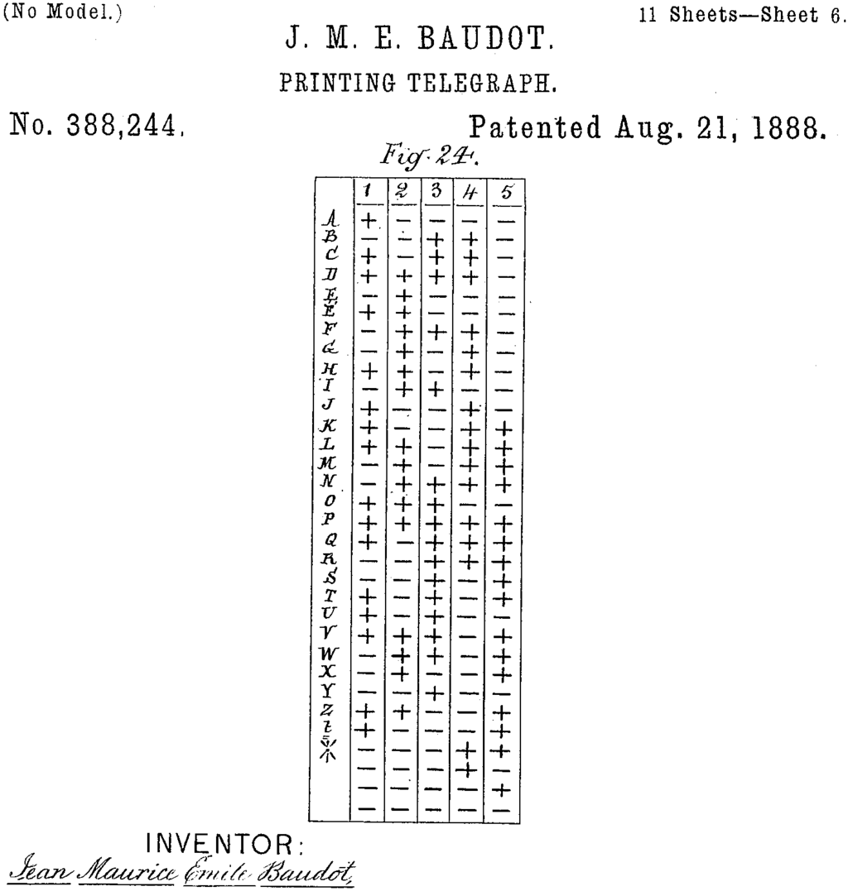
Baudot Decoder
“telex” alphabet
5 bits
RTTY: RADIO teletype
1 or 2 startbits
1, 1.5 or 2 stopbits
DWD: 50 baud, 1 startbit, 1.5 stopbits
→ demodulate FSK at 100 Baud
https://en.wikipedia.org/wiki/Baudot_code

Slide 73
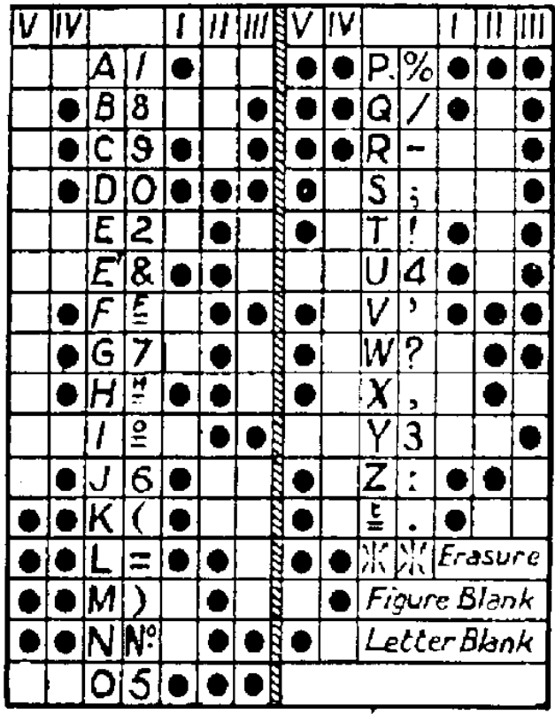
Baudot Decoder
https://www.rtty.com/England/fiveunits.htm

Slide 74
Baudot Decoder (3)
Decode at double bitrate
So we are looking for ?
2 startbits (“1”)
5 * 2 databits (which should be equal)
3 stopbits (“0”)
S1 S2 | D11 D12 | D21 D22 | D31 D32 | D41 D42 | D51 D52 | E1 E2 E3
1 1 d1 d1 d2 d2 d3 d3 d4 d4 d5 d5 0 0 0

Slide 75
Baudot Decoder (3)
Take in 29 bits and search for the “baudot” pattern
Compare received bits with pattern, give ”score”
1 1 0 0 0 1 1 1 1 0 0 1 1 0 0 1 1 0 0 0 1 1 1 1 0 0 0 0 0 0 1 1
1 1 a a b b c c d d e e 0 0 0 2 + 2 + 2
1 1 a a b b c c d d e e 0 0 0 1 + 4 + 2
1 1 a a b b c c d d e e 0 0 0 ...
1 1 a a b b c c d d e e 0 0 0 ...
1 1 a a b b c c d d e e 0 0 0 ...
1 1 a a b b c c d d e e 0 0 0 ...
1 1 a a b b c c d d e e 0 0 0 2 + 5 + 3
1 1 a a b b c c d d e e 0 0 0 ...
(…)
1 1 a a b b c c d d e e 0 0 0 ...
Once found, shift out bit-pattern with the highest score, and fill up the buffer (up to 29 bits)

Slide 76
Baudot Decoder (4)
Look for character in the table, or switch to other table
Print character

Slide 77
Putting it all together
Run GNU Radio flow on receiver PC
  Demodulated bits → UDP packets (IP multicast)
Additional python script:
  tcp server (i.e. wait for incoming connections)
  Per tcp session: baudot decoder

Slide 78
Baudot decoder enhancements (1)
FSK demodulator at 200 bits/sec (instead of 100 bits/sec.)
  100 bits/sec: For every “baudot” bit → 2 bits received
    Ex. 3 bits received (010):
  a1 a2 : b1 b2 : c1 c2
  0 0 1 1 0 0
  200 bits/sec: For every “baudot” bit → 4 bits received
    Ex. 3 bits received (10):
  a1 a2 a3 a4 : b1 b2 b3 b4 : c1 c2 c3 c4
  0 0 0 0 1 1 1 1 0 0 0 0

Slide 79
Baudot decoder enhancements (1b)
    Ex. 3 bits received:
  a1 a2 a3 a4 : b1 b2 b3 b4 : c1 c2 c3 c4
  0 0 0 0 1 1 1 1 0 0 0 0
  Ignore bits “1” and “4” (adjacent to previous / next bits). Only look at bits 2 and 3.
  Should help against “inter-symbol-interference
  Q: but is that the real problem?
  Q: will the clock recovery block be able to handle this?

Slide 80
Baudot decoder enhancements (2)
DWD transmissions contain a lot of text, a lot of very simular text
“SEEWET?…”
Next char? “U” (10100) or “T” (10101)
Machine learning:
  Make lists, what character is the most common after “WET”?
  Based on texts that are known to be correct (100 % “baudot pattern” match)

Slide 81
Question time (2)
Questions?

Slide 82
GNU Radio … summary (1)
Use:
Practical applications:
  Less known protocols:
    Satellite telemetry decoder
  Simulations
    Radio Channel simulations
Experimenting / learning receivers/decoders – encoders/transmitters
Educational tool

Slide 83
GNU Radio … summary (2)
Use:
Advanced telecom techniques
  e.g. spacial diversity reception
Cybersecurity

Slide 84
GNU Radio … summary (3)
Already a lot of blocks ready to use
  But what block does what?
  What do all these parameters do?
Relative easy to create your own blocks
But you must understand signal-processing techniques

Slide 85
GNU Radio … Getting started (1)
Main development environment is linux
  apt / yum / …
Mac: brew, MacPorts
Windows:
  No idea (no personal experience)
  Run GNU Radio in Linux VM
    Pentoo linux: GNU Radio pre-installed
  Use single-board computer (raspberry-pi, ...)

Slide 86
GNU Radio … Getting started (2)
Tutorials
  Articles on GNU Radio website
  Videos
SDR knowledge
  See resources list
“sdrbelgium” mailinglist
Workshop ???

Slide 87
Question time (final)
Questions?

