Slide 1
NASDAQ: SNDK · FISCAL YEAR 2026
Revenue up 175%.
The stock down 30%.
Sandisk's first full year on its own — and the gap between the business and the share price.
Quarterly revenue, Q1 to Q4 FY2026
All figures from Sandisk quarterly results. Fiscal 2026 ended 3 July 2026.
Notes:
Hook: this is a company whose revenue nearly tripled in a year and whose stock has just fallen 30% from its high. Both things are true at once — that's the story. FY2026 revenue $20.25B, up 175% year over year. Stock hit $2,354.39 on 22 June 2026 and was around $1,270-1,340 by 12 August.

Slide 2
The company
Spun out of Western Digital in February 2025
Sandisk makes NAND flash memory
— the storage inside SSDs, phones, cameras and, increasingly, AI data centres.
Western Digital bought it in 2016 and separated it again in February 2025.
It has traded as an independent company for about eighteen months.
FY2026 is its first full fiscal year standing alone.
$20.2B
+175%
FY2026 revenue
Revenue growth vs FY2025
$11.4B
$73.76
Milpitas, California · 10,000+ employees · CEO David Goeckeler
FY2026 net income (GAAP)
FY2026 diluted EPS (GAAP)
Sandisk FY2026 results. FY2025 revenue of about $7.4B is implied by the reported 175% growth.
Notes:
Keep this short — it's context, not the story. Key point: NAND flash. Commodity-ish memory business that has just been repriced by AI data centre demand. FY2025 revenue was roughly $7.4B; FY2026 was $20.25B.

Slide 3
What the share price did
Two moves, both enormous, in opposite directions
$2,354.39
$1,271–1,344
−30%
All-time high, 22 June 2026
Trading range on 12 August 2026 — sources differ on the close
Retreat from the June high
The drawdown came with no deterioration in the reported numbers. Q4 was the strongest quarter the company has ever posted, and it was posted after the high.
Price milestones as reported in August 2026. No continuous price series is shown here — see the animated charts.
Notes:
This is the setup for the whole video. Stock peaked 22 June at $2,354.39, then fell more than 30%. Q4 earnings landed 5 August — after the peak — and were a record. Be careful on air: sources disagree on the exact 12 Aug close (roughly $1,271 to $1,344), which is why the slide shows a range rather than a number to the cent. This is where you cut to the animated price chart if you render one locally.

Slide 4
Revenue, quarter by quarter
FY2026 — every quarter bigger than the last
3.9x
Q4 revenue versus Q1, four quarters apart
Q4 alone was bigger
than all of FY2025
Q4 FY2026 revenue of $8.97B against roughly $7.4B for the whole of the prior fiscal year.
Reported quarterly revenue. Quarters sum to $20.25B, the reported FY2026 total.
Notes:
The acceleration is the point: $2.31B → $3.03B → $5.95B → $8.97B. Two thirds of the year's revenue arrived in the second half. And Q4 on its own ($8.97B) was larger than the entire prior fiscal year (about $7.4B). Cut to: 01-quarterly-revenue.mp4

Slide 5
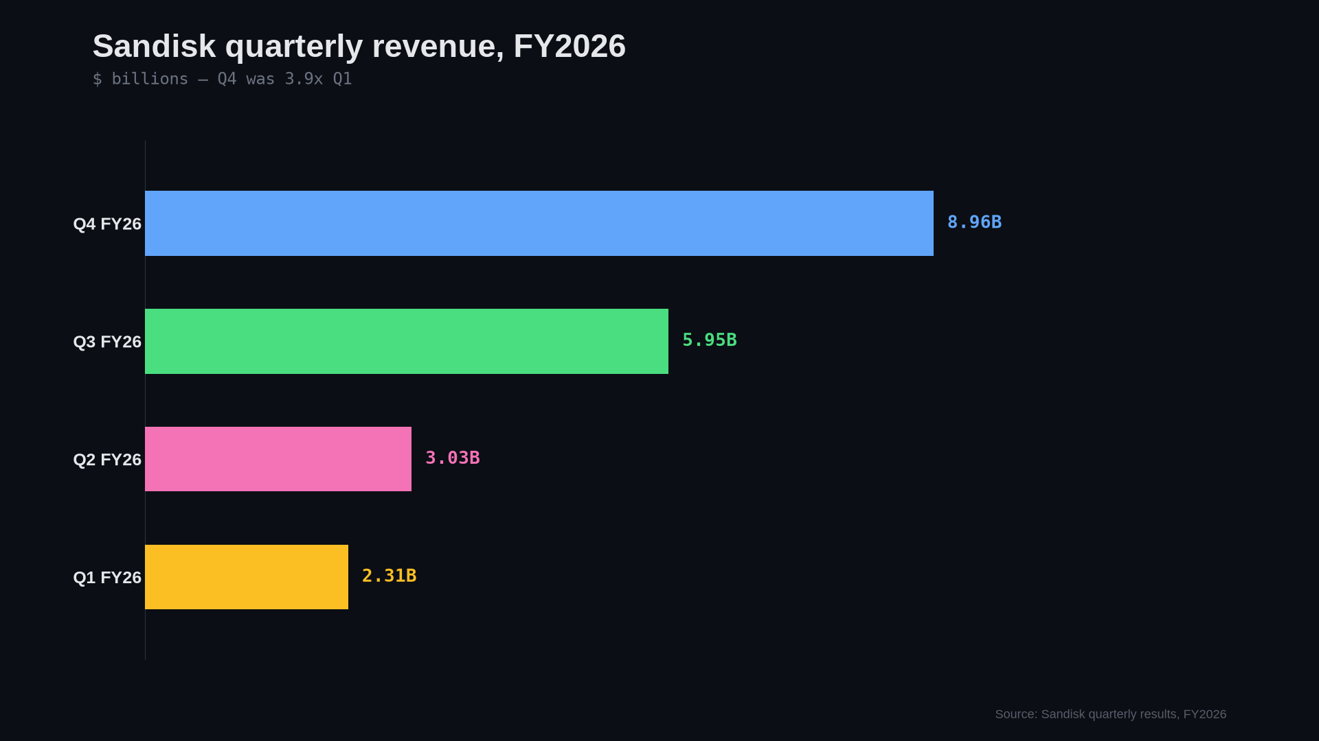
Notes:
The animated version of the slide before it. Let it run and talk over it — the bars stagger in over about five seconds and hold for two. $2.31B, $3.03B, $5.95B, $8.97B. Q4 alone was bigger than the whole of FY2025.

Slide 6
Gross margin
Non-GAAP, by quarter — the part that turned revenue into profit
+54.7
Percentage points added across FY2026
Why it matters
Revenue roughly quadrupled. Profit did far more than that, because each extra dollar of revenue arrived at a much higher margin than the one before it.
Non-GAAP gross margin as reported each quarter. Q4 FY2026: 84.6%.
Notes:
29.9% → 51.1% → 78.4% → 84.6%. That is a 54.7 point expansion in four quarters, which is extraordinary for a memory business. This is the single most important slide for explaining why earnings exploded rather than merely grew. Pricing power from multi-year datacenter agreements. Cut to: 03-gross-margin.mp4

Slide 7
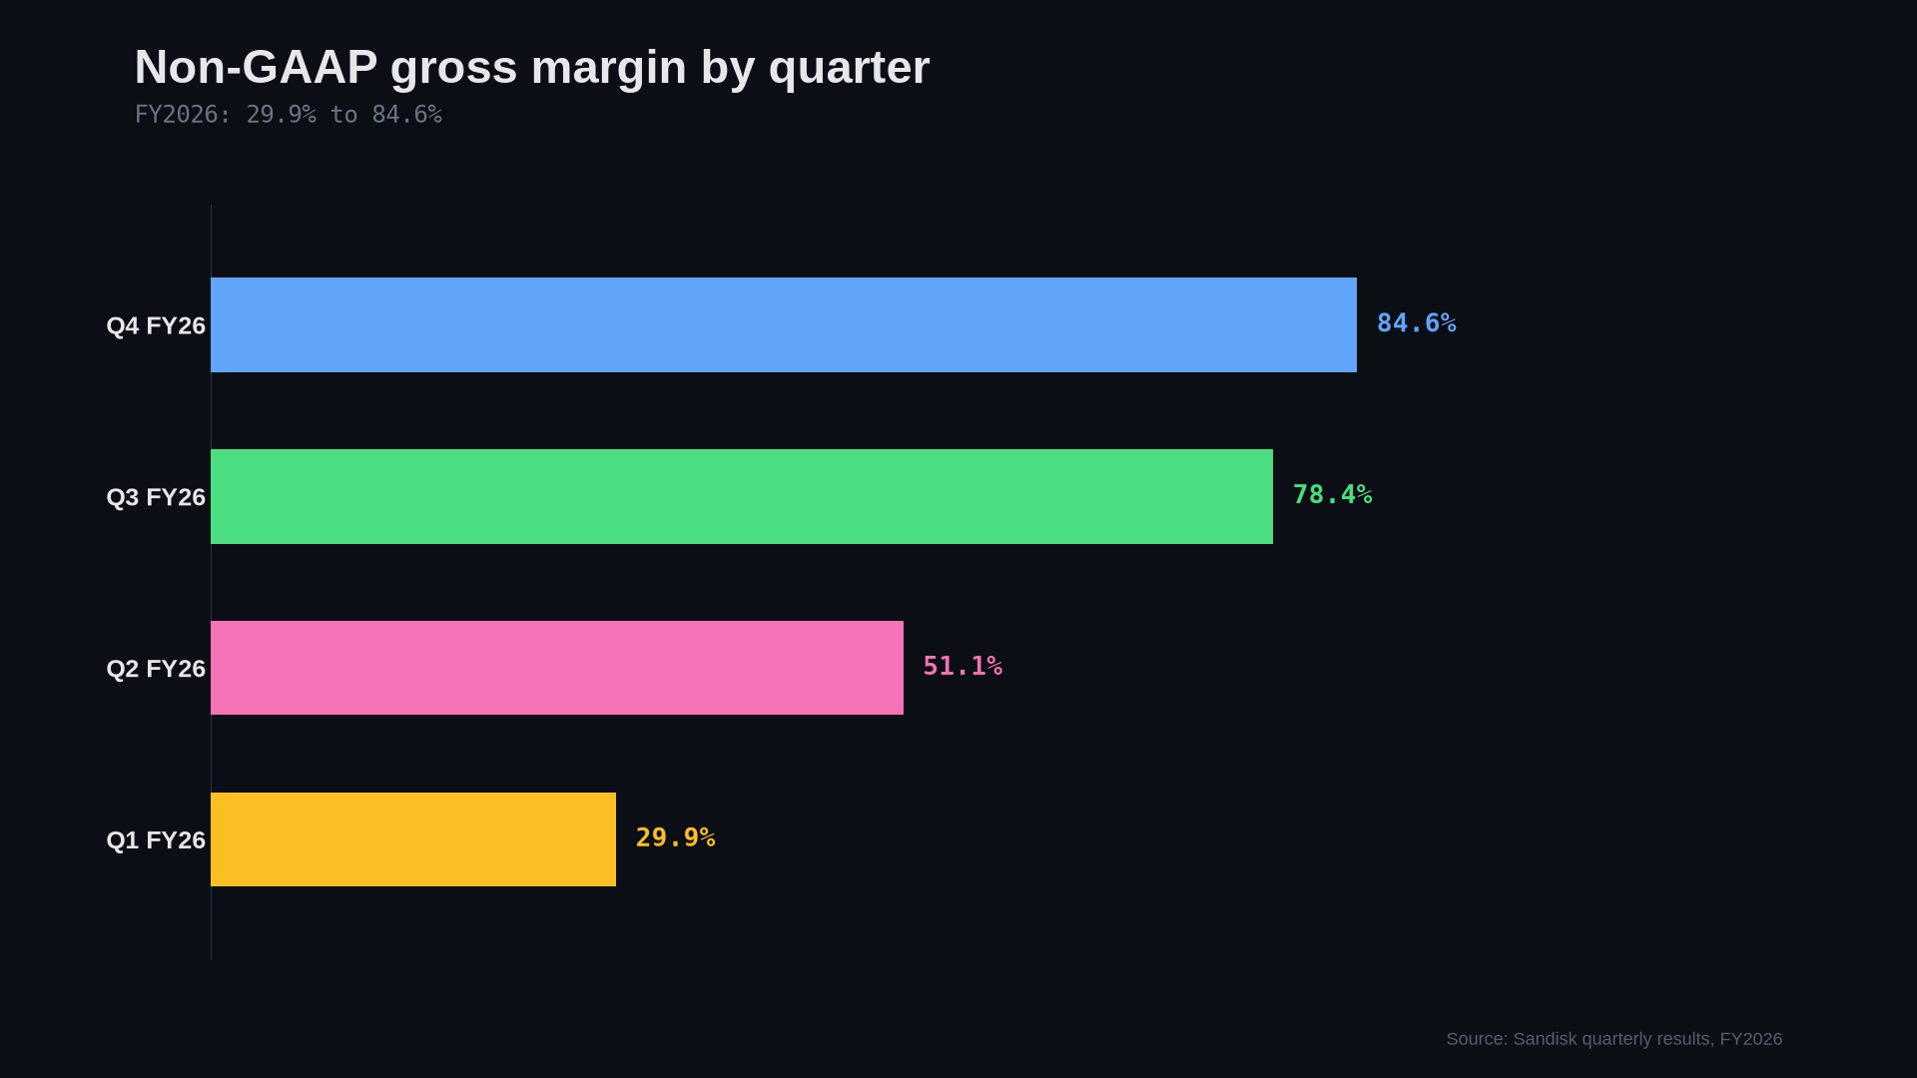
Notes:
Margin expansion, animated. 29.9% to 84.6% across four quarters. This is the one to linger on — it is the whole explanation for why earnings went up far faster than revenue did.

Slide 8
Earnings per share
GAAP diluted, by quarter
$73.76
FY2026 GAAP diluted EPS
$0.75
Q1 FY2026 — where the year started
$43.97
Q4 FY2026 — where it finished
GAAP diluted EPS. Q4 non-GAAP EPS was $39.25, against a consensus near $33.38.
Notes:
The chart everyone will screenshot. $0.75 → $5.15 → $23.03 → $43.97. Q4 non-GAAP EPS of $39.25 beat consensus of about $33.38 by roughly 18%. Full year GAAP diluted EPS $73.76, from net income of $11.43B.

Slide 9
Where the revenue comes from
FY2026 by segment — and what changed
+437%
Datacenter revenue, year over year
12% → 38%
Datacenter share of the portfolio, in one year
Edge is still the largest segment. Datacenter is the one that re-rated the company — and Consumer is shrinking as capacity is pointed at higher-value customers.
−32%
Consumer revenue, Q4 sequentially
FY2026 segment revenue. The three segments sum to the reported $20.25B total.
Notes:
Edge $12.16B, Datacenter $5.15B, Consumer $2.94B. The mix shift is the real story: datacenter was about 12% of bits a year ago and 38% of the portfolio exiting FY2026. Consumer fell 32% sequentially in Q4 — that is deliberate, capacity being reallocated, not demand collapse. Cut to: 02-segment-mix.mp4

Slide 10
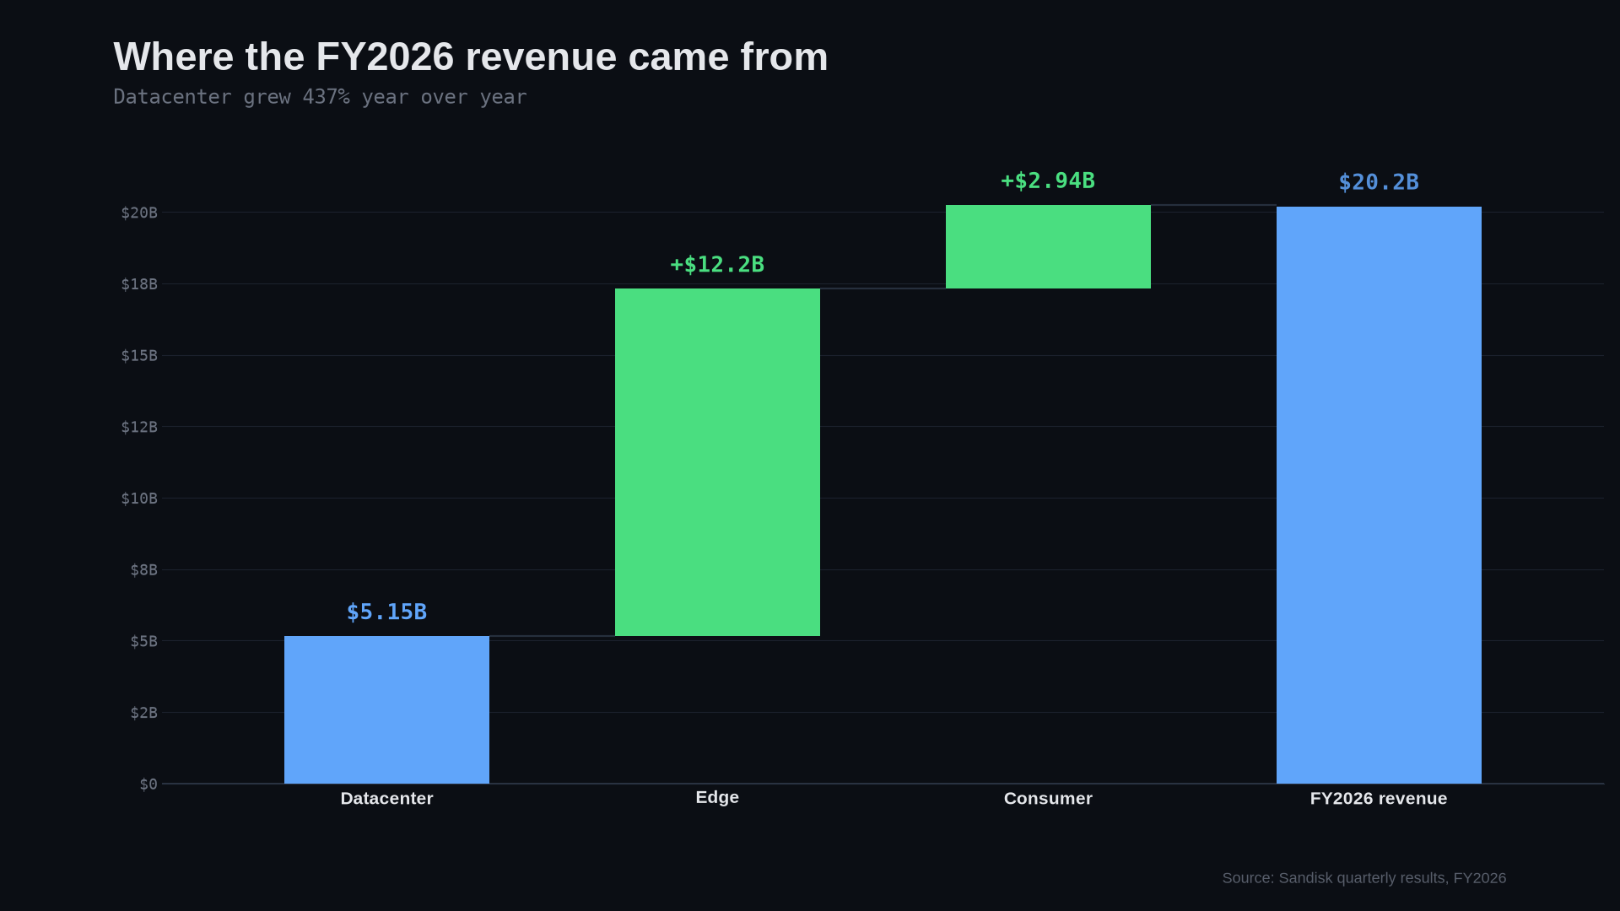
Notes:
The segment bridge, animated: Datacenter, then Edge, then Consumer, stacking up to the reported $20.25B. Worth saying out loud that these three are the whole company — that is why they add up.

Slide 11
Why the numbers moved
Three things behind the re-rating
1
2
3
AI data centre demand
BiCS10, the tenth-generation NAND
High Bandwidth Flash, with SK hynix
Enterprise AI storage capacity sold out under long-term agreements, with multi-year customer commitments behind it rather than spot orders.
1Tb TLC sampling at more than 29 Gb/mm², a 59% improvement in bit density — more capacity from the same wafer.
First OCP technical specification published August 2026: up to 512GB per stack and up to 3TB/s, aimed at the AI inference bottleneck.
Sandisk product announcements and FY2026 results commentary.
Notes:
Keep this tight — three reasons, one line each. 1. Demand: FY2026 enterprise AI storage capacity sold out under long-term agreements. 2. Technology: BiCS10 1Tb TLC, >29 Gb/mm², bit density up 59%. 3. HBF: joint standard with SK hynix, OCP spec released August 2026, 512GB and 3TB/s. Sampling to customers in the second half of 2026 — this one is future revenue, not current.

Slide 12
What management guided to
First quarter of fiscal 2027
$10.30–10.80B
$44.00–46.00
Q1 FY2027 revenue guidance
Q1 FY2027 non-GAAP diluted EPS guidance
The comparison that makes it land
A year earlier, Q1 FY2026 brought in $2.31B and earned $1.22 a share on a non-GAAP basis. The guided quarter is roughly four and a half times the revenue — and more than thirty times the earnings.
Guidance issued with Q4 FY2026 results, 5 August 2026. Guidance is management's estimate, not a result.
Notes:
Guidance: revenue $10.30-10.80B, non-GAAP EPS $44.00-46.00. The framing that works: a year ago that same quarter was $2.31B and $1.22 non-GAAP EPS. So ~4.5x the revenue and >30x the earnings. Say clearly that this is guidance, not a reported result.

Slide 13
What it trades at
After a 30% fall from the high
5.9x
0.14
$6.54B
149M
Forward price / earnings
PEG ratio
Net cash — about $43.89 a share
Shares outstanding
What the sell side says
The obvious question
$2,053.5
A single-digit forward multiple usually means the market does not believe the earnings are repeatable. For a memory company at a cyclical peak, that is a reasonable thing for the market to think — and the thing to argue about.
Average 12-month target across 23 analysts, consensus rating "Strong Buy".
Valuation metrics as reported in mid-August 2026; market capitalisation was quoted between $180B and $188B.
Notes:
Forward P/E about 5.9, PEG 0.14, net cash $6.54B ($43.89/share), 149M shares. Analyst average target $2,053.50 across 23 analysts, Strong Buy. Do not present the low multiple as free money. The right framing is the one on the right-hand card: a mid-single-digit forward multiple is the market pricing peak earnings, not a mispricing everyone else missed.

Slide 14
The argument
Both sides, from the same set of numbers
The bull case
The bear case
FY2026 enterprise AI storage capacity sold out under long-term agreements
Gross margin up 54.7 points in four quarters
Datacenter revenue up 437% year over year
Net cash of $6.54B and no debt
Guidance implies the acceleration continues into FY2027
Memory is historically the most cyclical business in semiconductors
84.6% gross margin is a peak, not a baseline
Consumer revenue fell 32% sequentially in Q4
Revenue is concentrated in a few very large hyperscale customers
The stock has already fallen more than 30% from its June high
Both columns are drawn from the same reported FY2026 figures.
Notes:
Give both sides properly — this is what makes the video worth watching rather than a pump. The strongest bear point is the third one: 84.6% gross margin is a cycle peak. Memory margins mean-revert violently. The strongest bull point is the sold-out capacity under multi-year commitments, which is what makes this cycle arguably different from previous ones.

Slide 15
Three numbers to remember
$20.2B
84.6%
−30%
FY2026 revenue, up 175% on the prior year
Q4 non-GAAP gross margin, from 29.9% in Q1
The share price, from its June high
The business and the share price have been telling different stories since June. Which one turns out to be right depends entirely on whether 84.6% is a new normal or a peak.
Sandisk FY2026 results, reported 5 August 2026. Not investment advice.
Notes:
Close on the tension rather than on a call. The one-line summary: revenue up 175%, margin up 54.7 points, stock down 30% — and the whole argument reduces to whether 84.6% gross margin is a peak or a plateau. Standard disclaimer: this is not investment advice.

