Slide 1
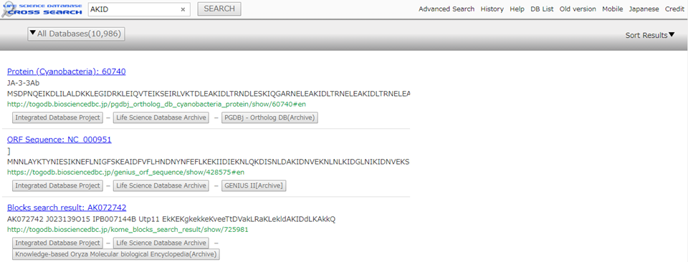
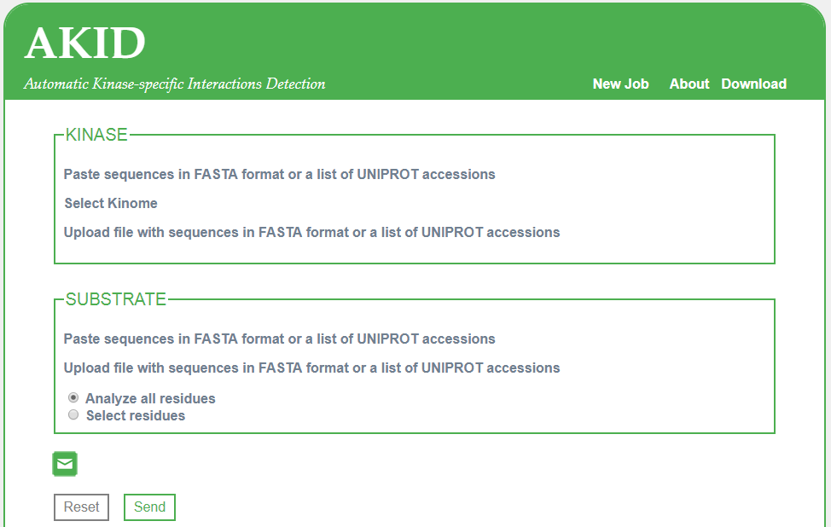
AKID http://akid.bio.uniroma2.it
AKID is a Deep Neural Network-based method that identifies kinase-specific phosphorylation events at single-kinase level in any given Eukaryotic proteome without prior functional annotation. It automatically detects kinase domains, their residues responsible for target specificity and finally their target peptides.
OS: Linux
Version:1.0
Author: Luca Parca
https://www.ncbi.nlm.nih.gov/m/pubmed/30016513/
link out 40 days

