Slide 1
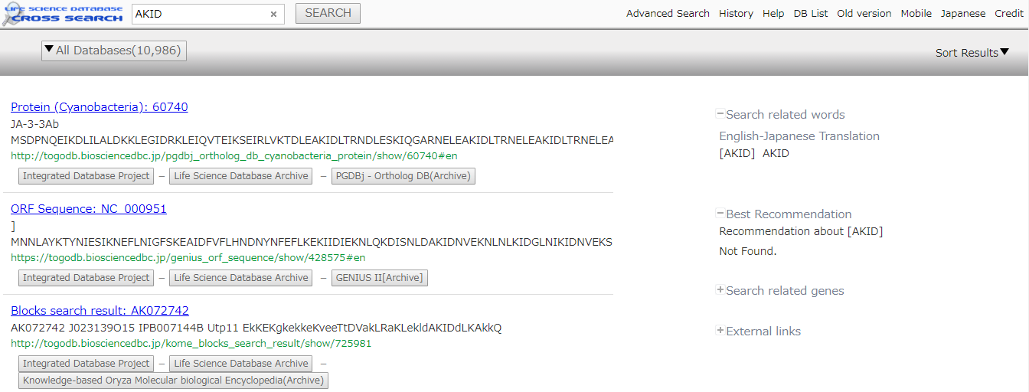
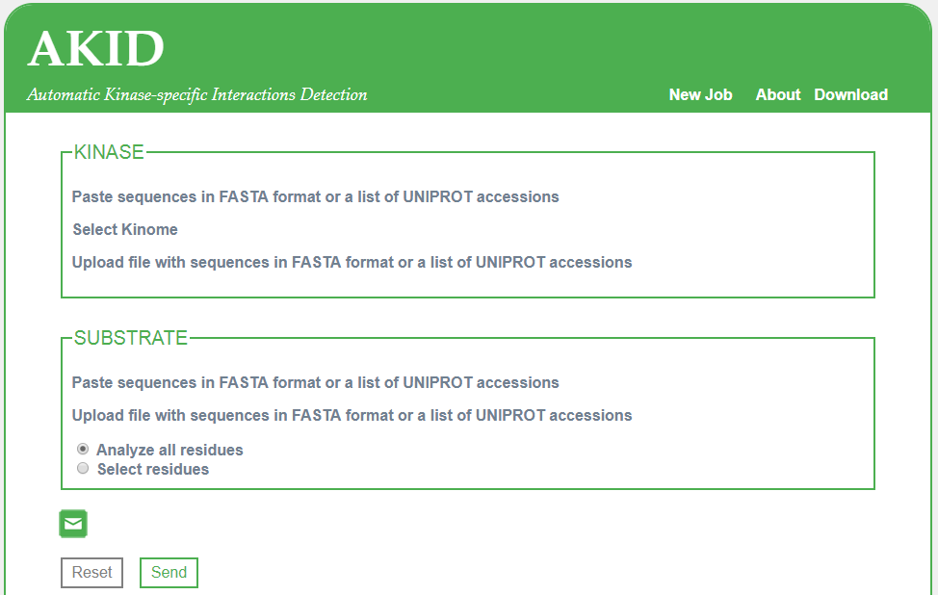

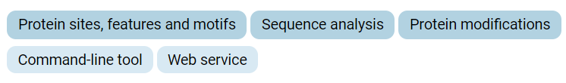
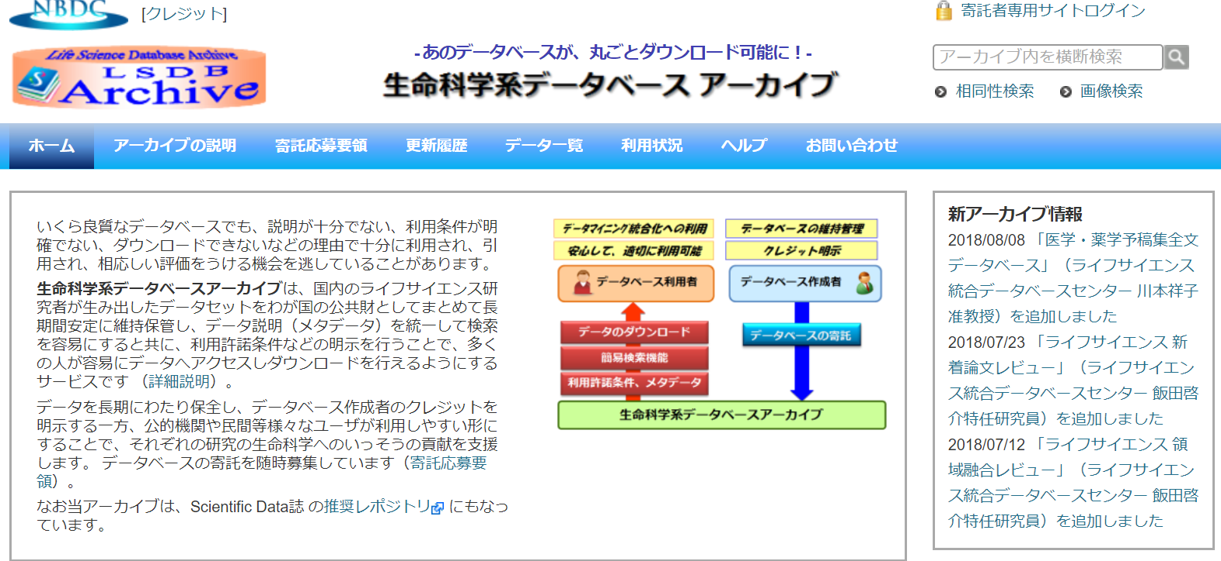
AKID http://akid.bio.uniroma2.it
AKID is a Deep Neural Network-based method that identifies kinase-specific phosphorylation events at single-kinase level in any given Eukaryotic proteome without prior functional annotation. It automatically detects kinase domains, their residues responsible for target specificity and finally their target peptides.
Version:1.0
Author: Luca Parca
Publication: https://www.ncbi.nlm.nih.gov/m/pubmed/30016513/
from bio.tools
ABCD http://abcd.com
ABCD is …..
Version:1.0
Author: Shigeru Yatsuzuka
Publication: https://www.ncbi.nlm.nih.gov/m/pubmed/111111111/
Inactive
(3days)
from bio.tools

