Slide 1
Controller Design Studio – Architecture & Design
BRINDA SANTH M
Dec, 2018

Slide 2
Agenda
Controller Design Studio Architecture
Controller Design Studio Data Flow
Controller Blueprints logical diagram
Controller Blueprints Type Definitions
Controller Blueprints Instance Models
Controller Blueprints Functions
Controller Blueprint Archive (CBA)
SLI Data exchange Optimisation

Slide 3




Controller Design Studio Architecture
Software:
Open Daylight Karaf ( Components, DG, Plugins)
Embed Tomcat ( CB MS, BP MS)
Embed Tomcat ( CDS UI MS)
Maria DB( CB MS, SDNC, CDS DB)
Frameworks:
Spring Boot
Technologies:
Directed Graph ( Micro Flows)
Java ( Capability Components)
Kotlin ( Capability Components)
Python, Jython(Adaptor Components )
Modeling :
JSON ( Blueprints )
YANG (ODL APIs)
Swagger (MS APIs )
Velocity ( Config files)
SQL (DB )
Adaptors:
Netconf
Restconf
Ansible
Controller Design
Studio MS
Controller Blueprints MS
CDS DB
Blueprint Processor Platform
CB DB
Rest
Adapters
Directed Graph
BP DB
Capability Components
DB
Adapters
DMaaP Producer
DmaaP
Consumer
Device
Components
A&AI
MS
Policy
MS
Networks / VNFs / Devices

Slide 4
Controller Design Studio Data Flow
1C. Auto load
Model Types, & Reusable Dictionaries
1D. Store
Model Types, & Reusable Dictionaries
GIT
1B. Jenkins Builds and Deploy to Maven Repo
MAVEN
Controller Blueprints
Microservice
CB DB
1A. User registers Model Types, & Reusable Dictionaries
2B. Enrich, Validate CBA file
Blueprint Processor Platform
Controller Design
Studio
Groovy
Executor
Component
Ansible
Executor
Component
DmaaP
CBA Listener
2A. User create CBA file
3D.Persist CBA file
Resource
Resolution
Component
Netconf
Executor
Component
3A.Store CBA file
2D.Test CBA file
3C.Consume CBA file
2C.Test Deploy CBA file
4B.Retrieve
CBA file
Self Service
Rest / GRPC API
BP MS
Python
Executor
Component
Restconf
Executor
Component
SDC
DMaaP
3B.Publish CBA file
4F.Return
Self Service Response
4C.Execute CBA
Directed Graph
4A.Send
Self Service
Request
4D.Execute CBA
Components
DMaaP
DmaaP
Publisher
Directed Graph
Executor
Component
Executor
SO
4H.Consume
Self Service
Response
4G.Publish
Self Service
Response

Slide 5
Functional Decomposition
Artifact Management(Blue Prints, Model Type, Resource Definitions)
Enrichment( Model Types/ Resource Definition)
Validation( Model Types/ Resource Definition)
CDS Frontend/UI MS
Spring Boot 2.1
CDS UI/ Client
Controller Blue Prints
Studio MS
Angular / Browser
Http / Websocket
Webflux Http / GRPC
CDS UI / Server
Webflux Http / GRPC
Loopback4 / Nodejs
Spring Boot
Process
Resource Resolution
Network Communication
Webflux Http / GRPC
Blue Prints Processor MS
Proxy Artifact Management(Blue Prints, Model Type, Resource Definitions)
Proxy Enhancement and Enrichment
User Event Management
User Access Control Management.
AAF
MS

Slide 6
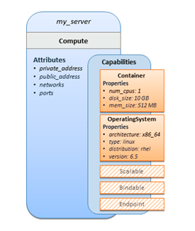
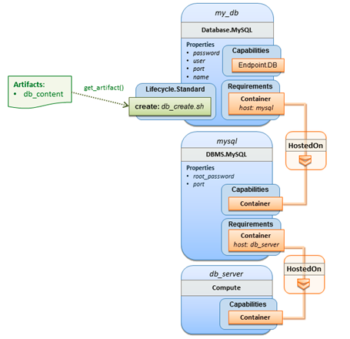
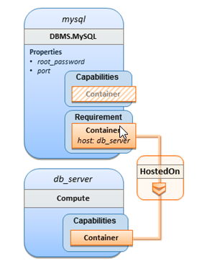
Controller Blueprints Logical Diagram

Slide 7
Controller Blueprints(CB) Type Definition
Service Template Keys | Required | Type | Description
tosca_definitions_version | yes | string | Defines the version of the Controller Blueprints(CB) Simple Profile specification the template (grammar) complies with.
metadata | no | map of string | Defines a section used to declare additional metadata information. Domain-specific TOSCA profile specifications may define keynames that are required for their implementations.
description | no | description | Declares a description for this Service Template and its contents.
imports | no | list of Import Definitions | Declares import statements external CB Definitions documents, may be file location or URIs relative to the service template file within the same CBA file.
artifact_types | no | list of Artifact Types | This section contains an optional list of artifact type definitions for use in the service template
data_types | no | list of Data Types | Declares a list of optional CB Data Type definitions.
capability_types | no | list of Capability Types | This section contains an optional list of capability type definitions for use in the service template.
relationship_types | no | list of Relationship Types | This section contains a set of relationship type definitions for use in the service template.
node_types | no | list of Node Types | This section contains a set of node type definitions for use in the service template.
policy_types | no | list of Policy Types | This section contains a list of policy type definitions for use in the service template.
topology_template | no | Topology Template definition | Defines the topology template of an application or service, consisting of node templates that represent the application’s or service’s components, as well as relationship templates representing relations between the components.

Slide 8
Controller Blueprints(CB) Instance Model
Topology Template Keys | Required | Type | Description
description | no | description | The optional description for the Topology Template.
inputs | no | list of parameter definitions | An optional list of input parameters (i.e., as parameter definitions) for the Topology Template.
node_templates | no | list of node templates | An optional list of node template definitions for the Topology Template.
policies | no | list of policy definitions | An optional list of Policy definitions for the Topology Template.
workflows | no | list of imperative workflow definitions | An optional map of imperative workflow definition for the Topology Template.
Node Template Keys | Required | Type | Description
type | yes | string | The required name of the Node Type the Node Template is based upon.
description | no | description | An optional description for the Node Template.
properties | no | list of property assignments | An optional list of property value assignments for the Node Template.
attributes | no | list of attribute assignments | An optional list of attribute value assignments for the Node Template.
requirements | no | list of requirement assignments | An optional list of requirement assignments for the Node Template.
capabilities | no | list of capability assignments | An optional list of capability assignments for the Node Template.
interfaces | no | list of interface definitions | An optional list of named interface definitions for the Node Template.
artifacts | no | list of artifact definitions | An optional list of named artifact definitions for the Node Template.

Slide 9
Controller Blueprints(CB) Instance Model ( Cont..)
Property Assignment Keys | Required | Type | Description
<property_name> | yes | Any( JsonNode) | <property_name>: <property_value> | { <property_value_expression> }
Attribute Assignment Keys | Required | Type | Description
<attribute_name> | yes | Any( JsonNode) | This will assigned internally during the Node Template Operation Processing.
Requirement Assignment Keys | Required | Type | Description
capability | no | string | The optional reserved keyname used to provide the name of either a: • Capability definition within a target node template that can fulfill the requirement.
node | no | string | The optional reserved keyname used to identify the target node of a relationship. specifically, it is used to provide either a: • Node Template name that can fulfill the target node requirement.
relationship | no | string | The optional reserved keyname used to provide the name of either a: • Relationship Type that the provider will use to select a type-compatible relationship template to relate the source node to the target node at runtime.

Slide 10
Controller Blueprints(CB) Instance Model ( Cont..)
Artifact Definition Keys | Required | Type | Description
type | yes | string | The required artifact type for the artifact definition.
file | yes | string | The required URI string (relative or absolute) which can be used to locate the artifact’s file.
repository | no | string | The optional name of the repository definition which contains the location of the external repository that contains the artifact. The artifact is expected to be referenceable by its file URI within the repository.
description | no | description | The optional description for the artifact definition.
Capability Definition Keys | Required | Type | Description
properties | no | list of property assignments | An optional list of property definitions for the Capability definition.
attributes | no | list of attribute assignments | An optional list of attribute definitions for the Capability definition.
Interface Definition Keys | Required | Type | Description
operations | no | List of operation definitions | represents the required name of one or more operation definitions.

Slide 11
Controller Blueprints(CB) Instance Model ( Cont..)
Operation Definition Keys | Required | Type | Description
inputs | no | list of property definitions | The optional list of input property definitions available to all defined operations for interface definitions that are within Node or Relationship Type definitions.
 | no | list of property assignments | The optional list of input property assignments (i.e., parameters assignments) for interface definitions that are within Node or Relationship Template definitions.
outputs | no | list of property definitions | The optional list of output property definitions available to all defined operations for interface definitions that are within Node or Relationship Type definitions
 | no | list of property assignments | The optional list of output property assignments (i.e., parameters assignments) for interface definitions that are within Node or Relationship Template definitions.
implementation | no | Operation implementation definition | The optional definition for operation implementations.
policies | no | String[] | An optional list of Policy definition name for the Operation Definition.
Implementation Definition Keys | Required | Type | Description
primary | no | Artifact definition | The optional implementation artifact (i.e., the primary script file within a CBA file).
dependencies | no | list of Artifact definition | The optional ordered list of one or more dependent or secondary implementation artifacts which are referenced by the primary implementation artifact

Slide 12
Controller Blueprints(CB) Instance Model ( Cont..)
Policy Definition Keys | Required | Type | Description
type | yes | string | The required name of the policy type the policy definition is based upon.
description | no | description | The optional description for the policy definition.
metadata | no | map of string | Defines a section used to declare additional metadata information.
properties | no | list of property assignments | An optional list of property value assignments for the policy definition.
targets | no | string[] | An optional list of valid Node Templates, Work Flows the Policy can be applied to.
Workflow Keys | Required | Type | Description
description | no | description | The optional description for the workflow definition.
metadata | no | map of string | Defines a section used to declare additional metadata information.
inputs | no | list of property definitions | The optional list of input parameter definitions.
steps | no | list of step definitions | An optional list of valid Node Templates or Groups the Policy can be applied to.

Slide 13
Controller Blueprints(CB) Instance Model ( Cont..)
Step keys | Required | Type | Description
target | yes | string | The target of the step (this can be a node template name, a group name)
activities | yes | list of activity_definition | The list of sequential activities to be performed in this step.
Activity Definitions Keys | Required | Type | Description
call_operation | no | string | A string that defines the name of the interface and operation to be called on the node using the <interface_name>.<operation_name> notation.

Slide 14
Controller Blueprints Functions
get_input
The get_input function is used to retrieve the values of properties declared within the inputs section of a TOSCA Service Template.
get_input: <input_property_name>
get_property
The get_property function is used to retrieve property values between modelable entities defined in the same service template.
get_property: [ <modelable_entity_name>, <optional_req_or_cap_name>, <property_name>, <nested_property_name_or_index_1>, ..., <nested_property_name_or_index_n> ]
get_attribute
The get_attribute function is used to retrieve the values of named attributes declared by the referenced node or relationship template name.
get_attribute: [ <modelable_entity_name>, <optional_req_or_cap_name>, <attribute_name>, <nested_attribute_name_or_index_1>, ..., <nested_attribute_name_or_index_n> ]
get_operation_output
The get_operation_output function is used to retrieve the values of variables exposed / exported from an interface operation.
get_operation_output: <modelable_entity_name>, <interface_name>, <operation_name>, <output_variable_name>
get_artifact
The get_artifact function is used to retrieve artifact location between modelable entities defined in the same service template.
get_artifact: [ <modelable_entity_name>, <artifact_name>, <location>, <remove> ]

Slide 15
Controller Blueprints Archive(CBA) Format
Controller Blueprints definitions file, Resource Definition, Others
Formats : .json
Blueprint environment properties or application properties file.
Formats: .json
Flow Definitions files, such as directed graph, dataflow dsl, etc.
Formats: .json, .xml
Executions scripts used during flows.
Formats: .py, .js, .kotlin
Templates used duting processing.
Format: .vtl
Definition
Configuration
Plans
Scripts
Templates
.cba

Slide 16
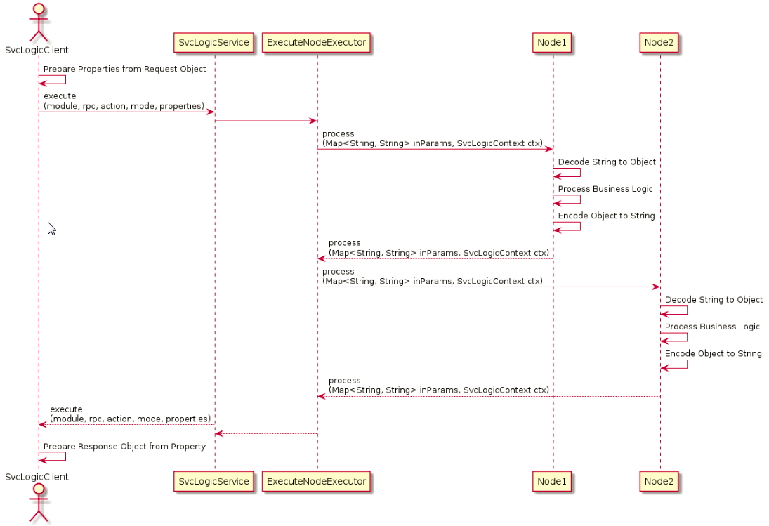
SLI Data Exchange (Current)
Context Data Exchange:
Svc Logic Client prepares the directed graph request property values in string format.
Svc Logic Service prepares the Svc Context using those values in string format.
Execute Node Executor passes the Svc Logic Context and resolved Input parameter values to corresponding execute Node in string format.
Execute Node constructs the complex Object from multiple property values in string format and perform business logic.
Execute Node converts the complex object into string value properties and stores in Svc Context.
Svc Logic Client will retrieve the response as string value from the Svc Context and construct the final response in complex object format.

Slide 17
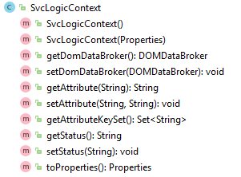
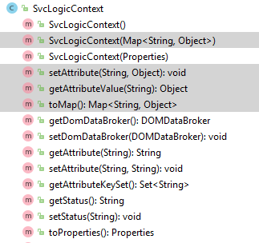
SLI Context Exchange Optimization (Proposed)
Optimization:
Enhance Svc Service logic overloaded execute method to take Map<String, Object> as an argument.
Enhance SVC Logic Context to manage attribute values in Object format.
Enhance Execute Node input parameter type to Map<String, Object>
Enhance property resolution in object value nature.
Benefits:
Reduces 40% of the code in an average for each execute node.
Saves 50% of developer’s time in prepare very complex key value pair test data.
Reuse Execute node implementation as it is for API services.
Interfacing & Communication between Execution nodes will be easier and transparent.
Execute Node Unit testing will be much simpler.
Nearly 20 to 30% improve in performance.

Slide 18

Contoller Blueprints Networks

Slide 19
Controller Blueprint Archive
Definition : sample-definition.json
Upload
Download
CBA File Hierarchy
File View
Test Deploy
SDC Deploy
Test Deploy
Deploy
Download
Upload

Slide 20
Controller Blueprints Definitions
Node Template (Component)
Policy
Definition
Node Types
Policy
Point
Policy Types
Capability
Point
aaf-policy
Capability Types
resource-assignment-dg
Requirements Types
Relationships
Point
netconf-device1
Work Flows
netconf-executor-comp
retrigger-policy
resource-assignment-comp
<Selected> Node Template / Data Type / Policy / Workflow
Properties
Attributes
Capabilities
Relationships
Artifacts
Interfaces

Slide 21
Resource Template
Resource Assignment Template :
Select Template file
Generate Mappings
File editor

Slide 22
Resource Mappings
Resource Information
Resouce name
Resouce Discription
Host-name
Resouce Type
Bundle-id
Ip-address
Default Value
Resouce Source
Resource Dependencies
Bundle-mac

Slide 23
Thank You

Slide 24
Backup

Slide 25
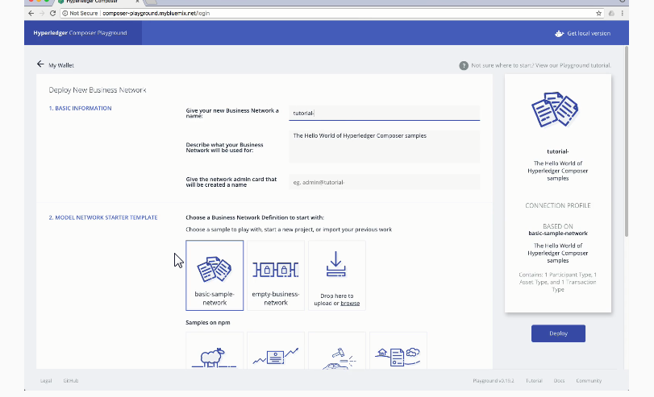

Slide 26
