Slide 1

HOTEL AGGREGATOR ANALYSIS
-- POWER BI

Slide 2
TABLE OF CONTENT
OVERVIEW OF THIS PRESENTATION
PROLEM STATEMENT | BRIEF EXPLANATION OF THE AIM OF THIS PROJECT AND WHAT WE WANT TO ACHIEVE
DATASET CLEANING AND PREP | ETTING TO KNOW OUR DATASET DESCRIBING CLEANING PREPAIRING IT FOR ANALYSIS
ANALYSIS IN POWER BI | DATA ANALYSIS USING POWER BI FOR CLEAR VISUALIZATION
FINDING | SHOWCASING OUR RESULTS IN POWER BI DASHBOARD AND REPORTS
RECOMMENDATIONS | PROVIDING ANALYZED AND VISUALIZED DATA AS RECOMENDED

Slide 3

Problem Statement
We will cover the experience of analyzing a hotel aggregator dataset using Power BI including visualizations, trends, patterns, and factors influencing listing performance in order to provide actionable insights for improving listing quality and competitiveness.

Slide 4

Dataset Cleaning & Preparation
Connecting Microsoft Power BI to our Dataset
Checking for null/duplicate/irrelevant values or columns
Starting up our Data exploration & Analysis

Slide 5
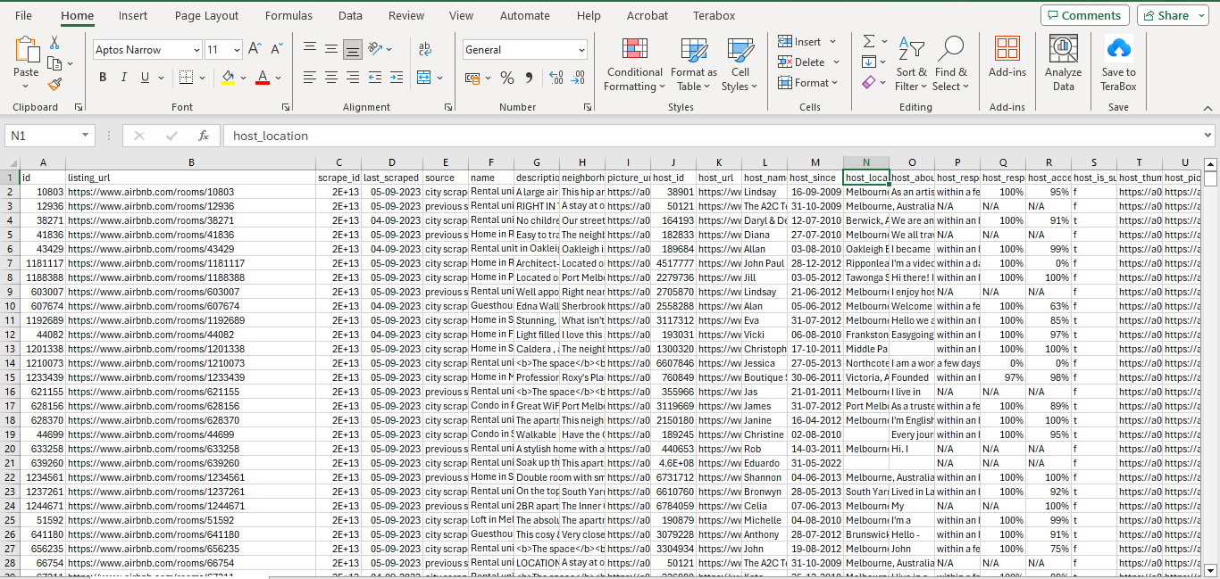
1
Load the dataset in Power BI

Slide 6




2
Data Analysis in Power BI
Geographical distribution
To identify popular neighborhoods, we Explore the geographical concentration of listings and host locations.
Pricing trends
We analyze pricing trends based on property types, room types, and accommodation capacity.
Host Characteristics
Including superhost status, response times, and verification methods.
Review Scores
We try to identify areas for improvement based on specific review categories.

Slide 7
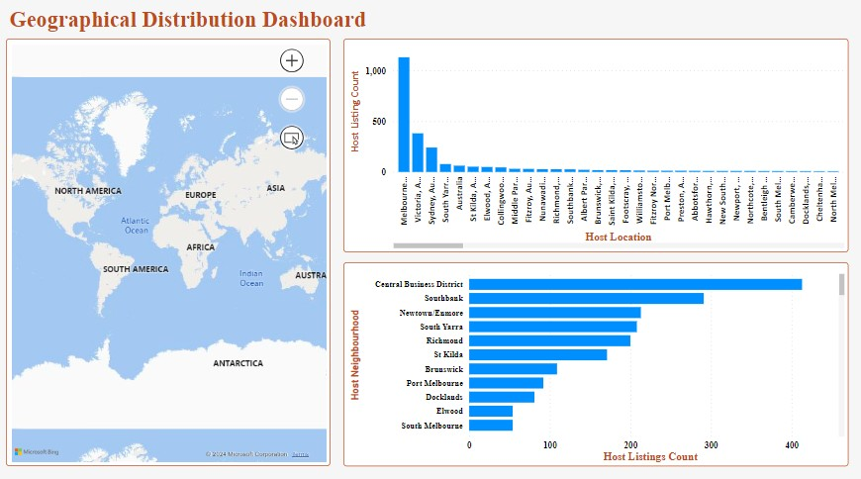
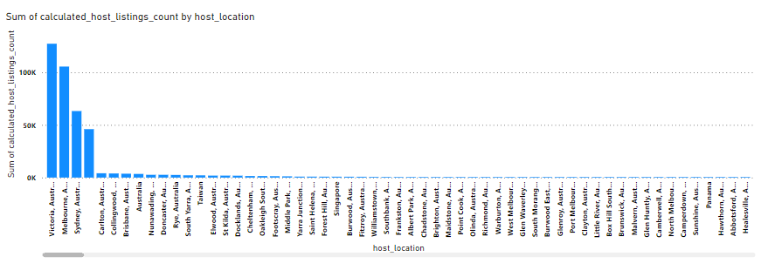
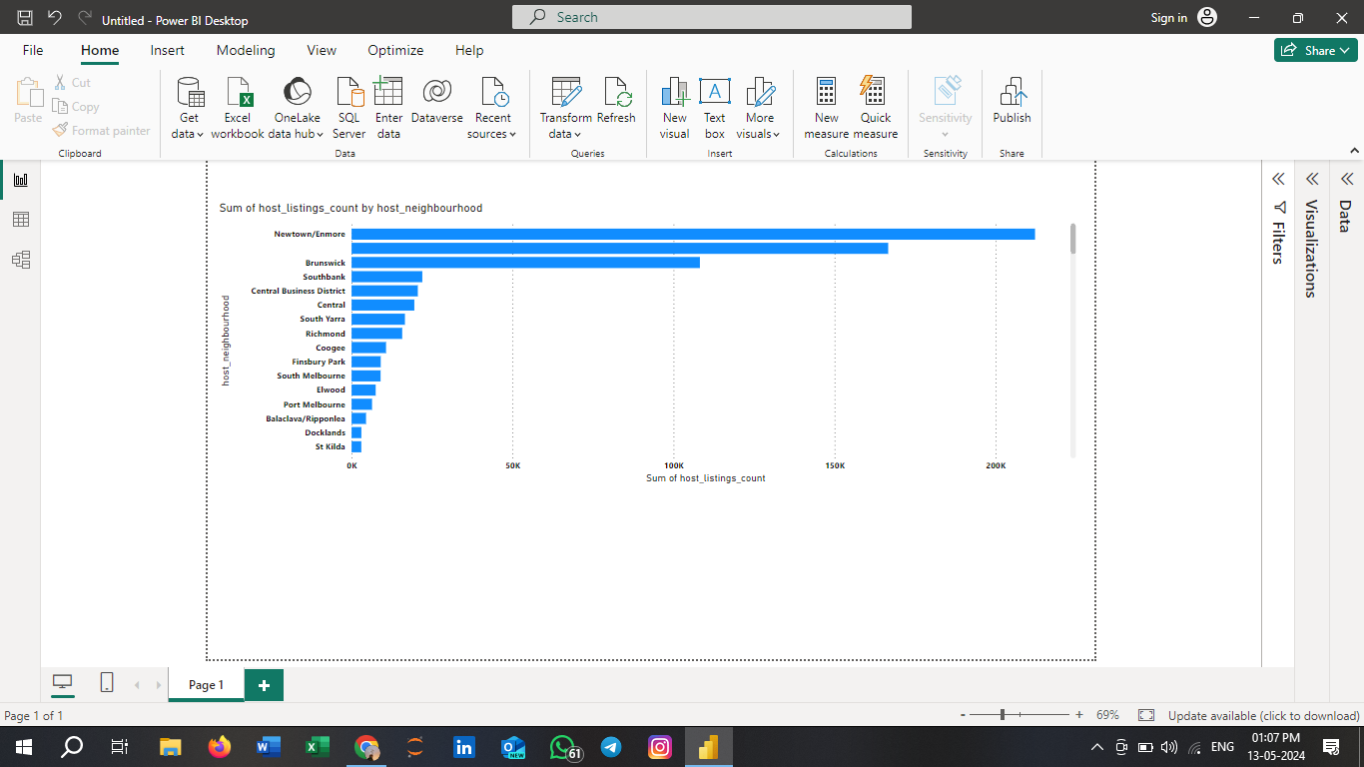
3
GEOGRAPHICAL DISTRIBUTION DASHBOARD

Slide 8
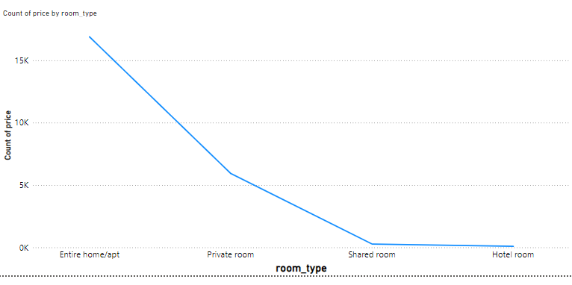
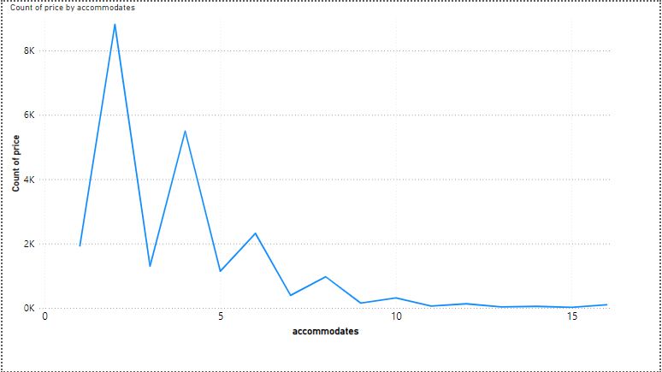
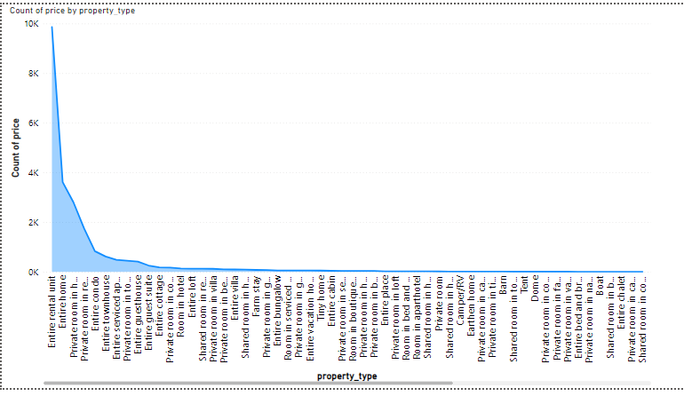
4
PRICING TRENDS DASHBOARD

Slide 9
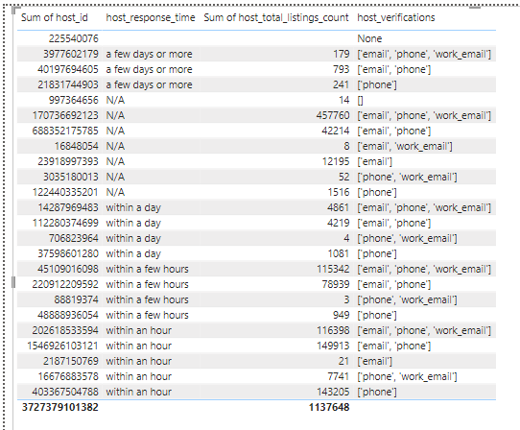
5
EVALUATE HOST CHARACTERISTICS DASHBOARD

Slide 10
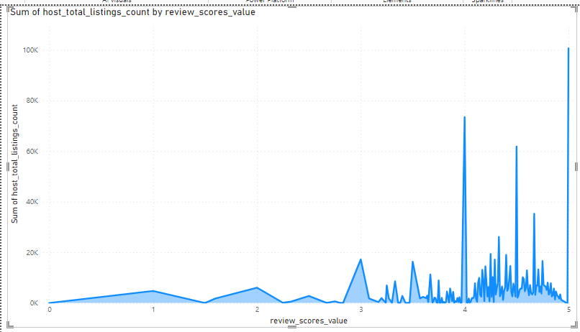
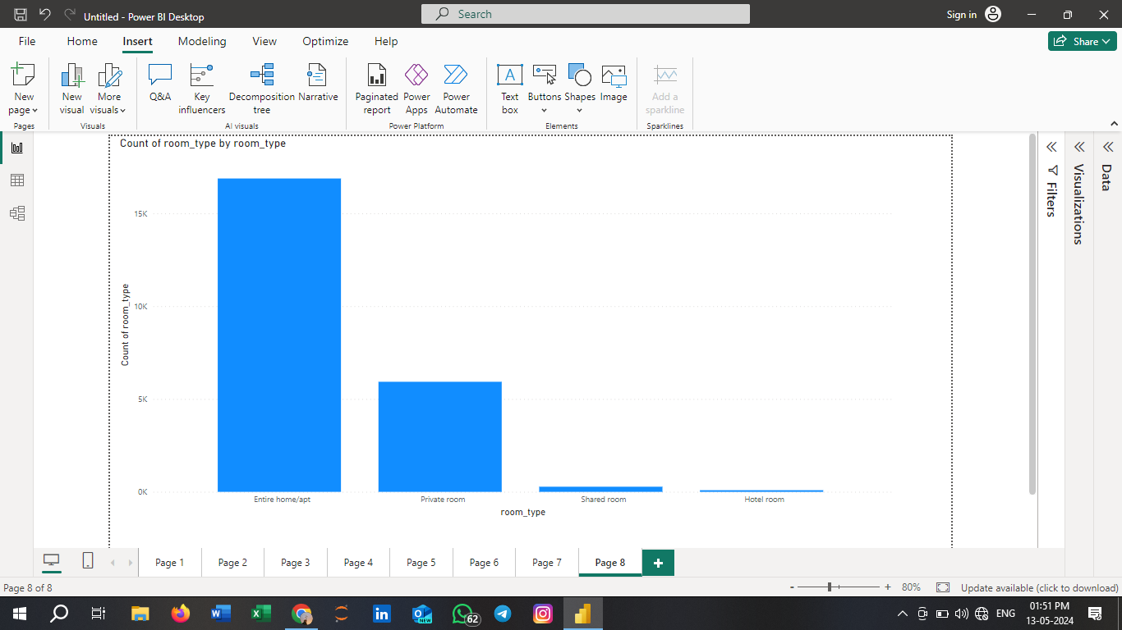
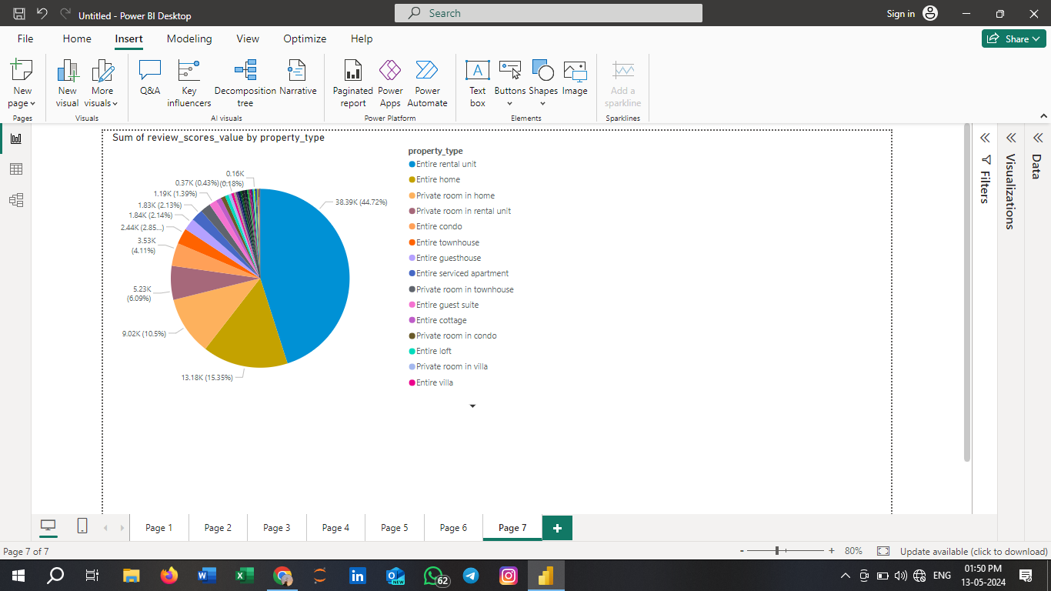
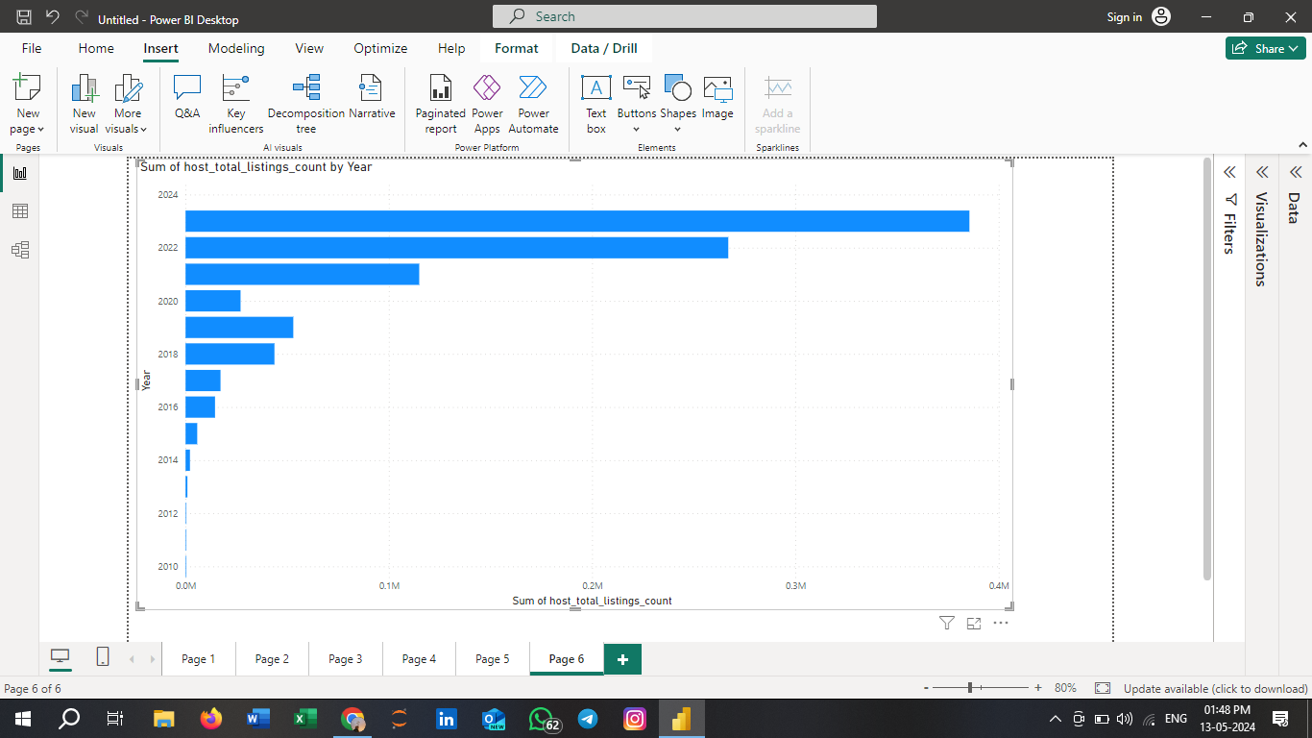
6
REVIWE SCORE PROPERTY TYPE & ROOM ANALYSIS DASHBOARD

Slide 11
7
Recommendations
Since 2016, the yearly availability is highly decreasing. Therefore, it is important to work on Increasing the availability on yearly level.
Capacity of accommodation doesn’t have a proportional relationship with the price.
The shared room type is the only type that can be affordable.
The response rate doesn’t affect the super host status.
There is a strong and clear proportional relationship between the count of total reviews and the total listings count. Thus, giving more the opportunity for rating makes the hosts more popular.

Slide 12
Thank You

