Slide 1
Predicting Tomorrow's Recovery
A personal-data machine learning project on 8 months of WHOOP data
Onat Safak
NYU Data Bootcamp · Spring 2026 · Final Project

Slide 2
The Question
Can I predict tomorrow's WHOOP Recovery score from today's data?
Why interesting:
· Recovery is the daily score I actually look at to decide how to train.
· I have 8 months of dense, multi-channel daily data on myself.
· Strong day-to-day variation suggests both autoregressive and lifestyle drivers.
Three angles, all from the bootcamp toolkit:
1. Regression, predict next-day Recovery (autoregression + exogenous).
2. Classification, predict tomorrow's Recovery zone (Red / Yellow / Green).
3. Clustering, identify Good Day vs Bad Day profiles unsupervised.
Onat Safak · NYU Data Bootcamp Sp26 · 2/20

Slide 3
The Data
237
340
258
1,050
days
workouts
sleeps
journal entries
Four CSV exports joined on cycle date
physiological_cycles.csv , Recovery%, HRV, RHR, skin temp, SpO₂, Day Strain, sleep stage minutes, sleep need & debt.
workouts.csv , per-workout duration, activity name, strain, HR zones (walking dominates, then running, lifting).
sleeps.csv , sleep onset & wake times, sleep architecture, naps.
journal_entries.csv , yes/no lifestyle answers: caffeine, alcohol, late food, magnesium, protein, dimmed lights, screens in bed, AM sunlight.
Onat Safak · NYU Data Bootcamp Sp26 · 3/20

Slide 4
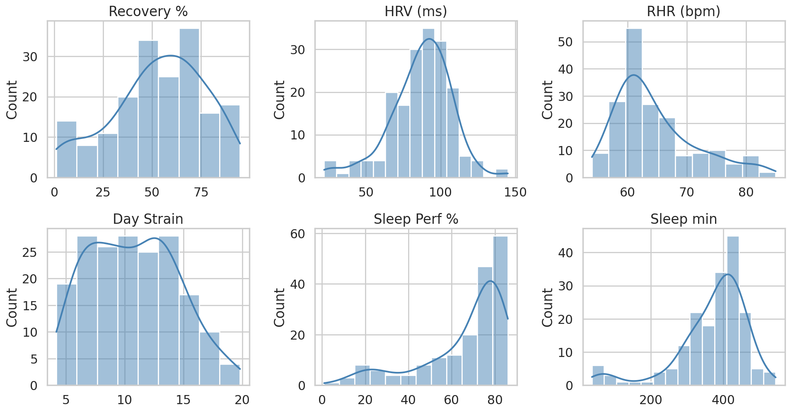
EDA: Univariate distributions
What the histograms tell us
Recovery, near-symmetric around 53; the full 0-100 range is used.
HRV, unimodal around 90 ms.
RHR, tight; mean ≈ 55 bpm (athletic range).
Day Strain, right-skewed; lots of low-strain walking days punctuated by heavier sessions.
Sleep Perf, left-skewed toward 70-95% (the WHOOP target is met often).
Sleep min, concentrated around 6.5-8 hr with a thin tail of short nights.
Onat Safak · NYU Data Bootcamp Sp26 · 4/20

Slide 5
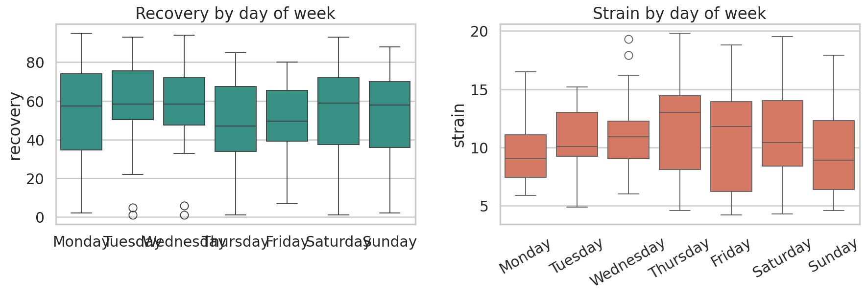
EDA: Day-of-week patterns
Weekly rhythm
Recovery: weekend medians sit a little higher than mid-week, consistent with lighter Monday-Wednesday training and better weekend sleep.
Strain: Tuesday and Saturday are the highest-strain days on average, gym days and long weekend walks.
Implication: include a weekend flag and day-of-week feature in the model.
Onat Safak · NYU Data Bootcamp Sp26 · 5/20

Slide 6
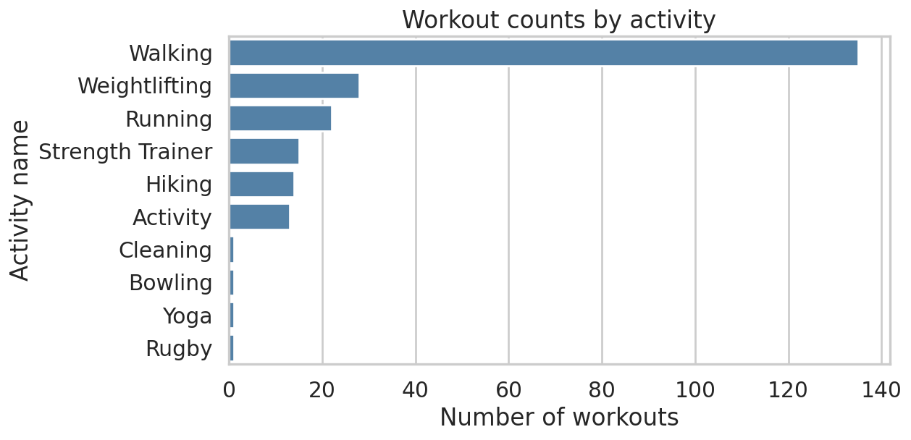
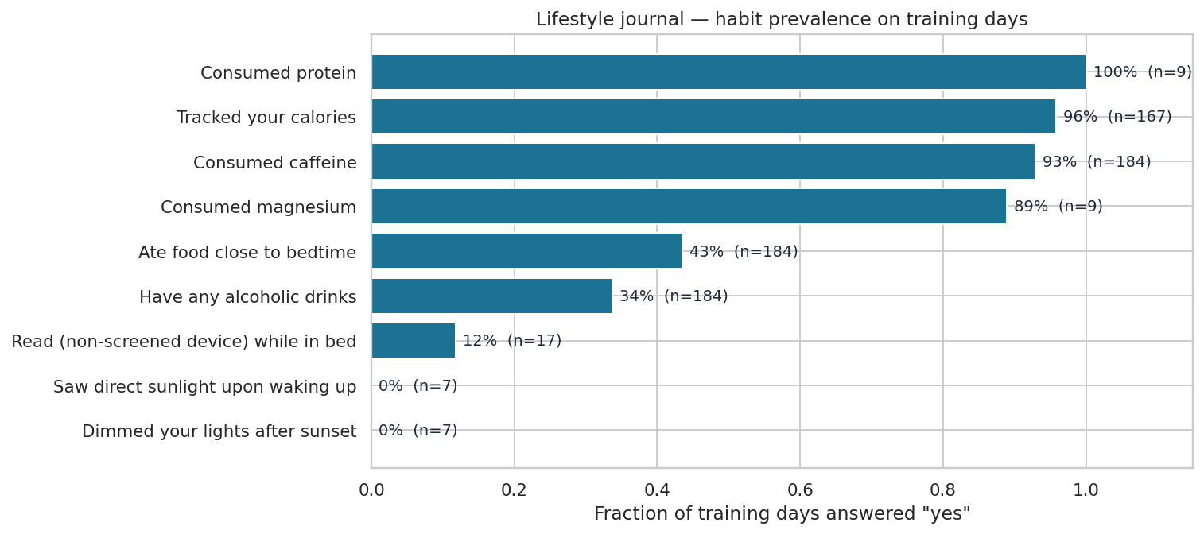
EDA: Workout & lifestyle landscape
Activity mix
Journal habit prevalence
Takeaway. Walking dominates the workouts (~60%); running and weightlifting are next. Among lifestyle questions, caffeine is essentially daily and late-night eating is common, while alcohol is rare. Only the consistently-asked questions (caffeine, alcohol, late food, tracked calories) have enough samples for reliable modelling.
Onat Safak · NYU Data Bootcamp Sp26 · 6/20

Slide 7
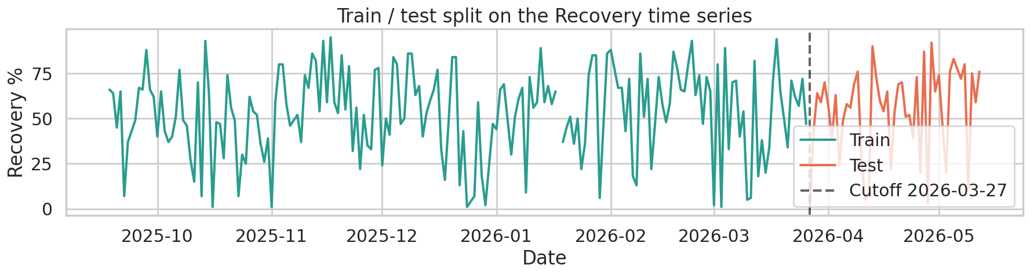
Methodology: Train / Test Split
Why this split, why this way
80% earliest days → train.
20% most recent days → test.
sklearn train_test_split(shuffle=False).
Why no shuffle? Lag features make adjacent days near-duplicates. A random split would mix them across train/test.
EDA only touches training data · KNN tuned by TimeSeriesSplit CV · Test set held out until the final pass · Final model refit on full data
Train: 180 days (2025-09-19 → 2026-03-25) Test: 46 days (2026-03-26 → 2026-05-11)
Onat Safak · NYU Data Bootcamp Sp26 · 7/20

Slide 8
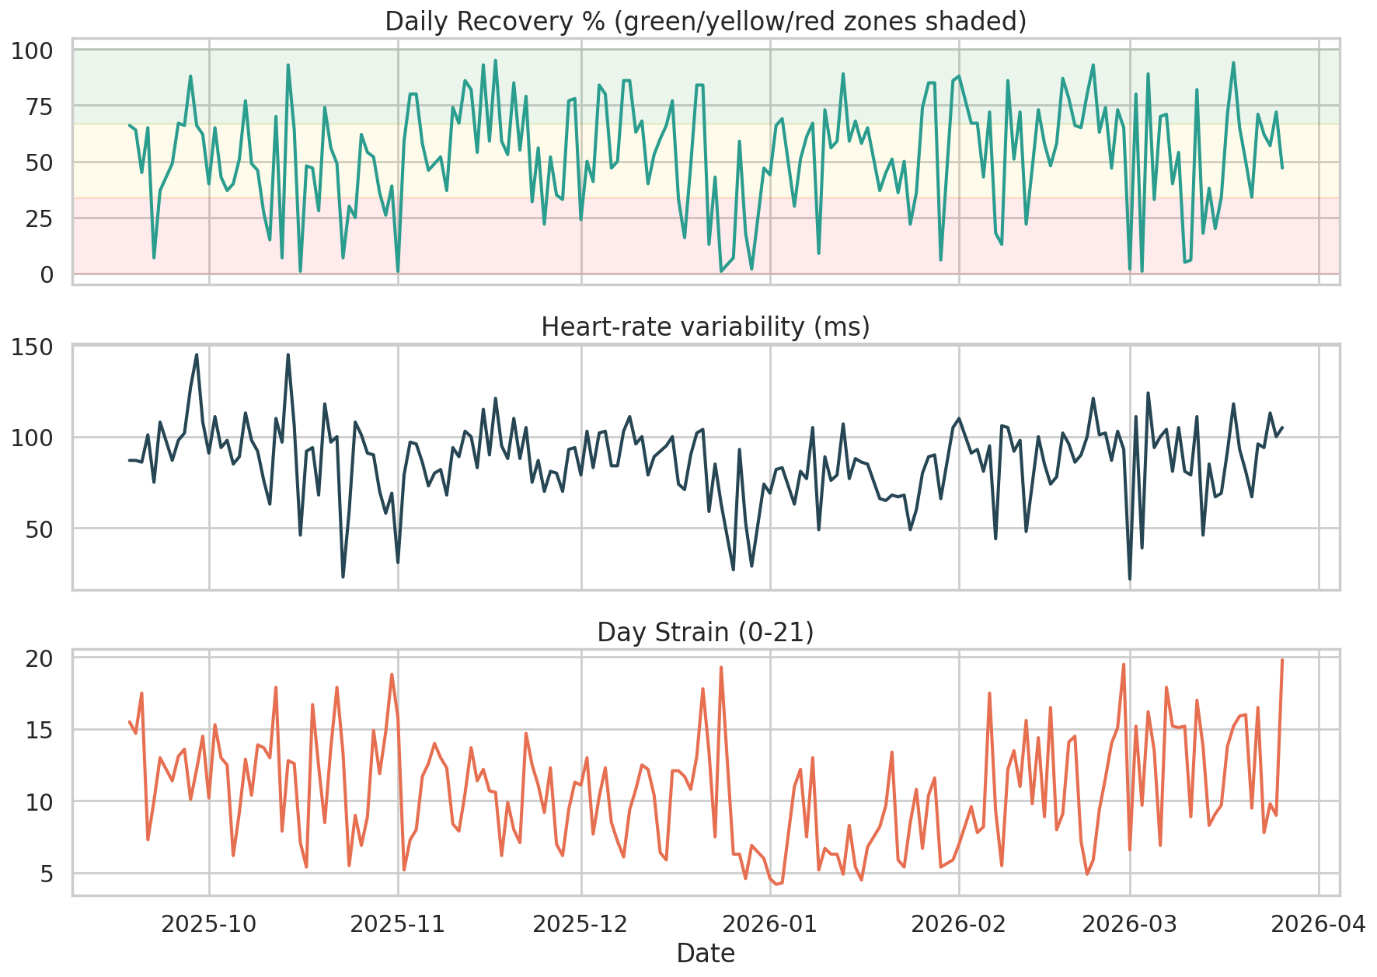
EDA: What the daily metrics look like
Key observations
Recovery oscillates day-to-day, but no clean long-term trend.
HRV moves on slower (multi-day) cycles, illness, travel, hard training blocks.
Strain is sparser; many low-intensity 'walking' days punctuated by harder sessions.
Recovery sits ~53% on average, close to WHOOP's mid-Yellow zone.
Onat Safak · NYU Data Bootcamp Sp26 · 8/20

Slide 9
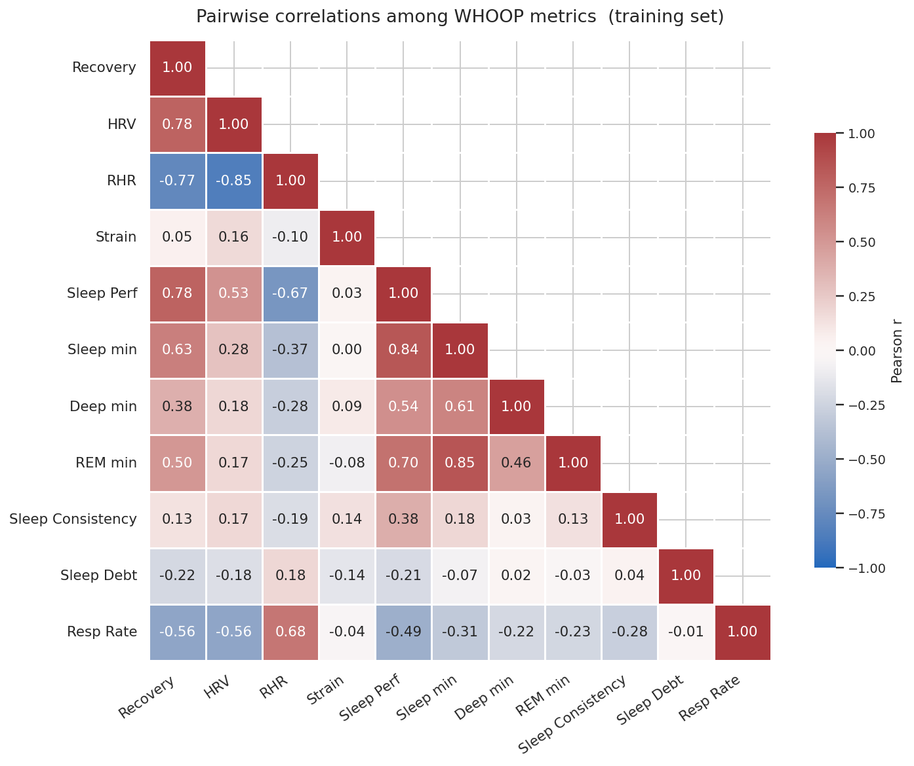
EDA: What correlates with Recovery?
Reading the heatmap
HRV is the strongest positive correlate of same-day Recovery (r = 0.78).
RHR is the strongest negative correlate (r = -0.77).
Sleep stages (deep, REM) carry signal but are collinear with total sleep.
Strain ≠ Recovery on the same day, the effect is delayed, so we use lag features.
Onat Safak · NYU Data Bootcamp Sp26 · 9/20

Slide 10
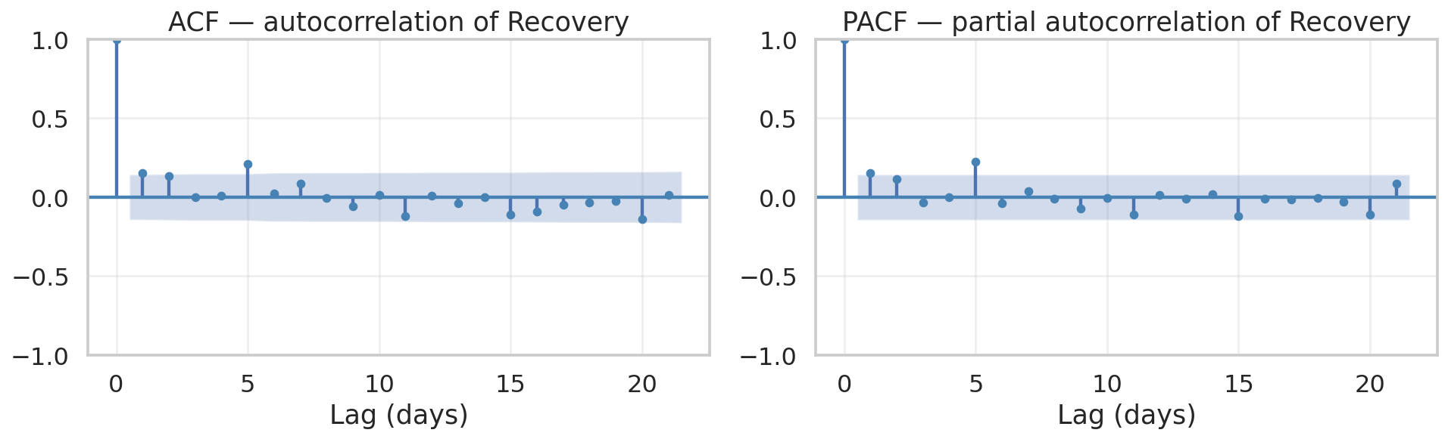
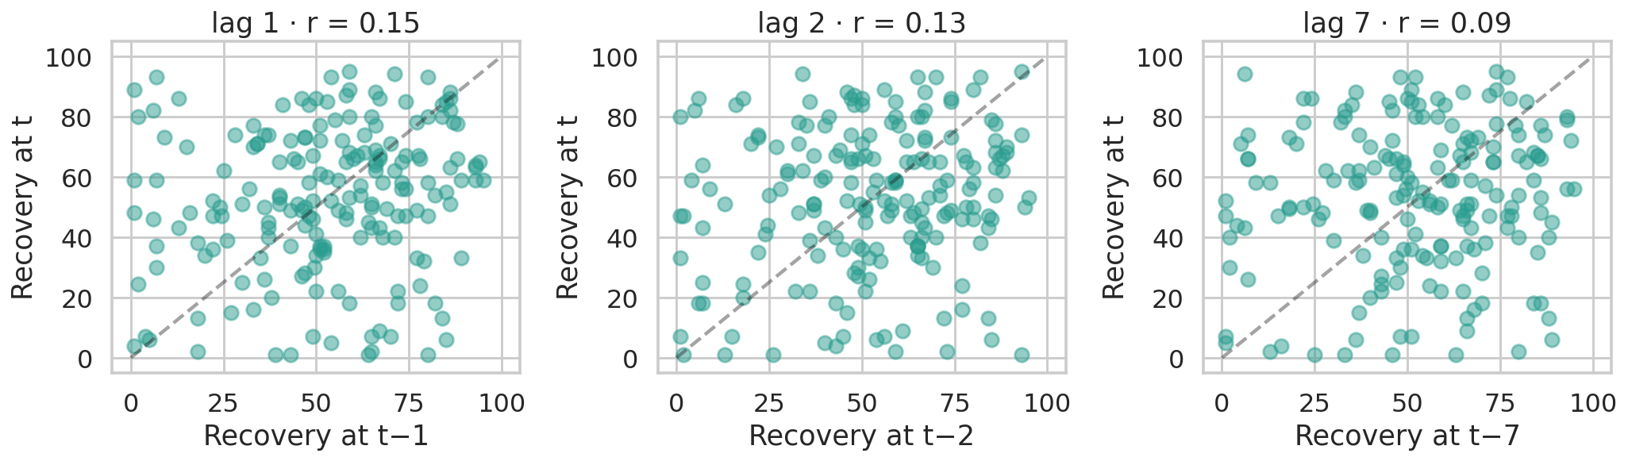
Autoregressive structure: ACF & PACF
What the diagnostics tell us
ADF stationarity: p-value < 0.05, Recovery is stationary, so a plain AR(p) is appropriate (no differencing).
PACF: small spikes at lag 1 (r ≈ 0.15) and lag 5; most other lags sit inside the band. Day-to-day persistence is modest.
AIC picks p* = 7, but AR alone barely beats the mean baseline on test (RMSE 25.0 vs 24.5). Recovery is more mean-reverting than persistent.
Onat Safak · NYU Data Bootcamp Sp26 · 10/20

Slide 11
AR(7), classical statsmodels fit
Step 1 · AIC over p ∈ {1, …, 7}
Step 2 · Coefficients & p-values (AR(7), statsmodels)
Reading the AR(7) fit
p | AIC
1 | 1711.22
2 | 1702.42
3 | 1695.75
4 | 1685.72
5 | 1669.85
6 | 1663.37
7 | 1656.89 ← min
Lag | coef | p-value
L1 | 0.148 | 0.047 *
L2 | 0.111 | 0.141
L3 | -0.062 | 0.402
L4 | -0.016 | 0.824
L5 | 0.224 | 0.003 **
L6 | -0.050 | 0.495
L7 | 0.045 | 0.539
AIC keeps falling as p grows up to 7. The drops are real but small after p=5.
Only two lags are significant: L1 (p=0.047) and L5 (p=0.003).
L1 ≈ 0.15 is small, yesterday's Recovery shifts tomorrow's by only ~15% of its own deviation.
L5 ≈ 0.22 is intriguing, a faint weekly echo (5 days), likely a workout-cycle artifact.
* p < 0.05 ** p < 0.01
Bottom line: the model finds genuine but weak autoregressive structure, only 2 of 7 lags are significant and the L1 coefficient is just 0.15. That's why pure AR can't beat the baseline; the predictive juice has to come from elsewhere.
Sklearn LinearRegression on the same lag features returns identical L1, L7 coefficients (0.148, 0.045), confirming the statsmodels AR and sklearn lag-feature regression are the same model.
Onat Safak · NYU Data Bootcamp Sp26 · 11/20

Slide 12
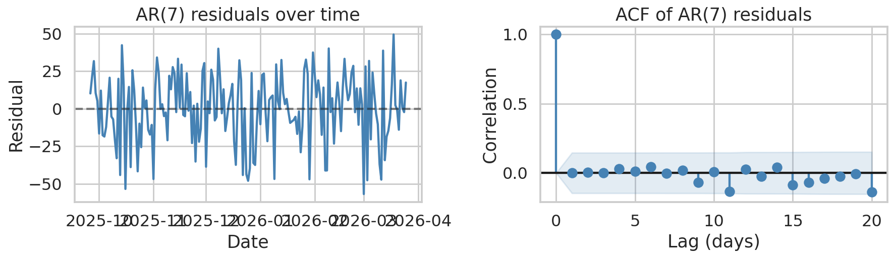
AR(7), residual diagnostics
Did the AR(7) absorb the autocorrelation?
Residual time-series centers on zero with no obvious trend or volatility clusters.
Residual ACF sits inside the 95% band at every positive lag → residuals look like white noise.
Verdict: AR(7) captured the linear autocorrelation that exists in the data. The remaining error isn't autoregressive structure we're missing, it's signal from outside the lag history.
→ Next step: bring in the exogenous regressors (HRV, RHR, sleep, training load, lifestyle) and let Ridge regression handle the multicollinearity.
Onat Safak · NYU Data Bootcamp Sp26 · 12/20

Slide 13
Models & Methods
Baseline
AR(7) lags
AR + exogenous
DummyRegressor (mean)
LinearRegression on recovery_lag{1..7}
Ridge regression, full feature set
Sanity floor.
Pure autoregression in sklearn, matches statsmodels.
HRV, RHR, sleep, strain, journal, day-of-week, rolling 7-day workouts.
KNN
Classification
Plus, KMeans clustering
KNeighborsRegressor (K tuned via TimeSeriesSplit CV)
LogisticRegression on Red/Yellow/Green zone
Unsupervised pass on physiology only
K chosen by silhouette + elbow; labels mapped Good / Average / Bad day by cluster-mean Recovery.
Non-linear comparison.
Same features, classification framing.
Onat Safak · NYU Data Bootcamp Sp26 · 13/20

Slide 14
Results: Regression scoreboard
Headline result
Pure autoregression isn't enough.
Recovery has weak day-to-day persistence on this dataset, yesterday's score alone barely beats the mean.
Adding physiology + lifestyle wins.
Ridge AR + exogenous: RMSE 20.05, MAE 15.0, R^2 = 0.33 on 46 held-out days.
KNN sits in between, useful sanity check that the structure is mostly linear.
Onat Safak · NYU Data Bootcamp Sp26 · 14/20

Slide 15
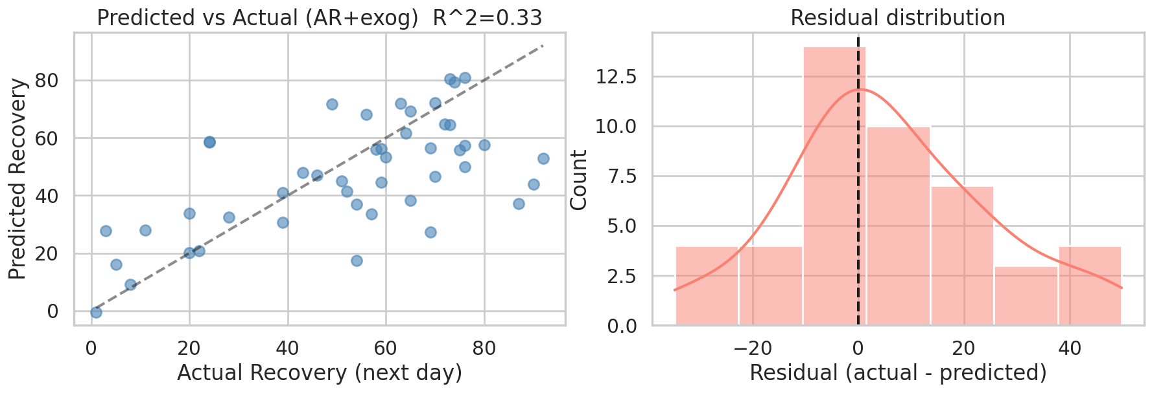
Ridge AR + exog: predicted vs actual
Interpreting the fit
Scatter: predictions track the y = x line in the middle band but compress on the extremes (the model rarely predicts <20 or >85). Classic Ridge shrinkage.
Residuals: approximately Gaussian, centered on zero, no obvious skew. MAE ≈ 15 percentage points.
RMSE
MAE
R^2
20.05
15.03
0.33
Onat Safak · NYU Data Bootcamp Sp26 · 15/20

Slide 16
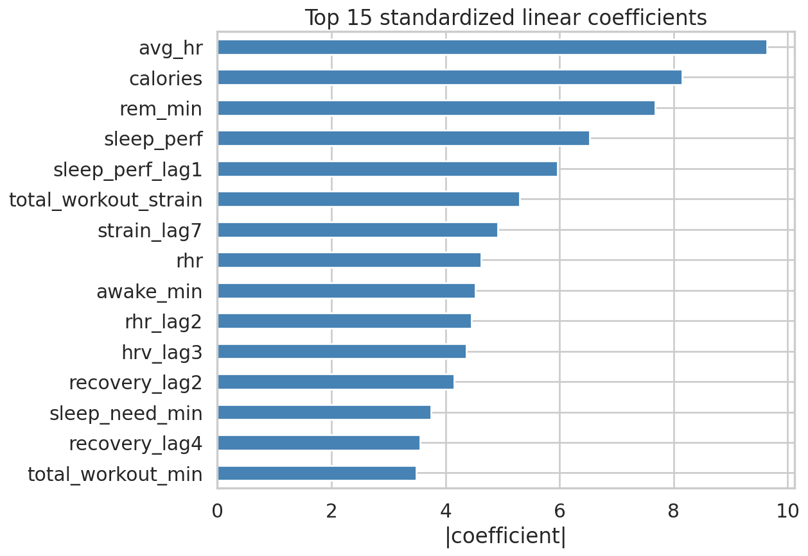
Ridge AR + exog: what features matter
What the coefficients say
Top predictors include average HR, energy burned (calories), and workout strain, proxies for today's physical load.
Sleep performance (today and yesterday) is the strongest sleep signal.
REM minutes carries weight even after Ridge shrinkage, despite collinearity with total sleep.
Journal yes/no features sit far below the physiology features, they capture marginal lifestyle effects but don't dominate.
Onat Safak · NYU Data Bootcamp Sp26 · 16/20

Slide 17
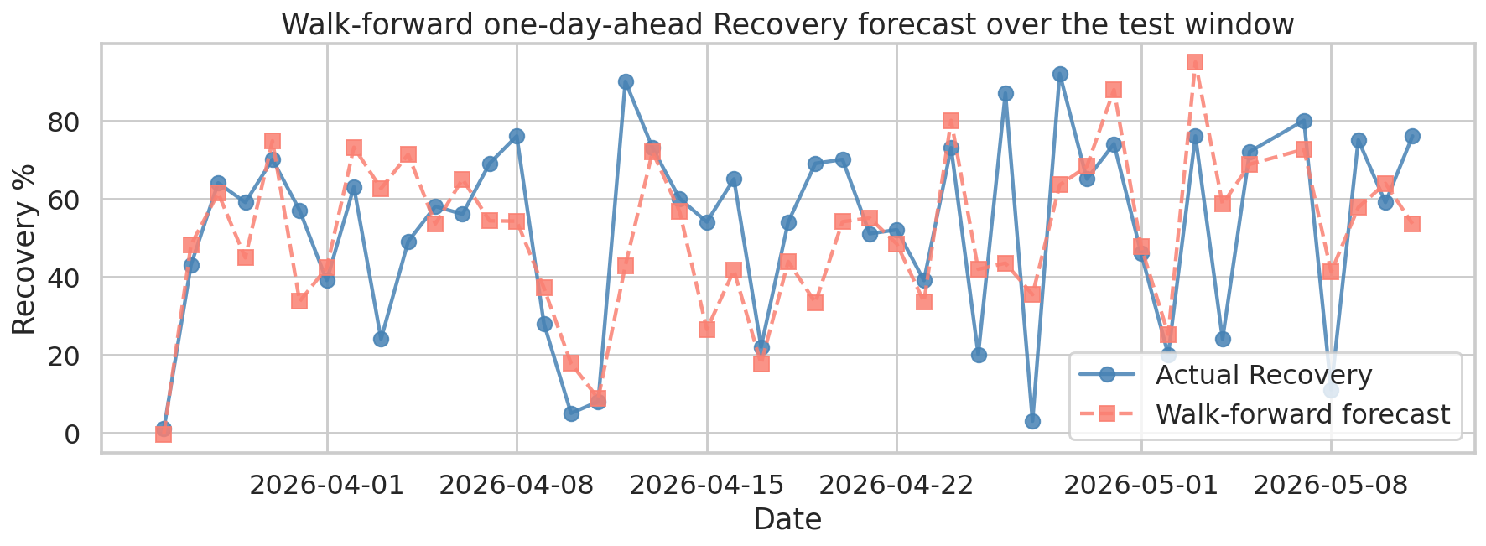
Walk-forward forecast and next-day prediction
Walk-forward (retrain every test day)
For each of the 46 test days we retrain Ridge AR + exog on every preceding day, then forecast that single day.
RMSE 19.26 MAE 14.70 R^2 0.38
Improvement over the static one-shot fit (RMSE 20.05, R^2 0.33) because recent days carry information.
Genuine next-day prediction (2026-05-13, unseen)
58.4%
Yellow zone
Inputs: features built from the latest cycle in the dataset (2026-05-12). Output: a single Recovery forecast for the day after, produced by the final model.
Onat Safak · NYU Data Bootcamp Sp26 · 17/20

Slide 18
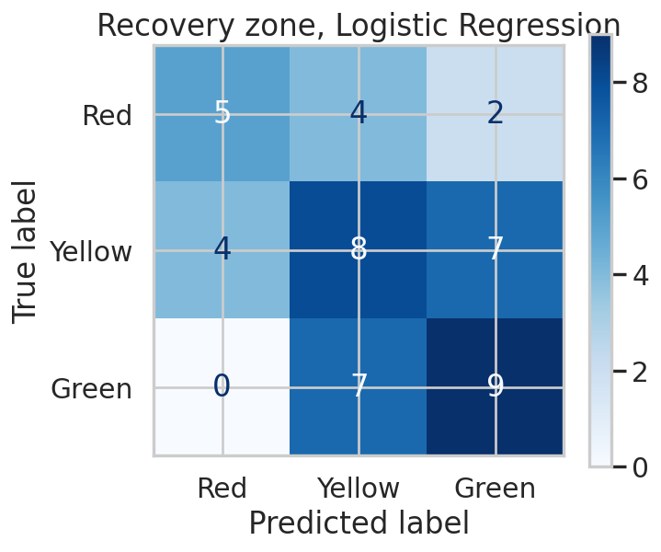
Classification: Recovery zone (Red / Yellow / Green)
Per-class report (test set)
 | Precision | Recall | F1 | Support
Green | 0.58 | 0.69 | 0.63 | 16
Yellow | 0.48 | 0.53 | 0.50 | 19
Red | 0.67 | 0.36 | 0.47 | 11
Accuracy |  |  | 54% | 46
54% test accuracy vs. 41% baseline (always-Yellow). Errors are mostly off-by-one (Yellow predicted for Green/Red) rather than opposite-corner mistakes, the model captures the gradient between zones.
Onat Safak · NYU Data Bootcamp Sp26 · 18/20

Slide 19
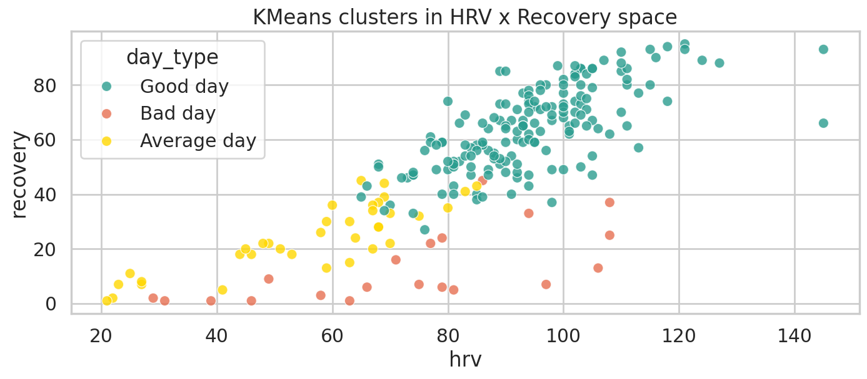
Clustering: Good Day vs. Bad Day
KMeans with K=3 recovers WHOOP's color zones
Good Day: high HRV, low RHR, longer sleep, moderate strain.
Average Day: middling on every metric.
Bad Day: low HRV, elevated RHR, short or fragmented sleep.
Behavioral fingerprint (journal pivot):
Bad-day cluster skews toward alcohol and late food.
Good-day cluster skews toward AM sunlight and tracked calories.
Onat Safak · NYU Data Bootcamp Sp26 · 19/20

Slide 20
Takeaways & Next Steps
What worked
Next steps
Ridge AR + exogenous wins the regression task: RMSE 20.05, R^2 0.33 on the static split.
Walk-forward forecast (retrain each day) improves to RMSE 19.26, R^2 0.38.
Genuine next-day prediction for 2026-05-13: 58.4% Recovery (Yellow zone).
Logistic Regression on Recovery zones: 54% vs 41% baseline accuracy.
KMeans cleanly recovers a Good / Average / Bad day partition that lines up with behavioral patterns.
AR diagnostics (ADF, ACF, PACF, residual ACF) show the data is stationary and AR(p) captures everything it can.
More data, another 6 months would let lag features carry more weight and enable proper time-series CV.
Try sktime / SARIMA for an explicit weekly seasonality term, PACF showed a lag-5 echo worth exploring.
Add gradient boosting as a non-linear benchmark.
Treat training regimes as hidden states via an HMM (course bonus material).
Slide 20 / 20 · Onat Safak · NYU Data Bootcamp Sp26

