Slide 1

Bank Transaction Analysis

Slide 2

Agenda
Problem Statement
Approach
Data Overview
Project Workflow
Exploratory Data Analysis
Key Insights
Dashboard Preview
Recommendation

Slide 3

Problem Statement

Slide 4
Problem Statement
Banks generate large volumes of transaction data through deposits, withdrawals, online transfers, and card payments across multiple customer segments. However, this data often remains underutilized due to the lack of integrated analysis and visualization.
The absence of a centralized analytical system makes it difficult for banks to monitor transaction trends, understand customer behavior, identify high-value customers, and detect operational inefficiencies such as failed transactions.
This project aims to perform exploratory data analysis using Excel, extract meaningful insights using SQL, and build an interactive Power BI dashboard to support data-driven decision-making in the banking domain.

Slide 5
Objectives
To analyze customer behavior based on transaction volume, frequency, and value.
To identify high-value and low-engagement customers for strategic decision-making.
To analyze failed transactions and identify operational bottlenecks.
To analyze failed transactions and identify operational bottlenecks.

Slide 6
Approach

Slide 7
Approach – Three phase solution
Exploratory Data Analysis
1. Deep dive into Customer, Loan & Transactions data.
2. Understanding of data, trends and patterns.
SQL Query
1. Write and Perform SQL queries for efficient data extraction.
Interactive Dashboard in
Power BI
1. Build a live view for business Users to self serve insights.
2. Enable slicing by session for dynamic view of the dashboard.

Slide 8
Project Workflow

Slide 9
Project Workflow
Define Business Objective
De
Data Collection
De
1
1
Understand the core problem and expected business outcomes.
1
2
Gather dummy Customer, Loan & Transactions data and understand schema.
Data Cleaning
De
De
Exploratory Data Analysis
1
1
4
Work with Pivot Table & charts to Extract Insights.
3
Handle nulls , type conversion, format columns.
De
Dashboarding & Recommendations
SQL Queries
De
1
1
5
Write and Perform SQL queries for efficient data extraction.
6
Build Power BI dashboard and present strategic findings.

Slide 10
Exploratory Data Analysis

Slide 11
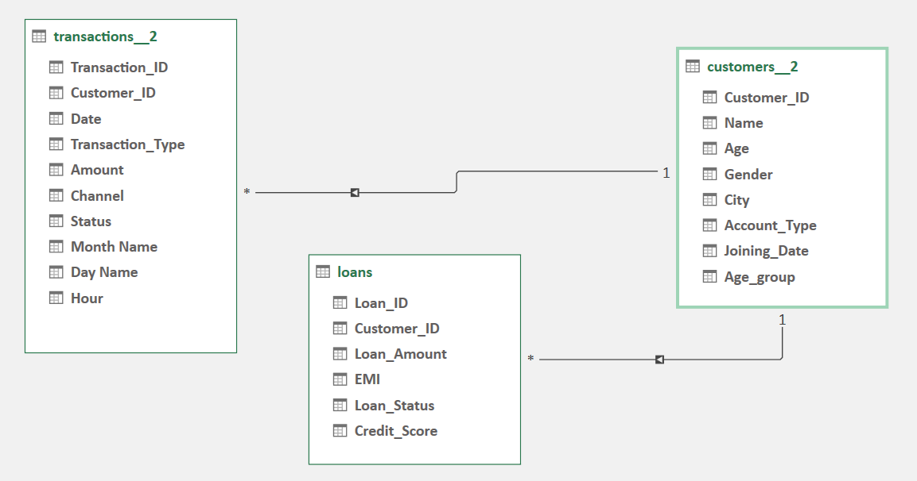
Raw Dataset Structure – Before Processing
Given data is banking data from Jan 2023 to July 2023

Slide 12

Exploratory Data Analysis (EDA)
Uncovering patterns, trends, and business insights from historical data !
Understanding the “What, Where & Why” behind the sales numbers
Exploring data through visuals, aggregations, and comparisons
Laying the groundwork for informed recommendations

Slide 13
EDA: Step‑by‑Step Process
Load Data in Excel Power Query
Initial Exploration
Pre-processing & Cleaning
Feature Engineering
EDA & Visualization
Key Insights
Recommendations

Slide 14
Pre-processing & Feature Engineering
The necessary steps applied to prepare this dataset for analysis.
Load dataset and perform Data profiling.
Remove Null values from all three dataset.
Performing data type conversion on necessary columns.
Create Custom column(Age_group) with help of age column in loan dataset.
Create Month, Day & Hour columns in transactions dataset.
Drop unwanted columns to make dataset understandable.
Checking and Removing of duplicated data from dataset.

Slide 15
Charts & Insights

Slide 16

Transaction Amount distribution by Transaction_type
Most Transaction type : Deposit (26.13%).
Withdrawal & Online Transactions comes 2nd and 3rd respectively.
Insights

Slide 17
Month & Day wise Transactions
Insights
Most transactions are occurred in January, March & May months
February & July is least transactions occurred Month
Nearly Equal transactions occurred each Day
Due to Saturday off least transaction occurred as Saturday

Slide 18
Age and Gender wise Transaction Amount
Insights
Male in Adulthood age class perform most transactions (~ 33.8M)
In Female Senior age class perform transactions as compare to Adulthood age class
In both Gender Teenagers perform nearly same Transactions

Slide 19
Loan Status
Insights
There are 145 Customers who Nill there loan & 155 customers loan is still pending

Slide 20
Channel wise Transaction Status
Insights
UPI is Most Use Transaction Channel (success transactions 1173 & failed transactions 99)
ATM is least Use Channel for transaction and also Most in term of Failed Transaction status

Slide 21
Transaction Amount Status by Transaction Type
Insights
Success rate and failed rate in deposit type is 23.94% & 2.19% respectively.
Card payment have least transaction failed rate .

Slide 22
Insights
Transaction occurred by Current and Saving Account is 65.05M and 60.85M respectively
In all Age groups Male perform Most Transactions

Slide 23
Key Insights

Slide 24

Key Insights
Total Success Transaction Amount is ~116.26M.
ATM is Most used channel contributing over 25.47% all transactions.
Withdrawal is highest transaction type by count.
Male in Adult and Female in Senior Perform Most Transaction Amount.
Most Transactions are occurred in Chennai.
Failed transactions are highest in ATM channel (due to network issues).
The bank saw around 49% is digital transactions.
Online transfers show a consistent growth trend.
310.76M is Total loan amount and 23.66K is Avg EMI Amount
Customer 860 & Customer 347 is most and least Loan paying Customers respectively.

Slide 25
Dashboard Preview

Slide 26
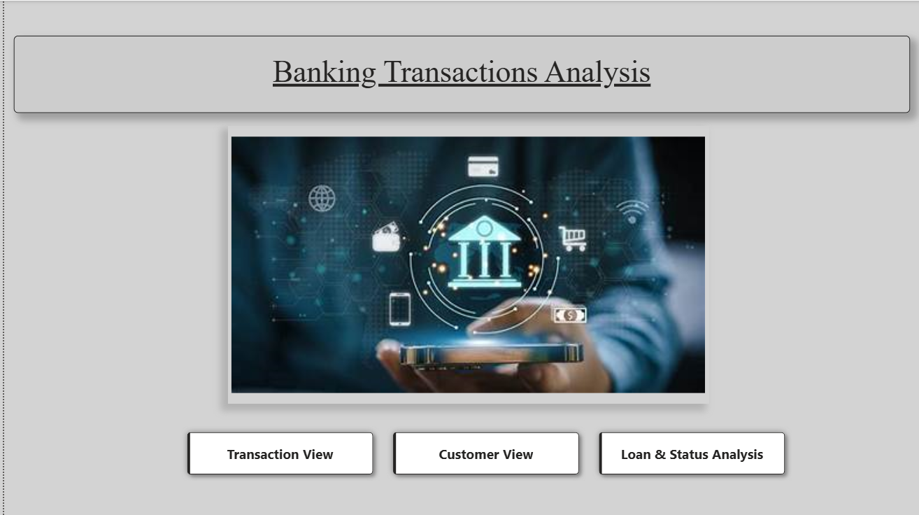
Page 1

Slide 27
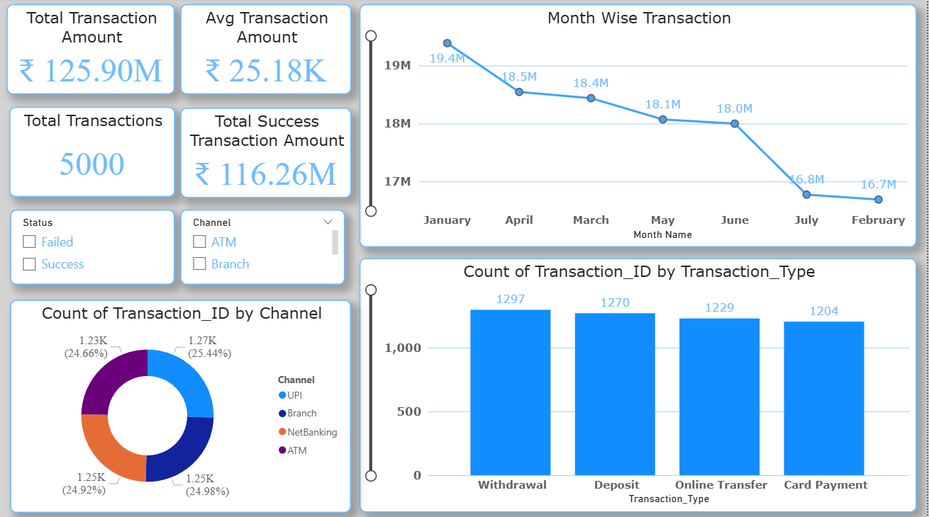
Page 2

Slide 28
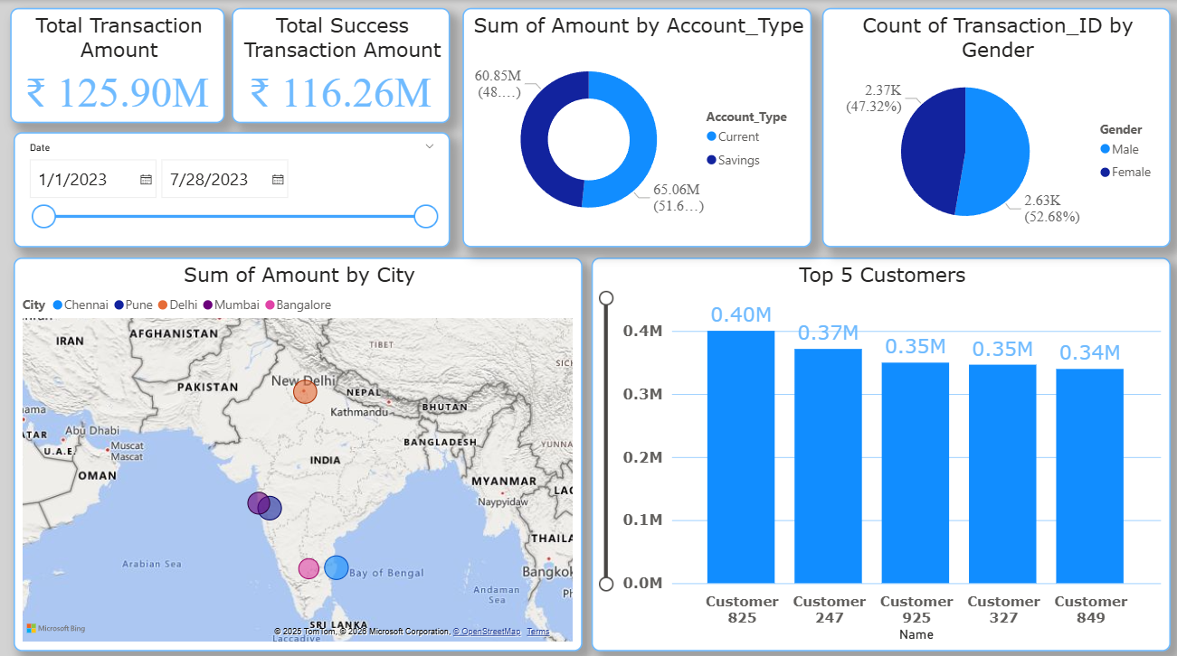
Page 3

Slide 29
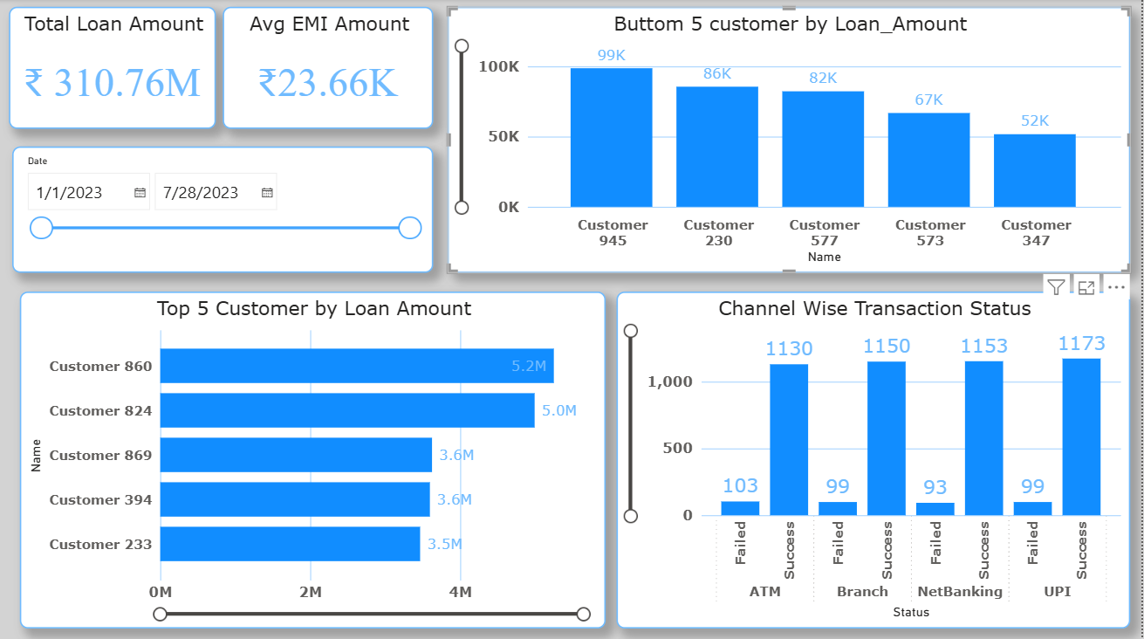
Page 4

Slide 30

Thank You…

