Slide 1
MPI
Advanced edition
Jakub Yaghob

Slide 2
Initializing MPI – threading
int MPI Init(int *argc, char ***argv, int required, int *provided);
Must be called as the first MPI routine
Establishes the MPI environment for multithreaded execution
MPI_THREAD_SINGLE
  Only one thread
MPI_THREAD_FUNNELED
  Only main thread will make MPI calls
MPI_THREAD_SERIALIZED
  Only one MPI call at time
MPI_THREAD_MULTIPLE
  Multiple threads with multiple calls

Slide 3
Communication modes
Most sending functions in three modes
  Standard – MPI_Send
    MPI decides whether outgoing messages will be buffered
    Non-local – a successful completion may depend on the occurrence of a matching receive
  Buffered – MPI_Bsend
    Can be started whether or not a matching receive has been posted
    It may complete before a patching receive is posted
    Local - a successful completion does not depend on the occurrence of a matching receive
  Synchronous – MPI_Ssend
    Can be started whether or not a matching receive has been posted
    It completes successfully only if a matching receive is posted and the receive operation has started to receive the message - rendezvous
    Non-local
  Ready – MPI_Rsend
    May be started only if the matching receive is already posted
    The same semantic as the standard mode, additional information can save a handshake

Slide 4
Non-blocking point-to-point – send
Posting a send – non-blocking operation
  int MPI_Isend(void* buf, int count, MPI_Datatype datatype, int dest, int tag, MPI_Comm comm, MPI_Request *request);
  None of the arguments should be read or written until the send is completed

Slide 5
Non-blocking point-to-point – receive
Posting a receive – non-blocking operation
  int MPI_Irecv(void* buf, int count, MPI_Datatype datatype, int source, int tag, MPI_Comm comm, MPI_Request *request);
  None of the arguments should be read or written until the send is completed

Slide 6
Completion
Posted sends and receives must be completed
Waiting – blocking completion
  int MPI_Wait(MPI_Request *request, MPI_Status *status);
Testing – non-blocking completion
  int MPI_Test(MPI_Request *request, int *flag, MPI_Status *status);
  If the flag is true, then the posted operation is complete and status contains proper information
  Returns immediately

Slide 7
Probe
Checking for presence of a message
  int MPI_Probe(int source, int tag, MPI_Comm comm, MPI_Status *status)
  int MPI_Iprobe(int source, int tag, MPI_Comm comm, int *flag, MPI_Status *status)
  Blocking/non-blocking versions
  flag==true
    Valid message awaits
  Allocate necessary memory for a message
    Size and type in status

Slide 8
Matching probe/receive
Solving a problem for multithreaded environment
  int MPI_Mprobe(int source, int tag, MPI_Comm comm, MPI_Message *message, MPI_Status *status)
  int MPI_Improbe(int source, int tag, MPI_Comm comm, int *flag, MPI_Message *message, MPI_Status *status)
  int MPI_Mrecv(void* buf, int count, MPI_Datatype datatype, MPI_Message *message, MPI_Status *status)
  int MPI_Imrecv(void* buf, int count, MPI_Datatype datatype, MPI_Message *message, MPI_Request *request)
  Blocking/non-blocking versions
  Mprobe removes the message from the queue
  Mrecv receives the message

Slide 9
Packing and unpacking
Noncontiguous data or heterogeneous data
  int MPI_Pack(void* inbuf, int incount, MPI_Datatype datatype, void *outbuf, int outsize, int *position, MPI_Comm comm);
  int MPI_Unpack(void* inbuf, int insize, int *position, void *outbuf, int outcount, MPI_Datatype datatype, MPI_Comm comm);
  outsize/insize in bytes
  position
    Input value – the first location in the output buffer
    Output value – the first location following the packed data
  MPI datatype MPI_PACK

Slide 10
Non-blocking collective operations
Only for MPI-3 conforming implementations
  Solve some interesting synchronization problem
  int MPI_Ibarrier(MPI_Comm comm, MPI_Request *request)
  And many others
    MPI_Ibcast, MPI_Igather, MPI_Igatherv, MPI_Iscatter, MPI_Iscatterv, MPI_Iallgather, MPI_Iallgatherv, MPI_Ialltoall, MPI_Ialltoallv, MPI_Ialltoallw, MPI_Ireduce,MPI_Iallreduce, MPI_Ireduce_scatter, MPI_Iscan, MPI_Iexscan
A
B
C

Slide 11
Communicators
Support for communication among a selected subgroup, virtual topologies
Group
  Ordered set of process identifiers
  Used to describe participants in a communication
Intra-communicator
  Contains a group of valid participants (including local process)
  The source and destination identified by process rank within that group
Inter-communicator
  Application with internal user-level servers, each server is a process group
  Clients are a process group as well
  Communication between processes in different groups

Slide 12
Group constructors
Determining the group handle from a communicator
  int MPI_Comm_group(MPI_Comm comm, MPI_Group *group);
Inclusion
  int MPI_Group_incl(MPI_Group group, int n, int *ranks, MPI_Group *newgroup);
  An empty group handler MPI_GROUP_EMPTY
Exclusion
  int MPI_Group_excl(MPI_Group group, int n, int *ranks, MPI_Group *newgroup);

Slide 13
Group accessors and destructors
Querying a process’s rank in a group
  int MPI_Group_rank(MPI_Group group, int *rank);
Size of a group
  int MPI_Group_size(MPI_Group group, int *size);
Destructor
  int MPI_Group_free(MPI_Group *group);

Slide 14
Intra-communicator constructors
Creating a communicator from a group
  int MPI_Comm_create(MPI_Comm comm, MPI_Group group, MPI_Comm *newcomm);
  Returns MPI_COMM_NULL for processes not within the group
Splitting a communicator
  int MPI_Comm_split(MPI_Comm comm, int color, int key, MPI_Comm *newcomm);
  Disjoint groups, one for each value of color
  Ranks within new groups according to key
  Collective call, each process provides different values for color and key

Slide 15
Intra-communicator accessors and destructor
Rank
  int MPI_Comm_rank(MPI_Comm comm, int *rank);
  Shortcut for MPI_Group_rank
Size
  int MPI_Comm_size(MPI_Comm comm, int *size);
  Shortcut for MPI_Group_size
Destructor
  int MPI_Comm_free(MPI_Comm *comm);

Slide 16
Virtual topologies
Cartesian
  Partitioning of matrices
  M x N matrix decomposed into P Q x N submatrices with each assigned to be worked on by one of the P processes
  Mapping of the linear process rank to a 2D virtual rank
Graph
  General topology

Slide 17
MPI-2 parallel I/O
Parallel I/O similar to message sending
Not all implementations support the full MPI-2 I/O
Physical decomposition with a certain number of I/O nodes can be configured
Blocking and nonblocking I/O
Collective and non-collective I/O

Slide 18
MPI-2 file structure
Characteristics
  MPI datatypes are written and read
  Partitioning of the file
  Sequential and random access
  Each process has its own view of the file
A view defines the current set of data visible and accessible by a process, it is defined by three quantities
  Displacement – where in the file to start
  Etype – the type od data
  Filetype – pattern of how the data is partitioned in the file
Default view: displacement=0, etype=MPI_BYTE, filetype=MPI_BYTE

Slide 19
One-sided communication
RMA (Remote Memory Access)
  One process specifies all communication parameters
  Two memory models
    Separate
      No assumption about consistency
      Highly portable
    Unified
      Exploits cache-coherency
      Hardware-accelerated one-sided operations
    Setting by a window attribute MPI_WIN_MODEL
  Two categories of communications
    Active target
      Both sides involved in communication
    Passive target
      Only originator involved, target passive

Slide 20
One-sided communication – initialization
Windows
  Part of memory exposed for RMA to the group
  Collective communications
  int MPI_Win_create(void *base, MPI_Aint size, int disp_unit, MPI_Info info, MPI_Comm comm, MPI_Win *win)
  Creates a window for given memory
  int MPI_Win_allocate(MPI_Aint size, int disp_unit, MPI_Info info, MPI_Comm comm, void **baseptr, MPI_Win *win)
  Creates and allocates a window
  int MPI_Win_allocate_shared(MPI_Aint size, int disp_unit, MPI_Info info, MPI_Comm comm, void **baseptr, MPI_Win *win)
  Creates and allocates a window in a shared memory, which can be accessed by all processes in a group by direct load/store memory operations
  int MPI_Win_free(MPI_Win *win)
  Destroys the window

Slide 21
One-sided communication – transfers
Communications calls
  From the caller memory to the target memory
  int MPI_Put(const void *origin_addr, int origin_count, MPI_Datatype origin_datatype, int target_rank, MPI_Aint target_disp, int target_count, MPI_Datatype target_datatype, MPI_Win win)
  From the target memory to the caller memory
  int MPI_Get(void *origin_addr, int origin_count, MPI_Datatype origin_datatype, int target_rank, MPI_Aint target_disp, int target_count, MPI_Datatype target_datatype, MPI_Win win)

Slide 22
One-sided communication – accumulate
Accumulate
  f(a,b) = a OP b
  MPI_REPLACE – f(a,b) = b
  MPI_NO_OP – f(a,b) = a
  int MPI_Accumulate(const void *origin_addr, int origin_count, MPI_Datatype origin_datatype, int target_rank, MPI_Aint target_disp, int target_count, MPI_Datatype target_datatype, MPI_Op op, MPI_Win win)
  Accumulate to the target

Slide 23
One-sided communication – accumulate cont.
Accumulate
  int MPI_Get_accumulate(const void *origin_addr, int origin_count, MPI_Datatype origin_datatype, void *result_addr, int result_count, MPI_Datatype result_datatype, int target_rank, MPI_Aint target_disp, int target_count, MPI_Datatype target_datatype, MPI_Op op, MPI_Win win)
  Fetches target buffer before accumulation
  int MPI_Fetch_and_op(const void *origin_addr, void *result_addr, MPI_Datatype datatype, int target_rank, MPI_Aint target_disp, MPI_Op op, MPI_Win win)
  Faster specialized version

Slide 24
One-sided communication – compare and replace
Compare and replace
  int MPI_Compare_and_swap(const void *origin_addr, const void *compare_addr, void *result_addr, MPI_Datatype datatype, int target_rank, MPI_Aint target_disp, MPI_Win win)
  Compare compare_addr with the target memory, if equal, replace with origin_addr. Returns the original value in result_addr

Slide 25
One-sided communication – request-based operations
Request-based operations
  Functions use MPI_Request for waiting
  Only for passive target
  MPI_Rput, MPI_Rget, MPI_Raccumulate, MPI_Rget_accumulate

Slide 26
One-sided communication – synchronization calls
Three mechanisms
  Fence
    Collective synchronization MPI_Win_fence
    Loosely-synchronous model
    Only for active targets
    An access epoch at an origin and an exposure epoch at an target are started and completed by MPI_Win_fence
  General active target synchronization
    An originator calls MPI_Win_start for starting an access epoch, MPI_Win_complete for ending the access epoch
    A target calls MPI_Win_post for starting an exposure epoch, MPI_Win_wait for wait for end of the exposure epoch
  General passive target synchronization
    Locking and unlocking window at an target by MPI_Win_lock, MPI_Win_lock_all, MPI_Win_unlock, MPI_Win_unlock_all

Slide 27
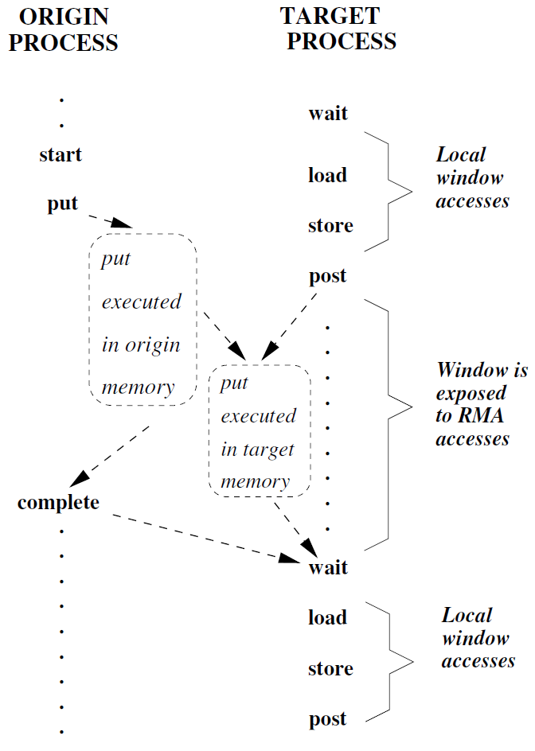
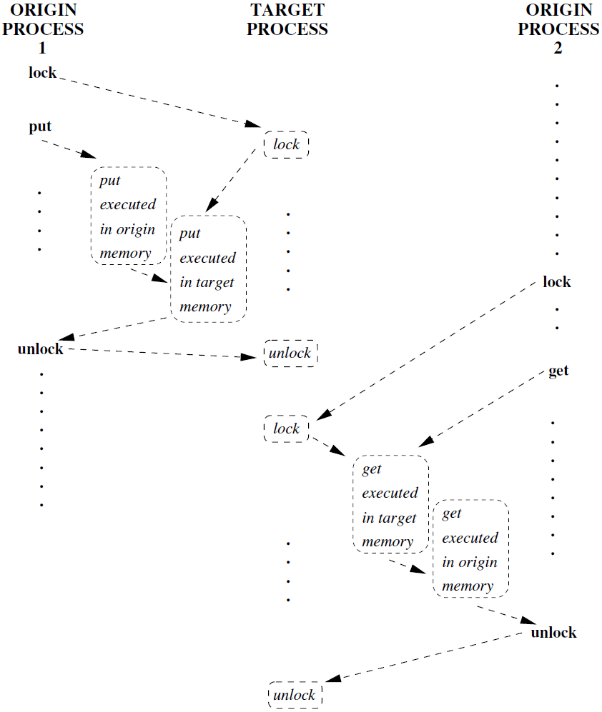
One-sided communication – active/passive targets

Slide 28
One-sided communication – fence
Fence
  int MPI_Win_fence(int assert, MPI_Win win)
  Collective call
  All RMA operations started at the given process and started before fence will finish before the fence call returns
  Operations will be completed at the target before the fence call returns at the target

Slide 29
One-sided communication – general active target sync
General active target synchronization
  int MPI_Win_start(MPI_Group group, int assert, MPI_Win win)
  Starts an access epoch
  Access only windows at processes in the group
  Each process in a group must issue MPI_Win_post
  RMA calls may be delayed until corresponding MPI_Win_post is issued
  int MPI_Win_complete(MPI_Win win)
  Completes the access epoch
  All RMA operations must complete at the origin (not at the target) before the call returns

Slide 30
One-sided communication – general active target sync
General active target synchronization
  int MPI_Win_post(MPI_Group group, int assert, MPI_Win win)
  Starts an exposure epoch for local window
  Only processes in the group can access the window
  Does not block
  int MPI_Win_wait(MPI_Win win)
  Completes the exposure epoch
  Will block until matching calls to MPI_Win_complete have occured

Slide 31
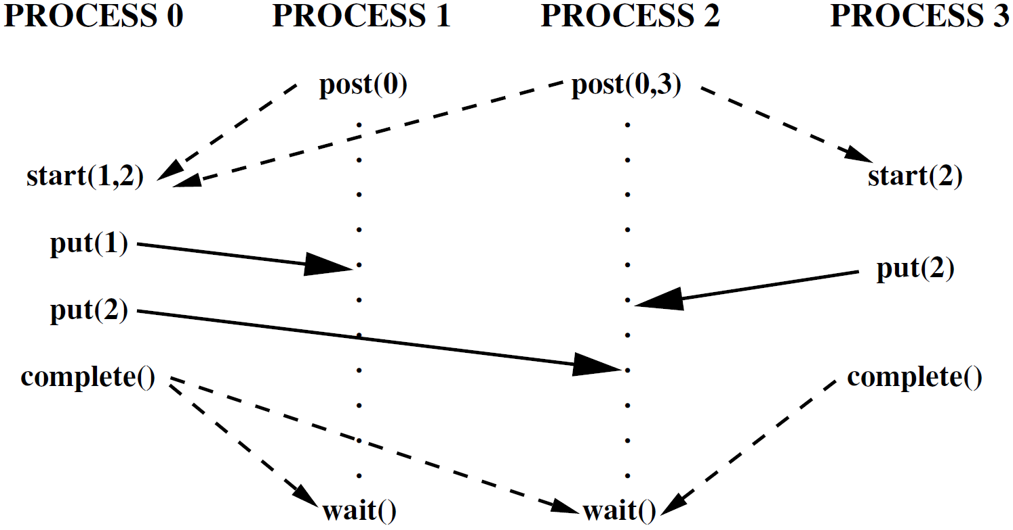
One-sided communication – multiple active targets

Slide 32
One-sided communication – general passive target sync
General passive target synchronization
  int MPI_Win_lock(int lock_type, int rank, int assert, MPI_Win win)
  Starts an access epoch at process rank
  MPI_LOCK_EXCLUSIVE, MPI_LOCK_SHARED
  int MPI_Win_lock_all(int assert, MPI_Win win)
  Starts an access epoch to all processes in win with lock type MPI_LOCK_SHARED
  Must be unlocked by MPI_Win_unlock_all
  Not collective, locks all processes in win

Slide 33
One-sided communication – general passive target sync
General passive target synchronization
  int MPI_Win_unlock(int rank, MPI_Win win)
  Completes an access epoch
  All RMA operations issued during the epoch are finished both at the origin and at the target before return
  int MPI_Win_unlock_all(MPI_Win win)
  Completes an access epoch started by MPI_Win_lock_all

