Slide 1

Efficient Top-k Subscription Matching for Location-Aware Publish/Subscribe
Jiafeng Hu¹, Reynold Cheng¹, Dingming Wu¹, Beihong Jin²
¹University of Hong Kong
²Institute of Software, Chinese Academy of Sciences

Slide 2
Outline
Background
Problem Formalization
Data Model
Problem Definition
R^{I}-tree based solution
Evaluation
Conclusion

Slide 3
Outline
Background
Problem Formalization
Data Model
Problem Definition
R^{I}-tree based solution
Evaluation
Conclusion

Slide 4
Publish/Subscribe (Pub/Sub) Systems
Pub/Sub systems are widely used to detect events which satisfy a set of predefined patterns/specifications
Subscriber
submit subscriptions to declare their interests
e.g., restaurant
(15 < age < 30)∧(interest = {barbecue})∧(gender = male)
Publisher
publish events (e.g., user’s profile)
e.g., mobile phone user
(age = 25)∧(interest = barbecue)∧(gender = male)∧(visited_time = 5)
Once a matching is found, notify the related subscriber

Slide 5
Ranked Pub/Sub Systems
Traditional pub/sub systems
Exact matching
When an event arrives, all matched subscriptions will be retrieved.
Ranked Pub/Sub systems
Inexact or partial matching
Only return the “most relevant” subscriptions
Top-k Subscription Matching based on some scoring functions

Slide 6






Targeted Advertising (A Billion-dollar Industry)
Advertisement (BE):
(18<age<35)
(credit-score>1000)
Advertiser
…
E.g. restaurant
(Num-visited>18)
Advertising Campaign
Subscriptions
Ads
Broker
(Top-k Relevant Ads)
User Profiles
(credit-score=812)
(age=24)
(Num-visited=20)
…
(credit-score=1600)
Mobile User
Mobile User
(age=34)
(gender=male)
Event
Event

Slide 7
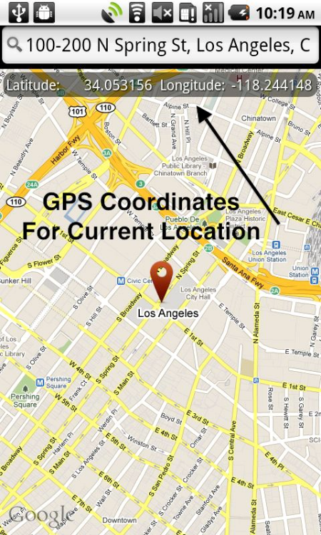

Location-Aware Pub/Sub Systems
Location information can be obtained easily
Global Positioning System (GPS)
“Check in” data in social networks
(e.g., Twitter, Foursquare)
Incorporate location information into ranked Pub/Sub systems

Slide 8
Location-Aware Pub/Sub Systems
Location information can be obtained easily
Global Positioning System (GPS)
“Check in” data in social networks
(e.g., Twitter, Foursquare)
Incorporate location information into ranked Pub/Sub systems

Slide 9
Applications
Location-based Targeted Advertising
Advertiser (Subscriber)
Mobile user(Publisher)
Location-based App Recommendation
App company (Subscriber)
Mobile user (Publisher)
Ride Sharing Recommendation
Driver ⬄ Passenger
Passenger ⬄ Passenger
……

Slide 10
Targeted Advertising (A Billion-dollar Industry)
Advertisement (BE):
(18<age<35)
(credit-score>1000)
Advertiser
…
E.g. restaurant
(Num-visited>18)
(Location)
Advertising Campaign
Subscriptions
Ads
Broker
(Top-k Relevant Ads)
(credit-score=812)
User Profiles
(age=24)
(Num-visited=20)
…
(credit-score=1600)
(Current location)
Mobile User
Mobile User
(age=34)
(gender=male)
(Current location)
Event
Event

Slide 11
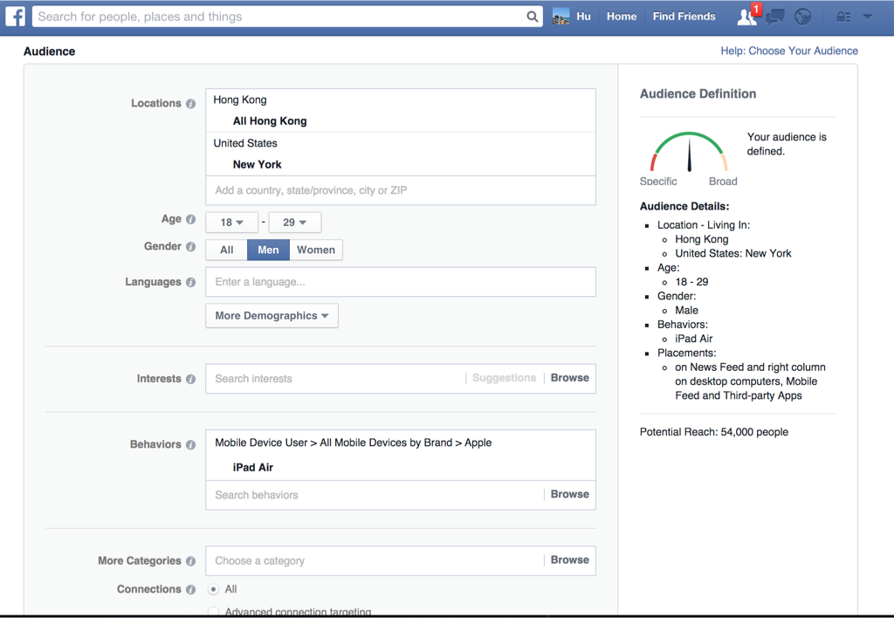
Location-based Targeted Advertising

Slide 12
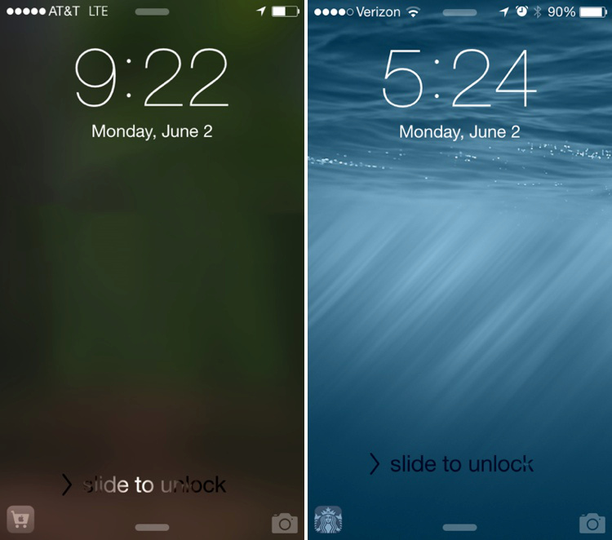

Location-based App Recommendation
This feature recently has appeared in Apple’s iOS 8
Show a picture of an app in the lock screen based on the user’s location and other information

Slide 13
Outline
Background
Problem Formalization
Data Model
Problem Definition
R^{I}-tree based solution
Evaluation
Conclusion

Slide 14
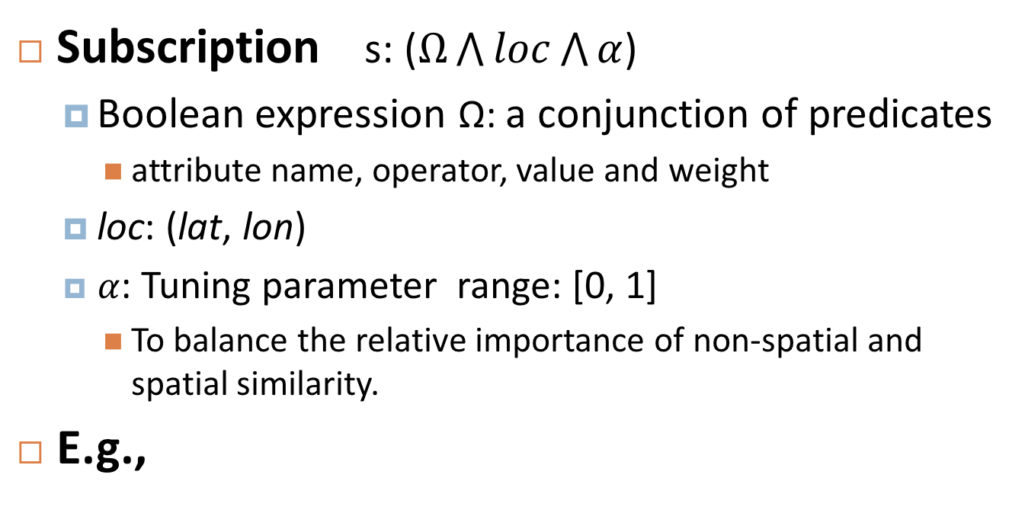
Data Model
Subscription s: ($Ω\bigwedge{loc}\bigwedge{α}$)
Boolean expression Ω: a conjunction of predicates
attribute name, operator, value and weight
loc: (lat, lon)
$α$: Tuning parameter range: [0, 1]
To balance the relative importance of non-spatial and spatial similarity.
E.g.,

Slide 15
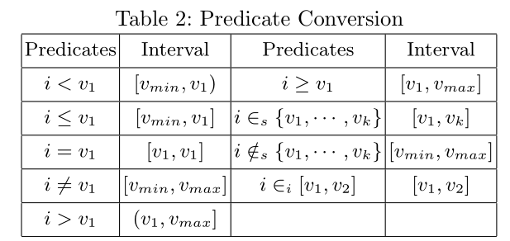
Data Model
Predicates with different types of operators can be converted into one-dimensional intervals [Sadoghi SIGMOD’11]
v_{min} and v_{max} are the smallest and largest possible values
v₁ … v_{k} are sorted in an ascending order
In this work, we focus on predicates in the form of intervals.

Slide 16
Data Model
Event
e: (attr₁ = val₁)∧···∧(attr_{|e|}=val_{|e|})∧(lat=val_{lat})∧(lon = val_{lon})
a set of attribute name and value pairs
loc: (lat, lon)
E.g.,

Slide 17



Similarity Function
Non-spatial similarity
Spatial similarity
Given an event e and a Subscription s, the similarity function ψ(e, s) is defined as follows.
Non-spatial similarity:
The check function is used to check whether the predicate s.p_{j} is satisfied by e.val_{i}
Spatial similarity:
the sum of weights of all matched predicates
common spatial similarity function

Slide 18
Problem Definition
Top-k subscription Matching problem
Given a set of subscriptions S, an event e, and an integer k, find top-k best matched subscriptions

Slide 19
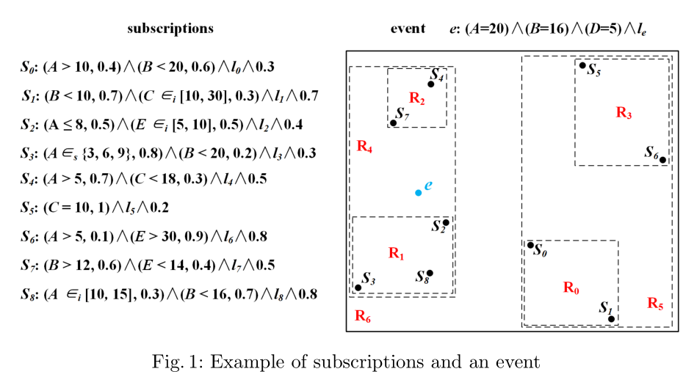
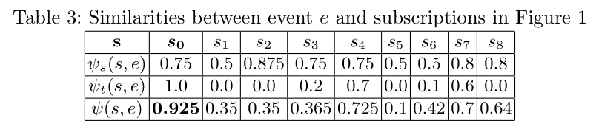
Example

Slide 20
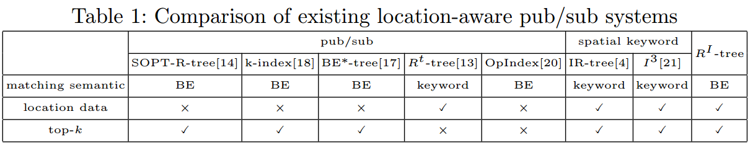
Related Work
Ranked pub/sub systems
SOPT-R-tree: [Machanavajjhala VLDB’08]
k-index [Whang, VLDB’09]
BE*-tree [Sadoghi ICDE’12]
Location-aware keyword matching pub/sub systems
R^{t}-tree [Li KDD’13]
[Hu ICDE’15, Yu TKDE’15]
Spatial-keyword search
[Cong VLDB’09, Zhang EDBT’13, Chen VLDB’13]
Cannot support location information
Cannot support Boolean Expressions

Slide 21
Our Contributions
Formalize a new variant of top-k subscription matching, permitting location data to be a part of a subscription or an event
Propose an R-tree based index, R^{I}-tree
Integrate the dynamic interval tree into nodes of the R-tree
Design an efficient matching algorithm based on the R^{I}-tree

Slide 22
Outline
Introduction
Problem Formalization
Data Model
Problem Definition
R^{I}-tree based solution
Evaluation
Conclusion

Slide 23
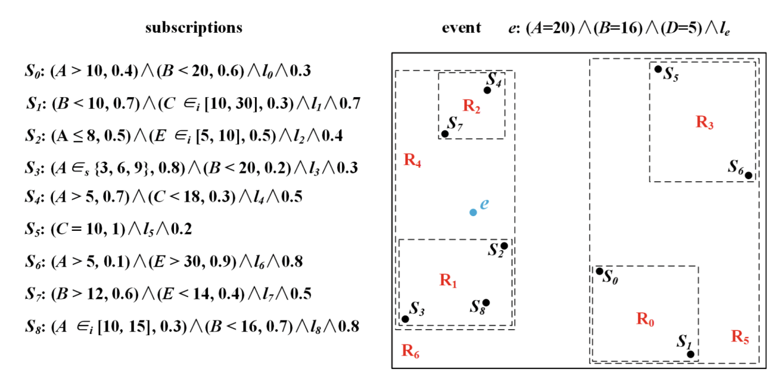
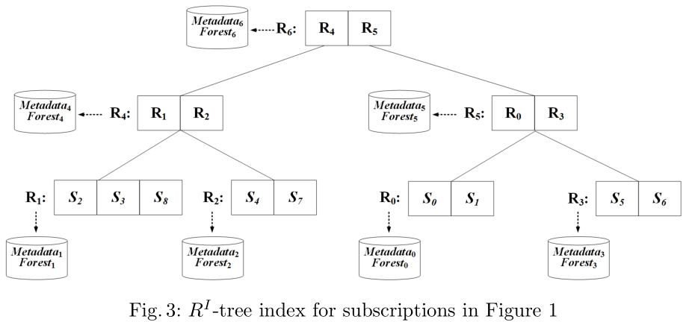
R^{I}-tree

Slide 24
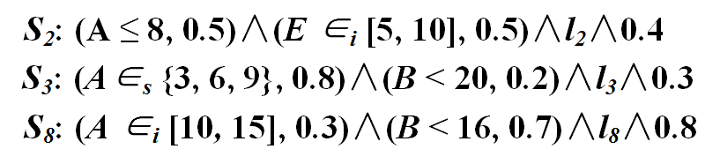
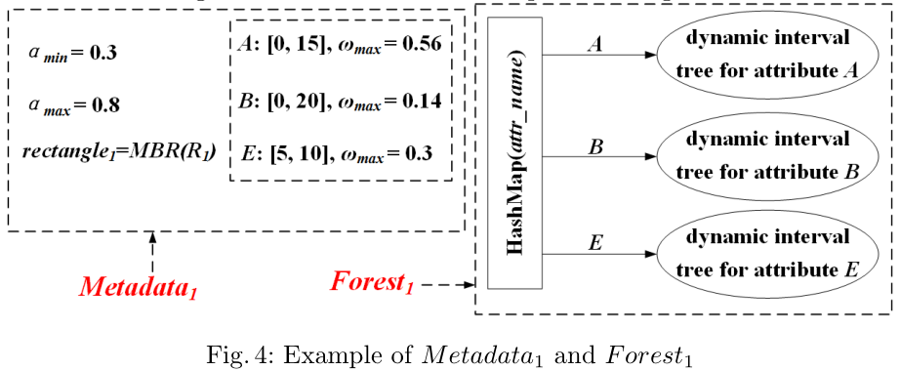
R^{I}-tree

Slide 25
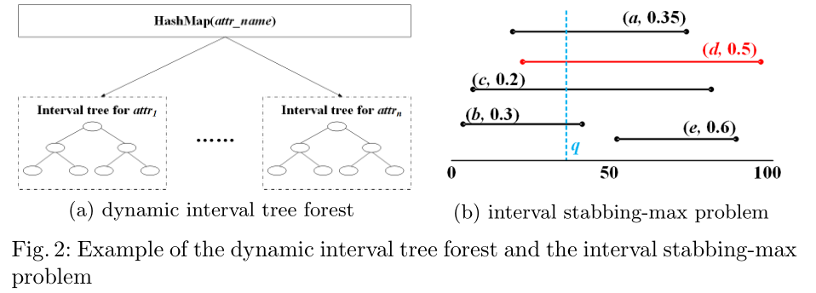
Dynamic interval tree forest
We use the dynamic interval tree structure proposed by Kaplan et al. [STOC’03]
Query O(log² n) Update O(log n)

Slide 26

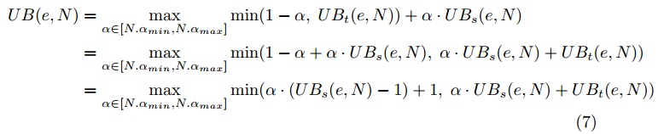
Upper Bound of the similarity (event and Node)
Given an event e and a node N on R^{I}-tree
Upper bound of non-spatial similarity
Upper bound of spatial similarity
Total upper bound
Max stabbing query
monotone decreasing
monotone increasing

Slide 27
Upper Bound of the similarity (event and Node)

Slide 28

Upper Bound of the similarity (event and Node)
Given an event e and a node N on R^{I}-tree
Upper bound of non-spatial similarity
Upper bound of spatial similarity
Total upper bound

Slide 29

Upper Bound of the similarity (event and Node)

Slide 30
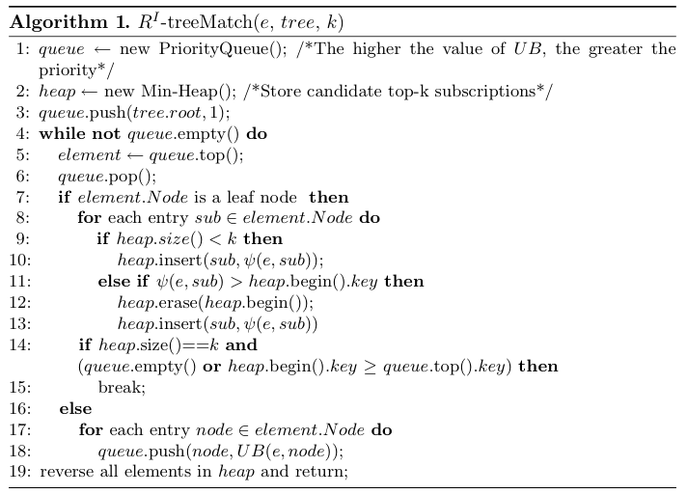
Matching Algorithm
Use the best-first traversal algorithm to retrieve the top-k best matched subscriptions

Slide 31
Outline
Background
Problem Formalization
Data Model
Problem Definition
R^{I}-tree based solution
Evaluation
Conclusion

Slide 32
Experiment Setup
Algorithms:
SCAN: sequential scan
R^{t}-tree: extend R^{t}-tree [Li KDD’13] to support our model
TAS: the threshold algorithm based solution
R^{I}-tree: the R^{I}-tree based solution

Slide 33
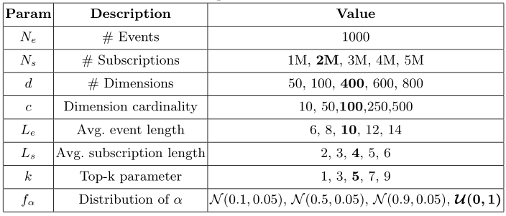
Experiment Setup
Dataset:
Use BE-Gen [Sadoghi SIGMOD’11] to generate non-spatial data (boolean expressions)
Randomly assign a location from the twitter dataset to each BE.
Uniform and Zipf distribution
7

Slide 34
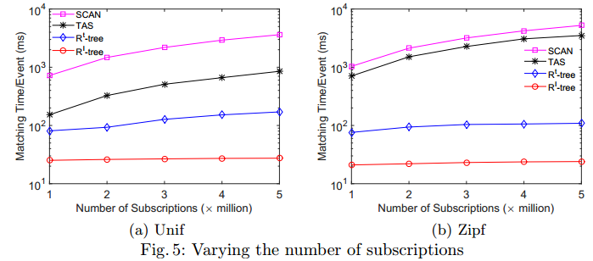
Experimental Results
20x
100x
4.8x
4.5x

Slide 35
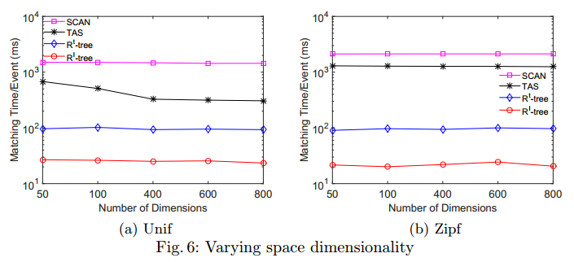
Experimental Results
3.7x
4.4x

Slide 36
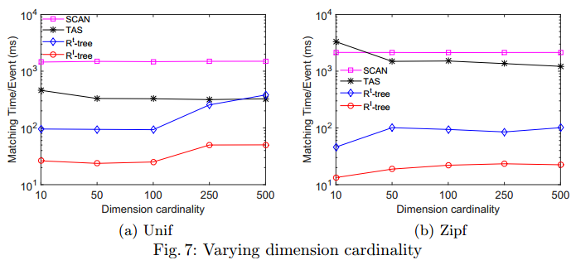
Experimental Results
4.8x
4.2x

Slide 37
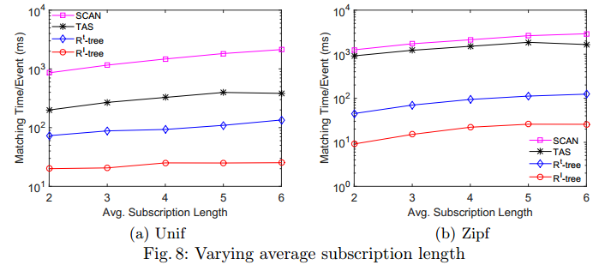
Experimental Results
4.6x
4.3x

Slide 38
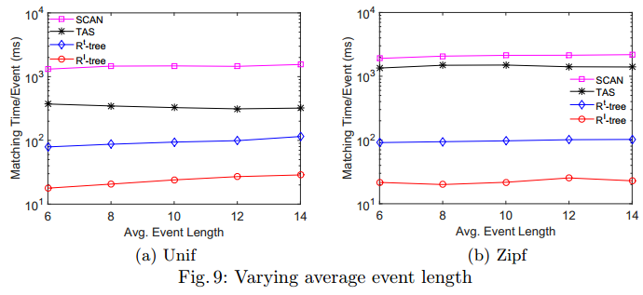
Experimental Results
4x
4.4x

Slide 39
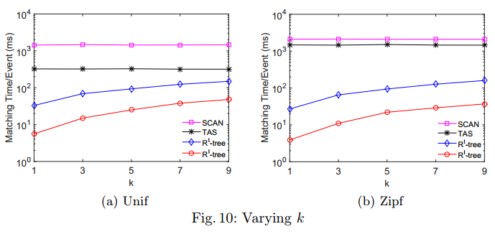
Experimental Results
4.3x
4x

Slide 40
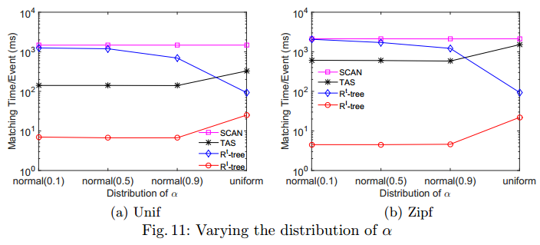
Experimental Results
133x
21x

Slide 41
Outline
Background
Problem Formalization
Data Model
Problem Definition
R^{I}-tree based solution
Evaluation
Conclusion

Slide 42
Conclusion
Formalize a variant of top-k subscription matching (BE + location)
Propose a novel index, R^{I}-tree (R-tree and dynamic interval-tree)
Design an efficient filtering strategy to reduce the search space
Evaluate the R^{I}-tree based solution on a large-scale dataset.

Slide 43

Thank you! Contact Info: Jiafeng Hu University of Hong Kong jhu@cs.hku.hk

Slide 44
Q&A

