Slide 1


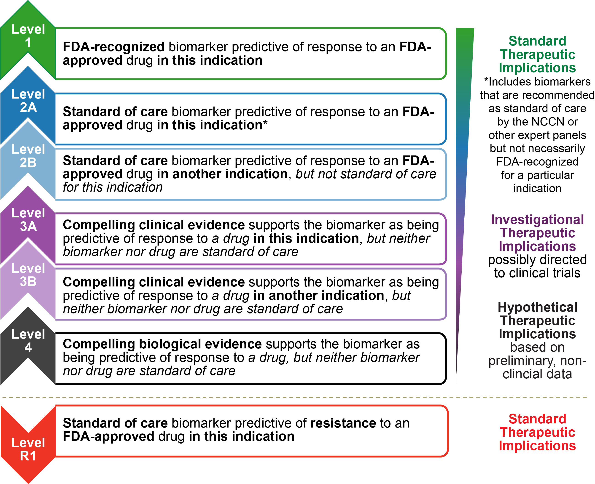
MSK Levels of Evidence
J Clin Oncol 34, 2016 (suppl; abstr 11583)

