Slide 1

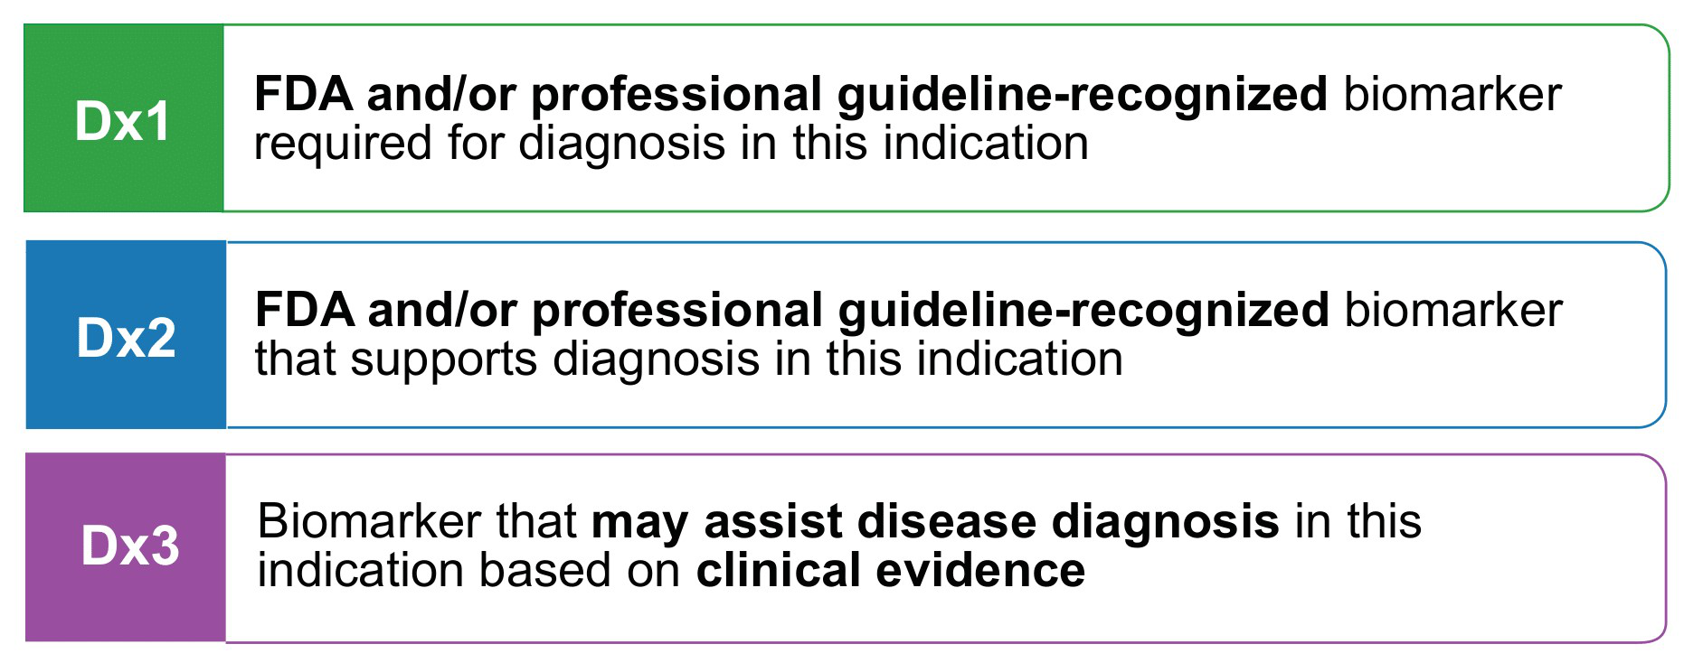

Diagnostic Levels of Evidence
Chakravarty et al., JCO PO 2017

