Slide 1
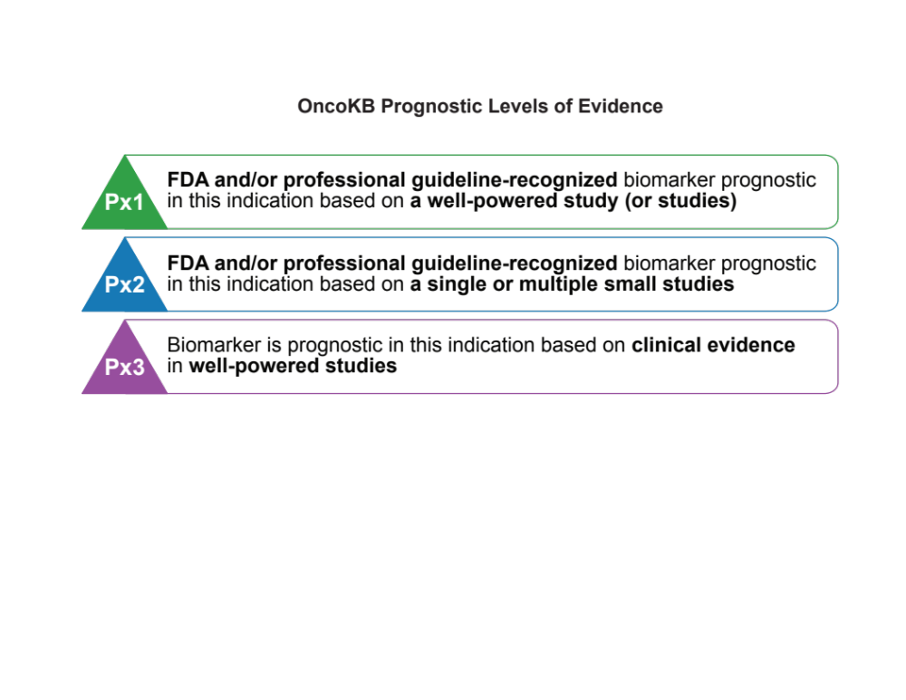

Chakravarty et al., JCO PO 2017

