Slide 1

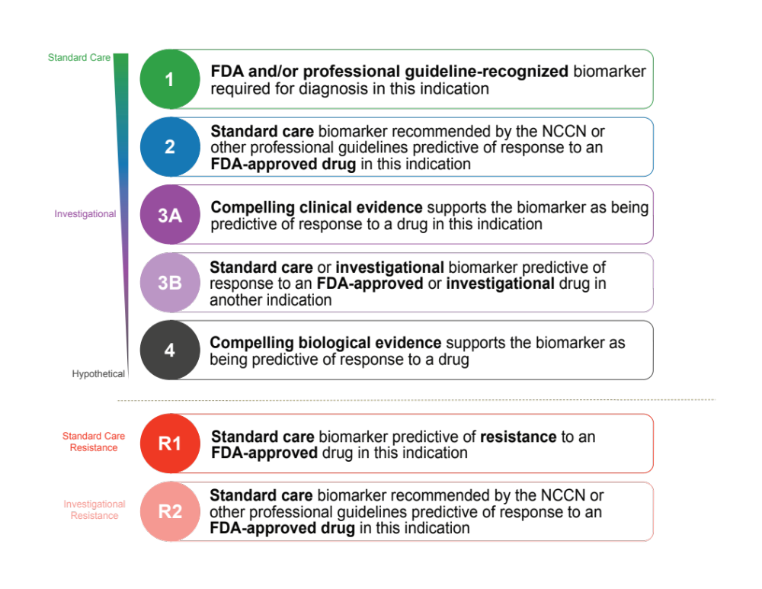

Therapeutic Levels of Evidence
Chakravarty et al., JCO PO 2017

