Slide 1

AI music
Ondřej Čermák

Slide 2
Application of AI in the music industry
Post-production remixing
Lyric writing help
Voice synthesizers
Voice cloning, conversion, synthesis

Slide 3
Identification
Copyright protection
Discovery (Shazam, Soundhound, …)
Audience analytics, recommendation systems
Music streaming platforms
Generation
Pseudo-generative AI (Soundraw, Soundful, …)
Generative AI (Jukebox, Suno, Udio, MuseNet, Magenta, AudioCraft, Stable Audio 2.0, …)

Slide 4
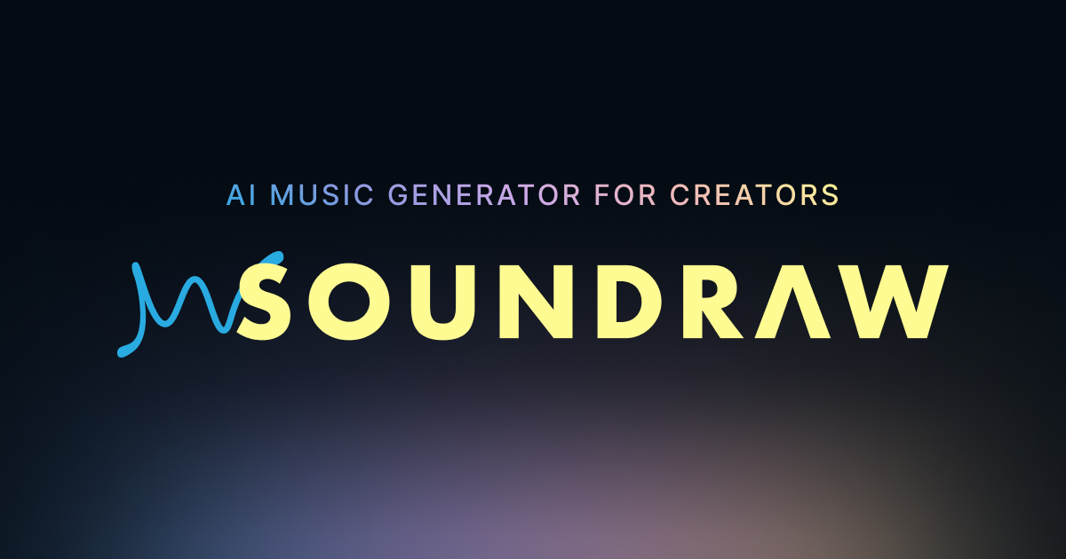
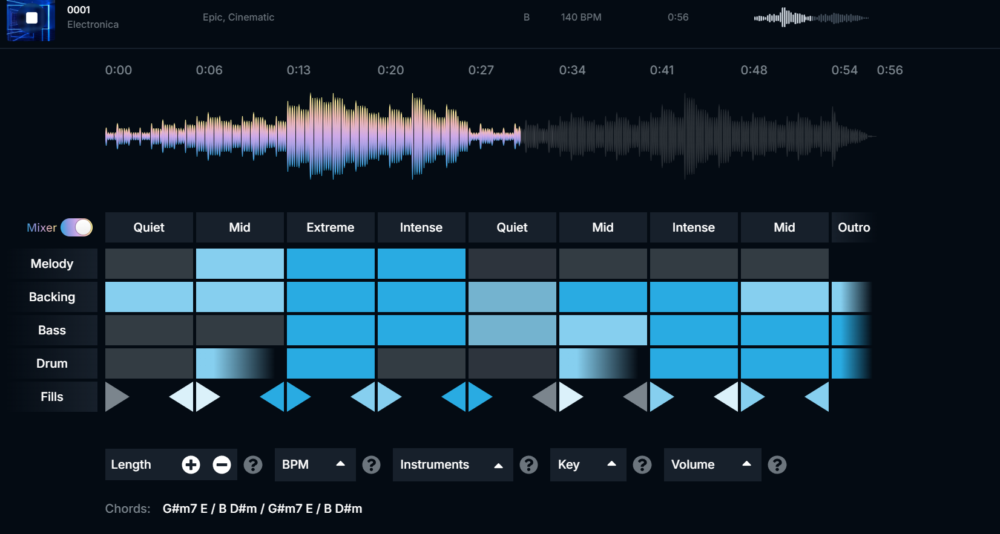
Soundraw (2020)
Pseudo-generative AI tool
Templates for various genres, moods, themes
Modify certain aspects in real time
No vocals
Eventually noticeable repetition of the template samples
Soundtracks made during paid subscription commercially usable under royalty-free license

Slide 5
Generative AI
Simplest way for the end user to generate a full song
First significant model – OpenAI Jukebox (April 2020)
Extending existing audio
Heavily reliant on the amount and quality of the training data
Highly advanced Text-to-music models came out recently (December 2023)
Adjustments of the generated songs can get complicated quickly

Slide 6
Do you think AI generated music is missing something?
Threat or a tool for individual creators?

Slide 7
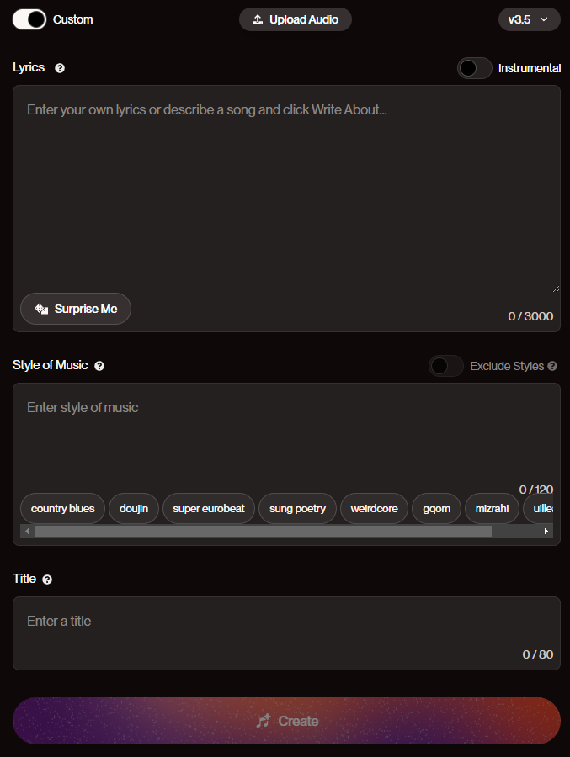
Suno (December 2023)
Text-to-music generator
Style of music
Instrumental / Generated lyrics / Custom lyrics
Various tags for song structure, voice, mood, genre, instrument
Extending audio
Along with Udio the most advanced and popular music generator as of today
Use cases
Inspiration, prototyping
Low-budget projects, background music
Entertainment
Songs made during a subscription plan are owned by the user
At least according to Suno's ToS
The copyright of generated content is unclear though

Slide 8
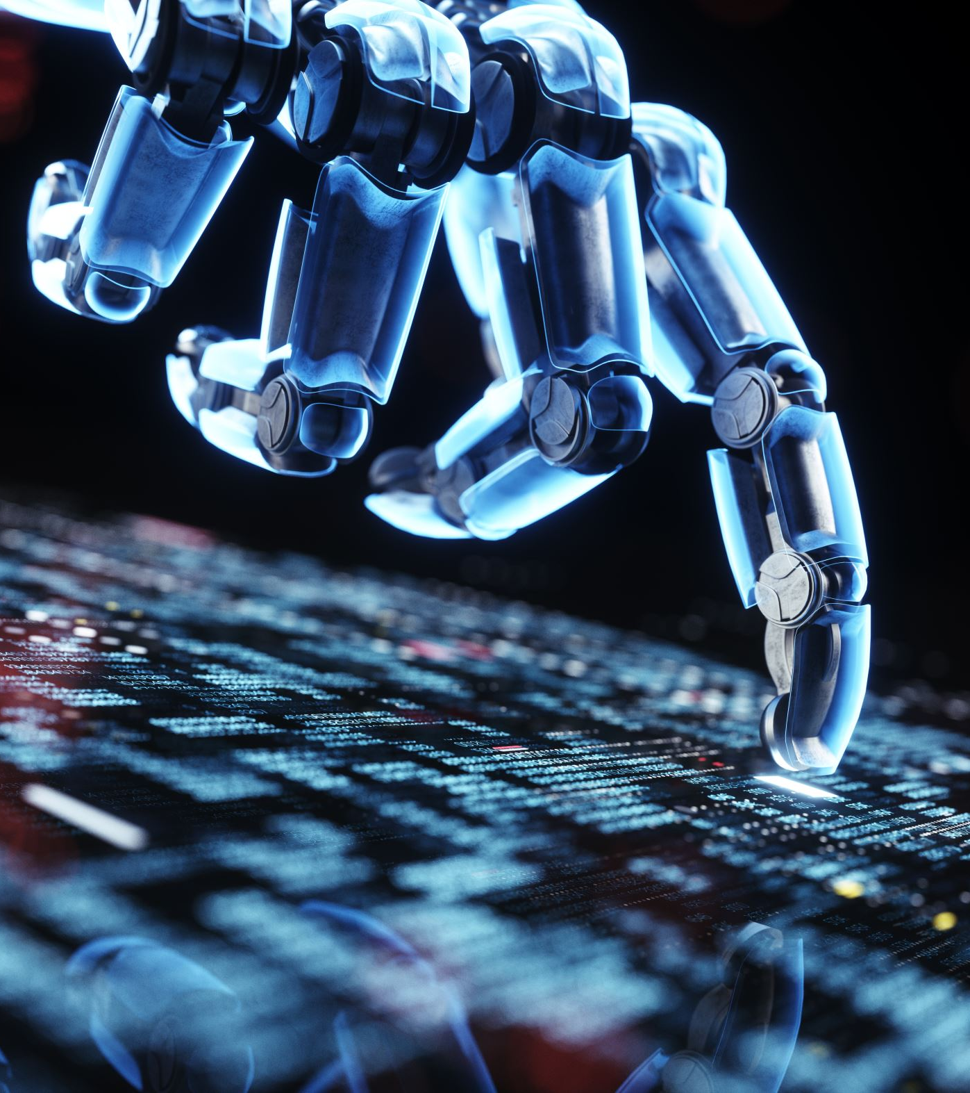
Would you consider using AI-generated soundtracks in your projects?
Would your answer differ in case of commercial use?

Slide 9
Doubts
Why are these 2 startups considered so much more advanced compared to projects from Meta, Google, OpenAI
One thing Suno and Udio have in common is publicly undisclosed training dataset

Slide 10
Lawsuit
June 2024 – Present
Plaintiffs:
RIAA
Universal Music Group
Sony Music
Warner Music Group
AI music models trained on allegedly unlicensed works
Seeking damages of $150,000 per copyright infringement
Defendants:
Suno AI
Udio
record label / music label – hudební vydavatelství
plaintiff – žalobce
defendant – obžalovaný
allegedly - údajně

Slide 11
Suspicions
Producer tags
Users of Suno noticed producer tags being sampled the same way as in the original copyrighted audio of the producers
Uncanny similarities
In both Suno and Udio's cases, audio generated with just the lyrics from copyrighted works had sampling similarities to the point of being recognized as the original by copyright detection algorithms
producer tag = a short sampled audio signature the music producer puts usually at the beginning of their beat

Slide 12
Progress of the lawsuit
1st August 2024
Suno and Udio admit to the use of copyrighted recordings in their training data
They claim their AI simply listened to music like any other artist taking inspiration from other songs and that this process falls under fair use
"Where Suno sees musicians, teachers, and everyday people using a new tool to create original music, the labels see a threat to their market share."
Recording Industry Association of America says stealing other artists' work doesn't fall under fair use
fair use = actions exempt from copyright under specific circumstances, such as educational content

Slide 13
Controversial topic
Many artists see AI generation as the end of creativity in music
Others see it as a powerful tool to create a baseplate they can use as an inspiration and build upon
Both sides of the lawsuit are seen as 'bad' by the general public
Music labels are viewed as a hostile environment for creators, offering low payouts to the actual artists
AI is flooding the world with 'soulless' generated sounds and people who know nothing about music composition

Slide 14
Which side winning the lawsuit would benefit a hobby music creator more, if any?
Do you believe the lawsuit could cause changes in the copyright law?
Do you think training a good AI model on 100% clean copyright-free data is realistic?

Slide 15
Many investors for Suno and Udio startups allegedly wouldn't consider doing so if that was the case
Stable Audio 2.0 and Meta's AudioCraft have been trained on licensed data
Suspicions among the public mention the Record labels' actual goal being to claim the technology for themselves, due to setting unfulfillable reparations in the lawsuit
data license = an arrangement between the owner and user of the data, specifying what the user can do with it

Slide 16

That's it.

Slide 17
Sources:
Scientific articles:
Originality and future of copyright in age of generative AI https://www.sciencedirect.com/science/article/pii/S0267364923001024
Systematic review of AI-based music generation
https://www.sciencedirect.com/science/article/pii/S0957417422013537
News articles:
https://arstechnica.com/information-technology/2024/06/music-labels-sue-ai-music-generators-for-copyright-infringement/
https://www.musicbusinessworldwide.com/as-suno-and-udio-admit-training-ai-with-unlicensed-music-record-industry-says-theres-nothing-fair-about-stealing-an-artists-lifes-work/
https://www.reuters.com/legal/litigation/music-ai-startups-suno-udio-slam-record-label-lawsuits-court-filings-2024-08-01/

Slide 18
Videos:
The AI lawsuit that's shaking the music world
https://www.youtube.com/watch?v=Hy8Or6af98c
Will Record Companies Suing Suno and Udio Make A Difference
https://www.youtube.com/watch?v=P56TV_Jz0i0
Recommended Youtube Creators covering this topic across various videos:
https://www.youtube.com/@SyncMyMusic
https://www.youtube.com/@TopMusicAttorney

