Slide 1

Ring Oscillator Simulation
ELEC 654 – Advanced Simulation of Electronic Circuits
ÖNDER GÖRMEZ
171021012

Slide 2
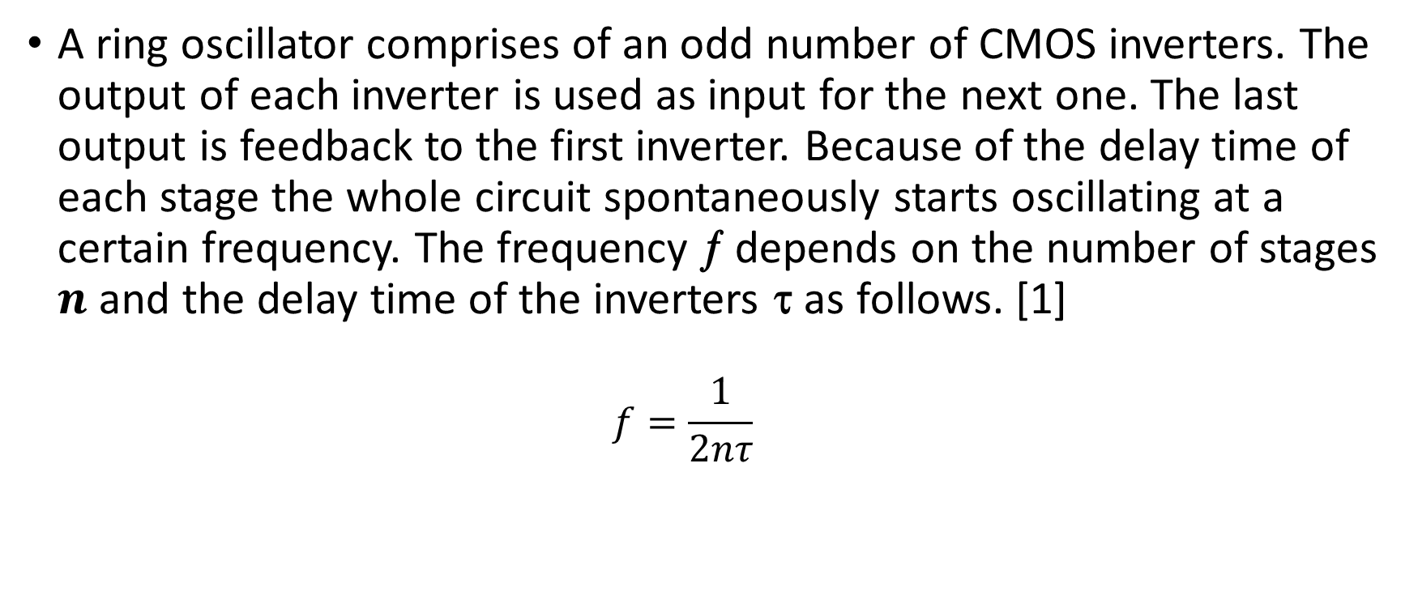
Ring Oscillator Simulation
I. Introduction
A ring oscillator comprises of an odd number of CMOS inverters. The output of each inverter is used as input for the next one. The last output is feedback to the first inverter. Because of the delay time of each stage the whole circuit spontaneously starts oscillating at a certain frequency. The frequency ƒ depends on the number of stages $n$ and the delay time of the inverters τ as follows. [1]
$$f=\frac{1}{2nτ}$$

Slide 3
Ring Oscillator Simulation
II. Details
A real ring oscillator only requires power to operate. Above a certain threshold voltage, oscillations begin spontaneously. To increase the frequency of oscillation, two methods are commonly used. Firstly, the applied voltage may be increased. This increases both the frequency of the oscillation and the current consumed. The maximum permissible voltage applied to the circuits limits the speed of a given oscillator. Secondly, making the ring from a smaller number of inverters results in a higher frequency of oscillation given a certain power consumption. [2]

Slide 4
Ring Oscillator Simulation
III. Operation
To understand the operation of a ring oscillator, one must first understand gate delay. In a physical device, no gate can switch instantaneously. In a device fabricated with MOSFETs, for example, the gate capacitance must be charged before current can flow between the source and the drain. Thus, the output of every inverter in a ring oscillator changes a finite amount of time after the input has changed. From here, it can be easily seen that adding more inverters to the chain increases the total gate delay, reducing the frequency of oscillation. [2]

Slide 5
Ring Oscillator Simulation
IV. Jitter
Period of ring oscillator vibrates in a random manner T=T+T' where T' is a random value. In high-quality circuits, the range of T' is relatively small compared to T. This variation in oscillator period is called jitter. Local temperature effects cause the period of a ring oscillator to wander above and below the long-term average period. When the local silicon is cold, the propagation delay is slightly shorter, causing the ring oscillator to run at a slightly higher frequency, which eventually raises the local temperature. When the local silicon is hot, the propagation delay is slightly longer, causing the ring oscillator to run at a slightly lower frequency, which eventually lowers the local temperature. [2]

Slide 6
Ring Oscillator Simulation
V. Applications
The voltage-controlled oscillator (VCO) in most phase-locked loops (PLL) is built from a ring oscillator.
Jitter of ring oscillators is commonly used in hardware random number generators.
Many wafers include a ring oscillator as part of the scribe line test structures. They are used during wafer testing to measure the effects of manufacturing process variations.
Ring oscillators can also be used to measure the effects of voltage and temperature on a chip. [2]

Slide 7
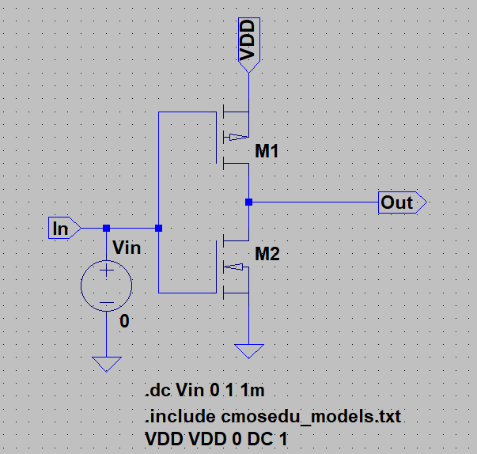
Ring Oscillator Simulation
VI. Simulation on LTspice

Slide 8
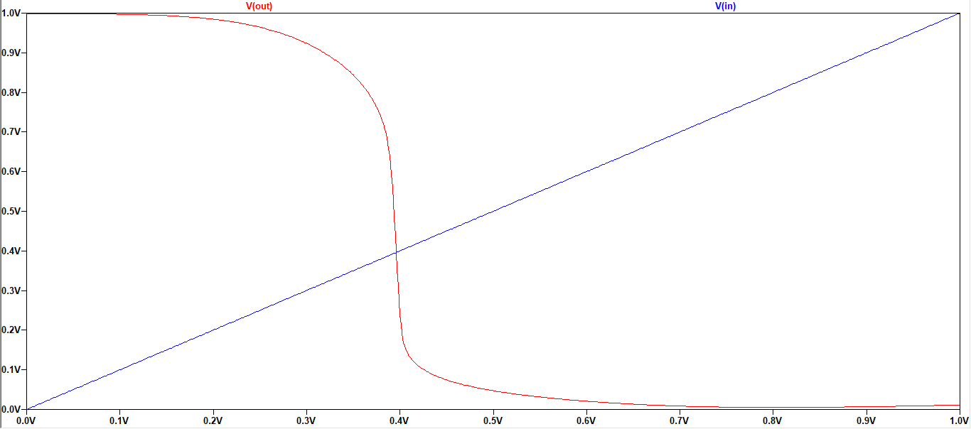
Ring Oscillator Simulation
VI. Simulation on LTspice

Slide 9
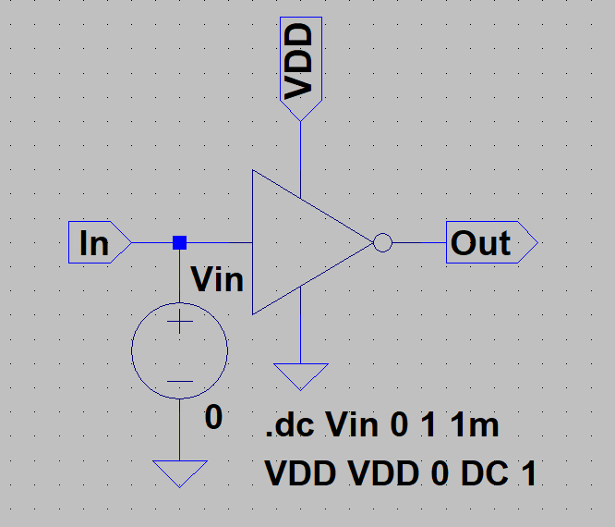
Ring Oscillator Simulation
VI. Simulation on LTspice

Slide 10
Ring Oscillator Simulation
VI. Simulation on LTspice

Slide 11
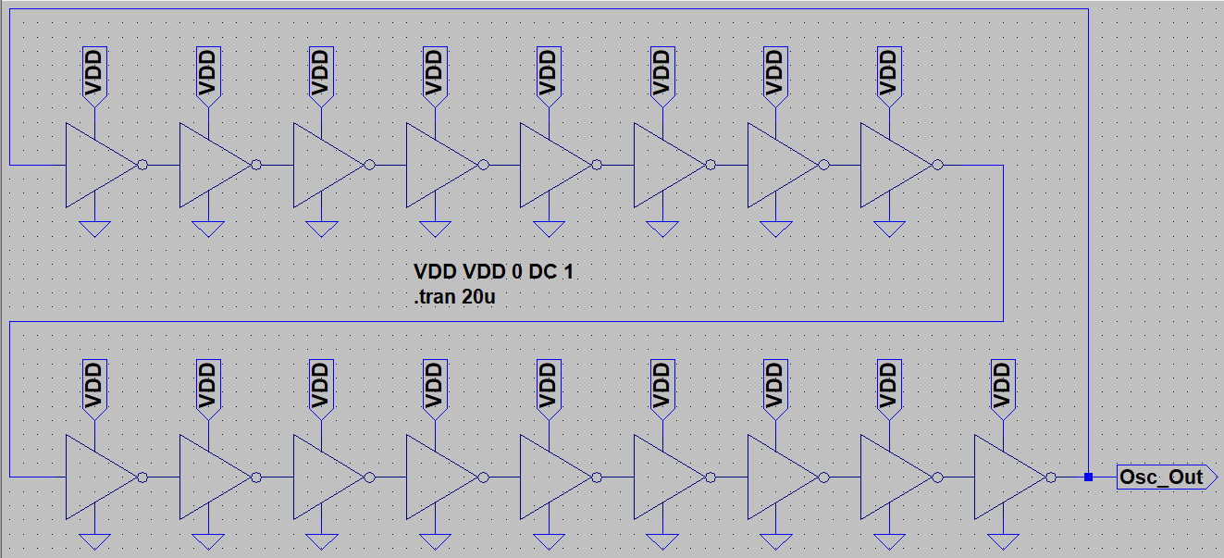
Ring Oscillator Simulation
VI. Simulation on LTspice

Slide 12
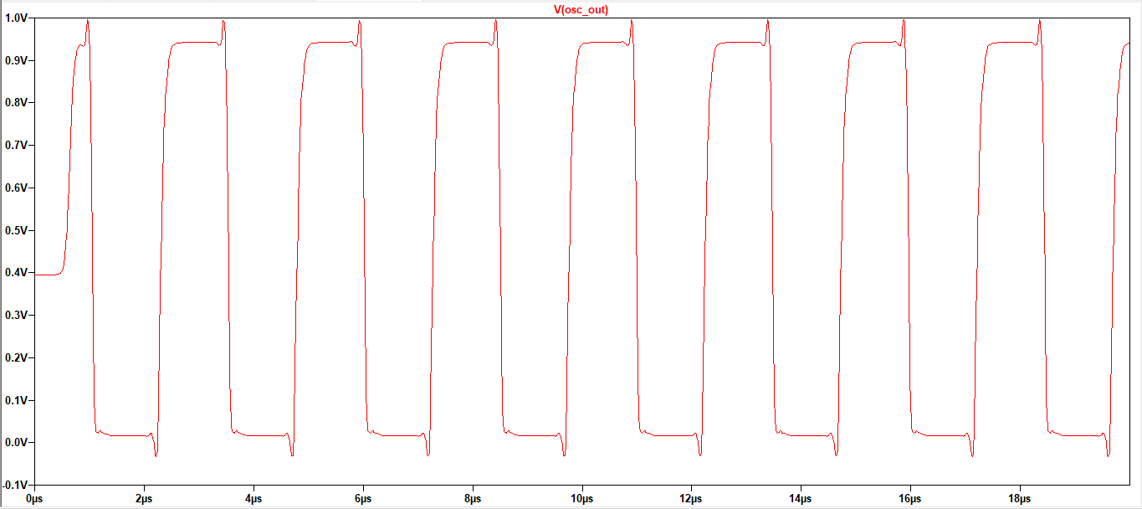
Ring Oscillator Simulation
VI. Simulation on LTspice

Slide 13
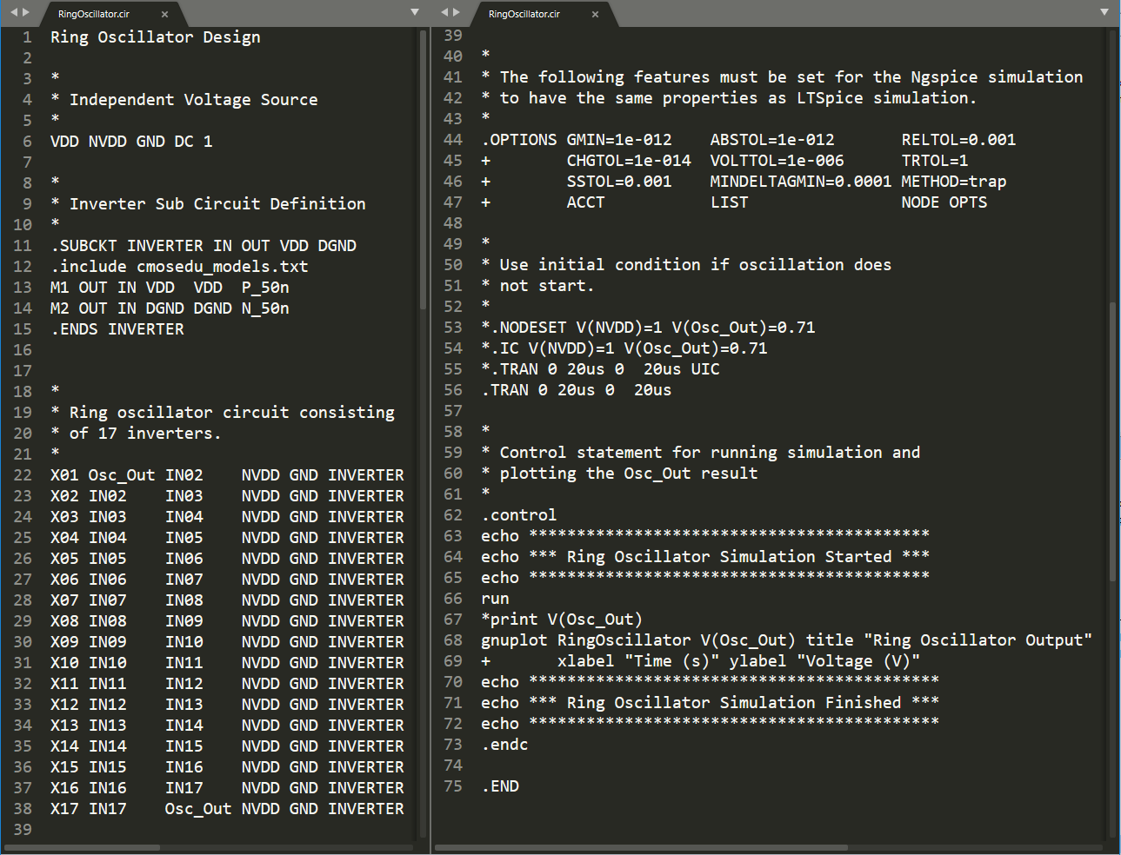
Ring Oscillator Simulation
VI. Simulation on Ngspice

Slide 14
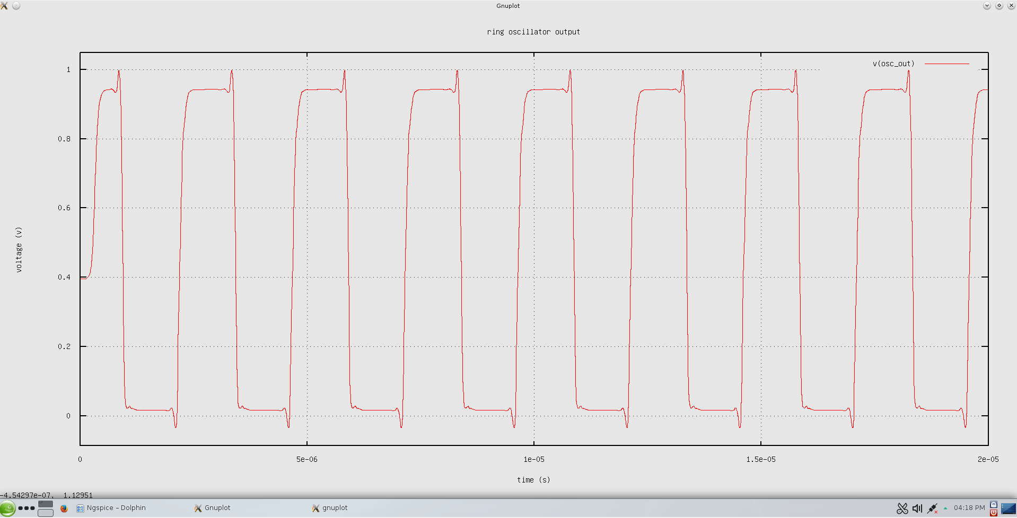
Ring Oscillator Simulation
VI. Simulation on Ngspice

Slide 15
Ring Oscillator Simulation
VII. References
[1] http://www.iue.tuwien.ac.at/phd/entner/node35.html
[2] https://en.wikipedia.org/wiki/Ring_oscillator
[3] http://cmosedu.com/
[4] https://www.youtube.com/watch?v=7ShqMMWj-WI&list=PLZuGFJzpFksCaPBHdNqThrkAiQ5AyY4SJ&index=4
[5] http://ngspice.sourceforge.net/docs/ngspice-manual.pdf

Slide 16
Ring Oscillator Simulation
THANK YOU FOR LISTENING…

