Slide 1
Once Only Technical System (OOTS)
High Level Architecture Q1 2023
April 6th 2023

Slide 2
HLA 1. Formal stuf relating to OOTS
https://ec.europa.eu/digital-building-blocks/wikis/download/attachments/323290750/%28ISA2%29.%28eDelivery%29.%28Piloting%20a%20REST%20API%20extension%20of%20CEF%20eDelivery%29.%28ISA%C2%B2%20IPS%20REST%20API%20Profile%29.%28v1.0%29.pdf?api=v2
https://ec.europa.eu/digital-building-blocks/wikis/download/attachments/323290750/%28ISA2%29.%28eDelivery%29.%28Piloting%20a%20REST%20API%20extension%20of%20CEF%20eDelivery%29.%28ISA%C2%B2%20IPS%20REST%20API%20Profile%29.%28v1.0%29.pdf?api=v2
2018. Single Digital Gateway Regulation
Annex II → 21 public procedures digital on Your Europe
Art 14.10 → Other systems established by EU-level
2022. Implementing Act Once Only Principle
Mentions Eucaris and Emrex
eDelivery (EbMS3/AS4 + REST-api EU )
Technal Design Documents (TDD) OOTS
SDG Working groups
technical
semantic
others
Enrolment HEI
Studypoints
Other procedures
OOTS
Emrex

Slide 3
HLA 2. Some OOTS Requirements
National exchange then EU exchange → bridge Emrex diploma’s to OOTS
User- centric (C2G) → P&C
Related systems → Diplomarequesters can resort tot Emrex
IMI as a backup (G2G)
33. End-to-end confidentiality → PKI encryption
34. End-to-end integrity → PKI signing
47. Logging

Slide 4
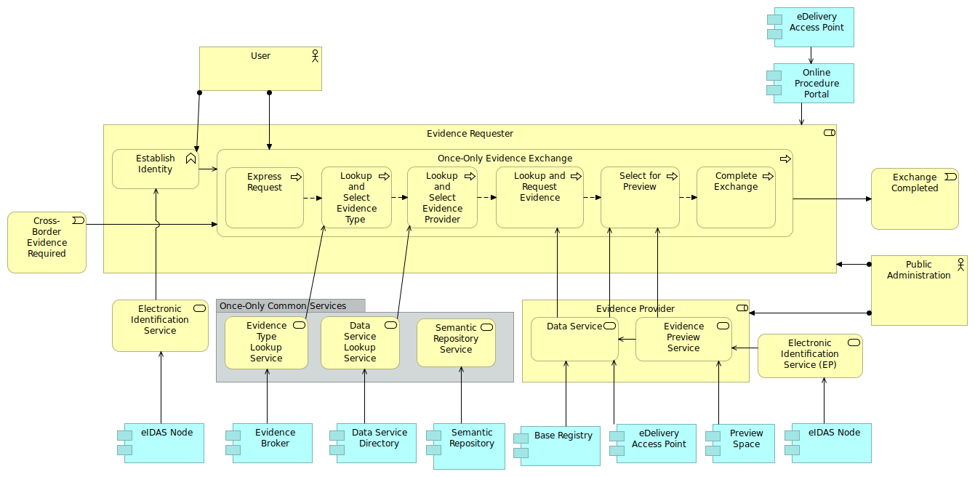
HLA 3. Overview
HLA 4
HLA 7
HLA 6
HLA 5
HLA 8
HLA 8

Slide 5
HLA 4. Requester
Express request: User wants to use OOTS?
Lookup&select evidence type: Optional, in case of Emrex not needed
Lookup&select provider/dataservice: Find dataservice, example Emrex, Dutch government
Lookup&request evidence: Find previewURL, example dataservice by Emreg/EWP (*)
Select for preview: Find evidence at dataprovider
Complete exchange
(*) Optional, identity matching to indicate most likely providers

Slide 6
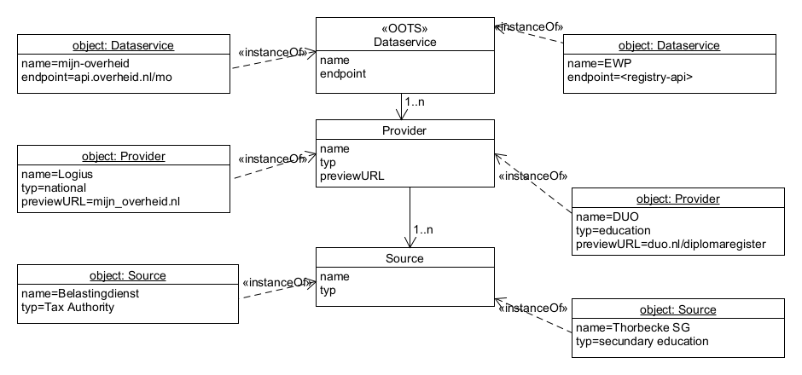
HLA 5. Provider

Slide 7
HLA 6. Common Services
Evidence broker not needed with Emrex
Data service directory (DSD) Interface = REST-api not EmbMS3/AS4
Semantic repository ELMO or ELM or …

Slide 8
HLA 7. Evidence exchange & eDelivery
Request Response
Loop1 (Emreg/EWP)
Type PreviewURL
User-attributes
Message metadata
Loop 2 (Provider)
Type Evidence
User-attributes
Message metadata
PreviewURL
consumer
NAP1
EbMS3/AS4
provider
NAP2
OOTS four-cornermodel

Slide 9
HLA 8. EiDAS
Obligations:
Authentication at evidence requester
Authentication at evidence provider
New: the same identityprovider at both sides

