Slide 2
Step 1
git clone https://github.com/onderyildirim/iotcentral-iiot-lab.git
cd iotcentral-iiot-lab
rgname="iotcoeehol"
regionname="eastus2"
instanceid="$RANDOM"
appname="iotcoeehol-$instanceid"
echo "Your application name is: $appname"
appid=$(az iot central app create \
--resource-group $rgname \
--name $appname --sku ST0 --location $regionname \
--subdomain $appname \
--display-name 'OEE HOL' --query applicationId --output tsv)
az iot central app identity assign --name $appname --resource-group $rgname --system-assigned
echo "App Id is $appid"
echo "You can now navigate to: https://$appname.azureiotcentral.com/device-templates"

Slide 3
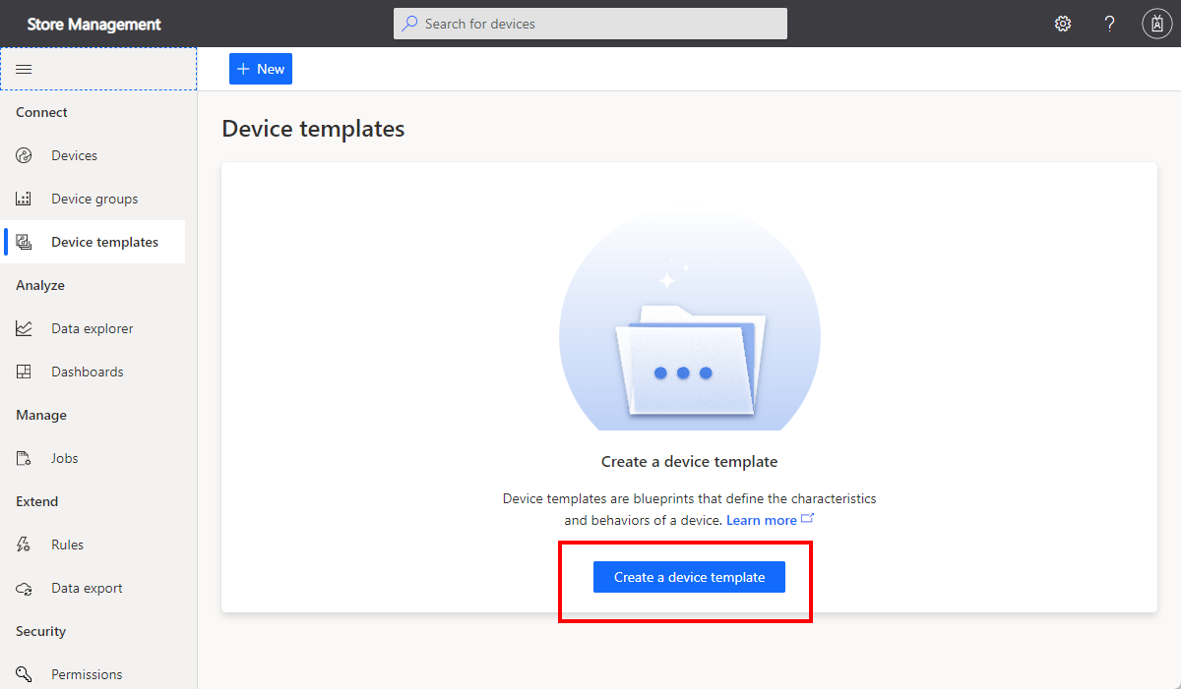
Step 2
Select Create a device template, choose the Azure IoT Edge tile, and then select Next: Customize.
Enter “OPCDevice” as the device template name. Then select Browse to upload a deployment manifest. Select the “opcua-edgeDeploymentManifest.json” file. IoT Central shows Validated after it checks the manifest. Select Next: Review.
Select Create to create the device template.

Slide 4
Step 2
Click “Module asset1”
Select “Edit DTDL”
Copy and paste contents from “opcua1.template.dtdl.json”
Click “Module asset2”
Select “Edit DTDL”
Copy and paste contents from “opcua2.template.dtdl.json”
Click Publish

Slide 5
Step 3
deviceid="opc1"
devicetemplate="OPCDevice"
devicetemplateid=($(az iot central device-template list --app-id $appid --compact --query "[?displayName.contains(@, '$devicetemplate')].\"@id\"" -o tsv))
echo "DeviceTemplateID=$devicetemplateid"
az iot central device create --app-id $appid --device-id $deviceid --template $devicetemplateid
idscope=($(az iot central device show-credentials --app-id $appid --device-id $deviceid --query "idScope" -o tsv))
devicekey=($(az iot central device show-credentials --app-id $appid --device-id $deviceid --query "symmetricKey.primaryKey" -o tsv))
echo "ID Scope=$idscope DeviceKey=$devicekey"

Slide 6
Step 4
vmname="iotcholedge-$RANDOM"
vmpassword="Password@12345"
az deployment group create \
--name $vmname \
--resource-group $rgname \
--template-file edgeModuleVMDeploy.json \
--parameters dnsLabelPrefix="$appname" \
--parameters adminUsername="azureuser" \
--parameters adminPassword="$vmpassword" \
--parameters scopeId="$scopeid" \
--parameters deviceId="$deviceid" \
--parameters deviceKey="$devicekey"
echo "You can now navigate to: https://$appname.azureiotcentral.com/devices"

Slide 7
Step 4
networkName="iiothol-network-$instanceid"
echo "Creating network $networkName"
az deployment group create --name NetworkDeployment --resource-group "$rgname" --template-file "./networkdeploy.json" --parameters networkName="$networkName"

Slide 8
Step 4
instanceid="111111"
rgname="iotcoeehol"
regionname="eastus2"
appname="iotcoee-$instanceid"
appid="4d4e578b-d125-4f14-a7f9-55a276ac0851"
networkName="iiothol-network-$instanceid"
simVMMachineName="iiotholsimvm-$instanceid"
adminUserSshPublicKey=$(cat $(readlink -f ~/.ssh/id_rsa.pub))
echo "Creating virtual machine $simVMMachineName"
simVMDeploymentOutput=($(az deployment group create --name SimulatorVMDeployment --resource-group "$rgname" --template-file "simVMTemplate.json" --parameters vmMachineName="$simVMMachineName" networkName="$networkName" adminUserName="azureuser" adminUserSshPublicKey="$adminUserSshPublicKey" vmSize="Standard_B1ms" --query "properties.outputs.[vmMachineName.value, vmMachineFqdn.value, vmAdminUserName.value]" -o tsv))
vmMachineName=${simVMDeploymentOutput[0]}
vmMachineFqdn=${simVMDeploymentOutput[1]}
vmAdminUserName=${simVMDeploymentOutput[2]}
echo "Simulator VM SSH : ssh ${vmAdminUserName}@${vmMachineFqdn}"

Slide 9
Step 4
deviceid="asset1"
devicetemplate="BoltMaker"
devicetemplateid=($(az iot central device-template list --app-id $appid --compact --query "[?displayName.contains(@, '$devicetemplate')].\"@id\"" -o tsv))
az iot central device create --app-id $appid --device-id $deviceid --template $devicetemplateid
scopeid=($(az iot central device show-credentials --app-id $appid --device-id $deviceid --query "idScope" -o tsv))
devicekey=($(az iot central device show-credentials --app-id $appid --device-id $deviceid --query "symmetricKey.primaryKey" -o tsv))
edgeVMMachineName="iiotholedgevm-$instanceid“
adminUserSshPublicKey=$(cat $(readlink -f ~/.ssh/id_rsa.pub))
echo "Creating virtual machine $edgeVMMachineName"
edgeVMDeploymentOutput=($(az deployment group create --name EdgeVMDeployment --resource-group "$rgname" --template-file "edgeVMTemplate.json" --parameters vmMachineName="$edgeVMMachineName" networkName="$networkName" adminUserName="azureuser" adminUserSshPublicKey="$adminUserSshPublicKey" vmSize="Standard_B1ms" scopeId="$scopeid" deviceId="$deviceid" deviceKey="$devicekey" --query "properties.outputs.[vmMachineName.value, vmMachineFqdn.value, vmAdminUserName.value]" -o tsv))
vmMachineName=${edgeVMDeploymentOutput[0]}
vmMachineFqdn=${edgeVMDeploymentOutput[1]}
vmAdminUserName=${edgeVMDeploymentOutput[2]}
echo "Edge VM SSH : ssh ${vmAdminUserName}@${vmMachineFqdn}"
echo "You can now navigate to: https://$appname.azureiotcentral.com/devices"

Slide 10
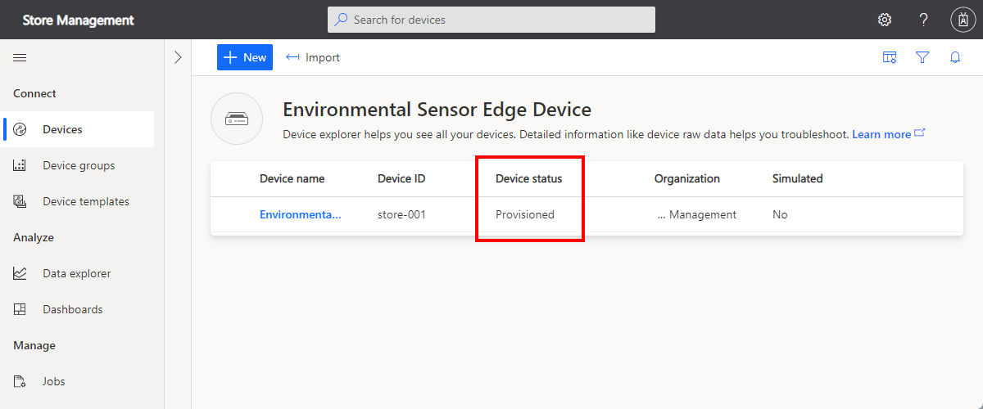
Step 5
The Device status changes from Registered to Provisioned when the IoT Edge device connects. May take several minutes.

Slide 11
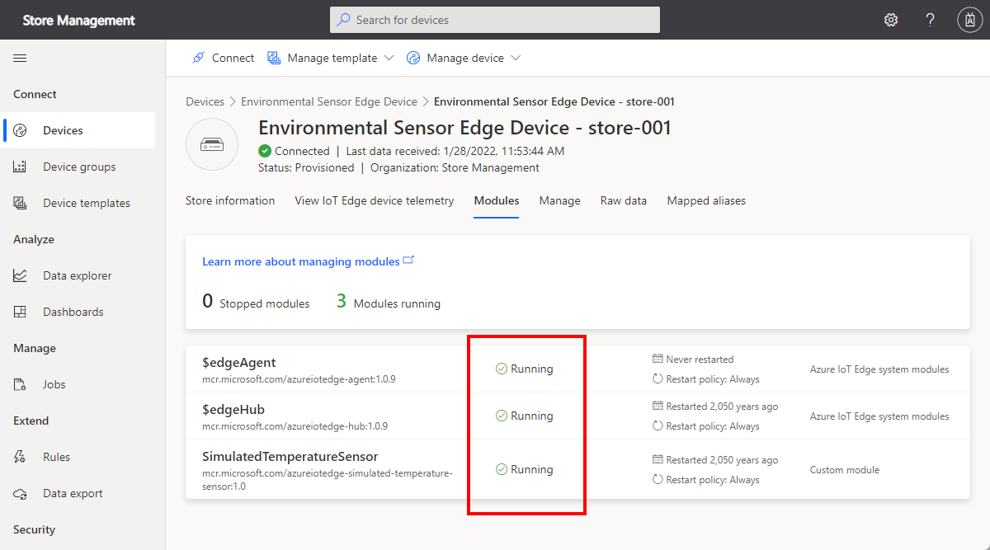
Step 6

Slide 12
Step 7
Create/start an ADX cluster
Enable streaming ingestion
Create a database
Grant IOT Central App ADX access
az ad sp create-for-rbac --skip-assignment --name "My SP for IoT Central" --scopes /subscriptions/<SubscriptionId>
.add database ['<YourDatabaseName>'] admins ('aadapp=<YourAppId>;<YourTenant>');
https://docs.microsoft.com/en-us/azure/iot-central/core/howto-export-to-azure-data-explorer?tabs=service-principal%2Cjavascript
Create table in your DB
.create table iotcexport (
EnqueuedTime:datetime,
Message:string,
Application:string,
Device:string,
Simulated:boolean,
Template:string,
Module:string,
Component:string,
Capability:string,
Value:dynamic
)
.alter database iotcholdb policy streamingingestion enable
.alter table iotcexport policy streamingingestion enable

