Slide 1
C♯ …
Rasmus Lystrøm
Associate Professor
ITU

Slide 2
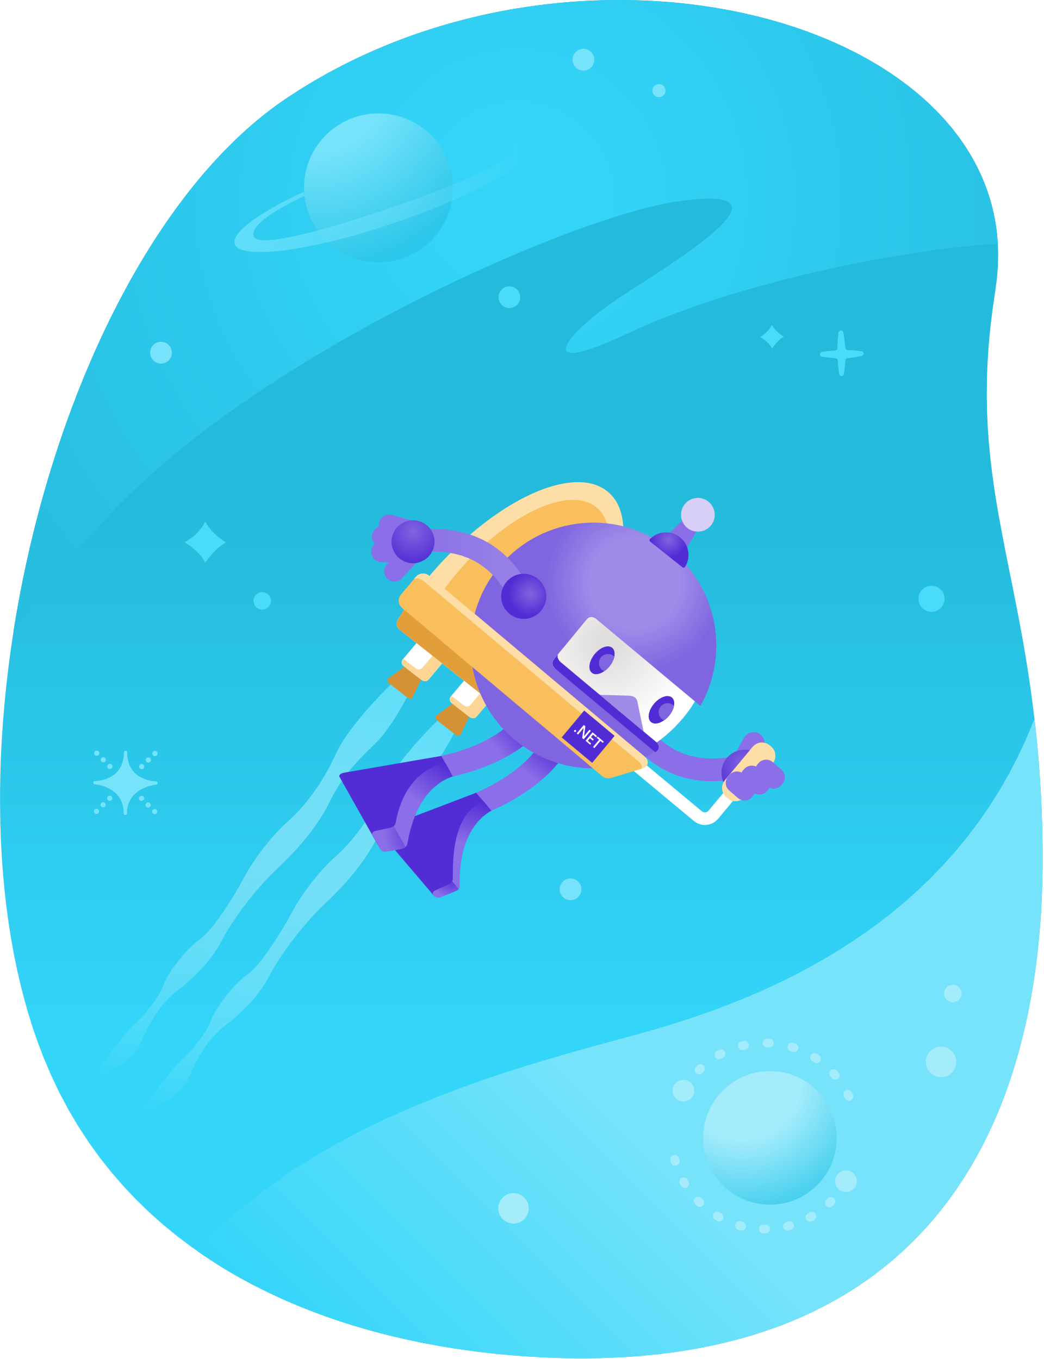
.NET Conf 2021
November 9-11: .NET Conf 2021
.NET 6
C# 10
Blazor
.NET MAUI
F# 6
EF Core 6
https://www.dotnetconf.net/
November 8: Visual Studio 2022
https://visualstudio.microsoft.com/launch/

Slide 3

Agenda
Docker and Docker Compose
gRPC
GraphQL
Integration Testing ASP.NET Core
This Photo by Unknown Author is licensed under CC BY-NC-ND

Slide 4
Docker & Docker Compose
Demo

Slide 5
gRPC

Slide 6
gRPC Remote Procedure Calls
gRPC is a modern, open source, high-performance remote procedure call (RPC) framework that can run anywhere. gRPC enables client and server applications to communicate transparently, and simplifies the building of connected systems.
$ dotnet new grpc
Source: https://github.com/grpc/grpc

Slide 7
GraphQL

Slide 8
GraphQL
GraphQL is a query language for APIs and a runtime for fulfilling those queries with your existing data. GraphQL provides a complete and understandable description of the data in your API, gives clients the power to ask for exactly what they need and nothing more, makes it easier to evolve APIs over time, and enables powerful developer tools.
Source: https://graphql.org/

