Slide 1
Identity in ASP.NET Core 2.x
Ondrej balas
@ondrejbalas  www.ondrejbalas.com  Ondrej@ondrejbalas.com →
Notes:
The icons use FontAwesome. If they appear to be missing, try installing the font from here: http://fortawesome.github.io/Font-Awesome/
The slides & code for this presentation are available online.

Slide 2




Ondrej balas
 Microsoft MVP in Visual Studio
 Blog at ondrejbalas.com
 Consultant since 2001
 Founded startup in 2017
 Game development for fun
 www.ondrejbalas.com
→ Ondrej@ondrejbalas.com
 @ondrejbalas
Notes:
Microsoft MVP in Visual Studio
Writing – topics related to .NET development including things like regular expressions, dependency injection, etc.
Consulting – Started in 2001 and played with several technology stacks, but focused solely on .NET after its release the following year.
Startup is focused around helping developers get a piece of the profits made from credit card processing solutions they implement. Why should Stripe make all the money?
I’d love to chat about any of those topics, and if you see me around the conference center stop me and say hi!

Slide 3
AspNetCore.Identity
Access Control (Authentication & Authorization)
First released as NuGet packages, compatible with .NET 4.5 and higher
ASP.NET Core MVC 2.1 templates use ASP.NET Core Identity 2.1
As of 2.1, UI (default views) is provided as a Razor Class Library

Slide 4
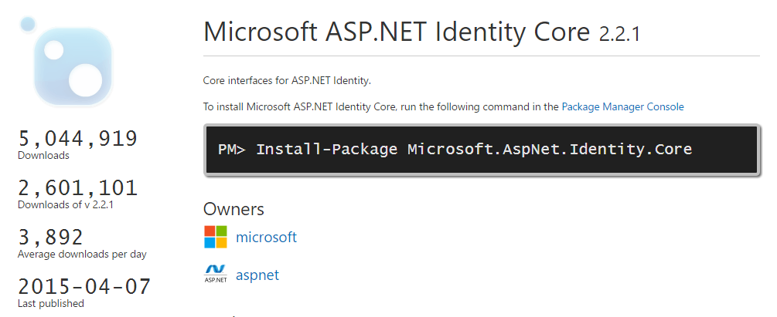
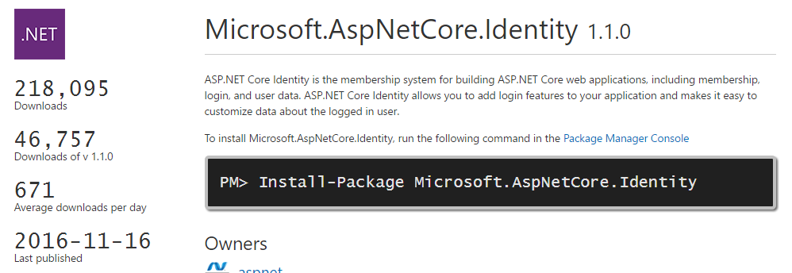
Use this when you ARE NOT
using ASP.NET Core
Use this when you ARE
using ASP.NET Core

Slide 5
ASP.NET Membership (2005)
Tightly coupled to SQL Server (with a specific schema)
Even other relational databases like MySQL required a complicated custom provider
Roles and passwords were required
Custom user profile fields were a PAIN!
Notes:
Keep in mind that when ASP.NET Membership shipped, it pre-dated things like MVC which didn’t release until much later. So this was a solution that made sense at the time.
Really only worked with SQL server. Other relational databases (even MySQL) required custom providers, and trying to write a custom provider for a non-relational database was very difficult
Things like roles and passwords were a requirement of the system. This meant no compatibility with things like OAuth, Claims based authentication, etc.
Adding fields to users was difficult. The mechanism was user profiles, but they way they worked was weird. Because of the tight coupling with SQL and a specific database schema, additional fields were all stored in a single column, in a relatively cryptic format. Nothing as neat as JSON or even XML. This made querying or reporting on user data overly complicated. And forget about doing SQL joins to any of that.

Slide 6
Simple Membership (2012)
Supports a custom database schema
You can choose the ID and username columns
There are extensions for OAuth and OpenID
Supports account reset token by default
Built on top of ASP.NET Membership so there is still a tight coupling to SQL Server
Making changes to persistence means rewriting things like password hashing too

Slide 7
AspNet.Identity
OAuth & OpenID Connect (Facebook, Google, Microsoft Live, LinkedIn, etc..)
Custom Data Stores (even NoSQL!) are easy to implement
Roles, Claims, or Both
Organizational Accounts Too (Active Directory, Azure AD, Office 365)
Happiness

Slide 8
Claims
Additional bits of information attached to a user
More granular than roles
A KeyValue store that lives with the user
Stored in the user’s (encrypted) cookie

Slide 9
Demonstrating
Authentication under the hood
Bare-bones no-password authentication
Adding the Identity bits
Managers & Stores
Authorization Policies

Slide 10
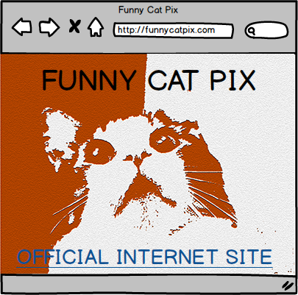
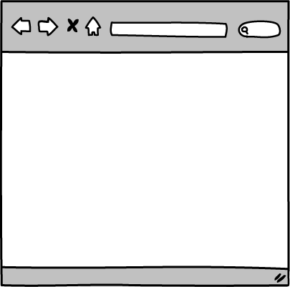
Request
Response
HTTP 200 (OK)
Notes:
It all starts when you go to your browser and type in the url to your favorite website. Behind the scenes, your browser will make a request, and the website will respond with an HTTP 200 (OK). The body of the response will contain the HTML needed to construct the page in your browser.

Slide 11
Request
Notes:
Let’s say you then click on a link that takes you to a protected part of the website. You can think of this as being an Action with an [Authorize] attribute surrounding it. The server will examine the request and determine if it’s an authenticated request. Using cookie authentication, it is looking for a specific cookie that should contain some kind of token that it can correlate to a user and validate. Since this request has no cookie, authentication fails, and the server responds with a 302 (redirect) to the login page.

Slide 12
[Authorize]
public IActionResult ProtectedPage()
{
// ...
}
Request
Notes:
Let’s say you then click on a link that takes you to a protected part of the website. You can think of this as being an Action with an [Authorize] attribute surrounding it. The server will examine the request and determine if it’s an authenticated request. Using cookie authentication, it is looking for a specific cookie that should contain some kind of token that it can correlate to a user and validate. Since this request has no cookie, authentication fails, and the server responds with a 302 (redirect) to the login page.

Slide 13
Request
Response
HTTP 302 (redirect) to login page
Notes:
Let’s say you then click on a link that takes you to a protected part of the website. You can think of this as being an Action with an [Authorize] attribute surrounding it. The server will examine the request and determine if it’s an authenticated request. Using cookie authentication, it is looking for a specific cookie that should contain some kind of token that it can correlate to a user and validate. Since this request has no cookie, authentication fails, and the server responds with a 302 (redirect) to the login page.

Slide 14
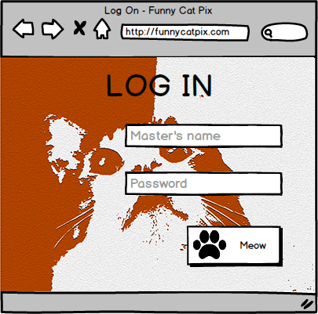
Request
Response
HTTP 200 (OK)
Notes:
The 302 has contains no body (content), only a URL of the next page to request. The browser will then make the next request, to the login page, and get the 200 (OK) response back from the server. At the login page, the user will type in their username and password, and then hit the login (or “Meow” in this case) button.

Slide 15
user=cat&pw=meow
POST Request
Response
HTTP 302 (redirect)
to protected page
Set-Cookie: login=somelongtoken; path=/
Notes:
That will trigger the browser to make an HTTP POST request, with the body containing the values you entered. This Is where SSL comes in handy! The server will respond with a 302 back to the protected page, but this time with a “Set-Cookie” header.

Slide 16
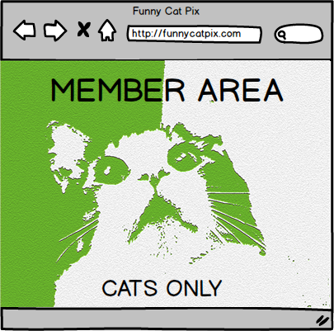
Cookie: login=somelongtoken
Request
Response
HTTP 200 (OK)
Notes:
At the login page, the user will type in their username and password, and then hit the login (or “Meow” in this case) button. That will trigger the browser to make an HTTP POST request, with the body containing the values you entered. This Is where SSL comes in handy! The server will respond with a 302 back to the protected page, but this time with a “Set-Cookie” header.

Slide 17
Demo Time

Slide 18
Managers
Stores
IUserStore
UserManager
IUserLoginStore
IUserClaimStore
RoleManager
IUserRoleStore
SignInManager
IRoleStore
IUserPasswordStore

Slide 19
Authorization Policies…
…are used on controllers and actions
[Authorize(Policy=“MemberSection”)]
SomeRequirement : IAuthorizationRequirement
…have requirements and handlers
AnotherHandler : AuthorizationHandler<SomeRequirement>
…and are wired up in Startup.cs
services.AddAuthorization(…)
Notes:
You probably noticed the [Authorize] attribute on the About action of the HomeController. In the past, the Authorize attribute was often used in conjunction with roles, only authorizing a user to execute an action if they were in that role. But now we have something called Authorization Policies: a way to use more complex logic than just a simple "are you in this role?"

Slide 20
Thanks!
 @ondrejbalas
 github.com/ondrejbalas
Ondrej balas
www.ondrejbalas.com  Ondrej@ondrejbalas.com →

