Slide 1
Building a Blockchain
Ondrej balas
@ondrejbalas  www.ondrejbalas.com  Ondrej@ondrejbalas.com →

Slide 2




Ondrej balas
 Microsoft MVP in Visual Studio
 Writer for Visual Studio Magazine
 Consultant since 2001
 Founded startup in 2017
 Game development for fun
 www.ondrejbalas.com
→ Ondrej@ondrejbalas.com
 @ondrejbalas
Notes:
Microsoft MVP in Visual Studio
Writing – topics related to .NET development including things like regular expressions, dependency injection, etc.
Consulting – Started in 2001 and played with several technology stacks, but focused solely on .NET after its release the following year.
Startup is focused around helping software ISVs increase per-customer revenue by turning their customer’s payment processing into a new revenue stream.
I’d love to chat about any of those topics, and if you see me around the conference center stop me and say hi!

Slide 3
2008
Notes:
2008 – I know what you’re thinking. “Yeah, yeah.. Bitcoin was launched on 2008.. Let’s get on with it”, but 2008 was important for other reasons as well. It was the year of the “global financial crisis” or AKA another recession. Recessions have a tendency to put people into a more anti-banking and pro-decentralization mindset, but for the first time in history the technology to solve some of the problems that prevent decentralization from being possible.

Slide 4
Bank Ledger
Date | Description | Amount | Balance
5/1/18 | Open Account | 100.00 | 100.00
5/2/18 | Electric Bill | -67.52 | 32.48
5/3/18 | Water Bill | -15.31 | 17.17
5/9/18 | Deposit | 200.00 | 217.17
5/12/18 | Groceries | -65.65 | 151.52
5/14/18 | Restaurant | -24.00 | 127.52
5/14/18 | Uber ride | -20.00 | 107.52
Notes:
It may not immediately come off as being just a single centralized ledger, but that’s because you’re used to a view of it like this.

Slide 5
Bank Ledger
Date | From | To | Description | Amount
5/1/18 | Cash Deposit | Steve | Open Account | 100.00
5/2/18 | Steve | Power Co. | Electric Bill | 67.52
5/3/18 | Steve | Water Co. | Water Bill | 15.31
5/9/18 | Steve’s Employer | Steve | Deposit | 200.00
5/12/18 | Steve | YummyFoodz | Groceries | 65.65
5/14/18 | Steve | General Taco’s | Restaurant | 24.00
5/14/18 | Steve | Uber | Uber ride | 20.00
Notes:
But this is it from the bank’s view of it.

Slide 6
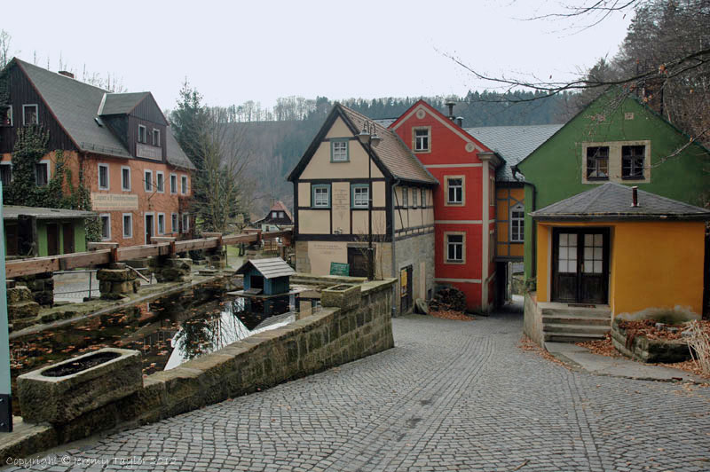

Slide 7
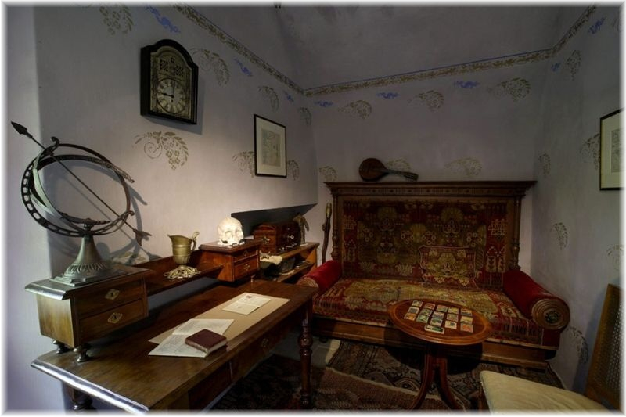

Slide 8
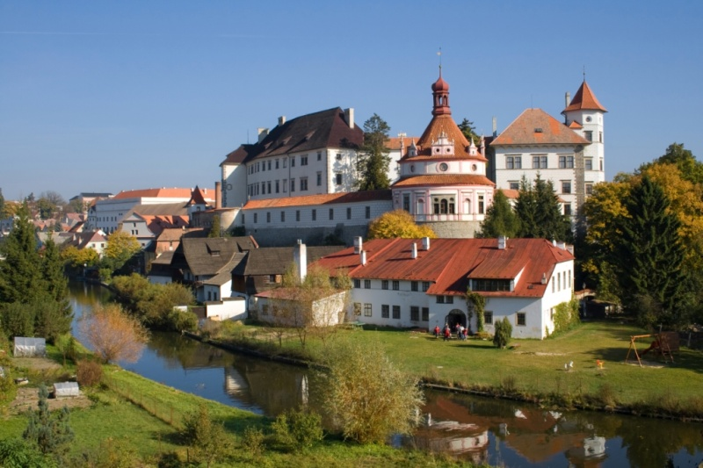

Slide 9


Slide 10
Ledger
Set of records
Usually used in the context of financial information
Read in sequence, row by row
Can be used to get a “point in time” snapshot
Notes:
Banks are nothing more than an entity whose job it is to manage the single centralized ledger.

Slide 11
Ledger
Single source of truth
Maintainer may get too busy, too expensive, or both.

Slide 12
Distributed Ledger
Everyone has a copy of the same ledger
Periodic reconciliation
Notes:
So what do we do? We distribute the ledger, everyone has a copy, and we just all get together once a week and match them up together.

Slide 13
The Double Spend Problem
Notes:
At reconciliation, everyone agrees that John has 5 coins.
He then goes and tells both Steve and Mary that he wants to buy something from them for those 5 coins. Both of them check their ledgers, mark it down, and complete the purchase.
At the next reconciliation, they realize that John double-spent his coins, and only one of the transactions is valid.

Slide 14
Blockchain
Technical solution to the bad actors problem
Automates the reconciliation
Nodes share information about pending transactions
Often used for carrying financial information, but can be used for other things as well. (It’s still JUST a ledger).
Notes:
This problem is finally solved by Blockchain. Blockchain can be said to “distribute trusted information”. This will get clarified as I go through the session.

Slide 15
Hash Function
Common algorithms
MD5
SHA-1
SHA-2 (often as SHA-256) CRC32
Deterministic (identical inputs lead to identical outputs)
Any size input; fixed output size
Uniform distribution
Irreversible
Difficult to find a collision
public interface ISimpleHashProvider
{
byte[] CalculateHash(byte[] data);
}
*In the demo we will use a uint return type for simplicity

Slide 16
Hashing - sample output
The hash of 6 is 297,858,791 The hash of 7 is 2,607,350,393 The hash of 8 is 843,211,308 The hash of “some string” is 747,016,153
Each output is 4 bytes. The decimal representations may vary in length, but the range of a 4-byte unsigned integer (uint) is 0 to 4,294,967,295

Slide 17
Cryptographic functions
Must support three key functions:
- Generate a key pair (public-key and private-key)
- Given a message and a private-key, generate a signature
- Verify a signed message given a message, a public-key, and a signature
public interface ICryptoProvider
{
void GenerateKeyPair(out byte[] privateKey, out byte[] publicKey);
byte[] Sign(byte[] message, byte[] privateKey);
bool Verify(byte[] message, byte[] publicKey, byte[] signature);
}

Slide 18

Bank Ledger
Date | From | To | Description | Amount
5/1/18 | Cash Deposit | Steve | Open Account | 100.00
5/2/18 | Steve | Power Co. | Electric Bill | 67.52
5/3/18 | Steve | Water Co. | Water Bill | 15.31
5/9/18 | Steve’s Employer | Steve | Deposit | 200.00
5/12/18 | Steve | YummyFoodz | Groceries | 65.65
5/14/18 | Steve | General Taco’s | Restaurant | 24.00
5/14/18 | Steve | Uber | Uber ride | 20.00
public class LedgerRow
{
public byte[] From { get; set; }
public byte[] To { get; set; }
public decimal Amount { get; set; }
}

Slide 19
public class LedgerRow
{
public byte[] From { get; set; }
public byte[] To { get; set; }
public decimal Amount { get; set; }
}

Slide 20
public class Transaction
{
public byte[] From { get; set; }
public byte[] To { get; set; }
public decimal Amount { get; set; }
public byte[] Signature { get; set; }
}

Slide 21
Cryptographic functions
Must support three key functions:
- Generate a key pair (public-key and private-key)
- Given a message and a private-key, generate a signature
- Verify a signed message given a message, a public-key, and a signature
public interface ICryptoProvider
{
void GenerateKeyPair(out byte[] privateKey, out byte[] publicKey);
byte[] Sign(byte[] message, byte[] privateKey);
bool Verify(byte[] message, byte[] publicKey, byte[] signature);
}

Slide 22
public class Transaction
{
public byte[] From { get; set; } public byte[] To { get; set; }
public decimal Amount { get; set; }
public byte[] Signature { get; set; }
}

Slide 26
The Genesis Block
The seed or first block of the chain.
Has no hash; values typically arbitrarily set by the blockchain creator.

Slide 28
Transaction Ledger
Signer Pub Key | Signature | Amount | Recipient
pub0 | priv0 | 100 | pub1
Balances
Owner | Pub | Amount
Genesis | pub0 | 0
Genesis | pub1 | 100

Slide 29
Transaction Ledger
Signer Pub Key | Signature | Amount | Recipient
pub0 | priv0 | 100 | pub1
pub1 | priv1 | 25 | pub2
Balances
Owner | Pub | Amount
Genesis | pub0 | 0
Genesis | pub1 | 75
Steve | pub2 | 25

Slide 30
Transaction Ledger
Signer Pub Key | Signature | Amount | Recipient
pub0 | priv0 | 100 | pub1
pub1 | priv1 | 25 | pub2
pub1 | priv1 | 30 | pub3
Balances
Owner | Pub | Amount
Genesis | pub0 | 0
Genesis | pub1 | 45
Steve | pub2 | 25
Mary | pub3 | 30

Slide 31
Transaction Ledger
Signer Pub Key | Signature | Amount | Recipient
pub0 | priv0 | 100 | pub1
pub1 | priv1 | 25 | pub2
pub1 | priv1 | 30 | pub3
pub1 | priv1 | 45 | pub4
Balances
Owner | Pub | Amount
Genesis | pub0 | 0
Genesis | pub1 | 0
Steve | pub2 | 25
Mary | pub3 | 30
Joe | pub4 | 45

Slide 32
Transaction Ledger
Signer Pub Key | Signature | Amount | Recipient
pub0 | priv0 | 100 | pub1
pub1 | priv1 | 25 | pub2
pub1 | priv1 | 30 | pub3
pub1 | priv1 | 45 | pub4
pub4 | priv4 | 12 | pub3
Balances
Owner | Pub | Amount
Genesis | pub0 | 0
Genesis | pub1 | 0
Steve | pub2 | 25
Mary | pub3 | 42
Joe | pub4 | 33

Slide 33
Code

Slide 34
Adding Blocks
Rules exist to throttle or control pace at which blocks are added to the chain. Several strategies exist:
Proof of Work (Mining) – Most common scenario; most cryptocurrencies are created this way.
Proof of Stake (Holding) – Deterministic algorithm can be applied to the chain to determine next “winner” and at what time the block can be added.
Proof of Authority – Few implementations exist. Only validating authorities can validate transactions and submit blocks. One becomes an authority by an implementation-specific process such as grants. Authority can be lost by attempting to be a bad actor.

Slide 35
Proof of Work
Hashes cost computational cycles.
Rules to reduce probability a given hash is valid
Rule 1 – Hashes without n leading bits as zeroes are invalid.
Rule 2 – Increasing the minimum Difficulty also invalidates hashes.

Slide 36
Leading Bits
Bits | Value
0 0 0 0 0 0 0 0 | 0
0 0 0 0 0 0 0 1 | 1
0 0 0 0 0 0 1 0 | 2
0 0 0 0 0 0 1 1 | 3
0 0 1 1 1 1 1 1 | 63
1 1 1 1 1 1 1 1 | 255
Leading 0s | Probability (1/n)
0 | 1
1 | 2
2 | 4
8 | 256
16 | 65,536
32 | 4,294,967,296
Notes:
This represents

Slide 37
Calculating Difficulty
Bits | Value
0 0 0 0 0 0 0 0 | 0
0 0 0 0 0 0 0 1 | 1
0 0 0 0 0 0 1 0 | 2
0 0 0 0 0 0 1 1 | 3
0 0 1 1 1 1 1 1 | 63
1 1 1 1 1 1 1 1 | 255
Requirement: 2 Leading Zeros
Highest possible hash meeting requirement is 00111111 (63)
Theoretical hash: 00010101 = 13
63 / 13 is a Difficulty rating of 4.4846

Slide 38
Orphaned Blocks

Slide 39
Orphaned Blocks
Notes:
Todo : COLOR THESE TRANSACTIONS. Top & bottom chains should represent different transactions existing in them.

Slide 40
Orphaned Blocks

Slide 41
Data?
The “Data” part of a transaction can be anything.
public class Transaction
{
public byte[] From { get; set; } public byte[] To { get; set; }
public decimal Amount { get; set; }
public byte[] Signature { get; set; }
}

Slide 42
SpeedChain
A Fictional Speeding Ticket Blockchain

Slide 43
SpeedChain Ledger
Signer Public Key | Signature | Speeding Ticket | Method | Grantee

Slide 44
SpeedChain Ledger
Signer Public Key | Signature | Speeding Ticket | Method | Grantee
pub0 | s-priv0 | (null) | Grant | pub1

Slide 45
SpeedChain Ledger
Signer Public Key | Signature | Speeding Ticket | Method | Grantee
pub0 | s-priv0 | (null) | Grant | pub1
pub1 | s-priv1 | John 5 over | (null) | (null)

Slide 46
SpeedChain Ledger
Signer Public Key | Signature | Speeding Ticket | Method | Grantee
pub0 | s-priv0 | (null) | Grant | pub1
pub1 | s-priv1 | John 5 over | (null) | (null)
pub1 | s-priv1 | Doug 20 under | (null) | (null)

Slide 47
SpeedChain Ledger
Signer Public Key | Signature | Speeding Ticket | Method | Grantee
pub0 | s-priv0 | (null) | Grant | pub1
pub1 | s-priv1 | John 5 over | (null) | (null)
pub1 | s-priv1 | Doug 20 under | (null) | (null)
pub1 | s-priv1 | Steve 15 over | (null) | (null)

Slide 48
SpeedChain Ledger
Signer Public Key | Signature | Speeding Ticket | Method | Grantee
pub0 | s-priv0 | (null) | Grant | pub1
pub1 | s-priv1 | John 5 over | (null) | (null)
pub1 | s-priv1 | Doug 20 under | (null) | (null)
pub1 | s-priv1 | Steve 15 over | (null) | (null)
pub1 | s-priv1 | (null) | Grant | pub2

Slide 49
SpeedChain Ledger
Signer Public Key | Signature | Speeding Ticket | Method | Grantee
pub0 | s-priv0 | (null) | Grant | pub1
pub1 | s-priv1 | John 5 over | (null) | (null)
pub1 | s-priv1 | Doug 20 under | (null) | (null)
pub1 | s-priv1 | Steve 15 over | (null) | (null)
pub1 | s-priv1 | (null) | Grant | pub2
pub1 | s-priv1 | (null) | Grant | pub3

Slide 50
SpeedChain Ledger
Signer Public Key | Signature | Speeding Ticket | Method | Grantee
pub0 | s-priv0 | (null) | Grant | pub1
pub1 | s-priv1 | John 5 over | (null) | (null)
pub1 | s-priv1 | Doug 20 under | (null) | (null)
pub1 | s-priv1 | Steve 15 over | (null) | (null)
pub1 | s-priv1 | (null) | Grant | pub2
pub1 | s-priv1 | (null) | Grant | pub3
pub2 | s-priv2 | Tony 10 over | (null) | (null)

Slide 51
SpeedChain Ledger
Signer Public Key | Signature | Speeding Ticket | Method | Grantee
pub0 | s-priv0 | (null) | Grant | pub1
pub1 | s-priv1 | John 5 over | (null) | (null)
pub1 | s-priv1 | Doug 20 under | (null) | (null)
pub1 | s-priv1 | Steve 15 over | (null) | (null)
pub1 | s-priv1 | (null) | Grant | pub2
pub1 | s-priv1 | (null) | Grant | pub3
pub2 | s-priv2 | Tony 10 over | (null) | (null)
pub1 | s-priv1 | (null) | Revoke | pub2

Slide 52
Scalability Limitations
Blockchains can get pretty big, with Bitcoin sitting at just under 170 GB as of June 2018. This is being solved in some implementations by allowing for lightweight or partial nodes.
Transaction throughput limit. A block can only be a certain size, and because they’re added at an average constant rate there is a throughput limit. In bitcoin, this is being solved by Lightning, a protocol that sits on top of Bitcoin to allow for “out of band” transactions between parties.

Slide 53
Thanks!
 @ondrejbalas
 github.com/ondrejbalas
Ondrej balas
www.ondrejbalas.com  Ondrej@ondrejbalas.com →

