Slide 1
ReSharper Discover the Secrets
Ondrej balas
@ondrejbalas  www.ondrejbalas.com  Ondrej@ondrejbalas.com →
Notes:
The icons use FontAwesome. If they appear to be missing, try installing the font from here: http://fortawesome.github.io/Font-Awesome/

Slide 2





































Platinum Sponsors
Gold Sponsors
Silver Sponsors

Slide 3
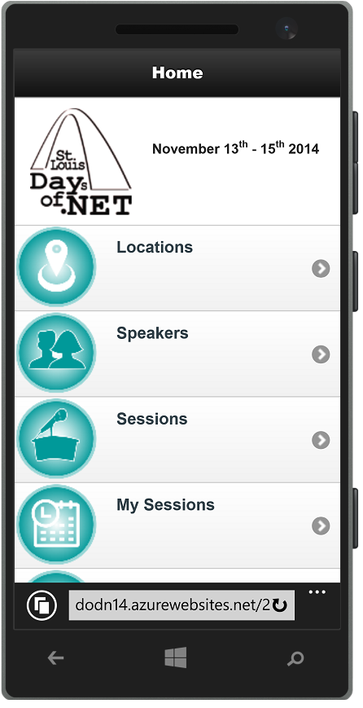
Conference Mobile App
dodn14.azurewebsites.net
Quick access to conference info
Build your custom agenda
Anonymously rate the sessions you attended
Share with the Twitter-verse

Slide 4




Fun Stuff Downstairs

Slide 5



Ondrej balas
 Husband & Father
 Microsoft MVP in C#
 Writer for Visual Studio Magazine “Code Focused”
 Owner of UseTech Design (est. 2001)
 Building software that drives business
 www.ondrejbalas.com
→ Ondrej@ondrejbalas.com
 @ondrejbalas

Slide 6


Notes:
VS plugin. Works in CE. Benefits. Drawbacks: slows down VS, but only really noticeable on older/slower machines

Slide 7
Hotkeys
If I do something that you didn’t follow – stop me

Slide 8
Hotkey Options
Visual Studio
ReSharper 2.x or IntelliJ IDEA

Slide 9
Let’s Dive In

Slide 10
Sometimes ReSharper tells you things that you don’t believe
Believe.

Slide 11
Things like
Possible multiple enumeration of IEnumerable
Function never returns
Expression is always ‘true’ or always ‘false’
Loop control variable is never changed inside loop
And hundreds more .. literally

Slide 12
Templates

Slide 13
Raffle

Slide 14
Thanks!
 tinyurl.com/obalas-resharper
 tinyurl.com/obalas-resharper-gist
 github.com/ondrejbalas
Ondrej balas
@ondrejbalas  www.ondrejbalas.com  Ondrej@ondrejbalas.com →

