Slide 1
Point Kinetics Equation model in XCOS – A little hiccup!
Author: Vikram Singh
Supervisor: Dr. Ondřej Chvála

Slide 2


What is XCOS?
Distributed with Scilab, Xcos is an efficient graphical editor to design hybrid dynamical systems models.
It is an alternative to MATLAB’s SIMULINK with similar feature sets.
It has a palette browser with pre-compiled function blocks and an editor where both discrete and continuous systems can be designed, loaded, compiled and simulated.
https://www.scilab.org/scilab/features/xcos

Slide 3
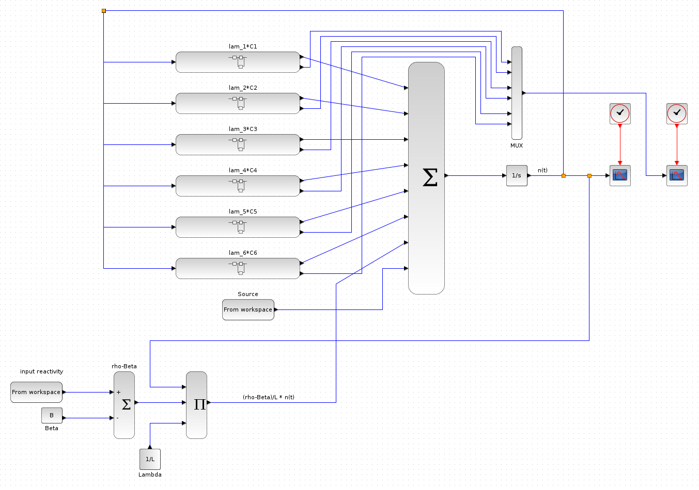
PKE Model - Explicit

Slide 4
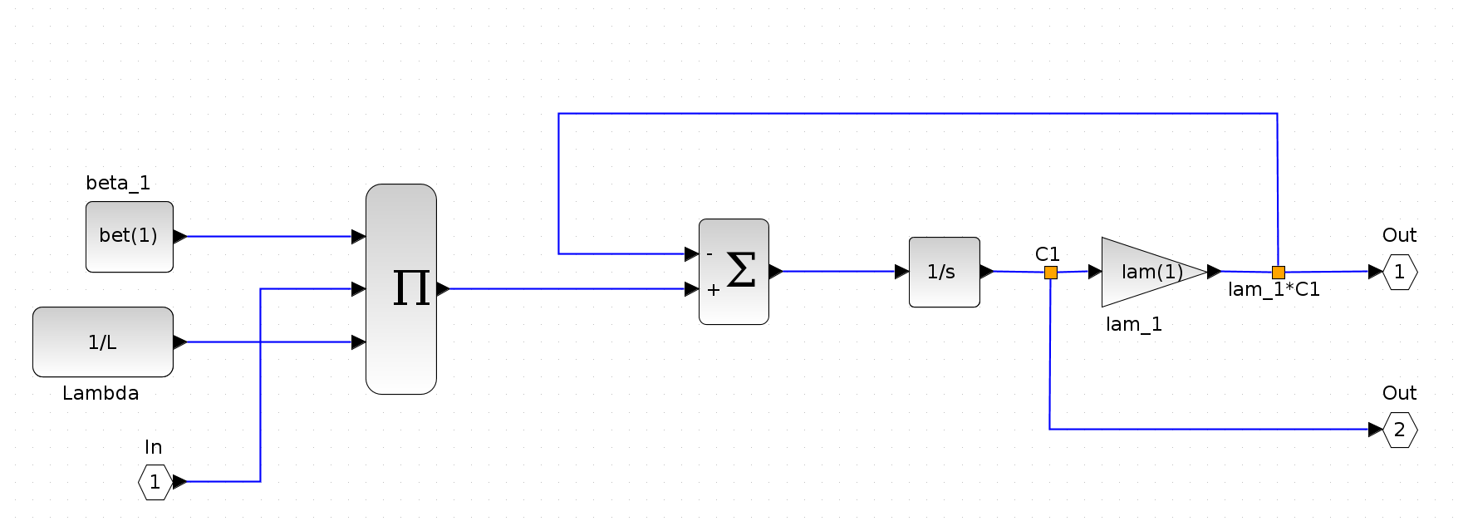
PKE C_{i}(t) Model - Explicit

Slide 5
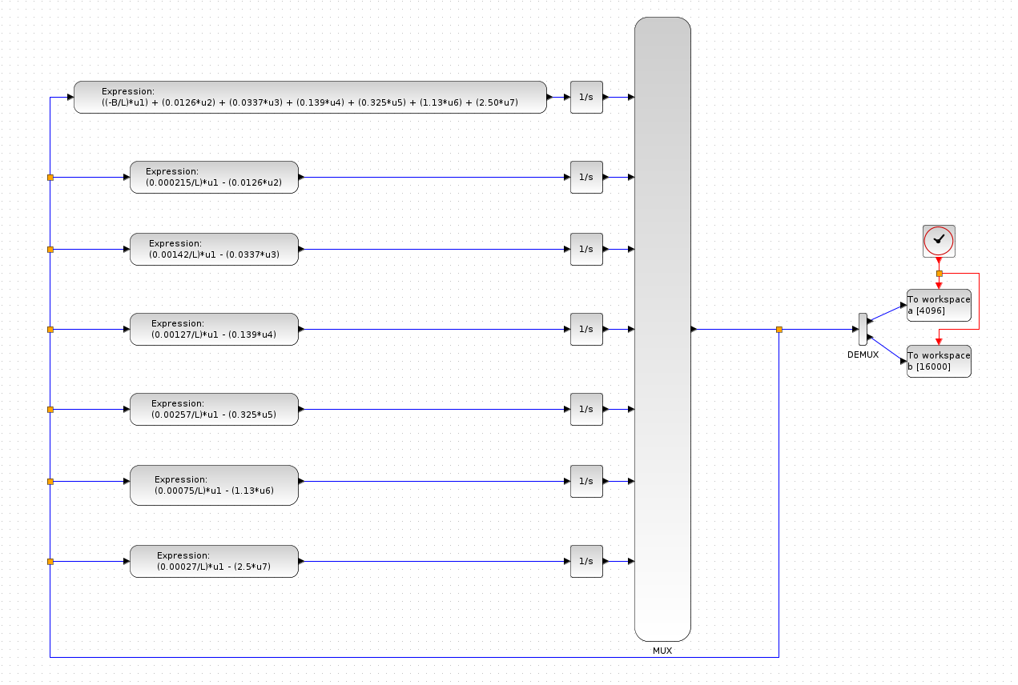
PKE Model - Interpreted

Slide 6
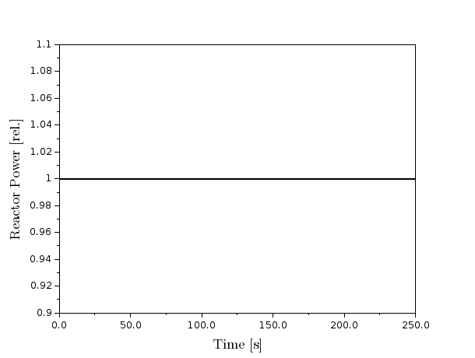
Steady State in Scilab for PKE solution using RK4 solver
For zero input reactivity the system remains at steady state. Figure shown here with the code running for 250 seconds.

Slide 7
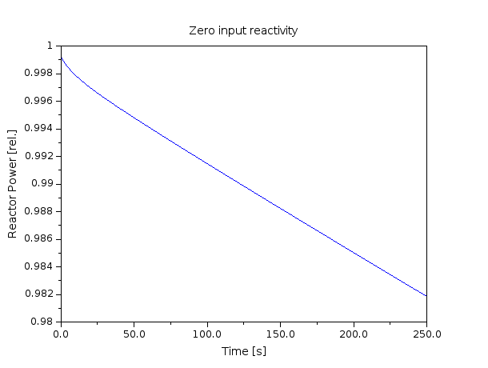
No steady state in XCOS model for PKE using RK4 solver for zero input reactivity
For zero input reactivity the system doesn’t ever reach steady state. Figure shown here with the simulation running for 250 seconds. The equations, input parameters, and initial conditions are same for both the code and graphical model.

Slide 8
Comparison with MATLAB/Simulink
We created equivalent PKE code and model in MATLAB and Simulink respectively to check if error was caused by a bug in the open-source software.
Using ODE45 in MATLAB yields steady state as seen in Scilab.
And just like XCOS, the Simulink model fails to achieve steady state using ODE45.
This means that the graphical models (using the same parameters and initial conditions) is unstable.

Slide 9
Looking for help!
Sought Matthew’s help and we recreated the problem in both XCOS and Simulink.
Posted a question on the MATLAB help forums but no responses yet.
Submitted help request to MathWorks technical support with sample code and model.
No responses yet.

Slide 10
Results
The XCOS PKE model is unstable.
Scilab code for the model works as expected.
For the same equations, parameters, and initial conditions the XCOS model fails to produce steady state.
The error is also seen when implementing the code and model in proprietary MATLAB/Simulink.
You can see the code and keep up with the progress at: https://github.com/viikraam/MSRdynamics

Slide 11
Future work
Find solution to the error in the XCOS and Simulink graphical implementations.
As before, the next step is to add fuel transit delay terms in the XCOS model.
Implement reactivity feedback terms and additional thermodynamics.

