Slide 1
Point Kinetics Equation model in XCOS
Author: Vikram Singh
Supervisor: Dr. Ondřej Chvála

Slide 2


What is Scilab?
High-level, numerically oriented, interpreted programming language like MATLAB, developed and distributed by Scilab Enterprises
Matrix based computation and automatic memory management make scientific programming easy and reduce lines of code
Scilab is open source and has great cross-platform support.
It also includes Xcos, an alternative to SIMULINK, for modeling dynamical systems.
http://www.scilab.org/

Slide 3
The Point Kinetics Equations
Describe time evolution of overall neutron population in the core – no spatial dependence.
Set of seven stiff, non-linear, coupled first-order differential equations for neutron density and delayed neutron precursor concentrations
n(t) is neutron population at time t
C_{i}(t) is concentration of i^{th} precursor group
λ_{i} is radioactive decay constant of i^{th} group
Λ is mean neutron generation time
β_{i} is delayed-neutron fraction of i^{th} group
β is the total delayed-neutron fraction
ρ is external reactivity
S(t) is external neutron source

Slide 4
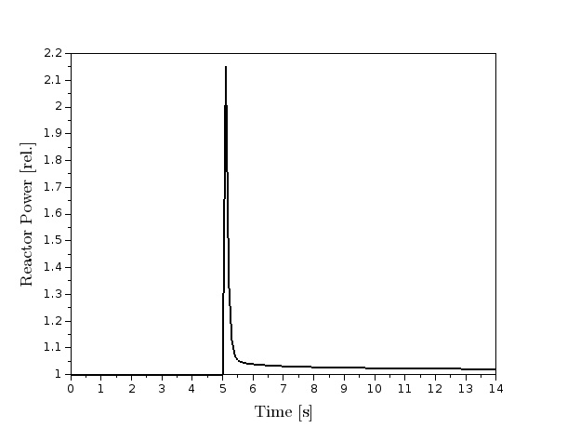
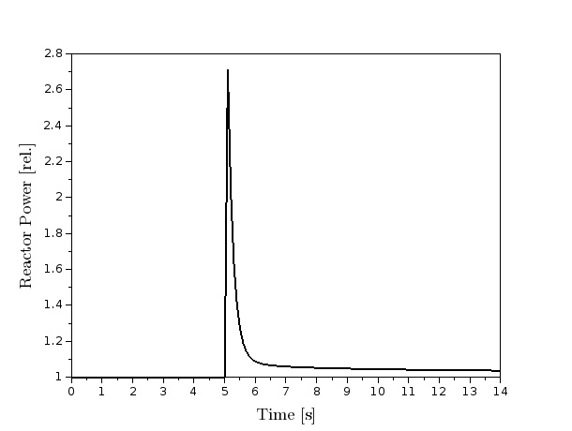
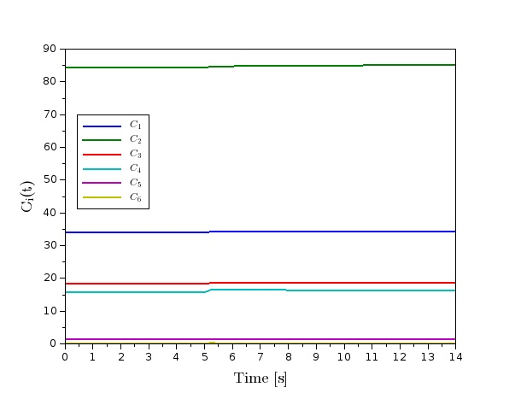
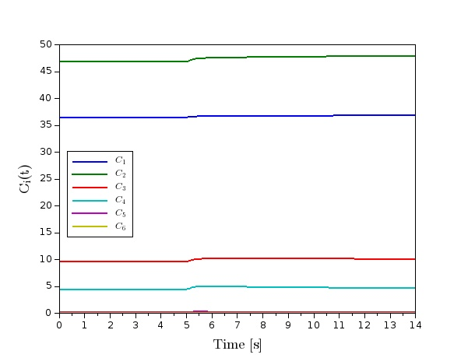
U 235
β = 0.64%
Pulse
ρ = 600pcm
for 0.1 s
U 233
β = 0.25%
U233 fueled reactor responds faster due to lower delayed neutron fraction

Slide 5
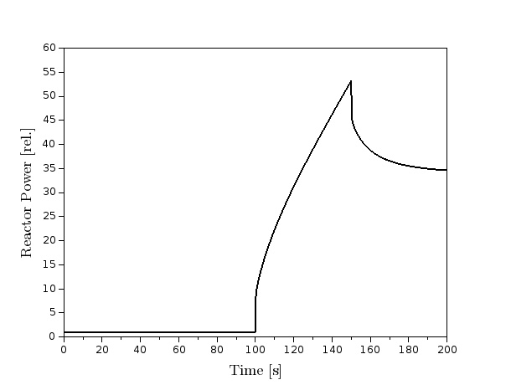
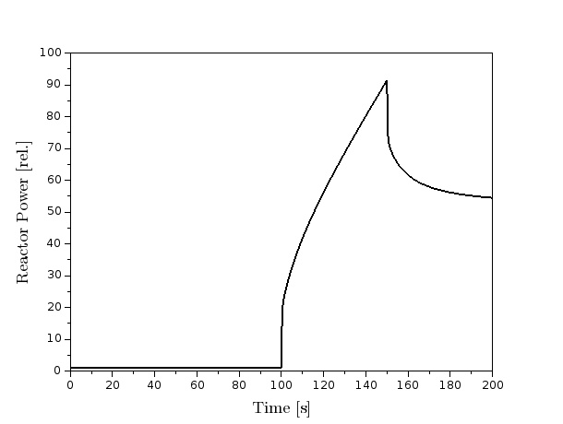
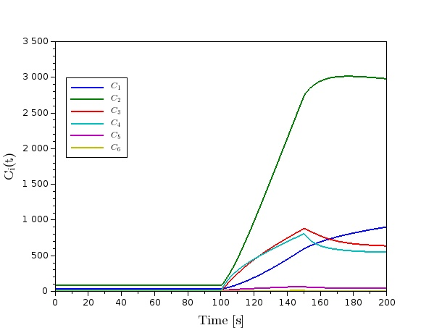
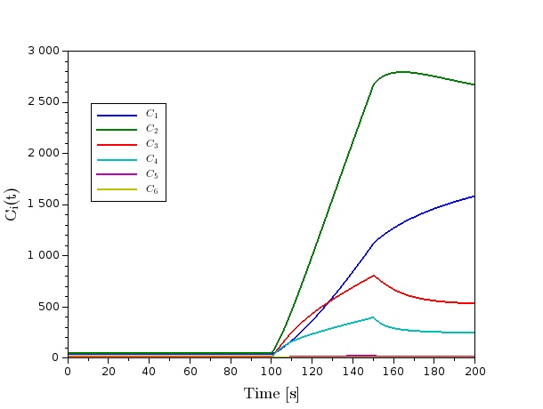
U 235
β = 0.64%
Source
Insertion
100 n/s
U 233
β = 0.25%
Again, U233 fueled reactor responds faster than U235 as seen on y-axis

Slide 6
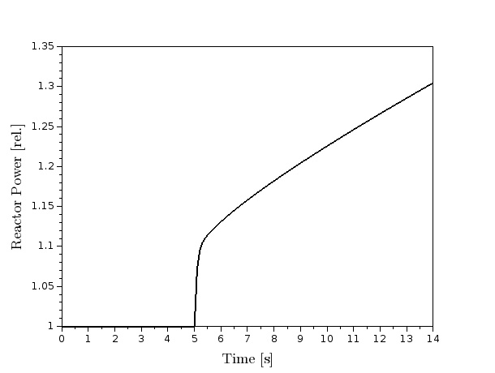
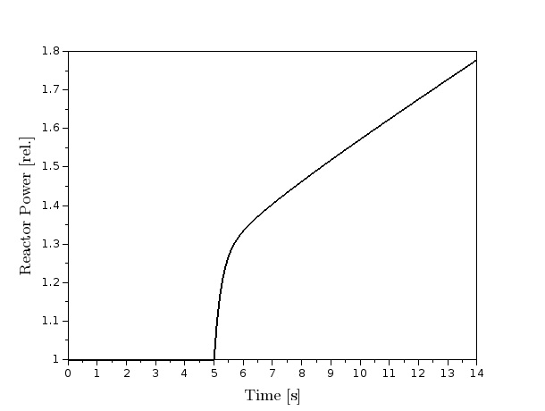
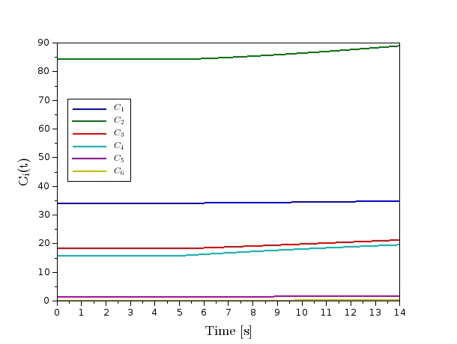
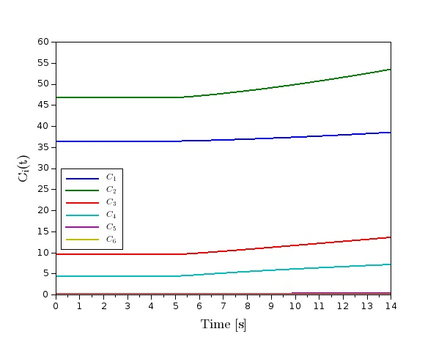
U 235
β = 0.64%
Step Up
ρ = 60pcm
U 233
β = 0.25%

Slide 7
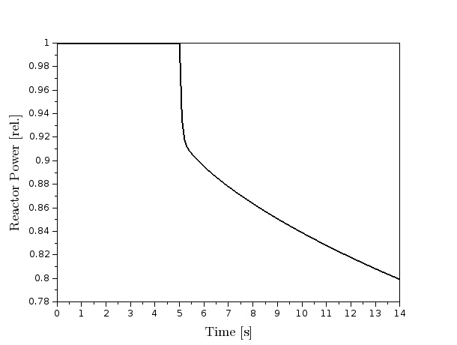
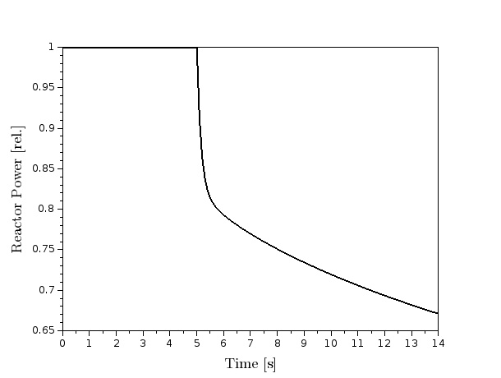
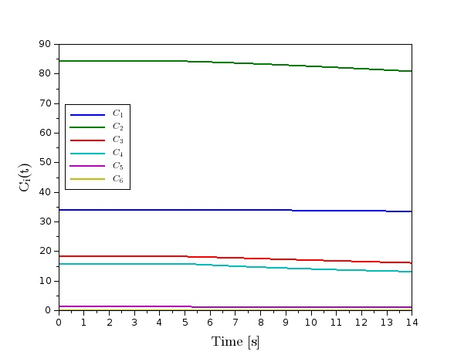
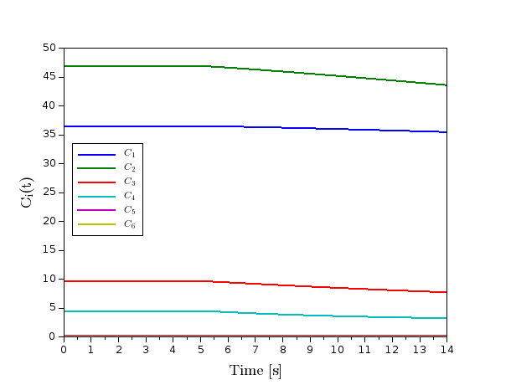
U 235
β = 0.64%
Step Down
ρ = -60pcm
U 233
β = 0.25%

Slide 8
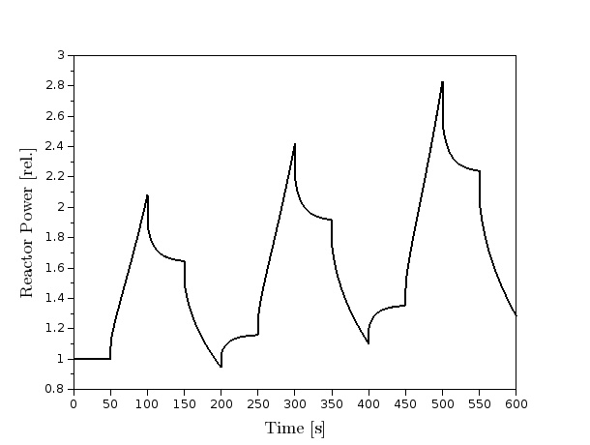
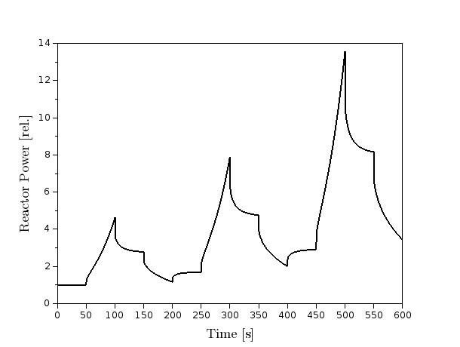
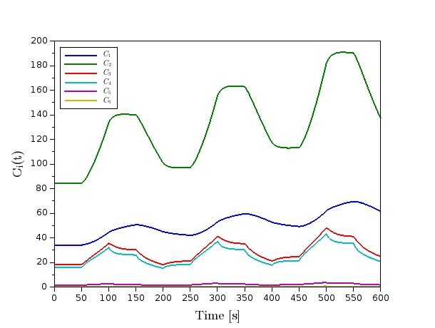
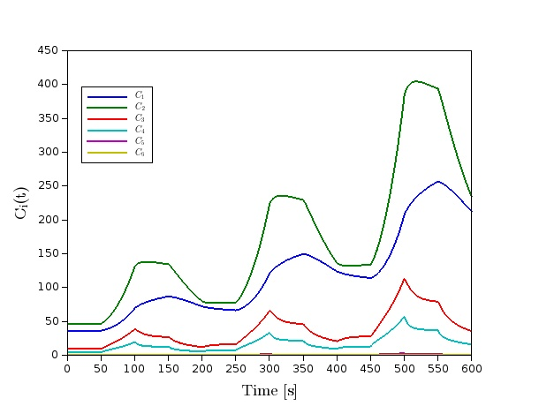
U 235
β = 0.64%
Periodic
ρ = ±60pcm
U 233
β = 0.25%

Slide 9
What is XCOS?
Distributed with Scilab, Xcos is an efficient graphical editor to design hybrid dynamical systems models.
It is an alternative to MATLAB’s SIMULINK with similar feature sets.
It has a palette browser with pre-compiled function blocks and an editor where both discrete and continuous systems can be designed, loaded, compiled and simulated.
https://www.scilab.org/scilab/features/xcos

Slide 10
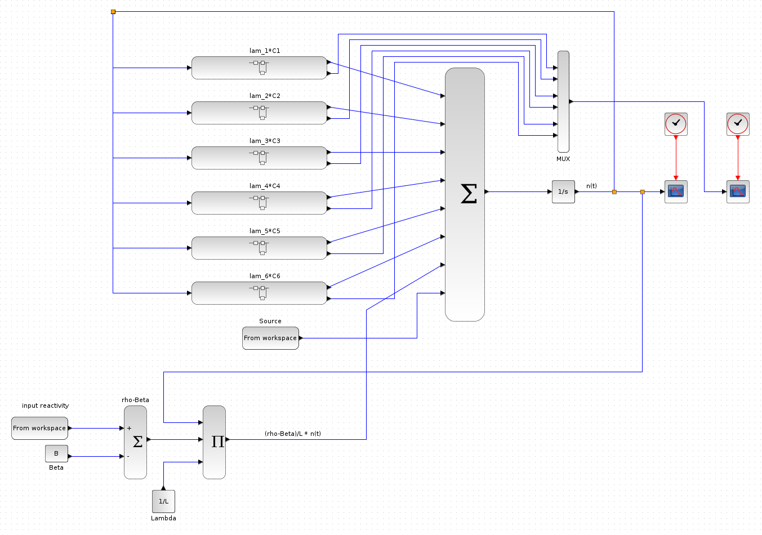
PKE Model

Slide 11
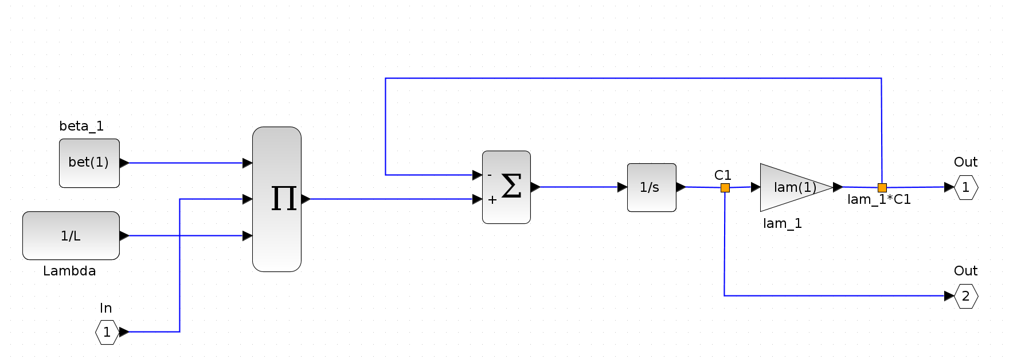
PKE C_{i}(t) Model

Slide 12
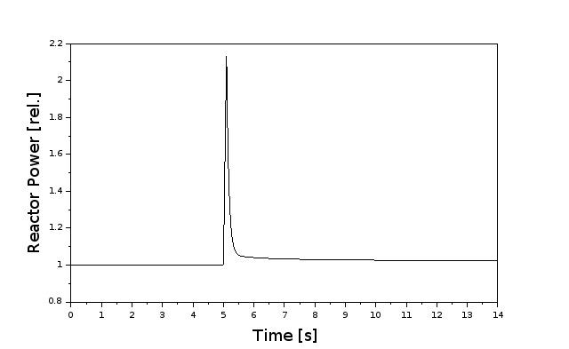
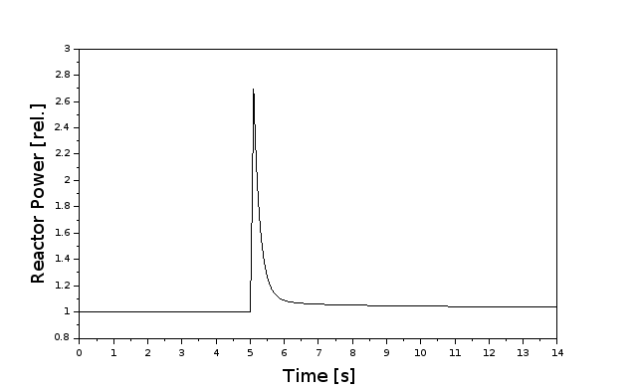
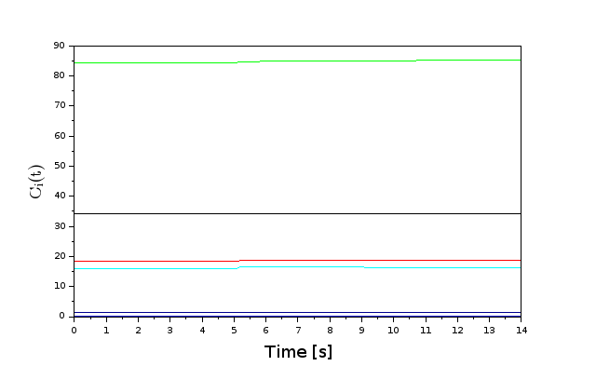
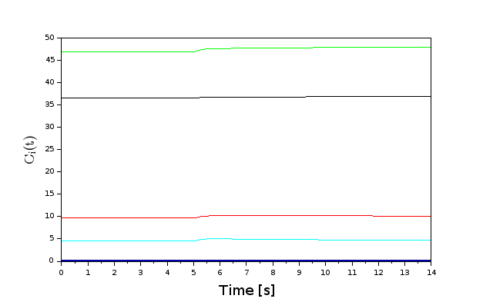
U 235
β = 0.64%
Pulse
ρ = 600pcm
for 0.1 s
U 233
β = 0.25%
U233 fueled reactor responds faster due to lower delayed neutron fraction

Slide 13
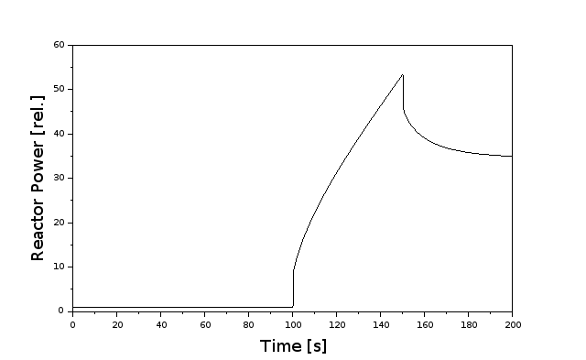
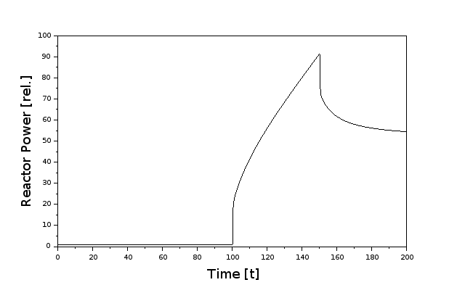
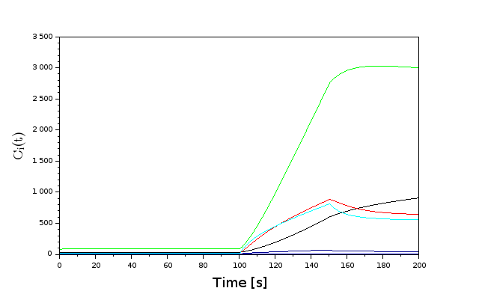
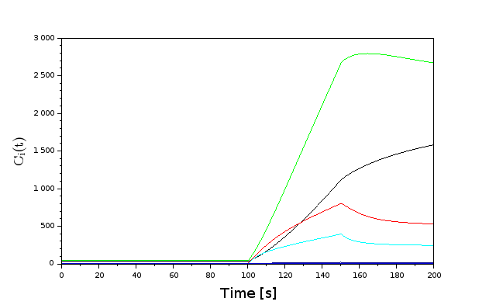
U 235
β = 0.64%
Source
Insertion
100 n/s
U 233
β = 0.25%
Again, U233 fueled reactor responds faster than U235 as seen on y-axis

Slide 14
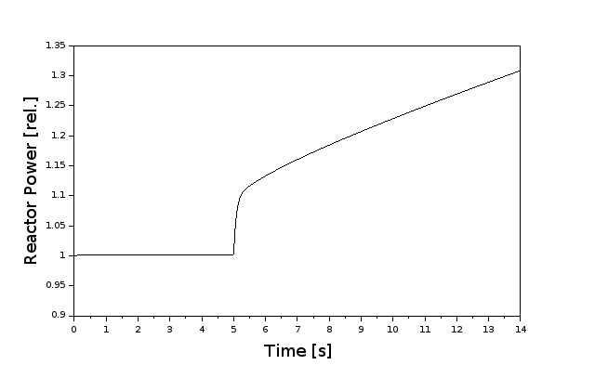
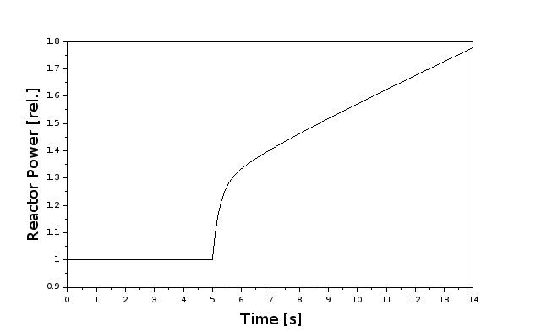
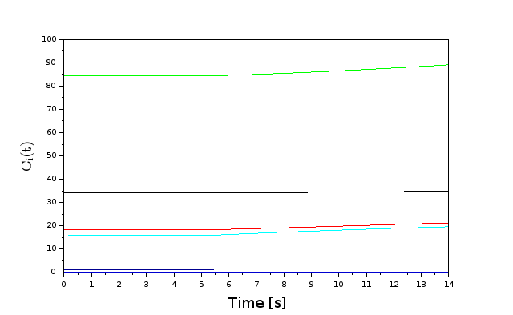
U 235
β = 0.64%
Step Up
ρ = 60pcm
U 233
β = 0.25%

Slide 15
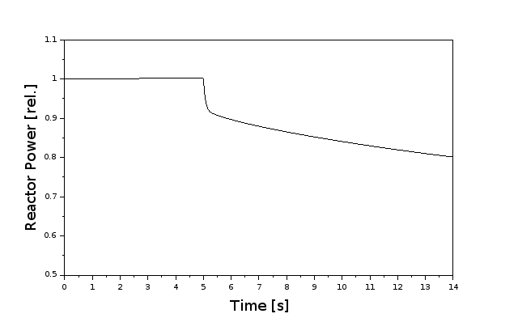
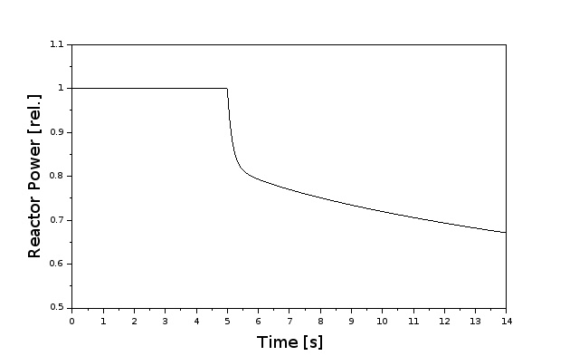
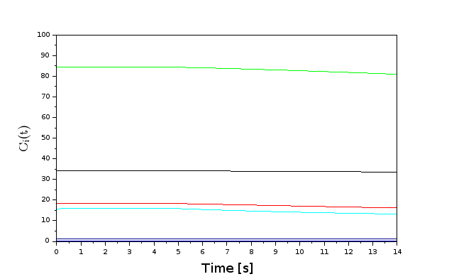
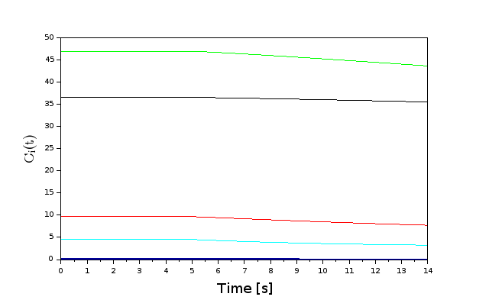
U 235
β = 0.64%
Step Down
ρ = -60pcm
U 233
β = 0.25%

Slide 16
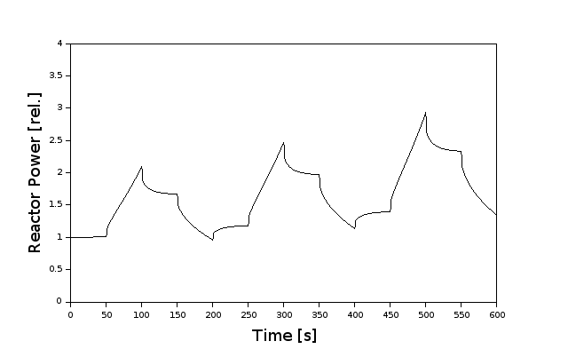
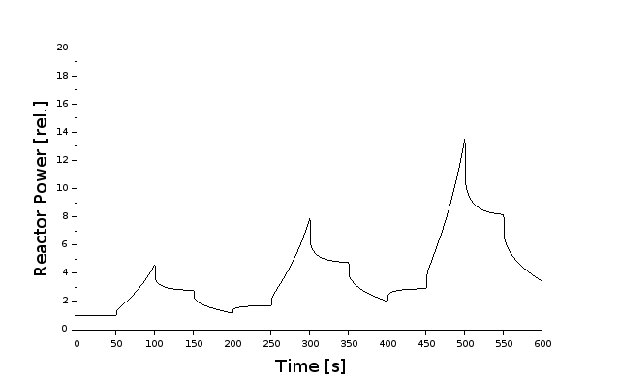
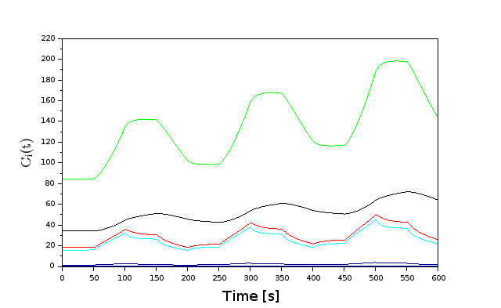
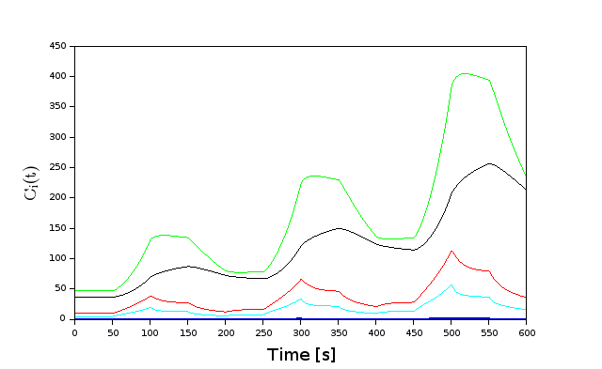
U 235
β = 0.64%
Periodic
ρ = ±60pcm
U 233
β = 0.25%

Slide 17
Comparison with Octave
Scilab and XCOS use the same inbuilt ODE solvers with wide variety of integration methods. For our solution we chose 4th order Runge-Kutta.
The ‘odepkg’ community developed package for Octave brings well-known MATLAB solvers to Octave. In our solutions for the general PKE we used ODE45 4th order RK solver.
When a constant-step time vector is passed to the solvers, the computation times are similar.
This does not compromise the accuracy of the solvers.
We compared the Scilab and Octave results for the different cases by computing the percent difference between the solutions.
i.e.,

Slide 18
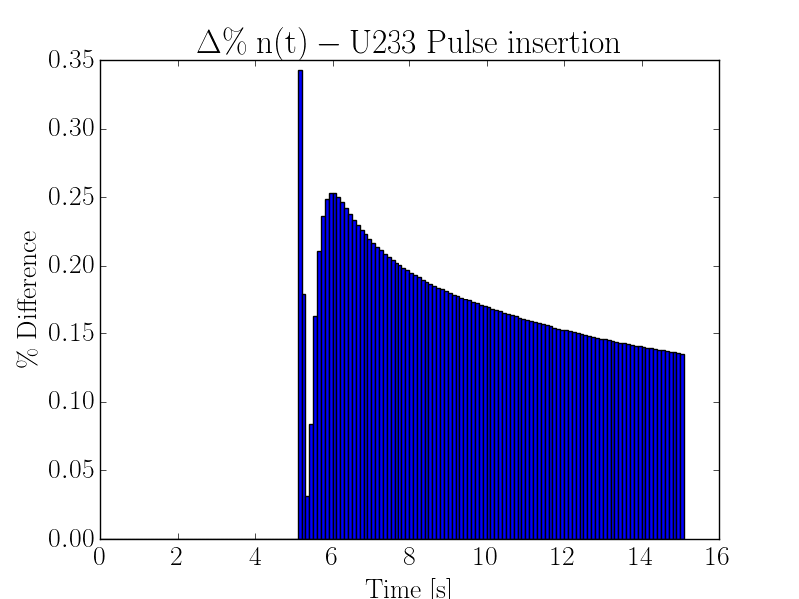
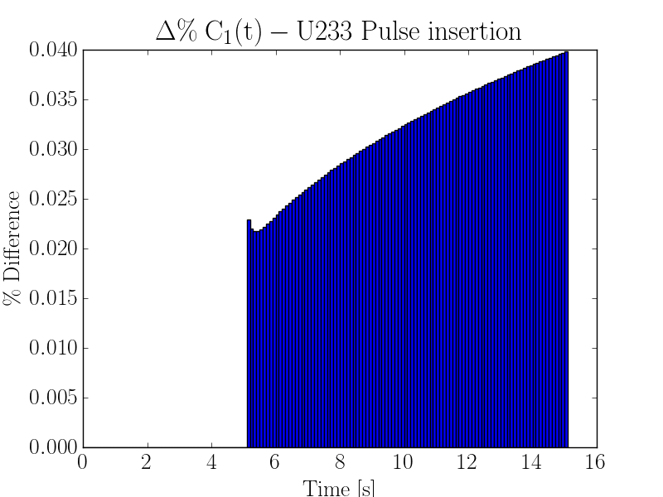
Pulse
ρ = 600pcm
for 0.1 s
The difference is well within 1% for the neutron change (relative power change) and under 0.1% for the longest living delayed neutron precursor.

Slide 19
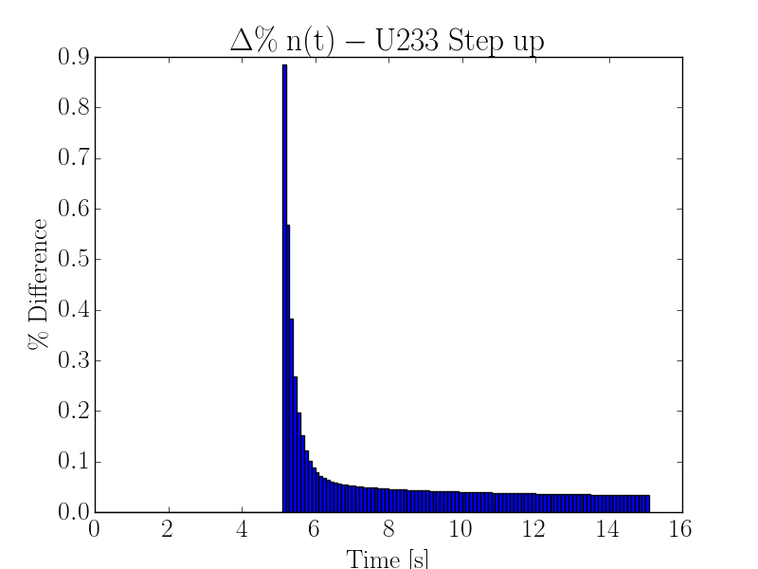
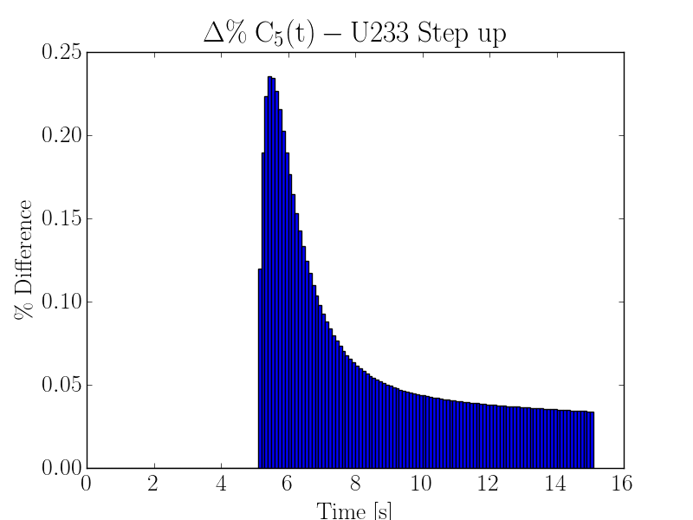
Step Up
ρ = 60pcm
Largest difference at prompt jump, but difference is again under 1%.

Slide 20
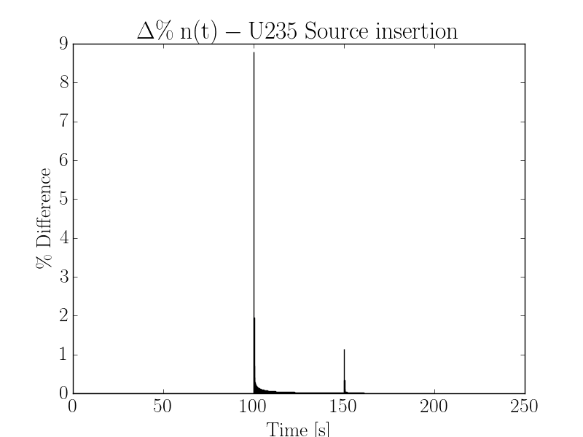
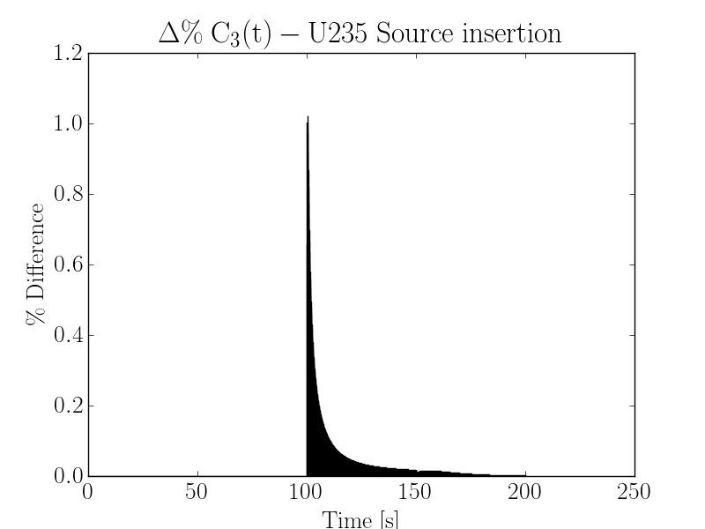
Source
Insertion
100 n/s
The difference is highest at the prompt jumps but soon fall to within 1%

Slide 21
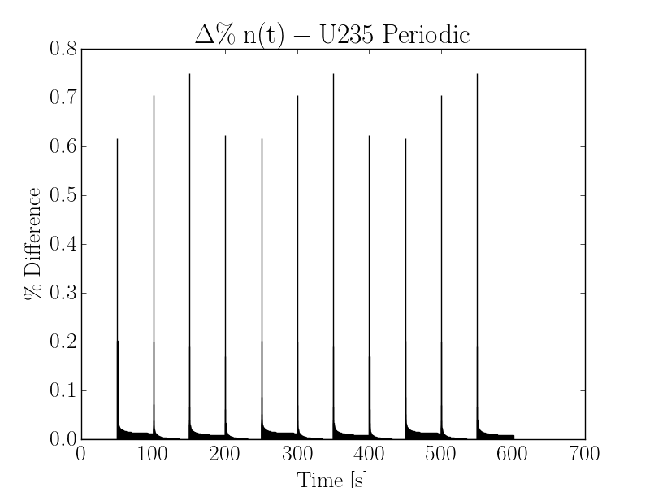
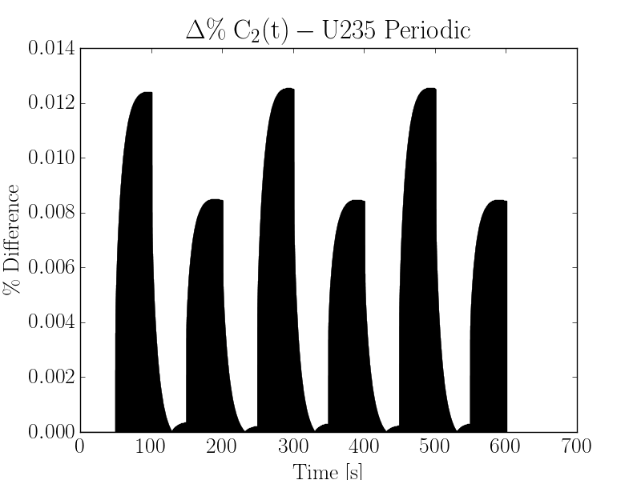
Periodic
ρ = ±60pcm
Again, the difference is highest at the prompt jumps but soon fall to within 0.1% for both cases, indicating that the solutions are in good agreement.

Slide 22
Results
The XCOS PKE model works as expected.
Cases shown correspond to typical textbook examples, but the code can model any ρ(t) and S(t) scenario.
The Scilab and Octave results are in good general agreement.
You can see the code and keep up with the progress at: https://github.com/viikraam/MSRdynamics

Slide 23
Future work
Implement fuel transit delay terms in the XCOS model.
Compare XCOS results with the previous results obtained in Octave for the delayed PKE.
Implement reactivity feedback terms in the model.

