Slide 1



Own CLI tooling in Go
Ondřej Šika
Freelance & SikaLabs s.r.o.
ondrej@sika.io
@ondrejsika
Gophercamp 2025
Brno, 25. 4. 2025

Slide 2

Ondřej Šika
DevOps {Engineer, Consultant, Trainer}
Founder and CEO
of the DevOps company SikaLabs.
I build and run infrastructures on Kubernetes, open-source and cloud native tools.
And I do DevOps trainings about it.

Slide 3
Own CLI Tool. Why?
Notes:
DAVID

Slide 4
Simplify repetitive tasks
We are lazy so we want to make our work easier
Notes:
DAVID

Slide 5
Our example use cases
Working with Kubernetes
CLI shortcuts and aliases
Code generation during development
Generating data for testing
Automatic commit messages
... and more
Notes:
DAVID

Slide 6
Solution?
Notes:
DAVID

Slide 7
Shell Scripts 🎉
Notes:
DAVID

Slide 8
Shell Scripts 😔
Notes:
DAVID

Slide 9
Shell Scripts
Write once, run forever
Shell works everywhere
Easy to write
All scripts in one Git repo
Notes:
DAVID

Slide 10
But …
Notes:
DAVID

Slide 11
But ...
Is Shell, Bash or ZSH really available everywhere?
Are they truly easy to write? if it's more than chain of few command
What about distribution without Git?
Or without internet?
Notes:
DAVID

Slide 12
Another solution?
Notes:
DAVID

Slide 13
Python 🎉
Notes:
DAVID

Slide 14
Python 😔
Notes:
DAVID

Slide 15
Python solves one problem but makes others worse
Notes:
DAVID

Slide 16
Pros
Easier and faster development than SH/BASH
Use of libraries, working with APIs, SDKs...
Notes:
DAVID

Slide 17
Cons
Python isn’t available everywhere
Different versions of Python, 2 vs 3
Dependency management isn't ideal (e.g., virtualenv...)
Still not a single binary for distribution
Notes:
DAVID

Slide 18
… solution?
Notes:
DAVID

Slide 19




easy to run
easy to write
Notes:
DAVID

Slide 20
Let's use Go 🎉🎉🎉
Notes:
DAVID

Slide 21

Why CLI Tool in Go?
Statically linked binaries
Easy development in Go (even for beginners)
Simple distribution (brew, curl | sh, winget, ...)
Tooling
  Goreleaser
  Cobra
  Viper
Notes:
DAVID

Slide 22
Statically Linked Binaries
Notes:
DAVID

Slide 23
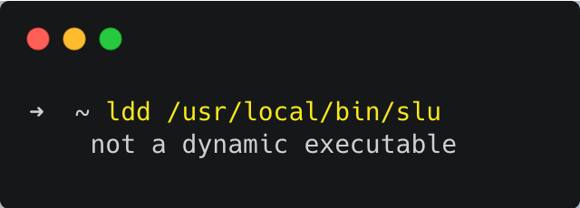
Notes:
DAVID

Slide 24
Statically Linked Binaries
Self contained executable, no external dependencies
Very easy to build statically linked binaries
CGO_ENABLED=0 go build
Binary for every platform and architecture:
  Linux, Mac, Windows, …
  amd64, arm64, …
Notes:
DAVID

Slide 25

Goreleaser
Notes:
DAVID

Slide 26
Goreleaser
Build binaries (for all platforms)
Build & push Docker image
Upload binaries to GitHub/Gitlab
Create Brew and Scoop packages
Notes:
DAVID

Slide 27
Go Binary Distribution
Thanks to Goreleaser, distribution is very easy:
brew install my-org/tap/my-cli-tool
curl -fsSL https://…/my-cli-tool/master/install.sh | sh
winget install -e --id my-org.my-cli-tool
scoop install https://…/scoop-bucket/master/my-cli-tool.json
Notes:
DAVID

Slide 28
Cobra & Viper
Notes:
DAVID

Slide 29
Cobra
Great library for writing CLI tools
Used by most CLI tools: Docker, Kubernetes, Helm, ArgoCD, ...
Very easy and pleasant to use
Automatically generates completions
BASH, ZSH, PowerShell, Fish
Generates documentation
Notes:
DAVID

Slide 30
Viper
Library for config files and ENV variables
setting defaults
reading from JSON, TOML, YAML, …
reading from environment variables
reading from remote config systems (etcd or Consul)
Notes:
DAVID

Slide 31
Completion
Supports: BASH, ZSH, FISH a PowerShell
Source in current shell
. <(my-cli-tool completion bash)
Add to .bashrc
echo ". <(my-cli-tool completion bash)" >> ~/.bashrc
Notes:
DAVID

Slide 32
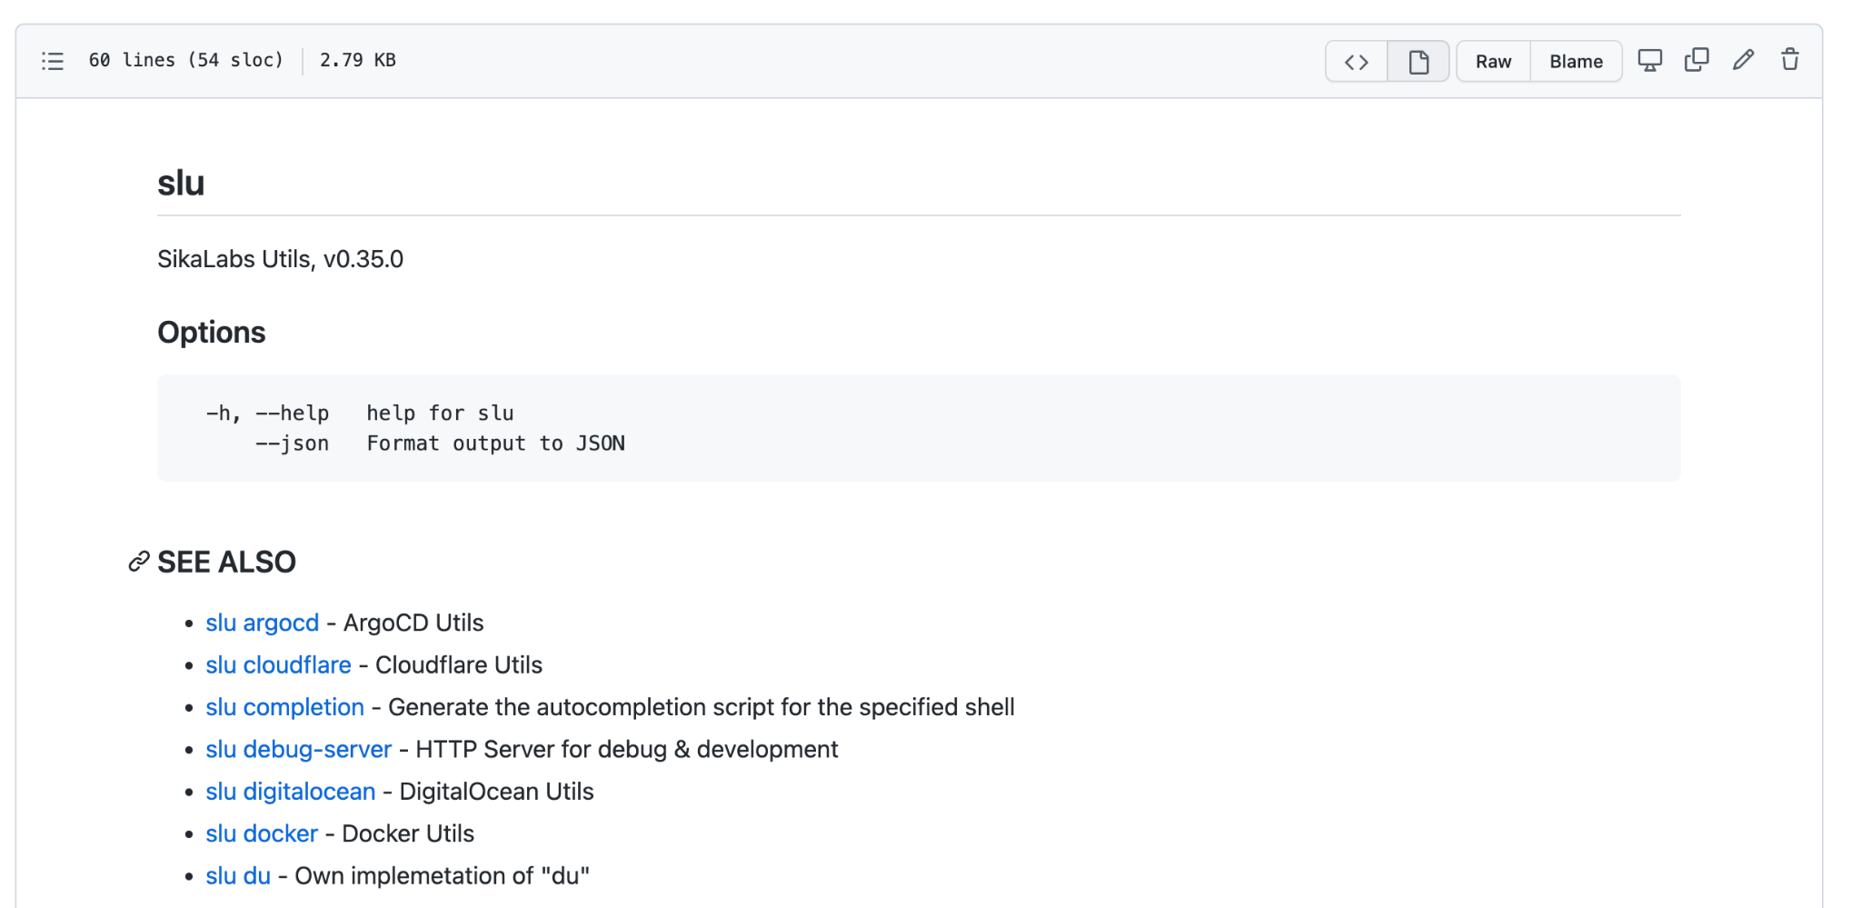
Generated Documentation
Notes:
DAVID

Slide 33
Our CLI Tools in Go
Notes:
DAVID

Slide 34
My CLI Tools in Go
slu - various utilities that might be useful (SikaLabs Utils)
training-cli - tool to simplify training preparation
tergum - Backup tool
gobble - alternative to Ansible
Notes:
DAVID

Slide 35
github.com/sikalabs/slu
Notes:
DAVID

Slide 36
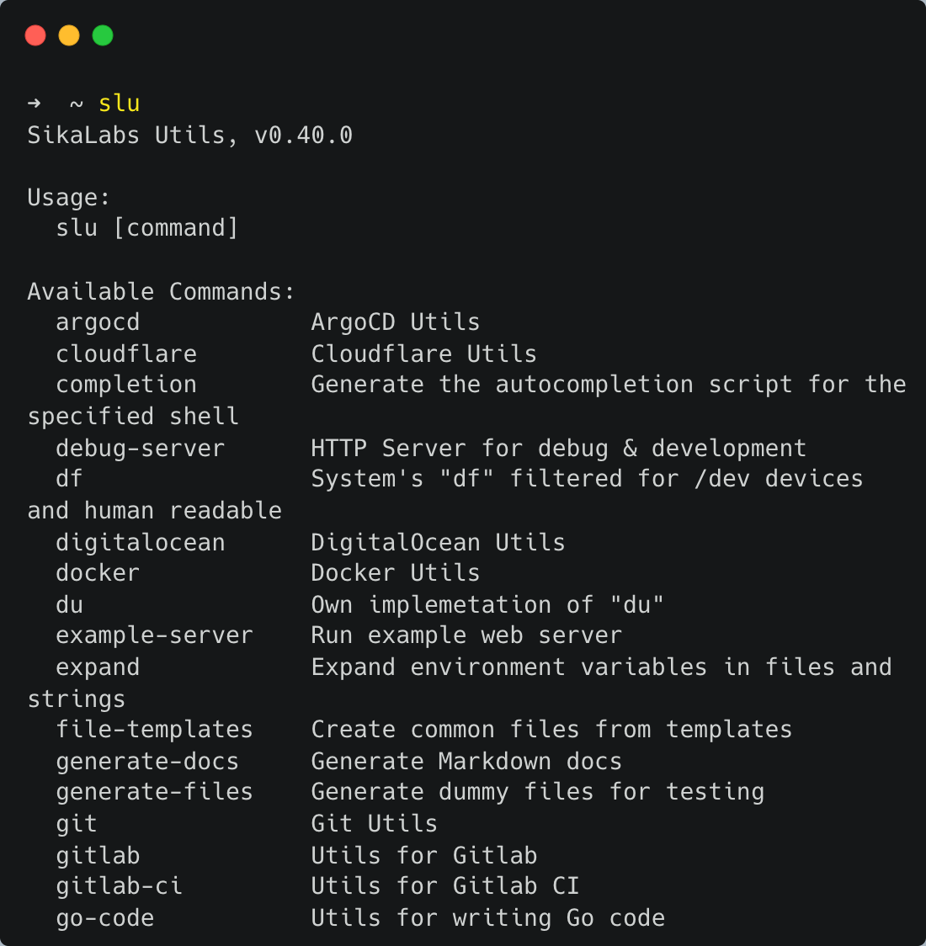
Notes:
DAVID

Slide 37
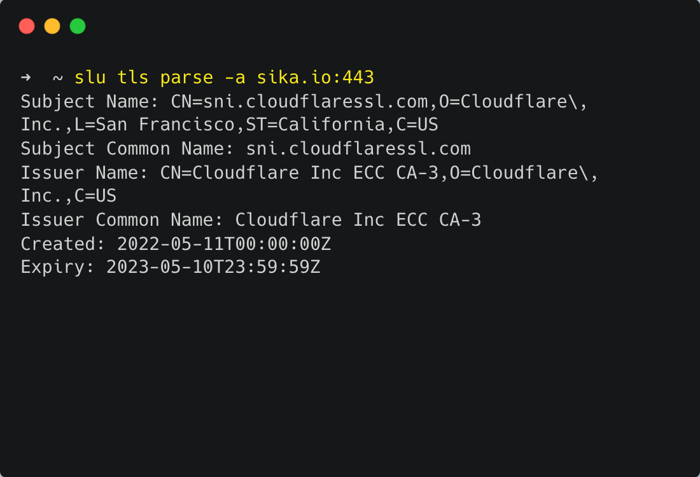
Notes:
DAVID

Slide 38
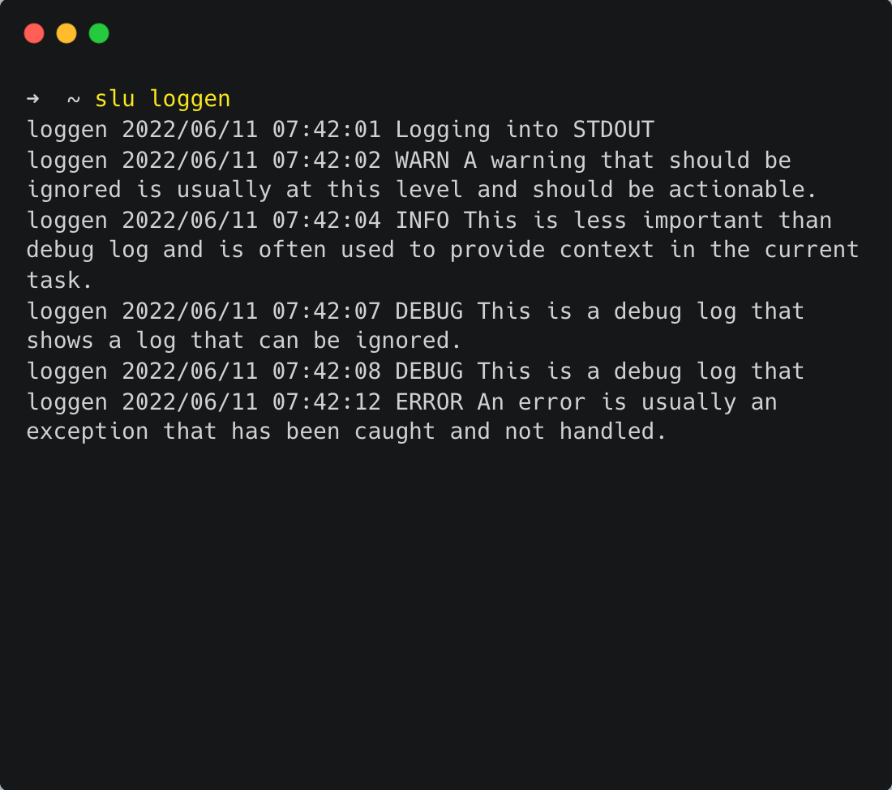
Notes:
DAVID

Slide 39
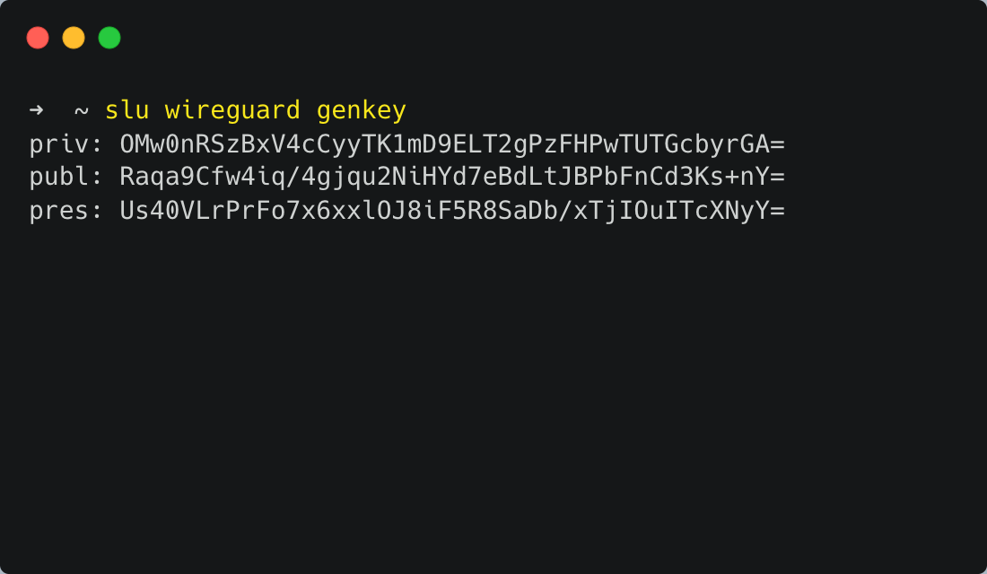
Notes:
DAVID

Slide 40
github.com/ondrejsika/training-cli
Notes:
DAVID

Slide 41
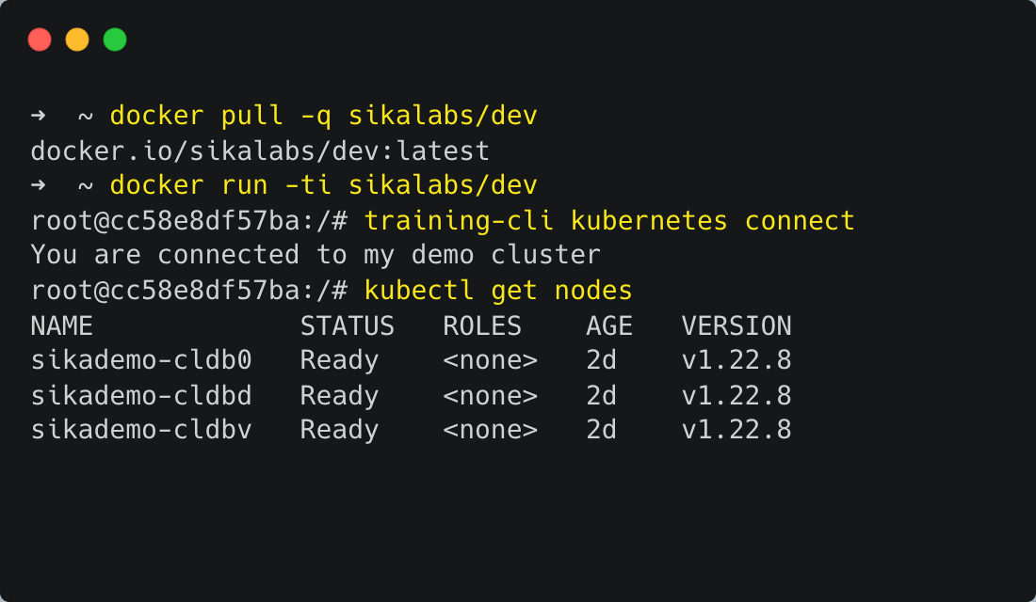
Notes:
DAVID

Slide 42
LIVE DEMO TIME

Slide 43
Summary
CLI tools in Go are great – proven in practice
Easy to use and distribute
Simple and fast to develop

Slide 44
Thank you for your attention.

Slide 45
Email ondrej@sika.io
Twitter
@ondrejsika
LinkedIn
/in/ondrejsika
Slides
sika.link/slides

