Slide 1
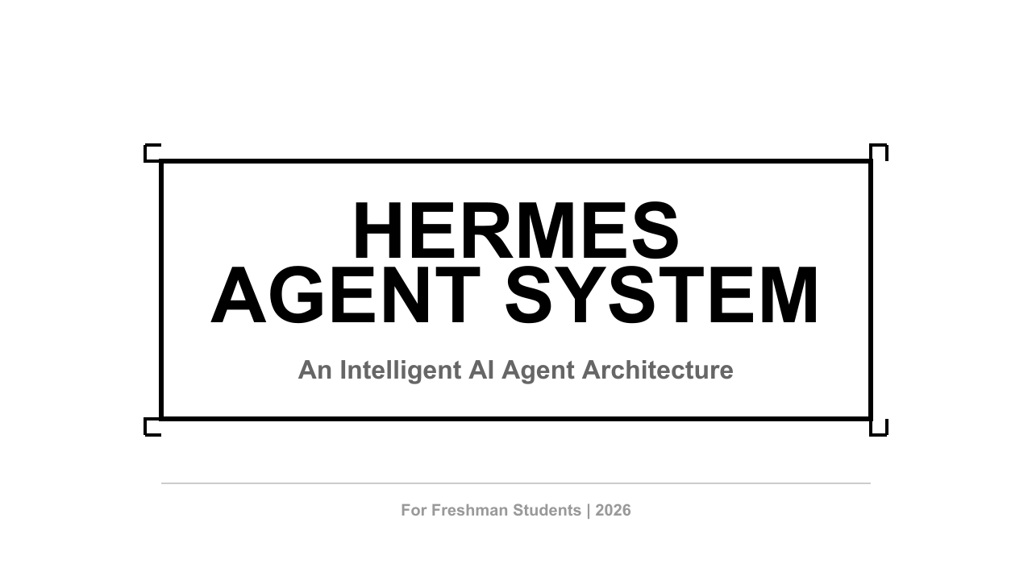
Notes:
Welcome everyone. Today we're going to explore Hermes Agent System — an intelligent AI agent architecture that goes far beyond what you might know as chatbots. This is a system designed to think, act, and learn like a human assistant.

Slide 2
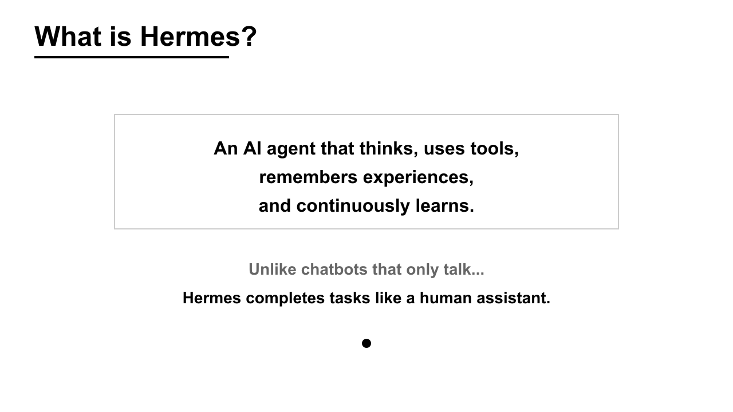
Notes:
So what exactly is Hermes? At its core, Hermes is an AI agent that thinks, uses tools, remembers experiences, and continuously learns. This is fundamentally different from the chatbots you might be familiar with. While chatbots can answer questions and have conversations, Hermes actually completes tasks — like a human assistant would. It doesn't just talk about doing things; it actually does them.

Slide 3
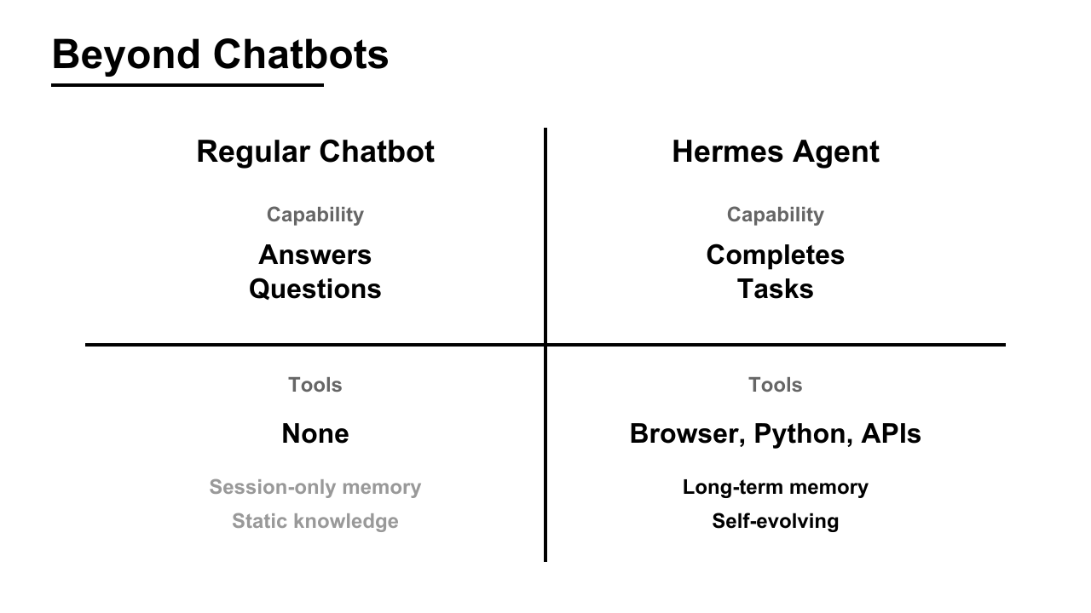
Notes:
Let's break down the key differences between a regular chatbot and Hermes Agent. A regular chatbot's capability is limited to answering questions. Hermes, on the other hand, completes tasks. When it comes to tools, chatbots have none — they're just language models responding to text. Hermes has access to browsers, Python environments, APIs, and file systems. Memory-wise, chatbots only remember what happened in the current session. Hermes has long-term memory that persists across sessions. And finally, chatbots are static — they don't improve over time. Hermes is self-evolving, learning from every interaction.

Slide 4
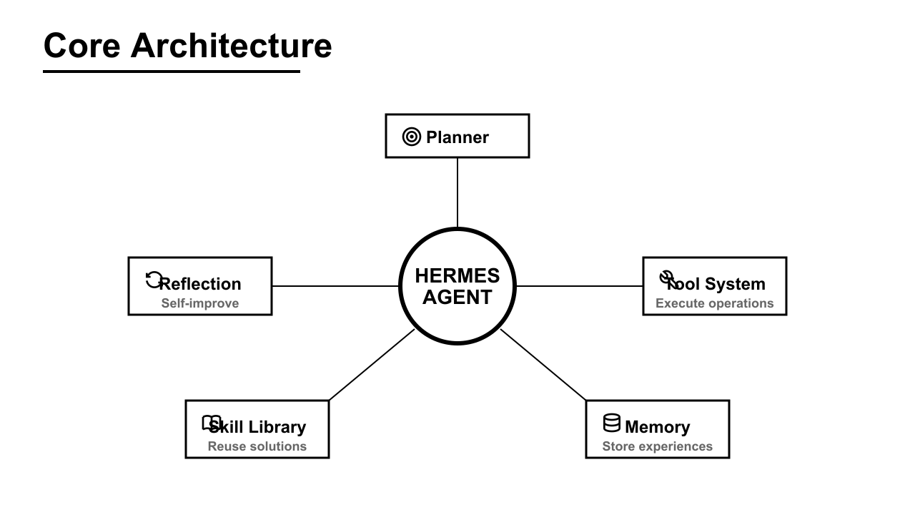
Notes:
Now let's look under the hood. Hermes is built on five core modules working together. At the center is the Hermes Agent itself, coordinating everything. The Planner module breaks down complex tasks into executable steps. The Tool System executes operations — running code, searching the web, reading files, calling APIs. The Memory module stores experiences and successful patterns for future use. The Skill Library accumulates reusable solutions, so Hermes doesn't have to solve the same problem twice. And the Reflection module enables self-improvement, analyzing what worked and what didn't. These five modules work in harmony to create an intelligent, adaptive system.

Slide 5
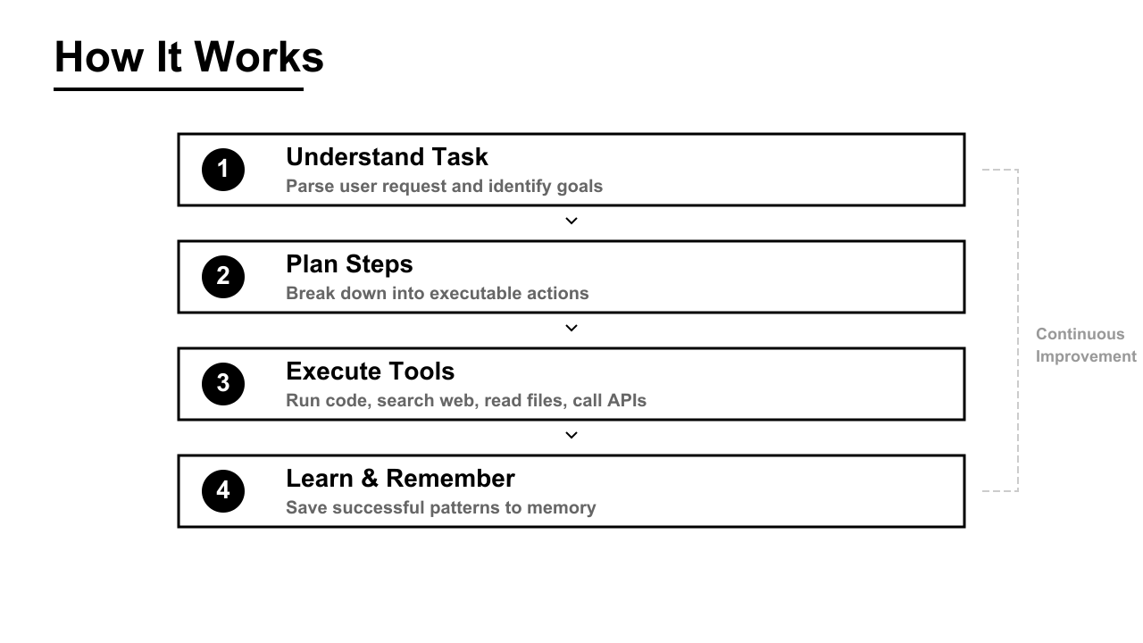
Notes:
Let's walk through how Hermes actually works when you give it a task. Step one: Understand Task. Hermes parses your request and identifies the goals. Step two: Plan Steps. It breaks down the task into executable actions. Step three: Execute Tools. This is where the real work happens — running code, searching the web, reading files, calling APIs. Step four: Learn and Remember. After completing the task, Hermes saves successful patterns to memory. And here's the key — this isn't a one-time process. There's a continuous improvement loop. Every task makes Hermes smarter for the next one.

Slide 6
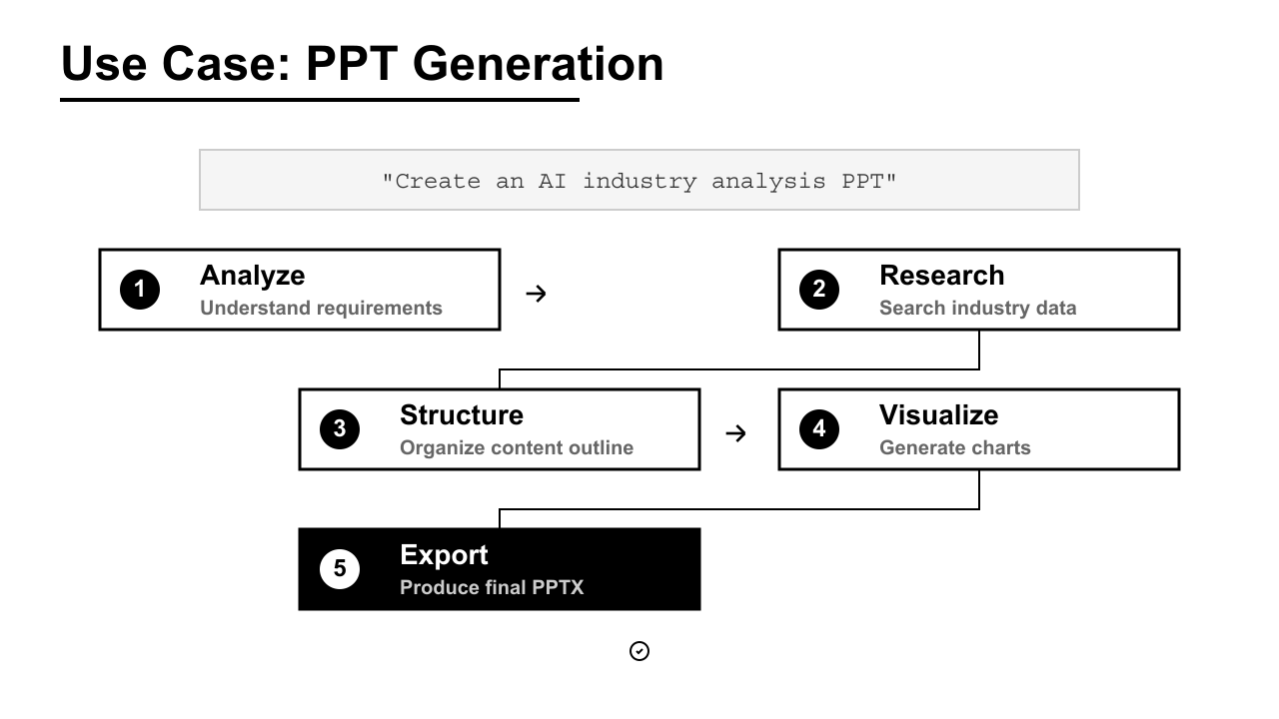
Notes:
Let's look at a real-world example. Imagine you ask Hermes: "Create an AI industry analysis PPT." Here's what happens. First, Hermes analyzes your request to understand the requirements. Second, it researches — searching for industry data, trends, and statistics. Third, it structures the content into a logical outline. Fourth, it visualizes the data by generating charts and diagrams. And finally, it exports the complete PPTX file, ready for you to present. This entire workflow — from understanding your request to delivering a finished presentation — happens automatically. That's the power of an agent system.

Slide 7
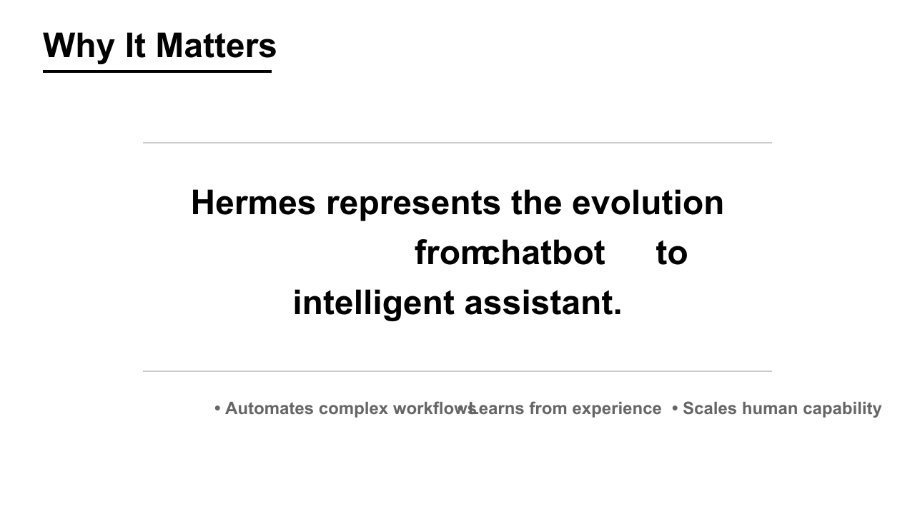
Notes:
So why does this matter? Hermes represents the evolution from chatbot to intelligent assistant. It's not just about answering questions anymore. Hermes automates complex workflows that would take humans hours or days. It learns from experience, getting better with every task. And most importantly, it scales human capability — allowing you to accomplish more than you could alone. This is the future of human-AI collaboration.

Slide 8
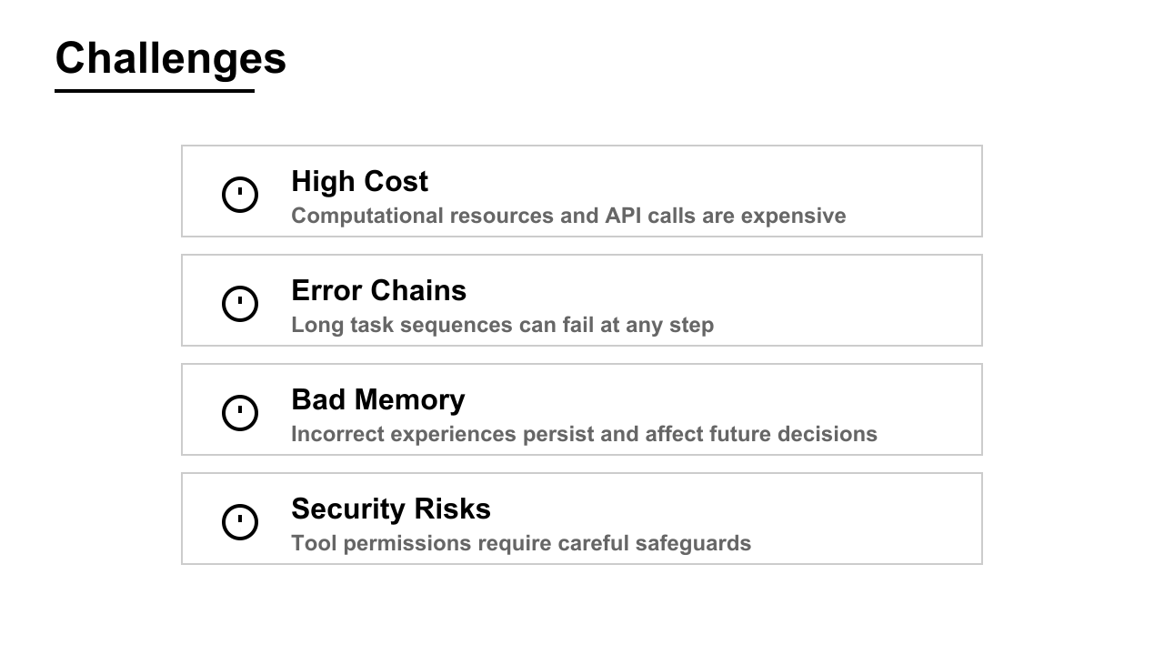
Notes:
Of course, no technology is perfect. Hermes faces several challenges. First, high cost. Computational resources and API calls are expensive, especially for complex tasks. Second, error chains. Because tasks involve multiple steps, a failure at any point can derail the entire workflow. Third, bad memory. If Hermes learns from an incorrect experience, that bad pattern persists and affects future decisions. And fourth, security risks. Giving an AI system access to tools and files requires careful safeguards to prevent misuse. These are active areas of research and development.

Slide 9
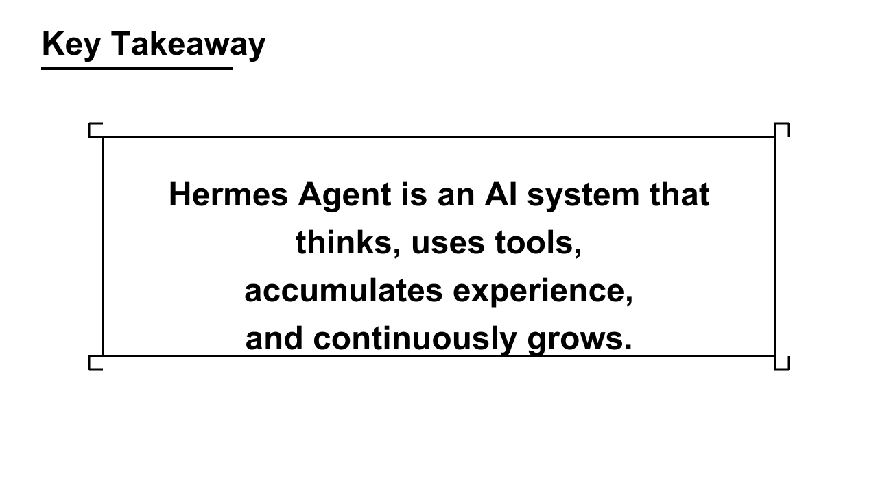
Notes:
Let me leave you with the key takeaway. Hermes Agent is an AI system that thinks, uses tools, accumulates experience, and continuously grows. It's not just a language model — it's an intelligent assistant that can complete real-world tasks. This is the next generation of AI.

Slide 10

Notes:
Thank you for your attention. I'd be happy to answer any questions you have about Hermes Agent System.

