Slide 1
justify-content: space-between;

Slide 2
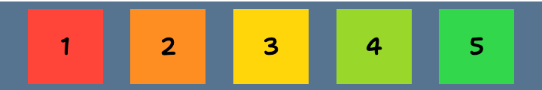

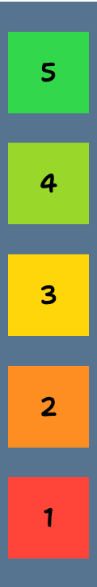

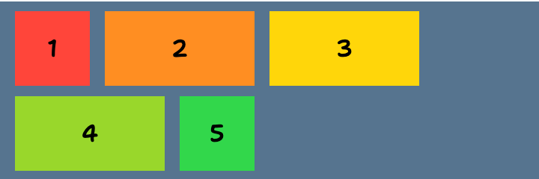
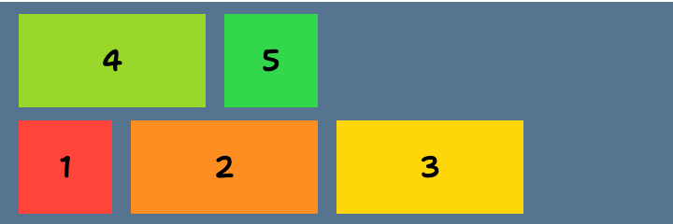
Default
flex-direction: column;
flex-direction: row;
FLEX-DIRECTION:
sets how flex items are placed in the flex container defining the main axis and the direction.
flex-direction: row-reverse;
flex-direction: column-reverse;
FLEX-WRAP:
sets whether flex items are forced onto one line or can wrap onto multiple lines. If wrapping is allowed, it sets the direction that lines are stacked.
flex-wrap: wrap;
flex-wrap: wrap-reverse;
flex-wrap: nowrap;

Slide 3
FLEXBOX
The Flexible Box Layout Module, usually referred to as Flexbox, was designed as a one-dimensional layout model, and as a method that could offer space distribution between items in an interface and powerful alignment capabilities.
MAIN AXIS
CROSS AXIS
display: flex;

Slide 4

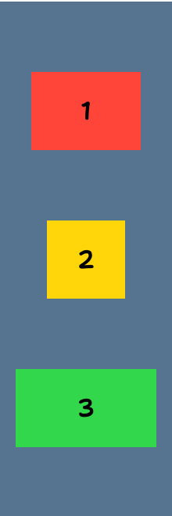
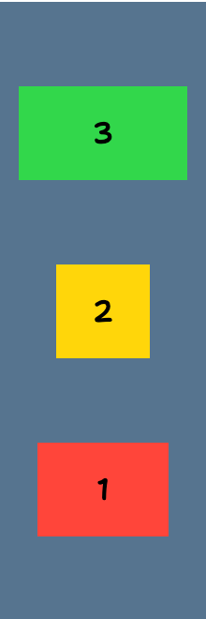

Default
flex-direction: row;
flex-direction: column;
FLEX-DIRECTION:
sets how flex items are placed in the flex container defining the main axis and the direction.
flex-direction: row-reverse;
flex-direction: column-reverse;

Slide 5
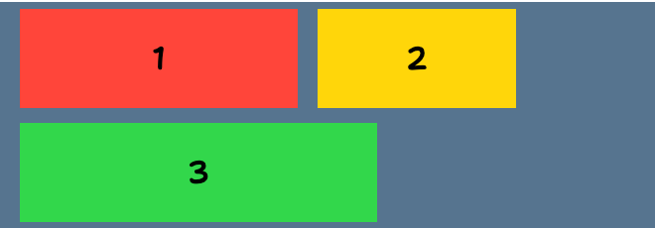
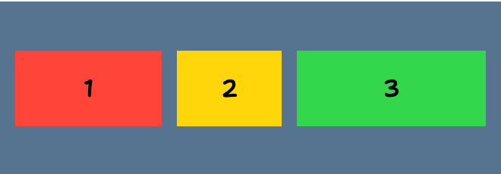
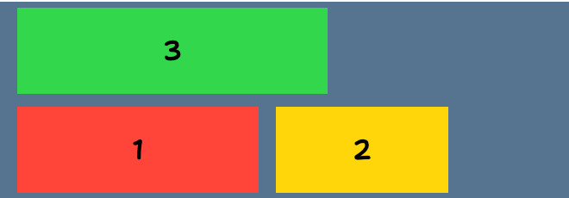
flex-wrap: wrap;
FLEX-WRAP:
sets whether flex items are forced onto one line or can wrap onto multiple lines. If wrapping is allowed, it sets the direction that lines are stacked.
Default
flex-wrap: nowrap;
flex-wrap: wrap-reverse;

Slide 6



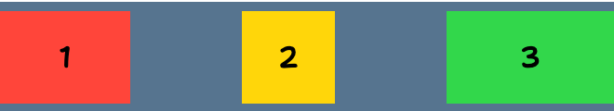

justify-content: flex-start;
justify-content: flex-end;
Default
justify-content: center;
JUSTIFY-CONTENT:
defines how the browser distributes space between and around content items along the main axis of a flex container.
justify-content: space-between;
justify-content: space-around;
justify-content: start;
end;
left;
right;
normal;
stretch;
justify-content: space-evenly;

Slide 7
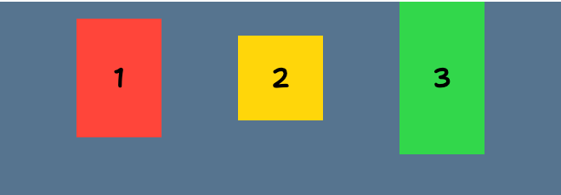
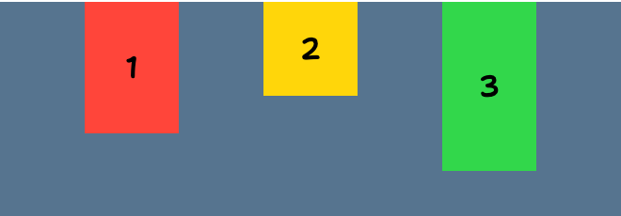
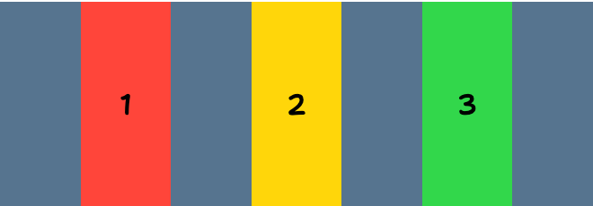
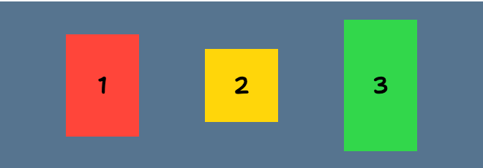
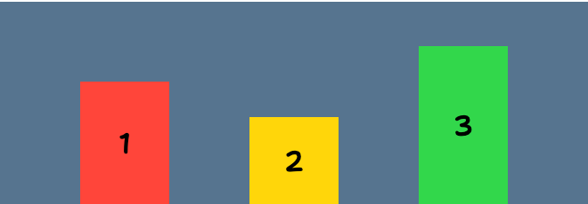
align-items: flex-start;
align-items: baseline;
Default
align-items: stretch;
align-items: start;
end;
self-start;
self-end;
first baseline;
last baseline;
align-items: center;
ALIGN-ITEMS:
sets the “align-self” value on all direct children as a group, it controls the alignment of items on the cross axis.
align-items: flex-end;

Slide 8
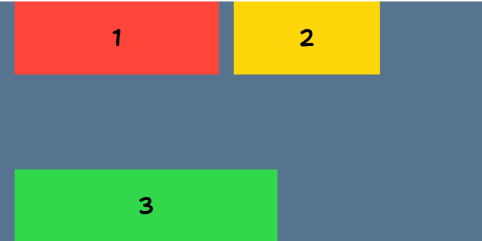
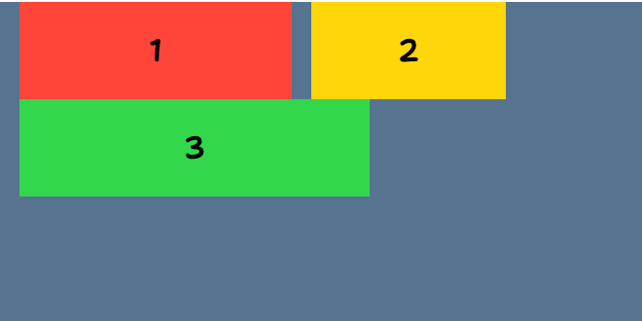
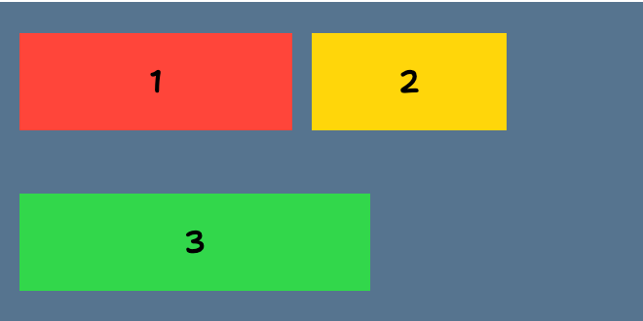
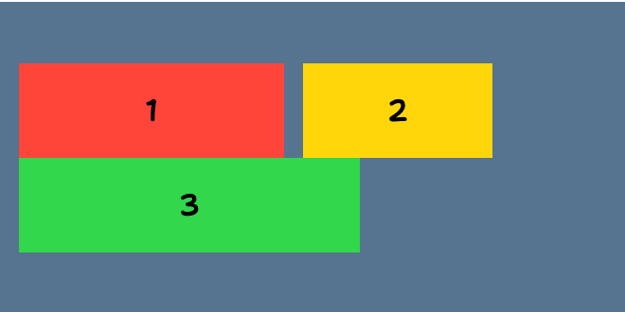
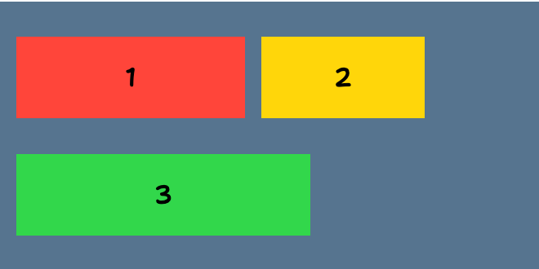
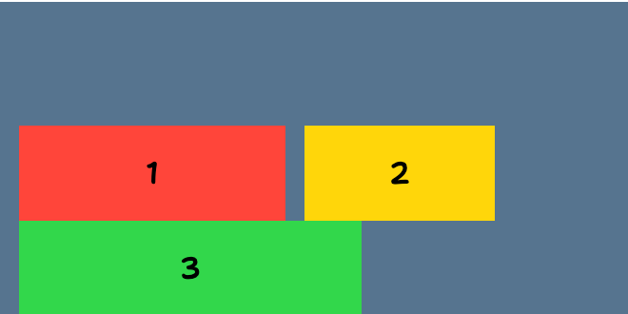
align-content: space-between;
align-content: flex-start;
ALIGN-CONTENT:
sets the distribution of space between and around content items along a Flexbox’s cross axis. This property has no effect on single line flex containers (i.e. ones with “flex-wrap: nowrap”).
align-content: space-around;
align-content: center;
align-content: flex-end;
align-content: space-evenly;

Slide 9
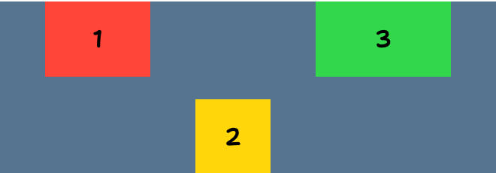
ALIGN-SELF:
overrides a flex item’s “align-items” value, and aligns the item on the cross axis.
align-self: flex-end;

Slide 10
FLEX-BASIS:
definition
flex-basis: wrap;

