Slide 1
JS and react
劉祐伸

Slide 2

議程
主題一 JS Async/Await
主題二 React + Vite
課後心得

Slide 3
主題一
JS Async/Await

Slide 4
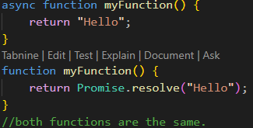
JS Async/Await
async makes a function return a Promise.
The keyword async before a function makes the function return a promise:

Slide 5
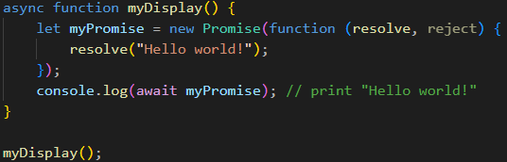
JS Async/Await
await makes a function wait for a Promise.
The await keyword can only be used inside an async function, and makes the function pause the execution and wait for a resolved promise before it continues.

Slide 6
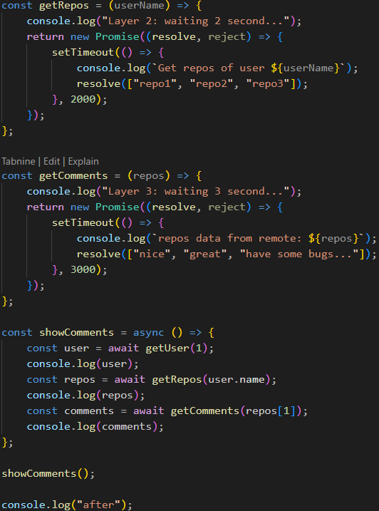
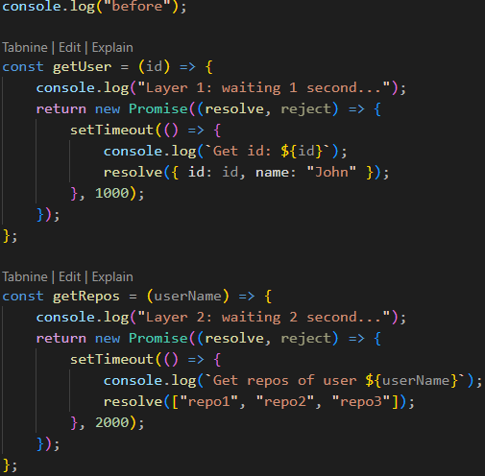
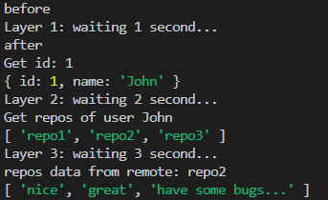
JS Async/Await
To demonstrate the use of async and await, we will use the callback examples from the previous chapter.

Slide 7
主題二
React + Vite

Slide 8
React + Vite
React, sometimes referred to as a front-end JavaScript framework, is a JavaScript library created by Facebook. React is a tool for building UI components.
Vite is a modern front-end build tool designed for fast and efficient development of web applications. Created by the developer of Vue.js, Evan You, Vite focuses on improving the developer experience through speed and simplicity.
To build React + Vite, we need to download Bun first.

Slide 9
React + Vite
Bun is a modern JavaScript runtime designed to provide an all-in-one solution for building and running JavaScript, TypeScript, and other web development projects. It is built from the ground up to be fast, efficient, and developer-friendly.
To install Bun in Windows, enter the command in PowerShell:
powershell -c "irm bun.sh/install.ps1 | iex“
For Linux or macOS:
curl -fsSL https://bun.sh/install | bash

Slide 10
React + Vite
Down below is an example of using Bun to create a Vite + React project in Windows:
bun create vite
enter [project name]
select "React"
select "JavaScript + SWC"
cd [project name]
bun install
Then change the script:
go "package.json"
change "dev" value into "bun --bun vite"
bun run dev // to create local website
Done! Now we've created a React + Vite project.

Slide 11



課後心得
好快就到了React的部分了，await的寫法又更簡化了上一節課程式，且更容易閱讀。
React + Vite的範例專案裡的架構有點複雜，它拆成很多塊去互相連結，有點難直接看出來彼此的關係。

Slide 12




感謝您
簡報者：劉祐伸

