Slide 1
JS and react
劉祐伸

Slide 2

議程
主題一 JS Async/Await
主題二 React
課後心得

Slide 3
主題一
JS Async/Await

Slide 4
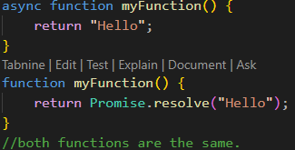
JS Async/Await
async makes a function return a Promise.
The keyword async before a function makes the function return a promise:

Slide 5
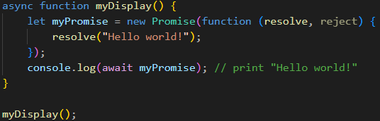
JS Async/Await
await makes a function wait for a Promise.
The await keyword can only be used inside an async function, and makes the function pause the execution and wait for a resolved promise before it continues.

Slide 6
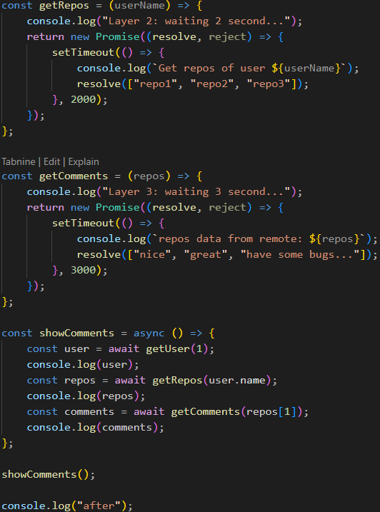
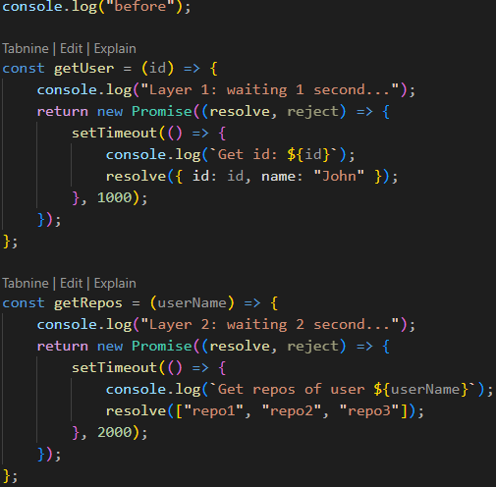
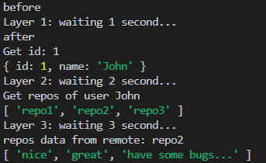
JS Async/Await
To demonstrate the use of async and await, we will use the callback examples from the previous chapter.

Slide 7
主題二
React

Slide 8
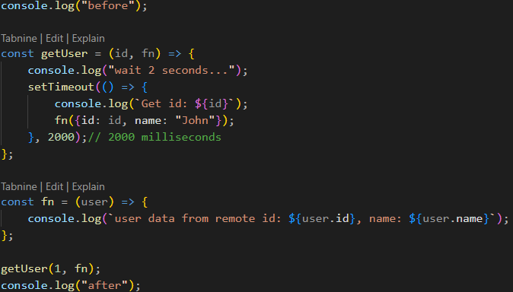

JS Asynchronous
In the real world, callbacks are most often used with asynchronous functions.
A typical example is JavaScript setTimeout().

Slide 9
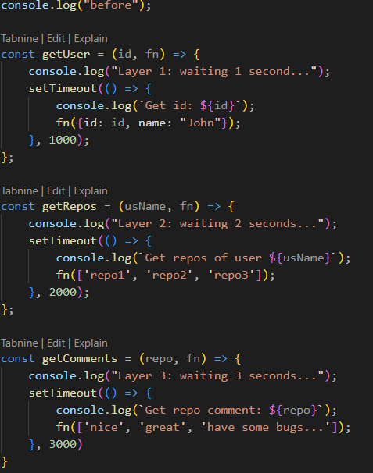
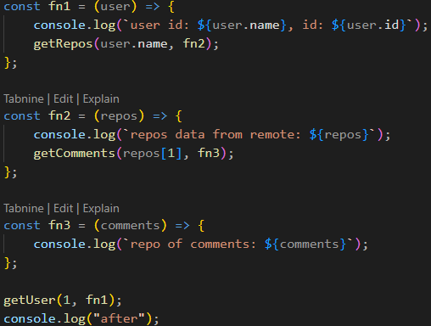
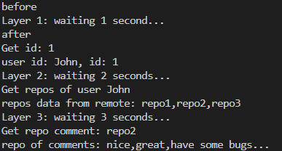
JS Asynchronous
This example shows that it can be built up with multi-layers.

Slide 10



課後心得
好快就教到非同步單元，學到了該怎麼操作回傳函數、等待時間及兌現物件，非同步特別在IO端口用最多，像是在按按鈕時，在執行主程式時會異步執行按鈕的函數，這樣就可以不用先等按鈕執行完才回來主程式，在大量IO端口執行下會快很多。

Slide 11




感謝您
簡報者：劉祐伸

