Slide 1
JS Async
劉祐伸

Slide 2

議程
主題一 JS Callback
主題二 JS Asynchronous
主題三 JS Promise
課後心得

Slide 3
主題一
JS Callback

Slide 4
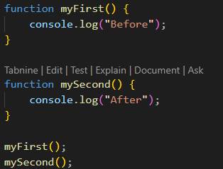

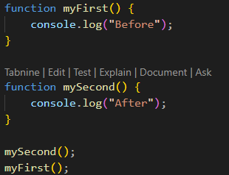

JS Callback
JavaScript functions are executed in the sequence they are called. Not in the sequence they are defined.
These examples show will end up displaying the difference between displaying "After" and "Before":

Slide 5
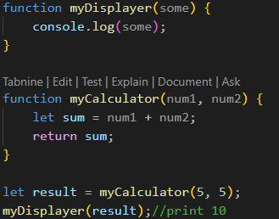
JS Callback
Sometimes you would like to have better control over when to execute a function.
Suppose you want to do a calculation, and then display the result.
You could call a calculator function (myCalculator), save the result, and then call another function (myDisplayer) to display the result.

Slide 6
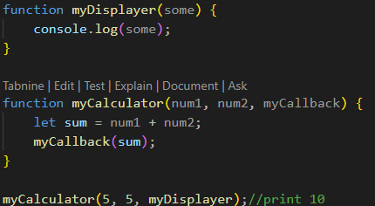
JS Callback
Using a callback, you could call the calculator function (myCalculator) with a callback (myCallback), and let the calculator function run the callback after the calculation is finished.
In this example, myDisplayer is a called a callback function.
It is passed to myCalculator() as an argument.

Slide 7
主題二
JS Asynchronous

Slide 8
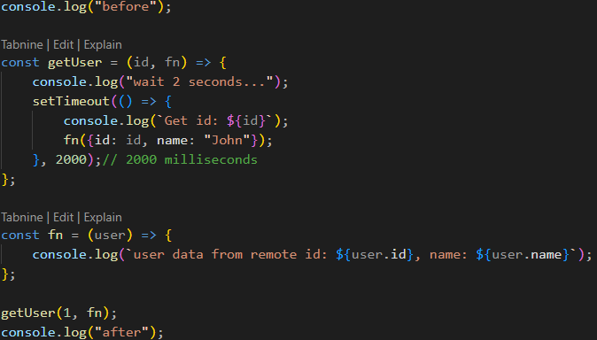

JS Asynchronous
In the real world, callbacks are most often used with asynchronous functions.
A typical example is JavaScript setTimeout().

Slide 9
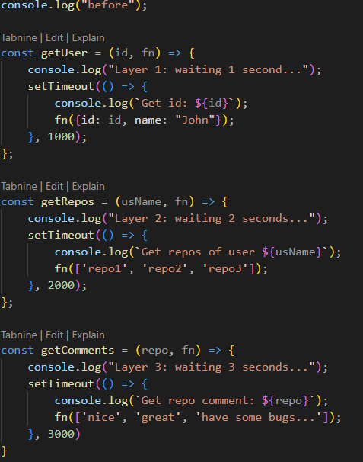
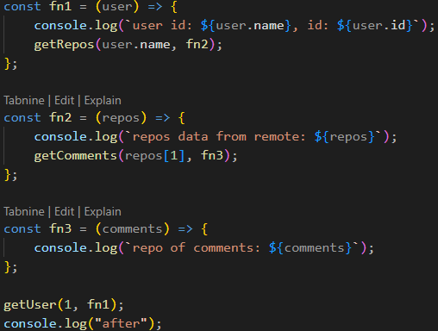
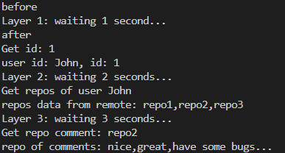
JS Asynchronous
This example shows that it can be built up with multi-layers.

Slide 10
主題三
JS Promise

Slide 11
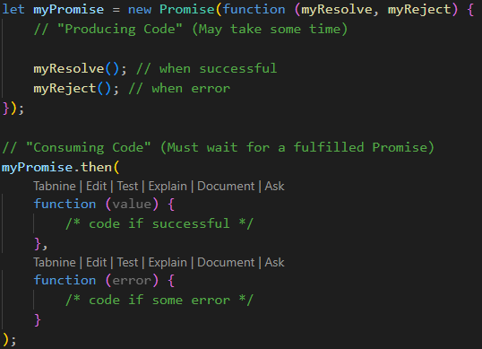
JS Promise
A Promise is an Object that links Producing code and Consuming code.
A Promise contains both the producing code and calls to the consuming code.

Slide 12
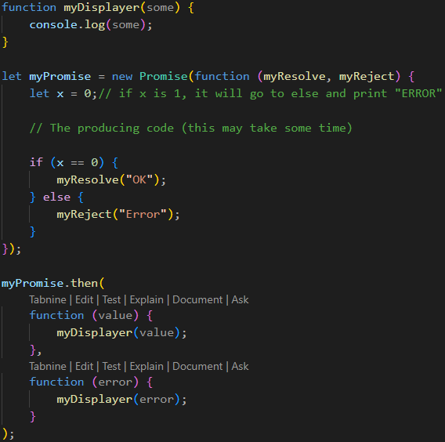
JS Promise
Promise.then() takes two arguments, a callback for success and another for failure.
Both are optional, so you can add a callback for success or failure only.

Slide 13
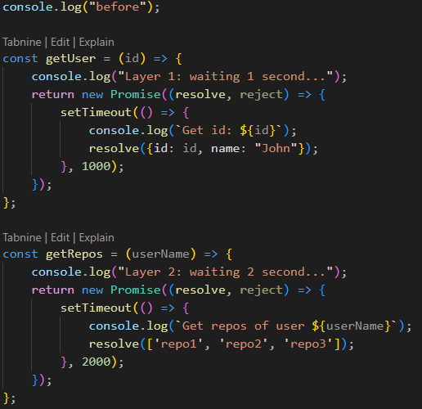
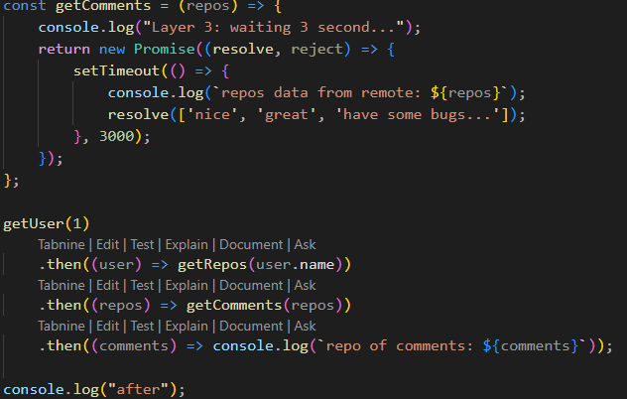
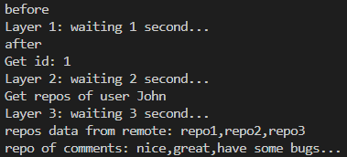
JS Promise
To demonstrate the use of promises, we will use the callback examples from the previous chapter.

Slide 14



課後心得
好快就教到非同步單元，學到了該怎麼操作回傳函數、等待時間及兌現物件，非同步特別在IO端口用最多，像是在按按鈕時，在執行主程式時會異步執行按鈕的函數，這樣就可以不用先等按鈕執行完才回來主程式，在大量IO端口執行下會快很多。

Slide 15




感謝您
簡報者：劉祐伸

