Slide 1
CSS 單位與排版
劉祐伸

Slide 2

議程
主題一 CSS Units
主題二 CSS Pseudo Elements
主題三 CSS Box Model
課後心得

Slide 3
主題一
CSS Units

Slide 4
CSS Units
Many CSS properties take “length” values, such as width, margin, padding, font-size, etc.
Length is number followed by a length unit, such as 10px, 2em, etc.
Absolute Length units: cm (centermeters), mm (millimeters), in (inches), px *(pixels), pt (points), pc (picas, 1pc = 12pt).
Absolute length units are not recommended for use on screen, because screen sizes vary so much. However, they can be used if the output medium is known, such as for print layout.
* Pixels (px) are relative to the viewing device. For low-dpi devices, 1px is one device pixel (dot) of the display. For printers and high-resolution screens 1px implies multiple device pixels.

Slide 5
CSS Units
Relative Length units:
em (relative to the font-size of the element),
ex (relative to the x-height of current font, rarely used),
ch (relative to the width of the “0”),
rem (relative to the font-size of the root element),
vw (relative to 1% of the width of the viewport*),
vh (relative to 1% of the height of the viewport*),
vmin (relative to 1% of viewport's* smaller dimension),
vmax (relative to 1% of viewport's* larger dimension),
% (relative to the parent element).
* Viewport = the browser window size.

Slide 6
主題二
CSS Pseudo Elements

Slide 7
CSS Pseudo Elements
A CSS pseudo-element is used to style specified parts of an element.
For example, it can be used to:
Style the first letter, or line, of an element
Insert content before, or after, the content of an element
The syntax of pseudo-element: selector::pseudo-element { property: value; }
All CSS Pseudo Elements:
::after: Insert something after the content of each element
::before: Insert something before the content of each element
::first-letter: Selects the first letter of each element
::first-line: Selects the first line of each element
::marker: Selects the markers of list items
::selection: Selects the portion of an element that is selected by a user

Slide 8
主題三
CSS Box Model

Slide 9
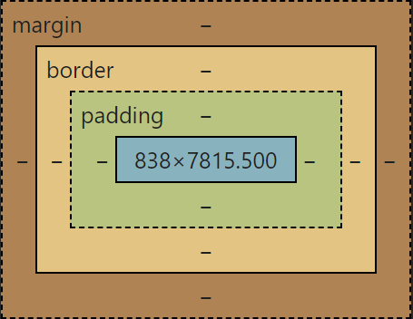
CSS Box Model
In CSS, the term "box model" is used when talking about design and layout.
The CSS box model is essentially a box that wraps around every HTML element. It consists of content, padding, borders and margins.
The image below illustrates the box model:

Slide 10
CSS Box Model
Content - The content of the box, where text and images appear
Padding - Clears an area around the content. The padding is transparent
Border - A border that goes around the padding and content
Margin - Clears an area outside the border. The margin is transparent
Box-sizing - Content-box and Border-box, Content-box is based on the content of the box to size the layout, the padding and margin are spread outward; Border-box is based on the border of the box to size the layout, the padding is inside the box, the margin is outside the box.
So, in intuition, it‘s mostly better to set Box-sizing to the border-box instance.

Slide 11



課後心得
今天學到了如何使用CSS中的單位長度與Box排版，瞭解到有關聯的長度單位在做排版是比較適合的，而絕對的長度單位是比較適合在框線粗細或是需要固定的大小上。Box排版的部分瞭解到在html上的元素位置關係、父子關係，每個元素都是由一個個箱子狀的容器包裝在一起，可以自由調整大小以及長寬，來達到更好的UI版面。

Slide 12




感謝您
簡報者：劉祐伸

