Slide 1
CSS 清單與選單
劉祐伸

Slide 2

議程
主題一 CSS List
主題二 CSS Menu
課後心得

Slide 3
主題一
CSS List

Slide 4
CSS List
In HTML, there are two main types of lists:
unordered lists (<ul>) - the list items are marked with bullets
ordered lists (<ol>) - the list items are marked with numbers or letters
The CSS list properties allow you to:
Set different list item markers for ordered lists
Set different list item markers for unordered lists
Set an image as the list item marker
Add background colors to lists and list items

Slide 5
CSS List
There are some properties can be set:
list-style-type: specifies the type of list item marker. ul has four values, disc (default), circle, square and none; and ol has serval types of values, numeric type(default), letter type, Rome numeric, Greek numeric, Armenian numeric, Georgian numeric, and other numeric system.
list-style-position: specifies the position of the list-item markers. Can be set to inside or outside.
list-style-image: specifies an image as the list item marker.
It has a pseudo-class can select any element that nth child of its parent:
:nth-child(n): it matches elements based on the indexes of the elements in the child list of their parents. n can be a number/index, a keyword (odd or even), or a formula (like 2 * n + 1).

Slide 6
主題二
CSS Menu

Slide 7
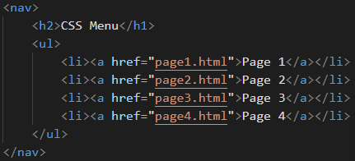
CSS Menu
Create a menu, we can use <nav> to organize a list of <ul> and <li>, and links them. Like this:
The <a> tag has a pseudo-class to set visited links style:
:visited: compares to :link, :link is used to set unvisited links style. To style links appropriately, put the :visited rule after the :link rule, but before the :hover and :active rules.

Slide 8



課後心得
今天學到了如何使用清單選項，有無序與有序的清單項目，其中無序的項目圖案可以匯入外部圖片，如果要調整圖案大小則要設成背景才能調整大小，最直接設定的話就直接把圖片resize吧；有序清單的話可以把數字改成其他方式的數字系統，設計不一樣的效果，使用:nth-child()來選擇清單項目的且設定其樣式，讓清單不單單只是一種顏色。
再來是menu，用<nav>把清單整合起來，然後在每個清單放上連結，類似菜單的樣子，做出網站的選擇器。

Slide 9




感謝您
簡報者：劉祐伸

