Slide 1




Submitted by:
Hazel Anne Mozo
Final Project: Enrollment System using Python and SQL

Slide 2






1
Schema
2
The Code
CONTENTS
3
Demo of The Code
4
Final Thoughts

Slide 3
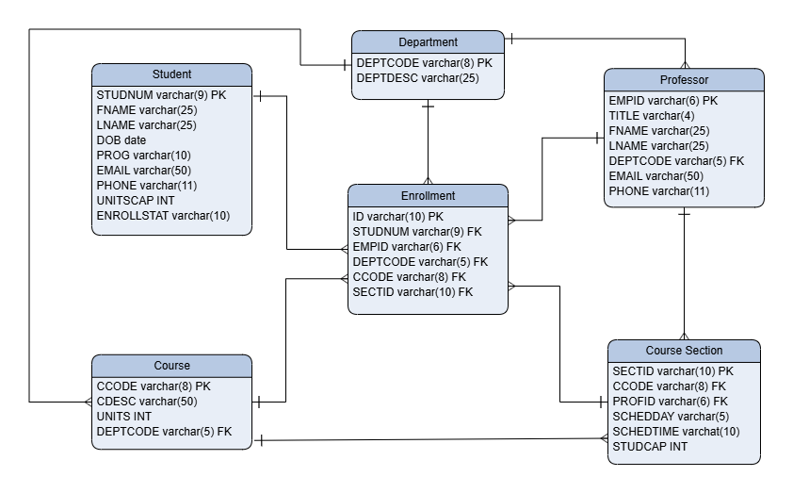

1
Schema

Slide 4
2
The Code
Creating the Classes
Since we will be dealing with accounts and want to put it in the table later, a Student Class was created. As required, an Enrollment System Class was also created. An Admin Class was added when it was determined that there was a need for it.
The Charts
We were also required to create charts from the data. It was included in the program under the Admin menu.
Getting the sample data in the Tables
Creating the Tables
The Sample data was derived from the enrollment data provided and were encouraged to use. The added data were either invented or randomly generated.
The tables were coded after the schema was created. The schema was finalized when everything that was need for the code was identified.

Slide 5
3
Demo of The Code
Create an Account
Student Timetable and Professor Roster
Add/Remove a Course
Generate Reports

Slide 6
4
Final Thoughts
This Program is...
an enrollment system where a student can: create an account, add and remove a course, finalize their course list, and get their timetable.
This system also enables an admin to: add info to a students account, generate a professors roster, and generate reports
Where this program could be improved...
a password system could have been implemented. A search function could have been made so that a student can search for the Course they are looking for. The UI could display the maximum units allowed and current total units so that the student can see it all the time. Finally, the program does not overwrite the csv files used, so the data from the user is lost. In the end the program is for demonstration purposes only. More of a proof of concept that an actual enrollment system that is ready for use.

Slide 7
Submitted by:
Hazel Anne Mozo
THANK YOU

