Slide 1
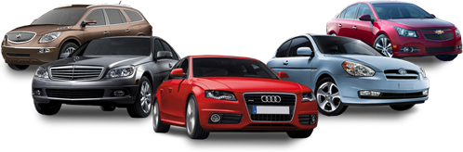
Cars on Sell @Refurbished

Slide 2
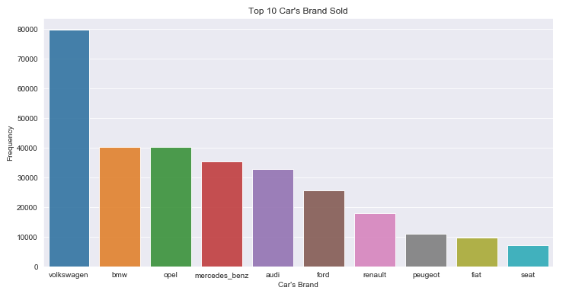
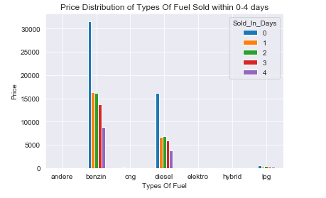
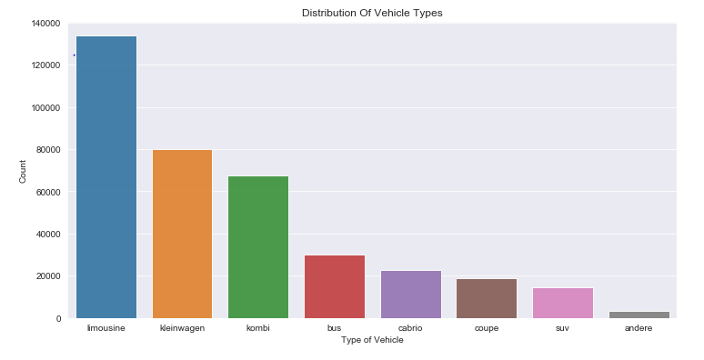
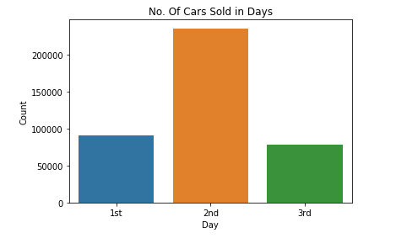
Univariate, Bivariate & Multivariate Analysis
Day | No. Of Cars Sold
1st Day | 48418
2nd Day | 23370
3rd Day | 23466

Slide 3
Observation
Privat car was sold more than any seller present on the observation
Angelbot was most accepted offer than others
Distribution of car price is normal
Both types (test & control) of testing was accepted
Limousine, Kleinwagen & Kombi were the most sold cars
In 1999 & 2006 car was mostly registered for sale
Manuell car was most preferable & liked by all the buyers
Car powered by 75 & 150 HP was most likely to be bought
Golf & Andere was the top model car sold
Most of the car was registered for sale in the month of March & June
Benzin & Diesel was most preferred car engine to be brought
Volkswagen, BMW & Opel was top most brand of car was sold
Interestingly most of the cars which was available for sell was not repaired
Not a single picture was needed to sell the car

Slide 4
Building Model, Prediction & Accuracy
Spliced data into train (70%) & test (30%)
Using Random Forest Regression Technique to predict the price of a car
Post running some analysis it was observed the best parameter to be used while building the model is mentioned below:
max_depth = 10
max_leaf_nodes = 100
n_estimators = 5
Features were taken into consideration while building model is mentioned below :
vehicleType, yearOfRegistration,gearbox,powerPS,kilometer, monthOfRegistration, fuelType, brand, notRepairedDamage, Sold_In_Days
Accuracy Score Found : 74 %
It is pretty good & as it is generalized.
Good enough to understand the inner pattern of the data so that it can predict well on unseen data.

