Slide 1

Tracing the arc
A Glimpse into the Past, Present, and Future of Artificial Intelligence
Dr. Edward Brash
A Lecture Series for the CNU Lifelong Learning Society
Fall 2023

Slide 2
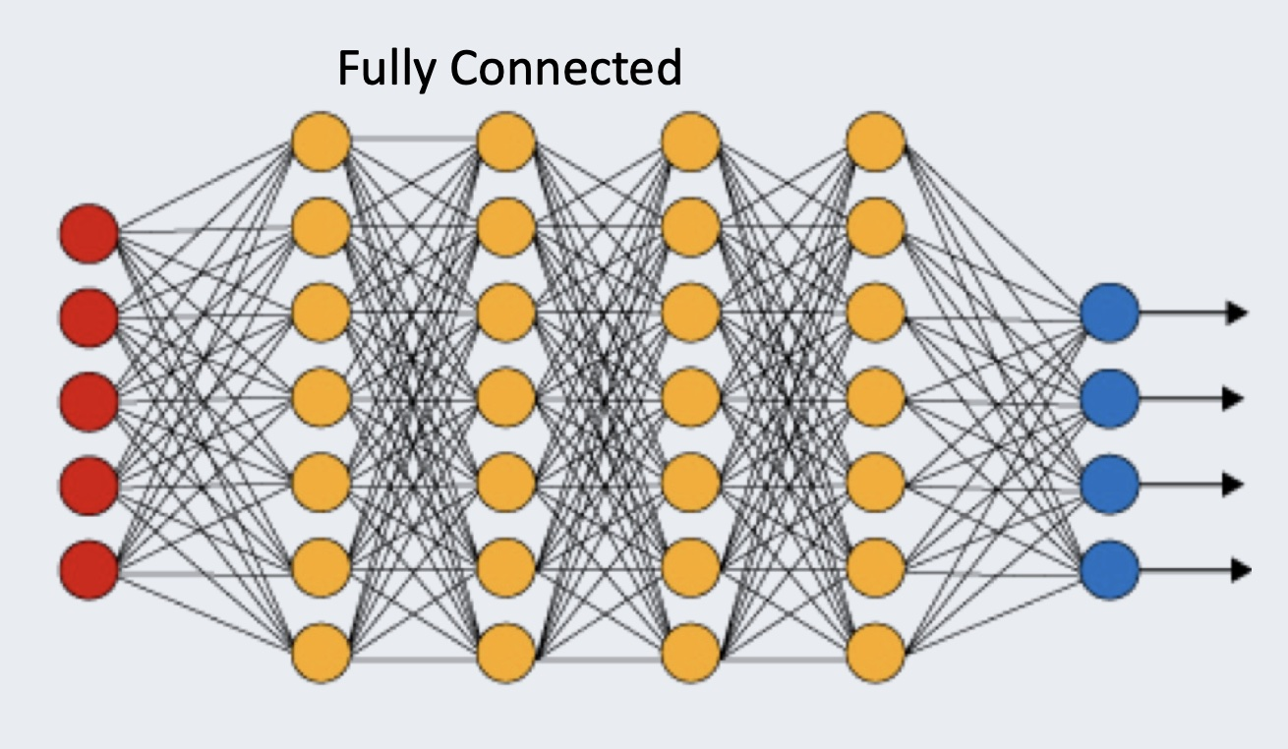
Deep Neural Networks
The red dots are the input data
The blue dots are the output results
The yellow dots are neurons
The lines joining things up represent the WEIGHTS in the model!!!!
Two interesting parameters in Neural Networks are:
The total number of neurons
The number of CONNECTIONS per neuron

Slide 3
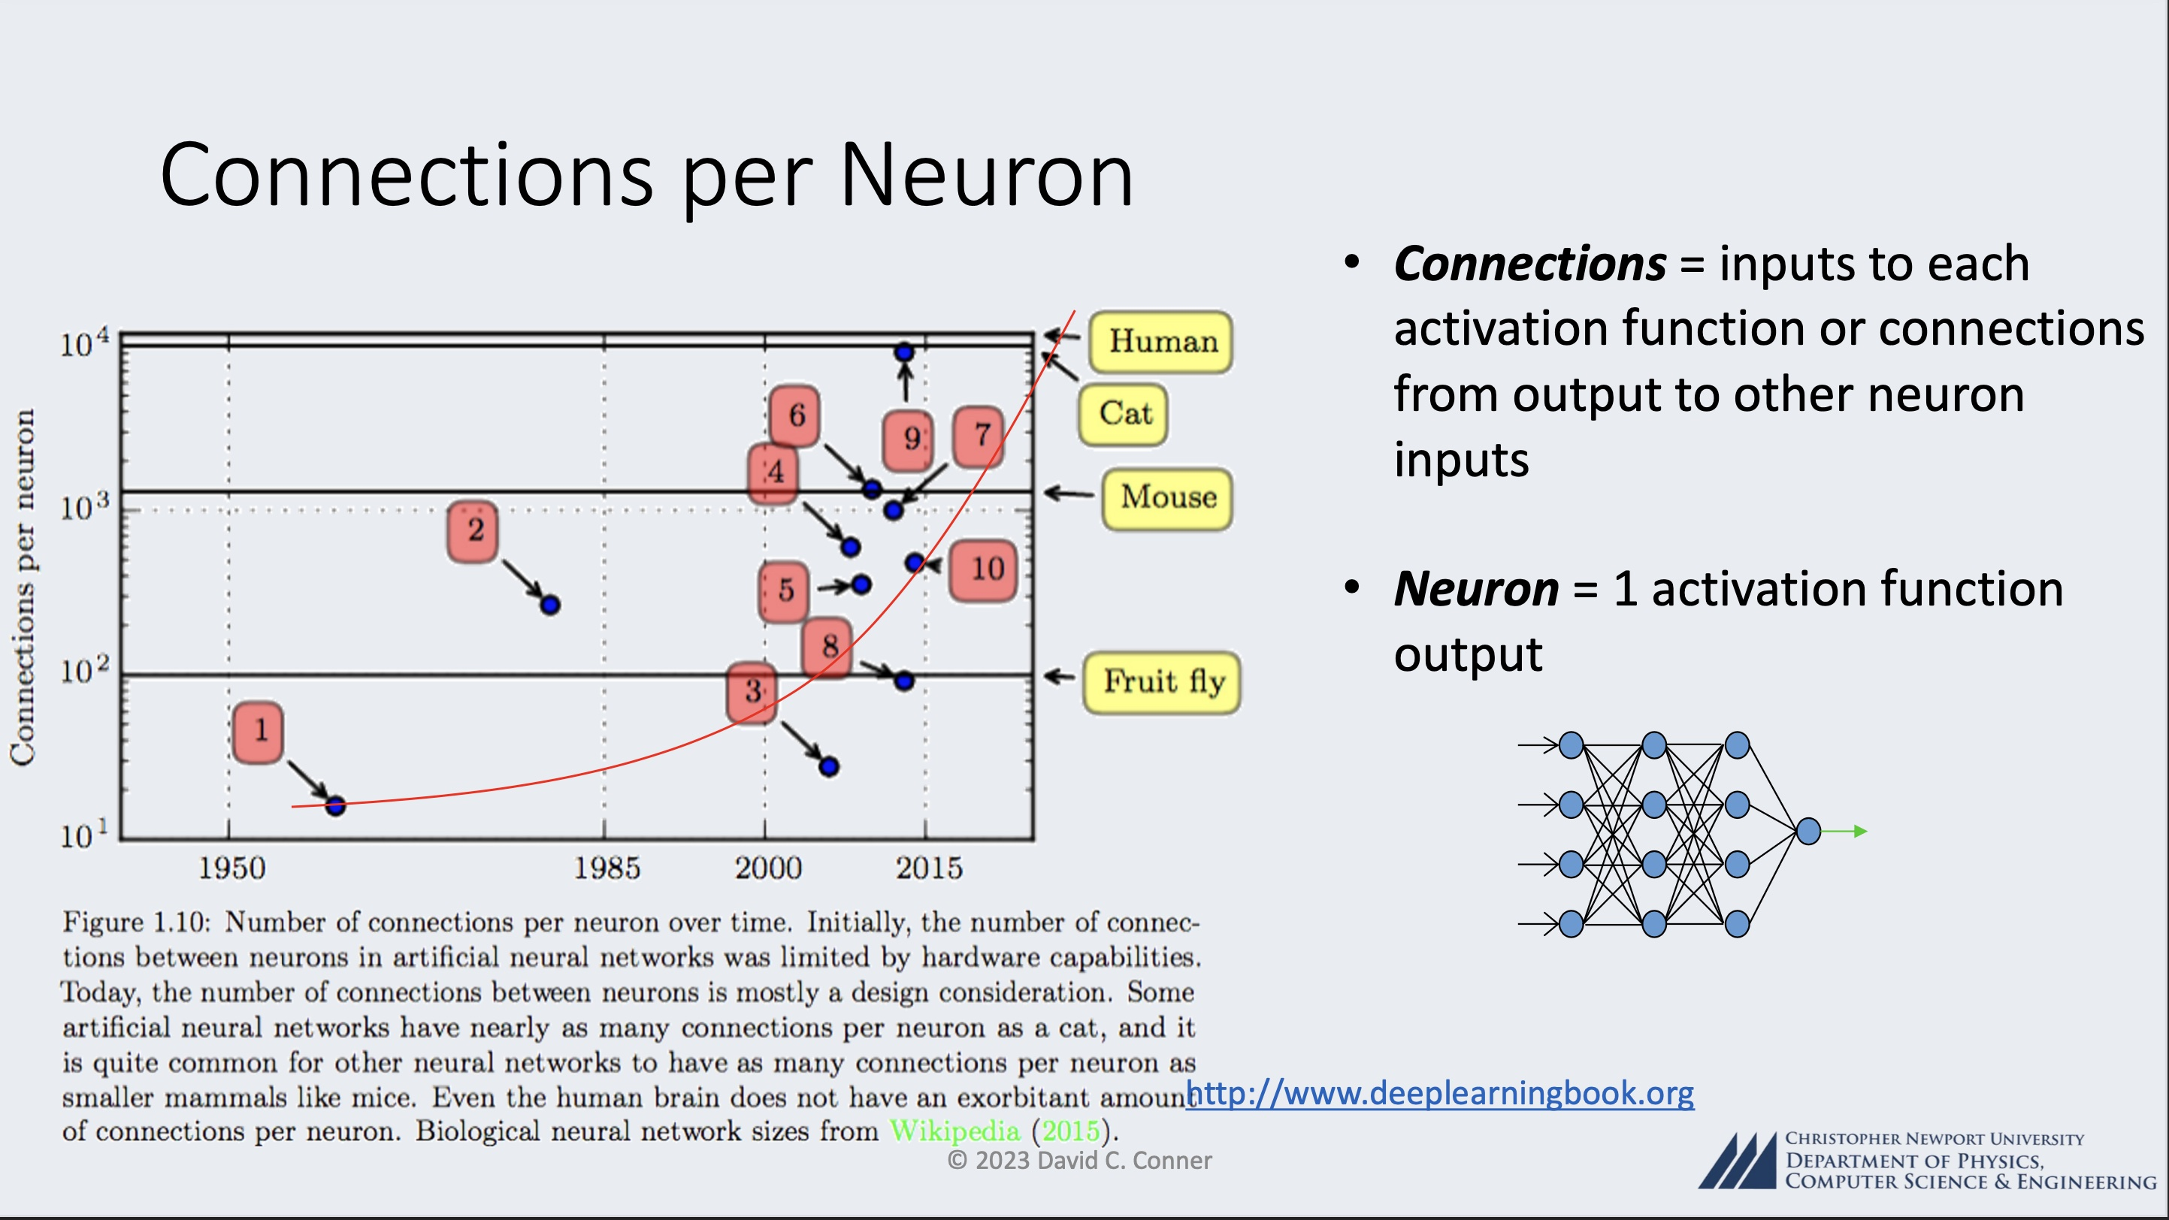

Slide 4
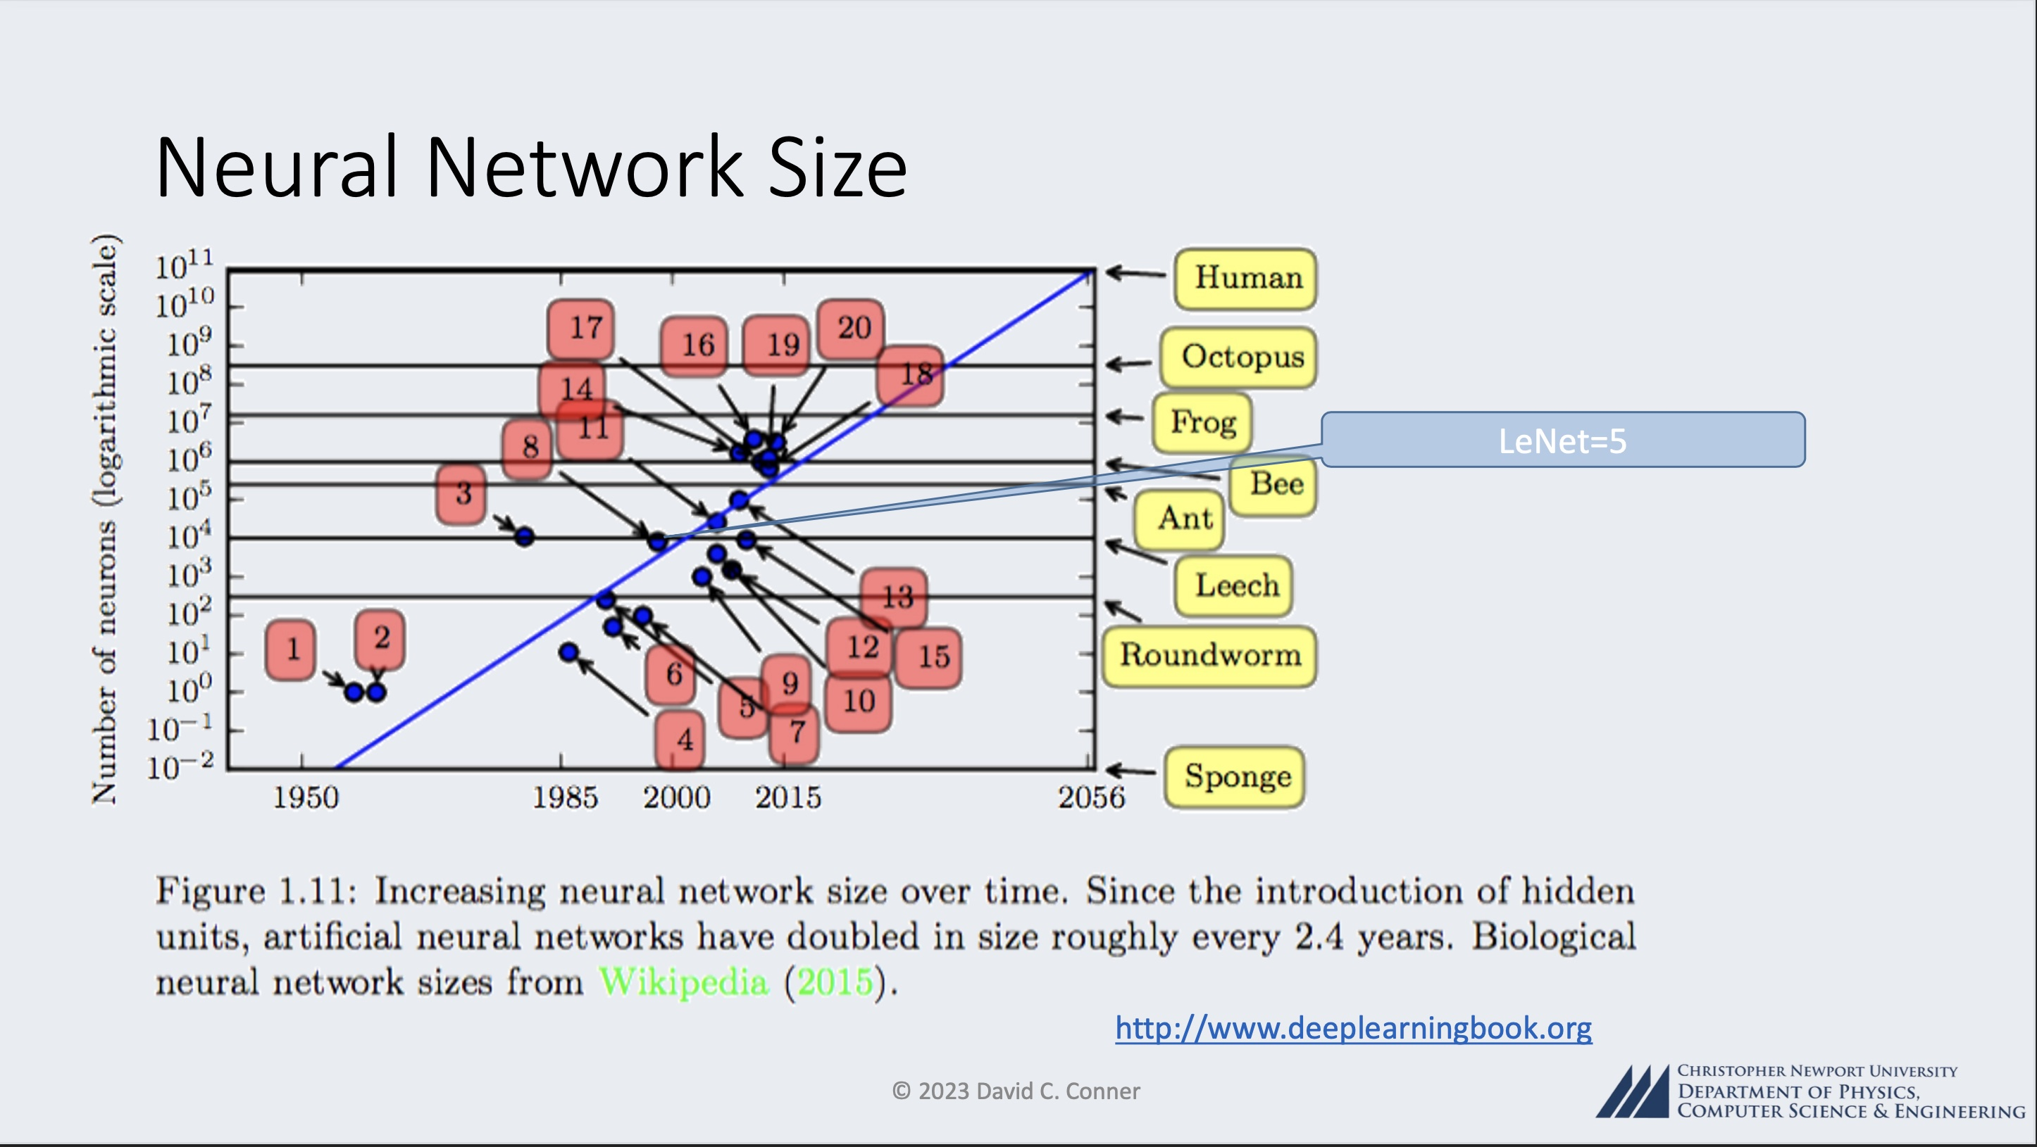

Slide 5
Applications of Deep Learning Neural Networks
Pioneering Models: Iconic models like LeNet-5, AlexNet, and VGGNet paved the way, demonstrating the potency of DLNNs in image classification tasks, notably in competitions like the ImageNet Large Scale Visual Recognition Challenge (ILSVRC).
Applications: DLNNs have permeated diverse domains, including:
medical image analysis
computer vision in autonomous vehicles
facial recognition, and more, any image-related ML task
Natural Language Processing (NLP): Deep learning, particularly models like Recurrent Neural Networks (RNNs) and Transformers, has revolutionized NLP, enabling machines to understand, generate, and translate human languages with unprecedented proficiency.

Slide 6
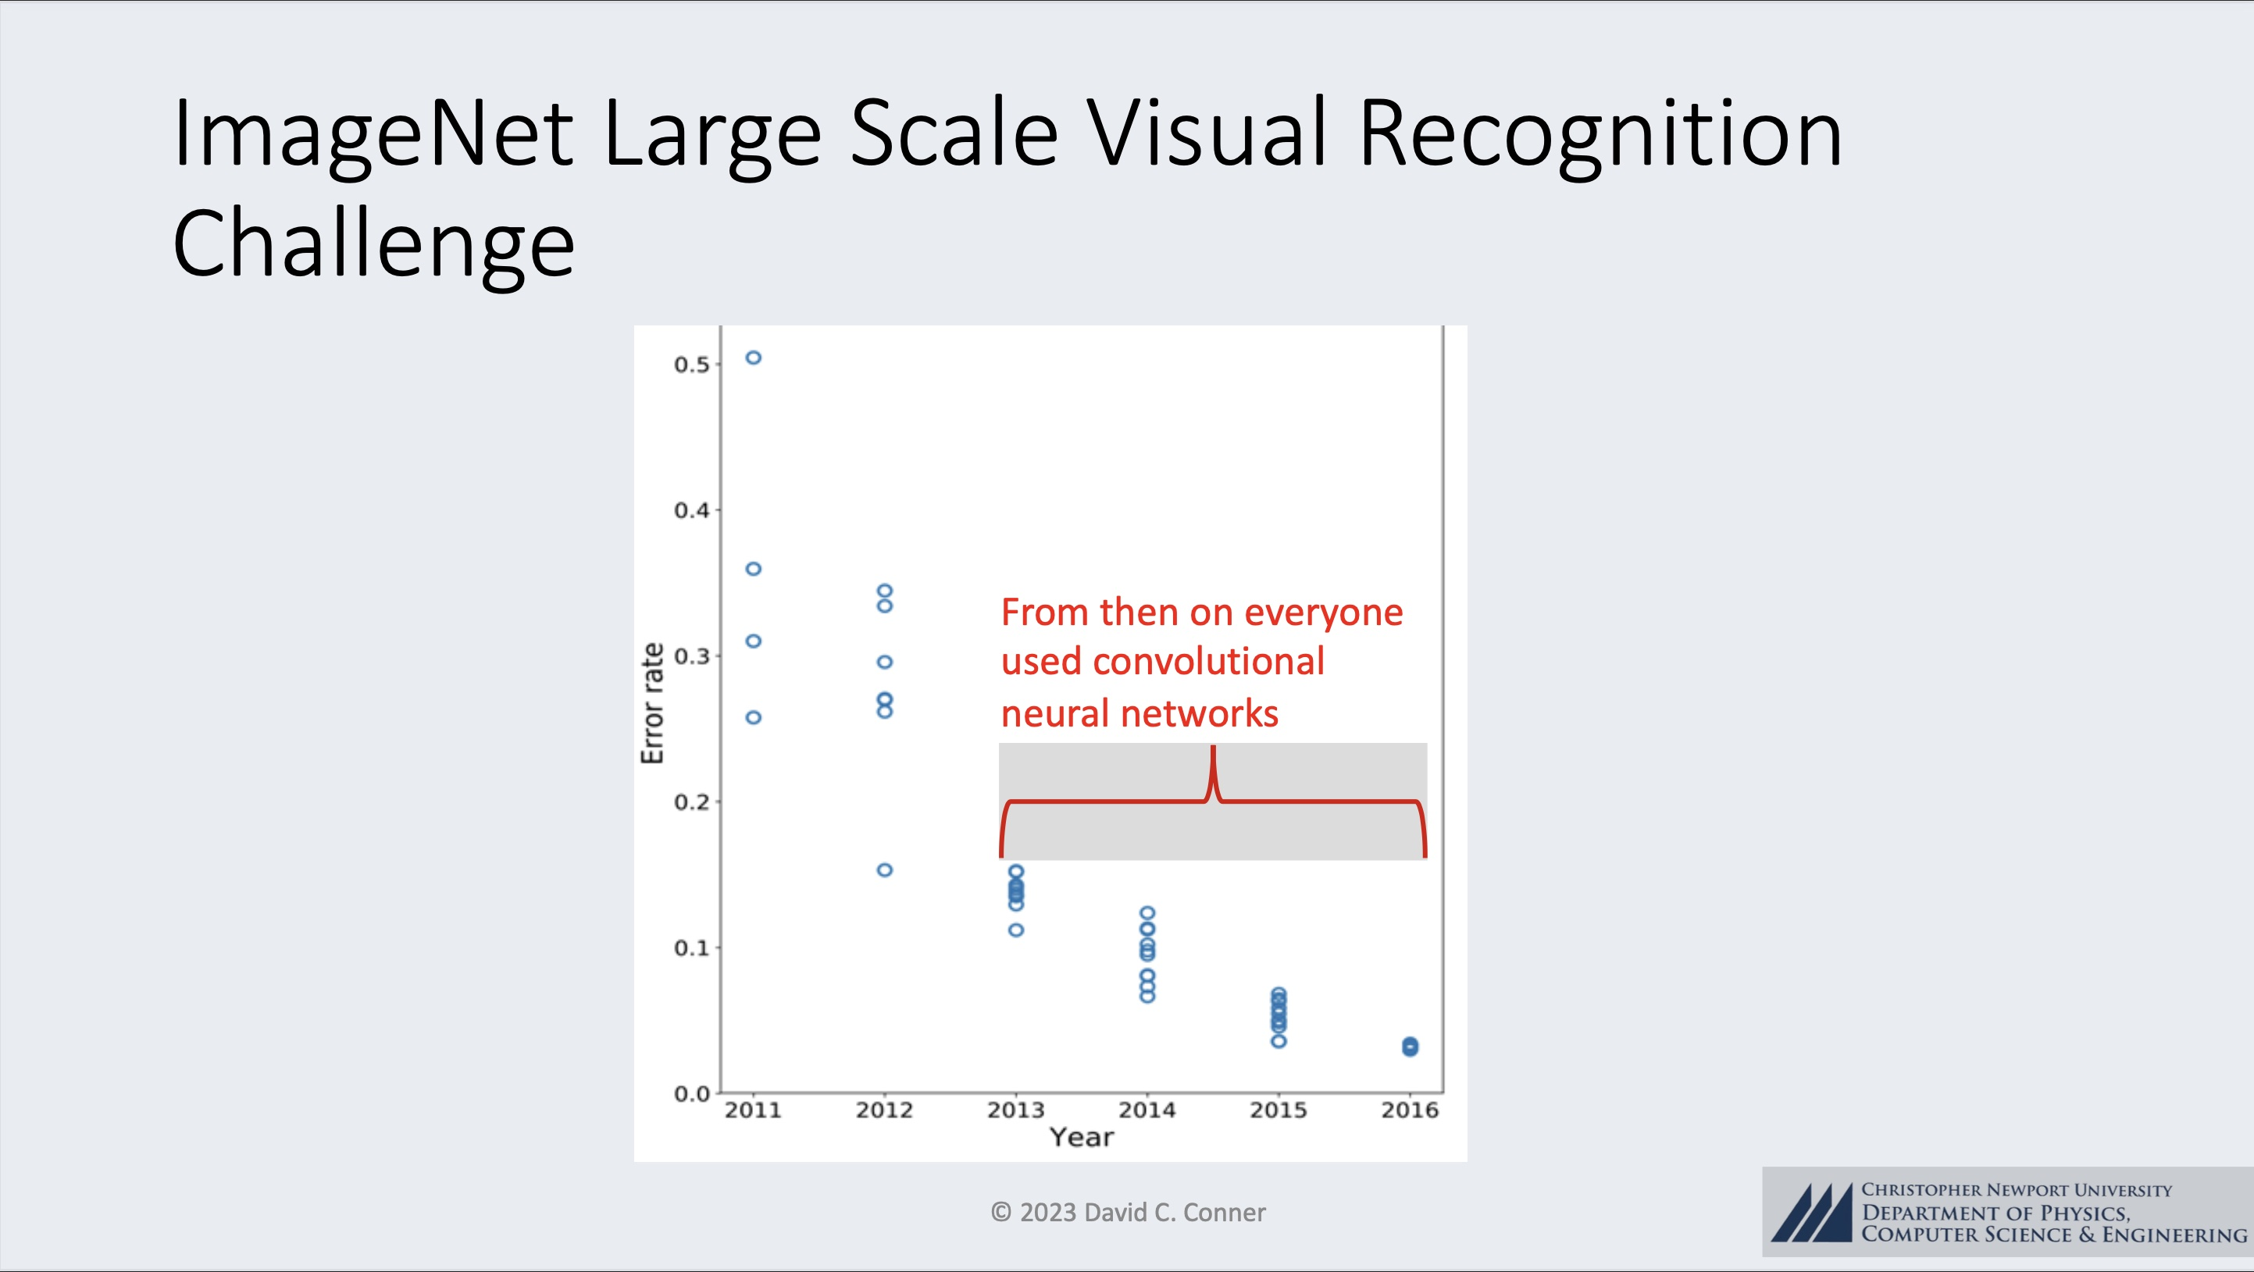
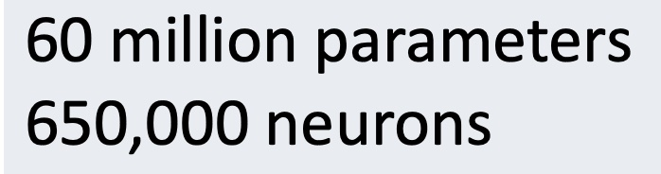
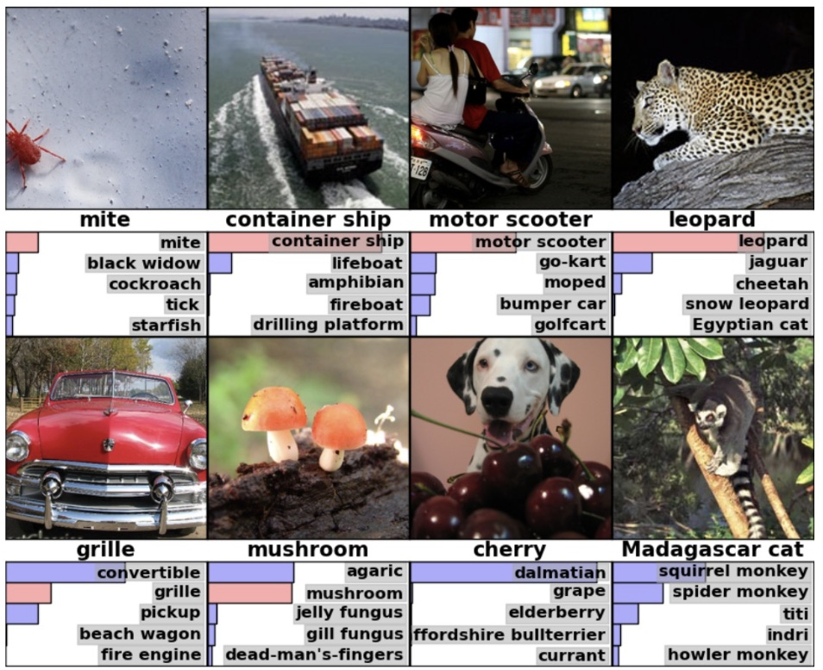

Slide 7
Applications of Deep Learning Neural Networks
Pioneering Models: Iconic models like LeNet-5, AlexNet, and VGGNet paved the way, demonstrating the potency of DLNNs in image classification tasks, notably in competitions like the ImageNet Large Scale Visual Recognition Challenge (ILSVRC).
Applications: DLNNs have permeated diverse domains, including:
medical image analysis
computer vision in autonomous vehicles
facial recognition, and more, any image-related ML task
Natural Language Processing (NLP): Deep learning, particularly models like Recurrent Neural Networks (RNNs) and Transformers, has revolutionized NLP, enabling machines to understand, generate, and translate human languages with unprecedented proficiency.

Slide 8
Conclusions, at this point …
Deep Learning Neural Network Artificial Intelligence Engines can, in the present day, do AMAZING THINGS!!!
Many (most?) of these things HELP HUMANITY
With that said (and I believe it to be true), there are aspects of the implementation and regulation of this technology where there exist very real and very concerning ethical and societal concerns.

