Slide 1

Tracing the arc
A Glimpse into the Past, Present, and Future of Artificial Intelligence
Dr. Edward Brash
A Lecture Series for the CNU Lifelong Learning Society
Fall 2023

Slide 2
List of References

Slide 3
List of References
1. The sum total of all human knowledge, as embodied in ChatGPT-4

Slide 4
What do you know?
Who are the three most important composers of the last 500 years, in Western music?

Slide 5
What do you know?
Who are the three most important composers of the last 500 years, in Western music?
Bach
Mozart
Beethoven

Slide 6
What do you know?
Who are the three most important authors in the West in the last 500 years?

Slide 7
What do you know?
Who are the three most important authors in the West in the last 500 years?
William Shakespeare
Leo Tolstoy
James Joyce

Slide 8
What do you know?
Who are the three most important artists in the last 500 years?

Slide 9
What do you know?
Who are the three most important artists in the last 500 years?
Leonardo da Vinci
Pablo Picasso
Vincent van Gogh

Slide 10
What do you know?
Who are the three most important artists in the last 500 years?
(Honorable Mentions)
Rambrandt
Michelangelo
Frida Kahlo****

Slide 11
What do you know?
Who are the three most well-known/important physicists in the last 500 years?

Slide 12
What do you know?
Who are the three most well-known/important physicists in the last 500 years?
Isaac Newton
Albert Einstein
Stephen Hawking/James Clerk Maxwell

Slide 13
What do you know?
Who are the three most well-known/important mathematicians in the last 500 years?

Slide 14
What do you know?
Who are the three most well-known/important mathematicians in the last 500 years?
Isaac Newton
Carl Friedrich Gauss
Leonhard Euler

Slide 15
What do you know?
Who are the three most well-known/important computer scientists, since the invention of computer science?

Slide 16
What do you know?
Who are the three most well-known/important computer scientists, since the invention of computer science?
Alan Turing (the father of computer science – the Turing Machine laid the foundations for theoretical computer science)
Ada Lovelace (the world’s first computer programmer – wrote the first algorithm designed to be processed by a machine)
John von Neumann (the von Neumann architecture forms the basis of almost every computer in use today, worked on the Manhattan Project, mathematician and physicist)

Slide 17
What do you know?
Who are the three most well-known/important people in the history of artificial intelligence?

Slide 18
What do you know?
Who are the three most well-known/important people in the history of artificial intelligence?
Alan Turing: Turing's contributions go beyond the foundational elements of computer science. His Turing Test, proposed in his paper "Computing Machinery and Intelligence" (1950), is one of the most discussed ideas in AI. The Turing Test was designed to provide a satisfactory operational definition of intelligence, sparking ongoing debates and research about machine intelligence and consciousness.

Slide 19
What do you know?
Who are the three most well-known/important people in the history of artificial intelligence?
Marvin Minsky: Often referred to as the "father of artificial intelligence," Minsky co-founded the Massachusetts Institute of Technology's AI laboratory and made several significant contributions to AI and cognitive psychology. His work on neural networks, artificial intelligence, and computer science theory played a pivotal role in developing and advancing the field. Minsky’s vision for AI was comprehensive, encompassing robotics, symbolic learning, and connectionism, among other aspects.

Slide 20
What do you know?
Who are the three most well-known/important people in the history of artificial intelligence?
John McCarthy: McCarthy coined the term "artificial intelligence" in 1955 and was one of the key figures in the early development of AI. He developed Lisp, a programming language widely used in AI research, and was instrumental in instituting the Stanford Artificial Intelligence Lab. McCarthy also proposed the idea of computer time-sharing (enabling the concurrent use of computers by multiple individuals), which was foundational to the development of cloud computing.

Slide 21
What do you know?
Who are the three most well-known/important people in the history of artificial intelligence?
Geoffrey Hinton: Known as the "Godfather of Deep Learning," Hinton's work on neural networks and deep learning architectures has significantly impacted machine learning and AI.
Yann LeCun: LeCun has made notable contributions to convolutional neural networks and deep learning, with his work having applications in image and pattern recognition.
Judea Pearl: Known for his work on Bayesian networks and the development of a theoretical framework for reasoning under uncertainty, Pearl’s contributions to AI are oriented towards the philosophy and theory behind understanding causality.

Slide 22
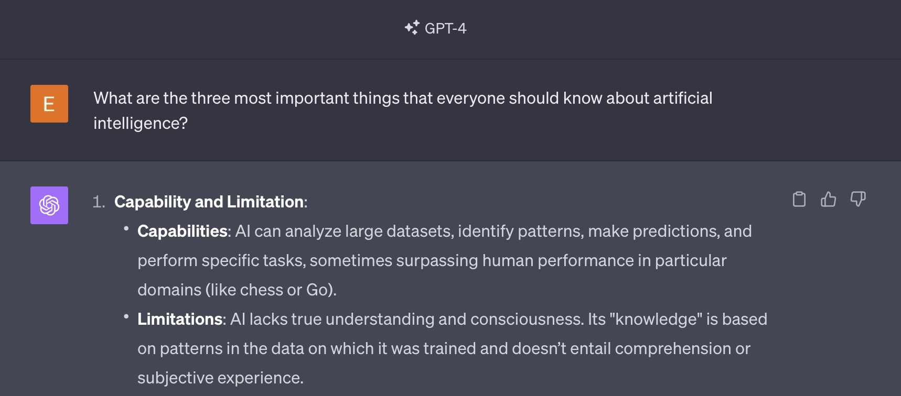
TL;DR

Slide 23
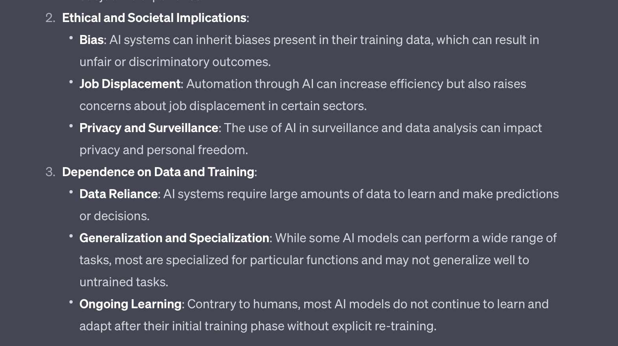
TL;DR

Slide 24
1. Introduction
Definition of Artificial Intelligence
Artificial Intelligence (AI) refers to the simulation of human intelligence in machines that are programmed to think like a human and mimic their actions. The term is applied to any machine that exhibits traits associated with a human mind such as learning, understanding, reasoning, problem-solving, perception, language understanding, and potentially, consciousness.
Explanation:
The fundamental objective of AI is to create systems capable of performing tasks that would typically require human intelligence.

Slide 25
What is “learning” (in humans/animals)?
"Learning" refers to the process of acquiring new, or modifying existing, knowledge, behaviors, skills, values, or preferences. The ability to learn is possessed by humans, animals, and some machines. Learning is not a singular process but occurs through various form:
Observational Learning: Learning by watching others, understanding, and then imitating the behavior.
Associative Learning: Making a new association between events in the environment, such as classical conditioning.
Reinforcement Learning: Learning through reward or punishment after performing an action.
Implicit Learning: Learning that takes place unconsciously or without awareness.
Explicit Learning: Learning that is conscious, where the individual is aware of the learning process.
Motor Learning: Acquiring and improving skills that involve movement, such as riding a bike.
Spatial Learning: Understanding and remembering the physical environment, spatial orientation, and dynamics.

Slide 26
What is “understanding” (in humans)?
"Understanding" refers to the ability to comprehend, grasp, or make sense of information or situations. It is a cognitive process whereby an entity processes and integrates information to make sense of it in a meaningful way. Understanding can pertain to concepts, problems, patterns, emotions, language, and more, and it's a fundamental aspect of intelligent behavior.
Cognitive Understanding: Grasping mental concepts, making sense of information, and being able to apply it to problem-solving situations.
Emotional Understanding: Being able to perceive and comprehend one’s own and others’ emotional states, also related to empathy.
Social Understanding: Recognizing and interpreting social cues, norms, and dynamics within a group or interaction.
Situational Understanding: Making sense of the events, entities, and implications in a given situation or scenario.

Slide 27
What is “understanding” (in AI)?
"Understanding" refers to the ability to comprehend, grasp, or make sense of information or situations. It is a cognitive process whereby an entity processes and integrates information to make sense of it in a meaningful way. Understanding can pertain to concepts, problems, patterns, emotions, language, and more, and it's a fundamental aspect of intelligent behavior.
Semantic Understanding: Machines processing and making sense of information at a level that goes beyond mere pattern recognition, incorporating meaning.
Contextual Understanding: Grasping the broader, relevant context in which information or data is embedded.
Natural Language Understanding (NLU): Interpreting and understanding human language, including the meaning of words in context, idiomatic expressions, and grammar.
Visual Understanding: Recognizing and interpreting visual data, understanding the relationship and significance of visual elements.

Slide 28
My favorite example of the problem with “understanding” in AI
Time flies like an arrow.

Slide 29
My favorite example of the problem with “understanding” in AI
Time flies like an arrow.
Fruit flies like an apple.

Slide 30
What is “understanding”?
In educational psychology, understanding is often related to Bloom's Taxonomy, where it is seen as the ability to explain ideas or concepts and goes beyond mere recall of facts.
In artificial intelligence, true understanding remains a formidable challenge. Machines struggle with abstract thinking, common-sense reasoning, and true semantic comprehension, even though advancements in machine learning and natural language processing have enabled systems to mimic understanding to a certain degree.
Understanding, whether in natural or artificial systems, forms the basis for informed decision-making, problem-solving, learning, and adaptation to new information and situations. It is a multifaceted concept explored in various domains, including psychology, cognitive science, philosophy, and computer science.

Slide 31
What is “consciousness” (in humans)?
"Consciousness" is a complex and multifaceted concept that has been explored and debated by philosophers, scientists, and thinkers throughout history.
Consciousness generally refers to the state of being aware of and able to think about one’s own existence, sensations, thoughts, and surroundings. It's the state of experiencing perceptions, emotions, and thoughts in a coordinated, integrated manner.
Psychological Aspect:
Self-awareness: Knowledge and thoughts about oneself.
Meta-awareness: Awareness of one’s own consciousness and mental processes.
Philosophical Aspect:
Dualism: The belief that mind and matter are fundamentally different.
Physicalism: The belief that everything about consciousness can be fully explained in terms of physical processes and phenomena.
Biological Aspect:
In biology, consciousness might be examined through the lens of evolutionary advantage and how it facilitates sophisticated interactions with the environment.

Slide 32
What is the current state of AI?
This is an incredibly important concept, as we move forward.
AI can be categorized broadly into two types:
Narrow AI (Weak AI): Systems that are designed and trained for a particular task without possessing general problem-solving abilities. For instance, voice assistants or image recognition systems.
General AI (Strong AI): Systems or machines with the ability to perform any intellectual task that a human being can. They can understand, learn, and apply knowledge across diverse domains, which is still largely theoretical and doesn’t exist yet.
According to experts in the field of artificial intelligence, Strong AI is something that is quite far off in the future; estimates vary, but are typically in the range of 50-100 years, at a minimum.

Slide 33
Modern Approaches and Subfields of AI
Machine Learning (ML): A subset of AI that allows systems to learn from data, improve from experience, and make predictions or decisions.
Example: classification systems – Captcha!
Deep Learning: A type of ML that utilizes neural networks with many layers (deep neural networks) to analyze various factors of data.
Example: understanding the stock market
Robotics: Design, construction, and operation of robots to perform tasks autonomously or semi-autonomously.
Examples: self-driving cars, drones
Natural Language Processing (NLP): Enabling machines to understand, interpret, generate, and respond to human language in a valuable way.
Examples: Siri, Alexa
Computer Vision: Allowing machines to interpret and make decisions based on visual data, i.e., images and videos.
Examples: Facial recognition systems

Slide 34
Applications of AI in Our World
Healthcare:
Diagnostic Aid: AI algorithms can analyze medical images, such as X-rays and MRIs, assisting in the early detection of conditions like cancer, diabetes, and cardiac diseases.
Treatment Personalization: AI facilitates personalized medicine by predicting patient responses to various treatments based on their medical history and genetic makeup.
Drug Development: AI accelerates the drug discovery process by analyzing complex biochemical interactions.

Slide 35
Applications of AI in Our World
Education:
Personalized Learning: AI can tailor educational experiences to meet individual student needs, adapting content and learning pathways to enhance knowledge acquisition.
Administrative Tasks: Automating administrative duties, such as grading assignments, allows educators to devote more time to teaching and student interaction.
Intelligent Tutoring Systems: AI tutors can offer additional support to students, guiding them through challenging topics outside classroom hours.

Slide 36
Applications of AI in Our World
Finance:
Algorithmic Trading: Employing algorithms to analyze market trends and execute trades at high speeds, optimizing financial outcomes.
Fraud Detection: AI systems can detect unusual patterns and activities within financial data, providing alerts related to potential fraud.
Customer Service: Chatbots and virtual assistants cater to customer inquiries and perform tasks like managing accounts and processing transactions.

Slide 37
Applications of AI in Our World
Manufacturing:
Quality Control: AI-driven systems monitor production lines, identifying and correcting imperfections, ensuring product quality.
Supply Chain Optimization: AI analyzes data to optimize inventory management and streamline supply chains, reducing operational costs.
Predictive Maintenance: Utilizing AI to predict when machinery is likely to fail or require maintenance, minimizing downtime.

Slide 38
Applications of AI in Our World
Retail:
Customer Experience: AI empowers retailers to offer personalized shopping experiences through recommendation engines and personalized marketing.
Inventory Management: Automating inventory control ensures optimal stock levels, reducing carrying costs, and preventing stockouts.
Virtual Try-Ons: Augmented Reality (AR) and AI enable customers to virtually try on products, enhancing online shopping experiences.

Slide 39
Applications of AI in Our World
Transportation and Automotive:
Autonomous Vehicles: Self-driving cars utilize AI to interpret sensor data, make decisions, and navigate roads with minimal human intervention.
Traffic Management: AI algorithms optimize traffic flow through smart signal control, reducing congestion and enhancing mobility.
Predictive Maintenance: AI predicts vehicle maintenance needs, enhancing reliability and reducing unexpected breakdowns.

Slide 40
Applications of AI in Our World
Agriculture:
Precision Farming: AI-driven technologies enable precise application of fertilizers and pesticides, optimizing yield while minimizing environmental impact.
Crop Monitoring: Employing drones and AI to monitor crop health, detect diseases, and predict yields.
Automated Harvesting: Developing autonomous machinery for tasks like harvesting, reducing labor needs, and enhancing efficiency.

Slide 41
Applications of AI in Our World
Environment and Climate Change:
Wildlife Preservation: Utilizing AI to monitor wildlife, predict threats, and develop conservation strategies.
Climate Modeling: Employing AI to enhance the predictive accuracy of climate models, aiding in the development of mitigation and adaptation strategies.
Resource Optimization: AI aids in optimizing resource utilization in various industries, contributing to sustainability and reducing environmental footprints.

Slide 42
Applications of AI in Our World
Legal:
Document Review: Automating the review of legal documents, AI can identify relevant materials, reducing manual labor and enhancing efficiency.
Legal Research: AI can streamline legal research, rapidly retrieving relevant case law and statutory provisions.
Contract Analysis: Employing AI to review and analyze contracts, identifying potential issues and providing insights.

