Slide 1
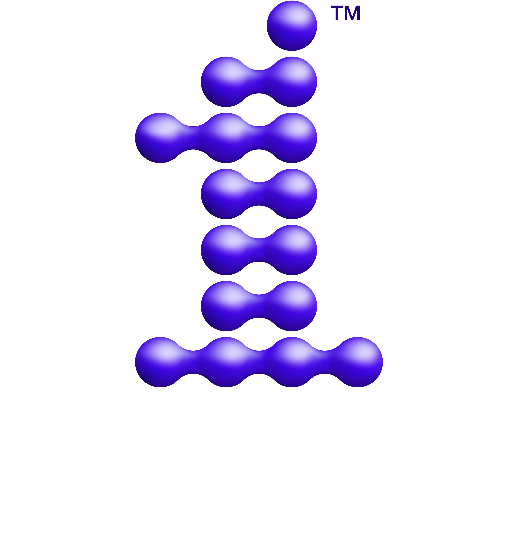
Data Parallel C++ Tab Meeting : Atomics
oneAPI Technical Advisory Board - July 1, 2020

Slide 2
Agenda
Motivation
Proposed Features
Questions & Next Steps

Slide 3
Motivation: Code Before Alignment with C++
template <typename T> void foo(global_ptr<T> a, local_ptr<T> b) { atomic(a).fetch_add(1); // Defaults to memory_order_relaxed atomic(b).fetch_add(1); // Defaults to memory_order_relaxed }
Three important differences relative to standard C++:
std::atomic cannot be constructed from a pointer
std::atomic and sycl::atomic default to different memory orderings
SYCL says nothing about how local memory is ordered with respect to global memory

Slide 4
Motivation: Common Patterns Are Broken
// write partial output to global reduction array reduction[it.get_group_id()[0]] = LocalSum[0]; // signal completion of write to global array int position = atomic(ncompleted).fetch_add(1); // if work-group is last to arrive if (position == it.get_group_range()[0] - 1) { // finish reduction }
Code like this is not guaranteed to work according to SYCL 1.2.1
Completion of atomic operation does not imply visibility of preceding writes

Slide 5
Motivation: Code After Alignment with C++
namespace sycl { namespace intel { template <typename T, memory_order DefaultOrder, memory_scope DefaultScope, access::address_space Space> struct atomic_ref; } } template <typename T> void foo(global_ptr<T>* a, local_ptr<T>* b) { atomic_ref<T, memory_order::seq_cst, memory_scope::device, access::address_space::global_space>(*a).fetch_add(1); atomic_ref<T, memory_order::seq_cst, memory_scope::device, access::address_space::local_space>(*b).fetch_add(1); }
Three changes:
std::atomic_ref and sycl::intel::atomic_ref can be constructed from reference
std::atomic_ref and sycl::intel::atomic_ref support all standard memory orders
a must always be updated before b ⇒ a single happens-before for all address spaces

Slide 6
sycl::atomic => intel::atomic_ref
Deprecate cl::sycl::atomic and replace it with intel::atomic_ref.
intel::atomic_ref is mostly aligned with C++20 std::atomic_ref:
Stores a reference instead of owning data
Can be constructed from a reference in the local or global address space
Default argument for memory_order determined by templates
Convenience operators like += and ++
Support for arithmetic operators on float/double
No wait(), notify_one() or notify_all() – synchronization is error-prone today

Slide 7
Memory Orderings and Scopes
We want to support:
All standard C++17 memory orderings (without consume)
Devices that cannot implement sequential consistency (e.g. OpenCL 1.2 devices)
Contexts that cannot implement inter-device sequential consistency
Optimizations based on intended visibility of memory updates
Queries return lists of supported values:
OpenCL 1.2 device: orders = { relaxed } scopes = { work_item, sub_group, work_group }
OpenCL 2.0 device: orders = { relaxed, acquire, release, acq_rel, seq_cst } scopes = { work_item, sub_group, work_group, device, system }

Slide 8
A Single Happens-Before Relation
OpenCL 2.0 splits the happens-before relation for local and global memory
More recent work suggests this split is unnecessary:
Gaster et. al suggest treating local memory as memory supporting limited scope [1]
CUDA does not appear to split the happens-before relation [2]
Writing a formal memory model extending C++ with scopes is a WIP
[1] https://uwe-repository.worktribe.com/preview/836458/opencl_memory_model.pdf [2] https://github.com/NVlabs/ptxmemorymodel/blob/master/PTXMemoryModelASPLOS2019.pdf

Slide 9
Changes to Fences and Barriers
Fences:
Deprecate nd_item::fence(address_space = global_and_local)
Introduce intel::atomic_fence(memory_order, memory_scope)
Barriers:
Need to be described in terms of how they interact with the memory model
e.g. A barrier should execute a release fence, synchronize, then an acquire fence

Slide 10
Changes to Memory Consistency Model
Based upon C++ memory model; default behavior of SYCL is very close* to C++.
All SYCL compilers required to support C++17 compilation (and C++17 memory model)
Different consistency guarantees at different scopes:
Work-item code follows sequenced-before rules
Work-groups can always enforce consistency via barriers, conditionally via atomics
Work-items in different work-groups can conditionally enforce consistency via atomics
Memory consistency guarantees are independent of forward progress guarantees. Implementing work-group synchronization is still not portable.
* There is still a difference due to the visibility of private and local memory

Slide 11
Questions
Should we support std::atomic_ref in device code?
If yes, should it forward to intel::atomic_ref<seq_cst, system>?
Do we need a std::atomic-like interface as well as atomic_ref?
If yes, what are the expectations regarding definitions and capture?
e.g. Passing a std::atomic<T>* to a kernel?
e.g. Defining std::atomic<T> objects in global or local memory?

Slide 12
Summary & Next Steps
New atomic features:
Adopt familiar C++ syntax and behavior
Expose new functionality to more capable devices
Next steps:
Shorthand atomic_accessor to replace access::atomic; need order and scope
Define formal memory model extending C++ with scopes

Slide 14
Notices & Disclaimers
This document contains information on products, services and/or processes in development. All information provided here is subject to change without notice.
Intel technologies’ features and benefits depend on system configuration and may require enabled hardware, software or service activation. Learn more at intel.com, or from the OEM or retailer.
Software and workloads used in performance tests may have been optimized for performance only on Intel microprocessors. Performance tests, such as SYSmark and MobileMark, are measured using specific computer systems, components, software, operations and functions. Any change to any of those factors may cause the results to vary. You should consult other information and performance tests to assist you in fully evaluating your contemplated purchases, including the performance of that product when combined with other products. For more complete information visit www.intel.com/benchmarks.
INFORMATION IN THIS DOCUMENT IS PROVIDED “AS IS”. NO LICENSE, EXPRESS OR IMPLIED, BY ESTOPPEL OR OTHERWISE, TO ANY INTELLECTUAL PROPERTY RIGHTS IS GRANTED BY THIS DOCUMENT. INTEL ASSUMES NO LIABILITY WHATSOEVER AND INTEL DISCLAIMS ANY EXPRESS OR IMPLIED WARRANTY, RELATING TO THIS INFORMATION INCLUDING LIABILITY OR WARRANTIES RELATING TO FITNESS FOR A PARTICULAR PURPOSE, MERCHANTABILITY, OR INFRINGEMENT OF ANY PATENT, COPYRIGHT OR OTHER INTELLECTUAL PROPERTY RIGHT.
Copyright © 2020, Intel Corporation. All rights reserved. Intel, the Intel logo, Xeon, Core, VTune, and OpenVINO are trademarks of Intel Corporation or its subsidiaries in the U.S. and other countries. Khronos® is a registered trademark and SYCL is a trademark of the Khronos Group, Inc.
Optimization Notice
Intel’s compilers may or may not optimize to the same degree for non-Intel microprocessors for optimizations that are not unique to Intel microprocessors. These optimizations include SSE2, SSE3, and SSSE3 instruction sets and other optimizations. Intel does not guarantee the availability, functionality, or effectiveness of any optimization on microprocessors not manufactured by Intel. Microprocessor-dependent optimizations in this product are intended for use with Intel microprocessors. Certain optimizations not specific to Intel microarchitecture are reserved for Intel microprocessors. Please refer to the applicable product User and Reference Guides for more information regarding the specific instruction sets covered by this notice. Notice revision #20110804

