Slide 1

Level Zero Specification & How to Participate

Slide 2
Introduction
Level Zero is foundational component of oneAPI
Spec v1.4 published in May
Extensions for querying device properties and topologies
Spec clarifications
Starting with Level Zero Spec v1.5
Support better community engagement
More visibility into the development of the spec
Open source the spec development framework (June)
https://github.com/oneapi-src/level-zero-spec
Notes:
Position about what this looks like…
Now that this is going to be open source… describe the spec development framework.

Slide 3
Level Zero Specification - Chapters
Introduction
Programming Guides
Core (ze)
Tools (zet)
Sysman (zes)
SPIR-V
Extensions
Standard
Experimental
API Documentation
Versions

Slide 4
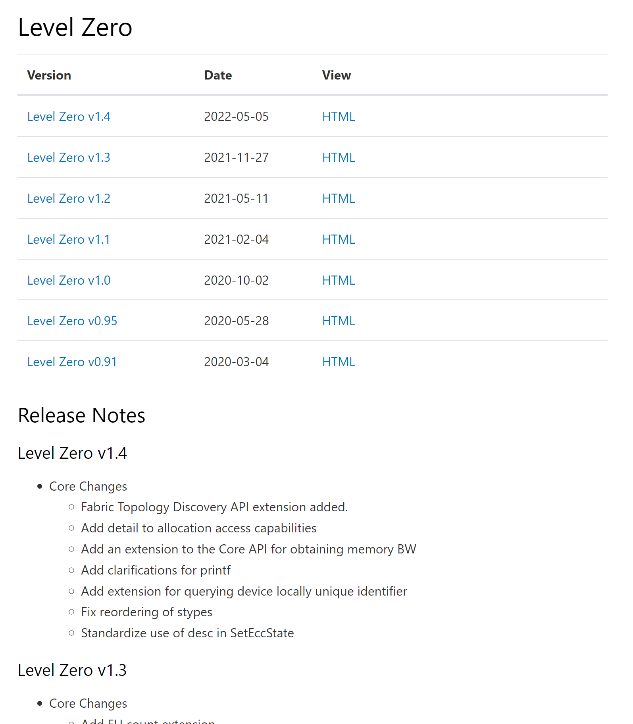
Level Zero Specification – Release Notes
https://spec.oneapi.io/releases/index.html#level-zero

Slide 5
Level Zero Specification - Framework
Scripts generate specification and headers
1
run.py
API Spec
.yml
2
parse_specs.py
Dictionary
Programming
Guide
generate_code.py
generate_docs.py
3
API .h/.cpp
Spec
HTML/PDF
4
5

Slide 6
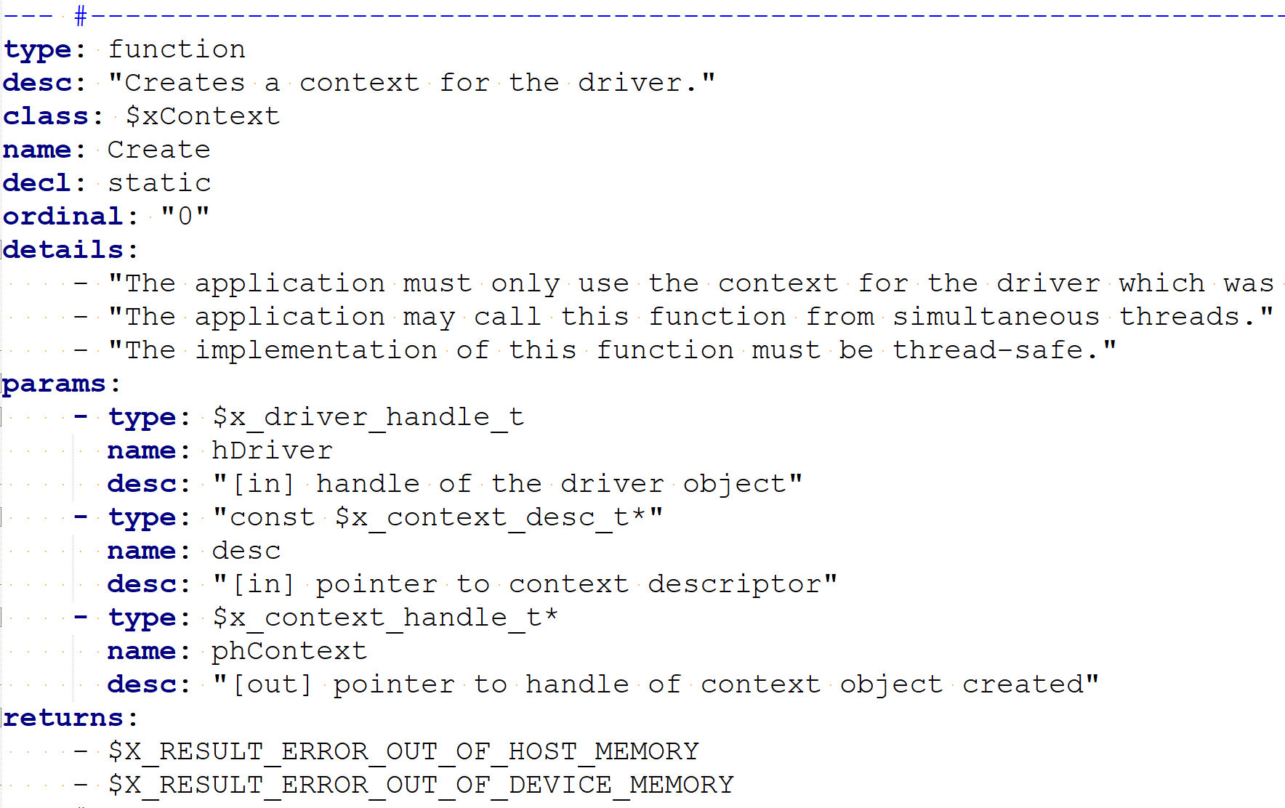
Level Zero Specification - YAML

Slide 7
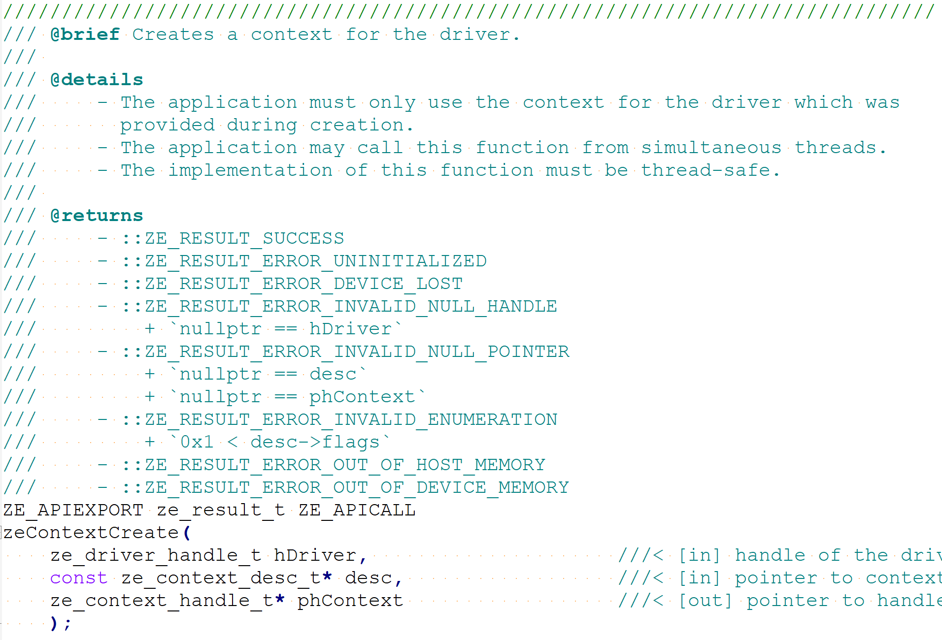
Level Zero Specification - Headers

Slide 8
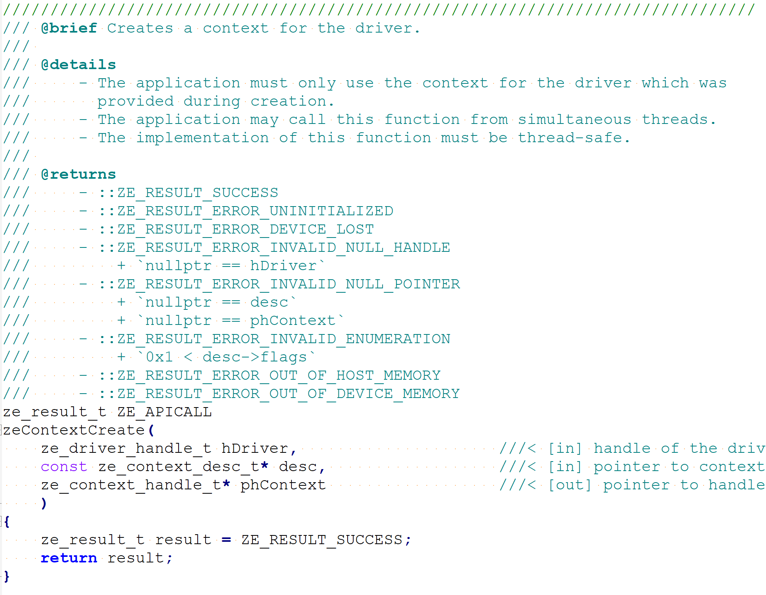
Level Zero Specification – Implementation

Slide 9
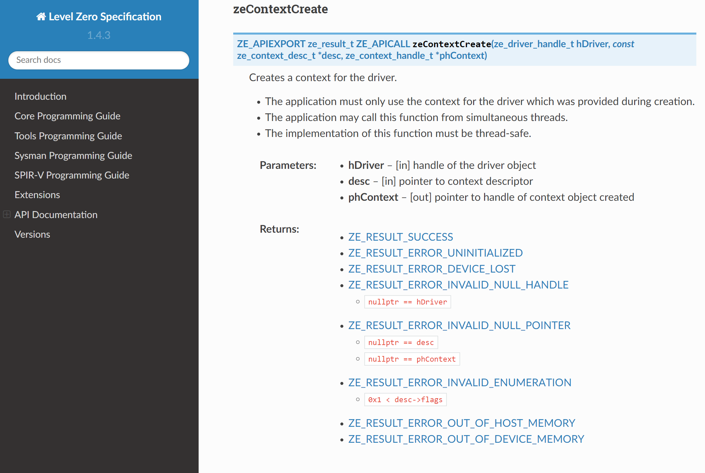
Level Zero Specification – API Specification

Slide 10
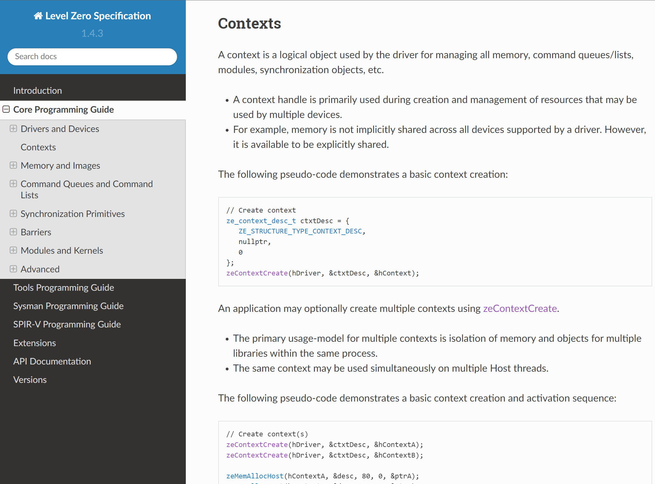
Level Zero Specification – Programming Guides

Slide 11
Level Zero Specification – Programming Guides
PROG.rst(122) : error : $xContextCreate parameter count mismatch - 2 actual vs. 3 expected
Line 122 = ${x}ContextCreate(hDriver, &ctxtDesc);

Slide 12
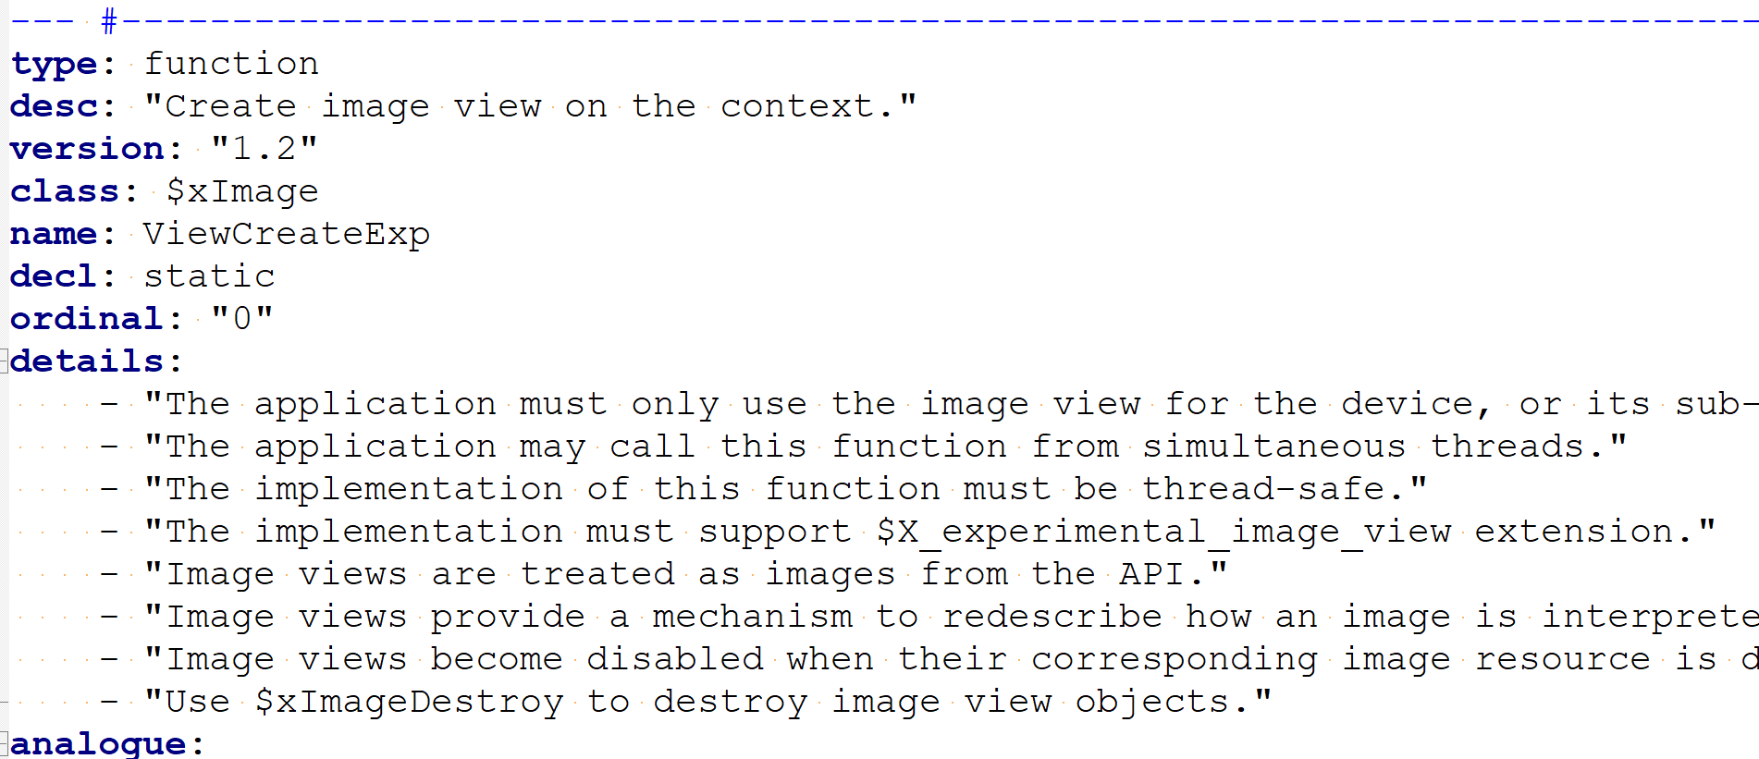
Level Zero Specification – YAML Versioning

Slide 13
Versioning - Backward Compatibility
Minor version increment
Additional functionality
Promoted extensions
Must retain backward compatibility
Adding new functions and structures
Adding enumerations, and using reserved bits
Major version increment
Modified or remove functionality
May break backward compatibility
Modifying existing functions and structures
Removing functions and structures

Slide 14
Next Steps
Release spec development framework
Post spec issues from internal repo
Organize candidate spec update for Spec v1.5
https://github.com/oneapi-src/level-zero-spec

Slide 15
Level Zero Specification and Repositories
Level Zero Specification​
https://spec.oneapi.com/versions/latest/elements/l0/source/index.html​
Level Zero Specification Github
https://github.com/oneapi-src/level-zero-spec
Level Zero Loader
https://github.com/oneapi-src/level-zero​
Level Zero Tests (Conformance and Performance)​
https://github.com/oneapi-src/level-zero-tests​
Level Zero Intel GPU Driver​
https://github.com/intel/compute-runtime​

Slide 16
Call to Action
Contribute to Level Zero Specification
Filing issues and contribute to discussions in GitHub
Contribute spec changes and extensions
Help us evolve Level Zero
What new Level Zero features should we consider?
Level Zero clarifications?
What refactoring should we do for Spec 2.0?
What Level Zero topics are interesting for future TAB meetings?

Slide 17
Thank You!
http://oneapi.io

Slide 18
Level Zero Extension Life Cycle
Private Driver Extension
Exposed via zeDriverGetExtensionFunctionAddress
For highly specific or experimental functionality
Experimental Extension (EXP)
Uses the spec and layers toolchain
No forward or backward compatibility guarantees!
Functionality can change or disappear
Standard Extension (EXT)
Adds compatibility guarantees
Ideally includes testing
Expect support for multiple hardware generations
Core API Feature
Versioned features with full compatibility guarantees
https://spec.oneapi.io/level-zero/latest/core/EXT.html#naming-convention

Slide 19
Level Zero Extension Life Cycle Notes
Private Driver Extension
All extensions may be optionally supported!
Can skip steps, e.g. some features may be implemented directly as standard extensions or core features
Some features may remain extensions indefinitely
Experimental extensions should (ideally) be short-lived
Either dropped or transitioned to standard extensions
Experimental Extension (EXP)
Standard Extension (EXT)
Core API Feature
https://spec.oneapi.io/level-zero/latest/core/EXT.html#naming-convention

