Slide 1

oneAPI Level Zero Technical Advisory Board

Slide 2
Welcome and Thanks
A unique opportunity to steer the parallel programming ecosystem
A problem worth solving
Multi-architecture, avoiding lock-in to 1 specific hardware architecture
Direct and library-based programming
Extending existing models
Performant
Your leadership, input, and feedback is critical

Slide 3
Rules of the Road
DO NOT share any confidential information or trade secrets with the group
DO keep the discussion at a High Level
Focus on the specific Agenda topics
We are asking for feedback on features for the oneAPI specification (e.g. requirements for functionality and performance)
We are NOT asking for feedback on any implementation details
Please submit any feedback in writing on Github in accordance with the Contribution Guidelines at spec.oneapi.com. This will allow Intel to further upstream your feedback to other standards bodies, including The Khronos Group SYCL* specification.

Slide 4
Agenda
oneAPI Welcome & Introduction – Paul Petersen, Intel
Level Zero:
Specification & How to Participate -- Zack Waters, Intel
Discussion Topic:
Separation of Sysman from core Level Zero APIs -- Ben Ashbaugh, Intel
Wrap up, Question & Answer – All

Slide 5
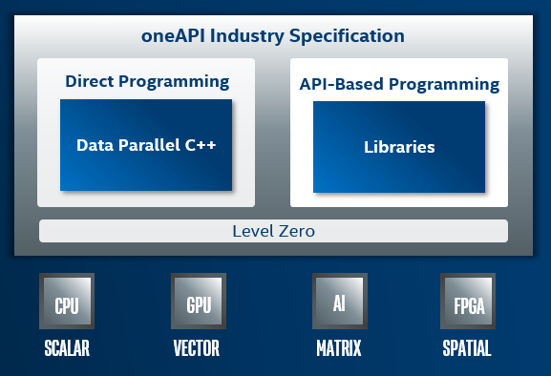
oneAPI
A unified programming model to simplify development across diverse architectures
Common developer experience across architectures
Unified and simplified language and libraries for expressing parallelism
Uncompromised native high-level language performance
Interoperates with existing languages and libraries
Support for CPU, GPU, AI and FPGA
Based on industry standards and open specifications

Slide 6
Does oneAPI need a Unified Runtime?
Why is Level Zero as a defned not already sufficient?
Level Zero provides a low-level abstraction to a device.
Can we provide richer constructs for cross-platform and cross-API enabling?
What are the Design principles?
Is it Deterministic – How would you support tuning heuristics?
Is it Stateless – How would you support callbacks to be registered?
What features are missing to support your favorite language?
Do we need special support for the CPU?
CPU device driver or resource management?
Leverage common components -- hwloc / memkind / numa?

Slide 7
Evolution of Level Zero
Level Zero
Unified Runtime
Device Abstractions

Slide 8
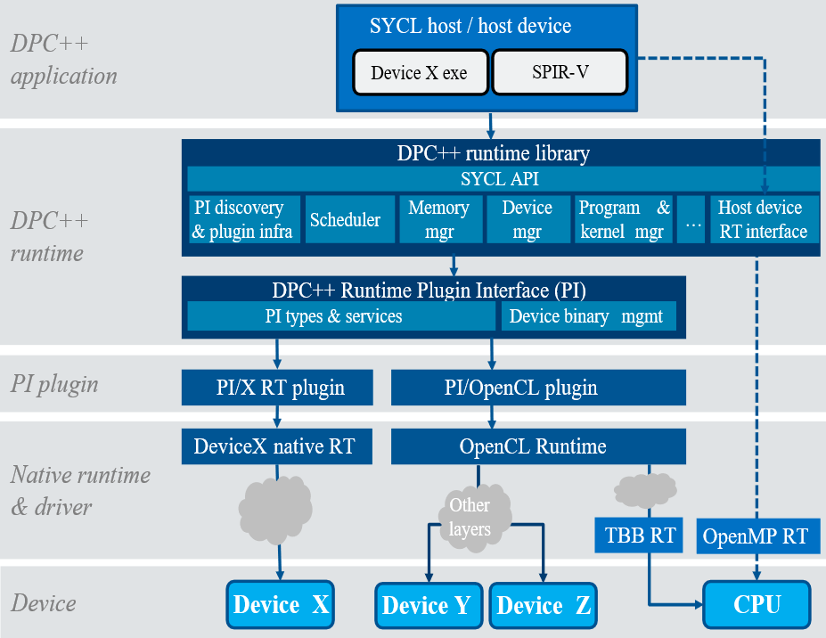
DPC++ Runtime Plugin Interface
Problem Statement:
Plugin Interface is an implementation detail
No formal specification
Plugin Interface is only usable by the DPC++ Runtime
Other language runtimes must duplicate functionality
Plugin Interface has deep OpenCL heritage
Diagram Source: https://github.com/intel/llvm/blob/sycl/sycl/doc/PluginInterface.md
(Note: slightly out-of-date!)

Slide 9
Proposal: Unified Runtime API
Refactor and formalize Plugin Interface into Unified Runtime APIs for use by multiple language runtimes
Refactor existing plugins into Unified Runtime API Adapters
Refactor, generalize, and modernize adapter interface
Enable new backends by implementing new Unified Runtime API Adapter
Eventually: Move common utility functionality to Unified Runtime API?
Parallel Language Runtimes
New
a
Unified Runtime API
e
Utility Functions?
c
b
d
Level Zero
“Driver” API
OpenCL Adapter
CUDA Adapter
ROCm Adapter
TBD API Adapter
Level Zero
Driver
OpenCL Driver
CUDA Driver
ROCm Driver
TBD API Driver
XPU
OpenCL XPU
NVIDIA GPU
AMD GPU
TBD XPU

Slide 10
Request
“Our” initiative – help to frame it for your needs
Be brutally honest – good and bad
Invite your friends – and have fun

Slide 11
oneCCL Specification
Thank You!
http://oneapi.com

