Slide 1
uNMR firmware progress
Jan – Feb -

Slide 2
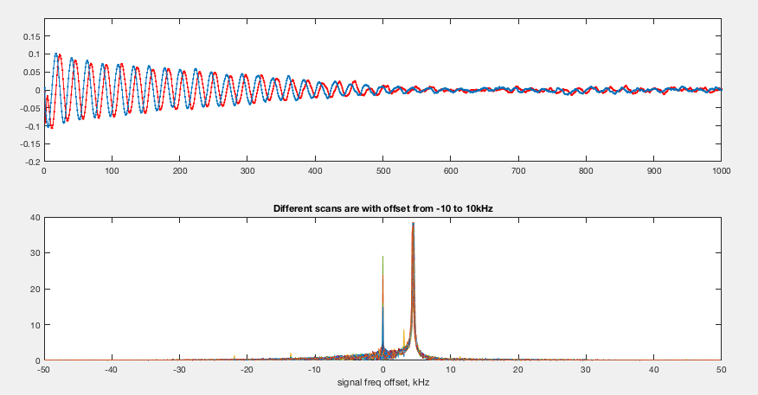
FID

Slide 3
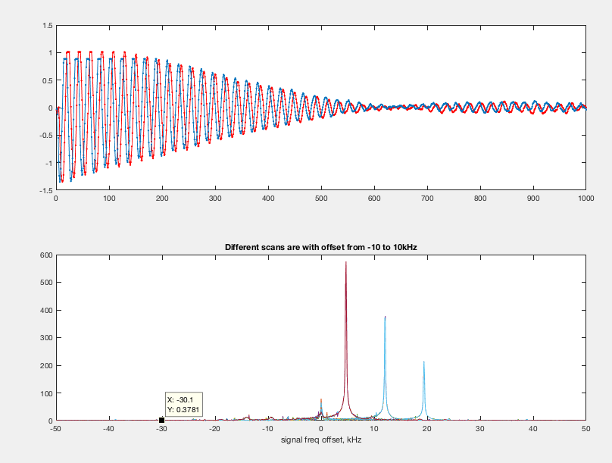
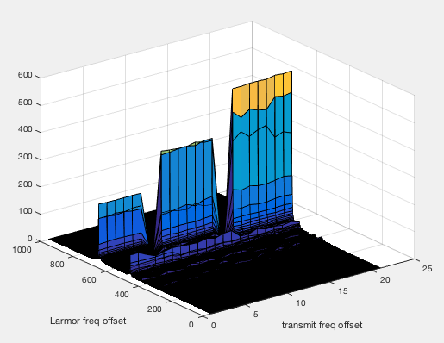
Freq issue

Slide 4
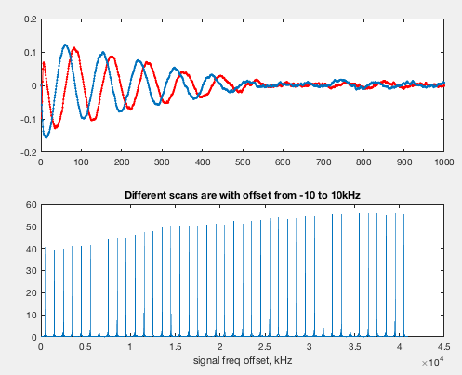
Tuning

Slide 5
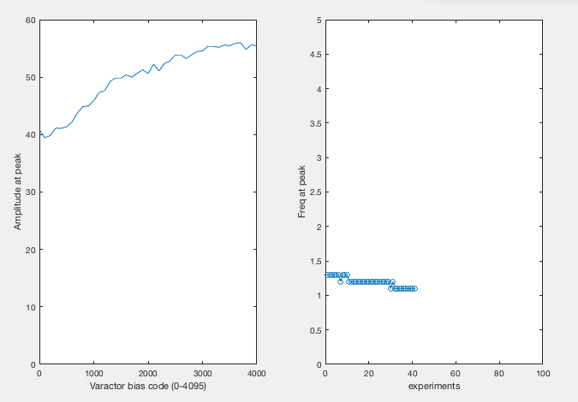

Slide 6
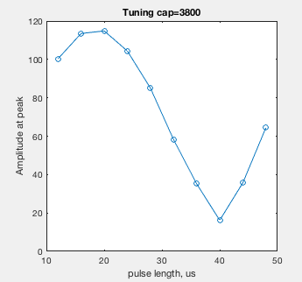
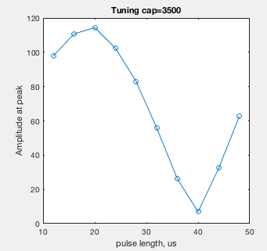
T90

Slide 10
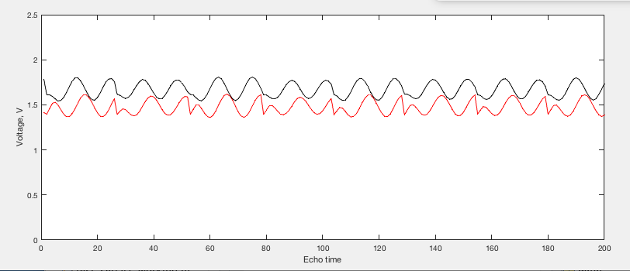
CPMG

Slide 11
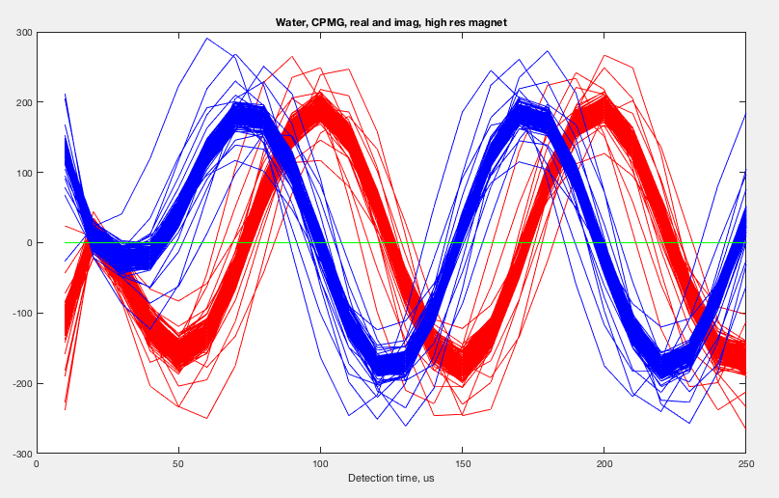

Slide 12
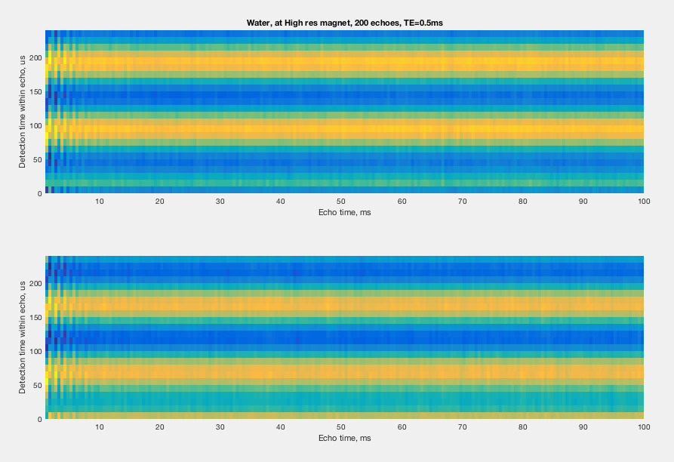

Slide 13
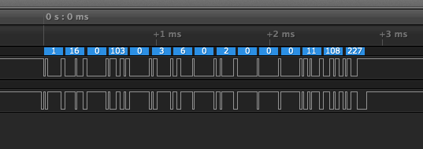
Serial transmission problem
Bit patterns with fwrite.
Fprintf does not transmit 10.

Slide 14
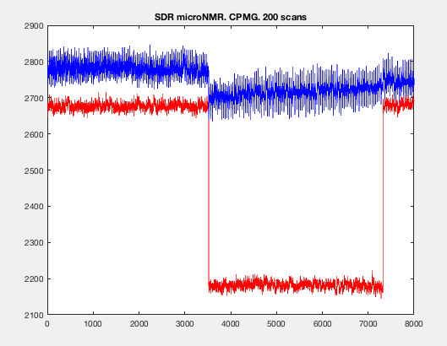
Sudden phase jump

Slide 15
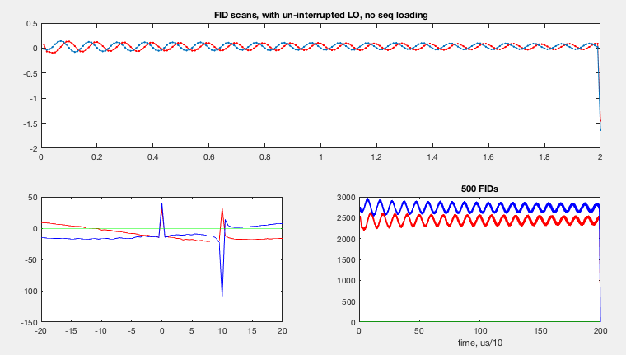
Phase testing

Slide 16
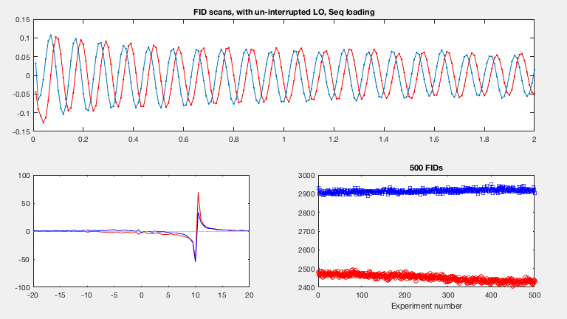
500 FIDs, with seq loading, LO uninterrupted

Slide 17
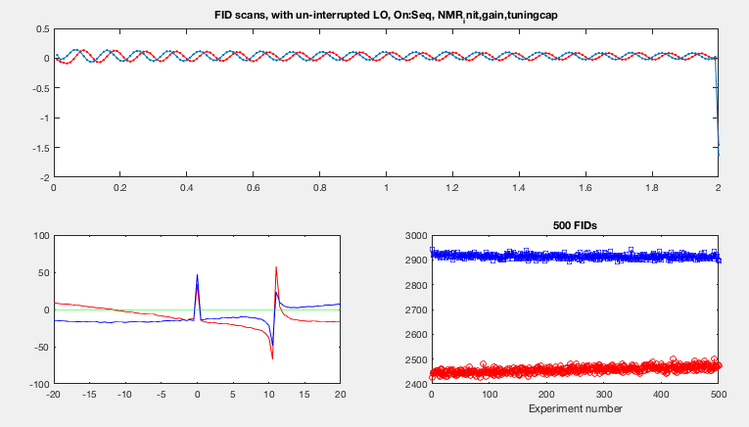
500 fids, LO uninterrupted, all others ON

Slide 18
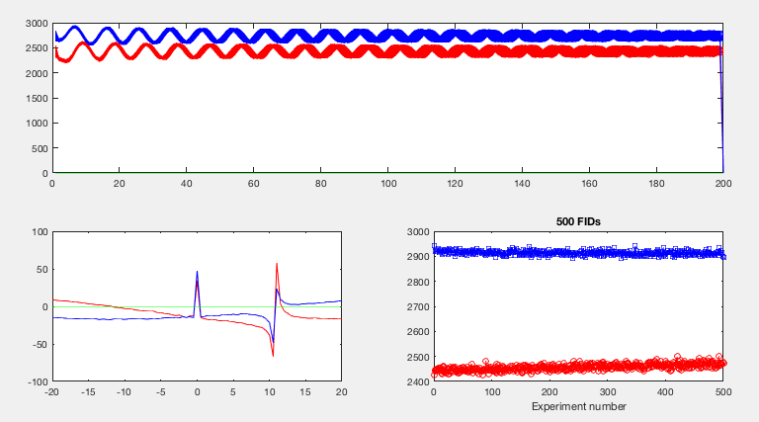
Same data as prev

Slide 19
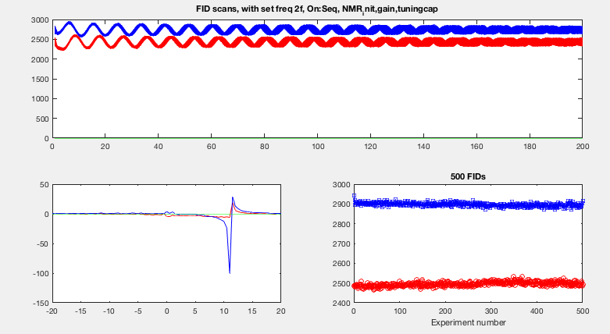
Set PLL freq.

Slide 20
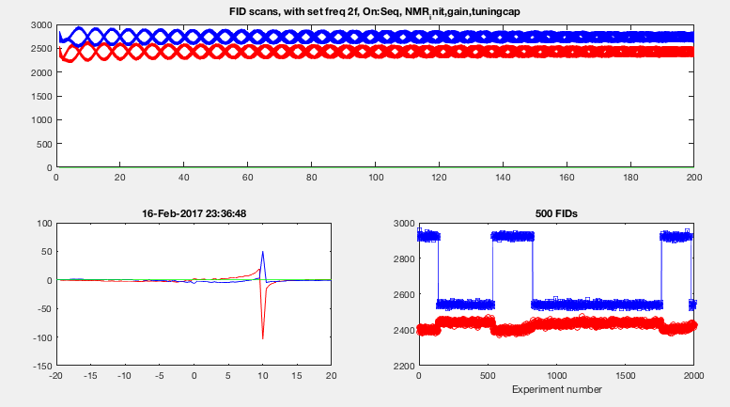
With set freq 2f

Slide 21
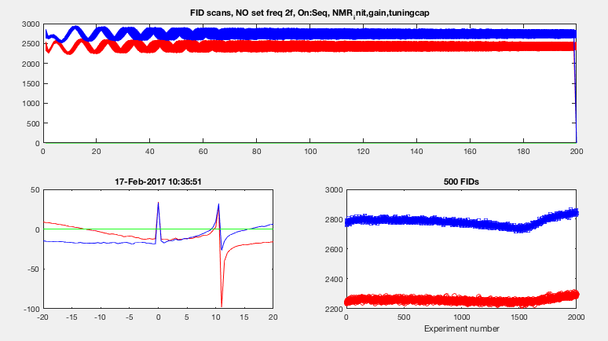
No set freq 2f

Slide 22
Circuit response measurement
Inject RF pulse through the tuning coil (weak coupling to tank circuit)
Pulse seq:
200 us – RF pulse (300 us) – wait time 100ms
Detect from the beginning, obtain RF pulse shape

Slide 23
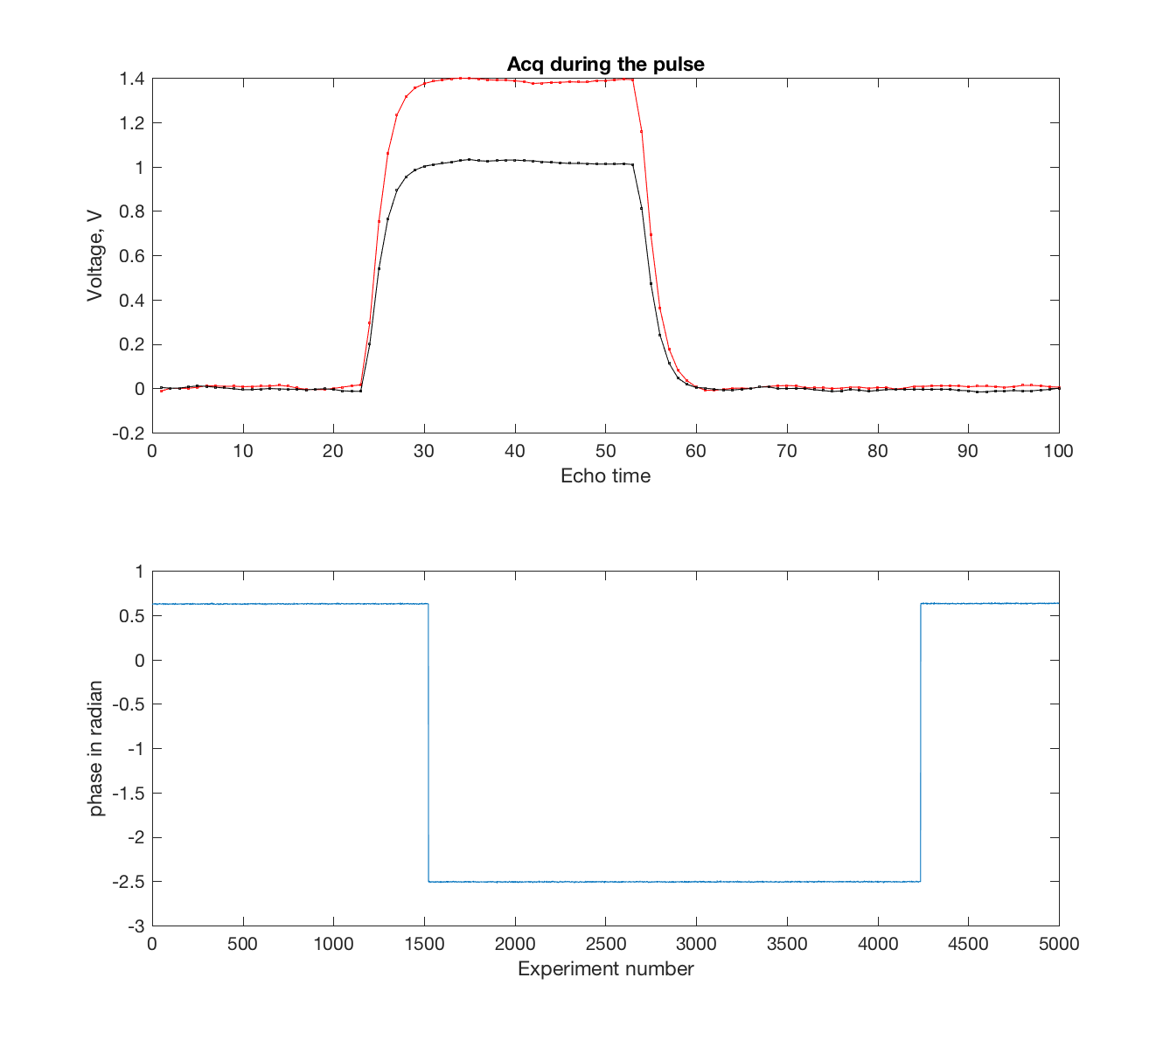
Detect signal during pulse
Phase of RF

Slide 24
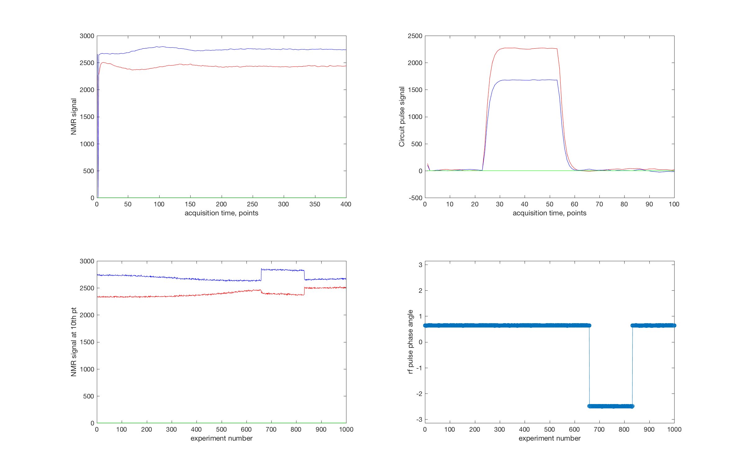
See phase jump in sync with NMR data

Slide 25
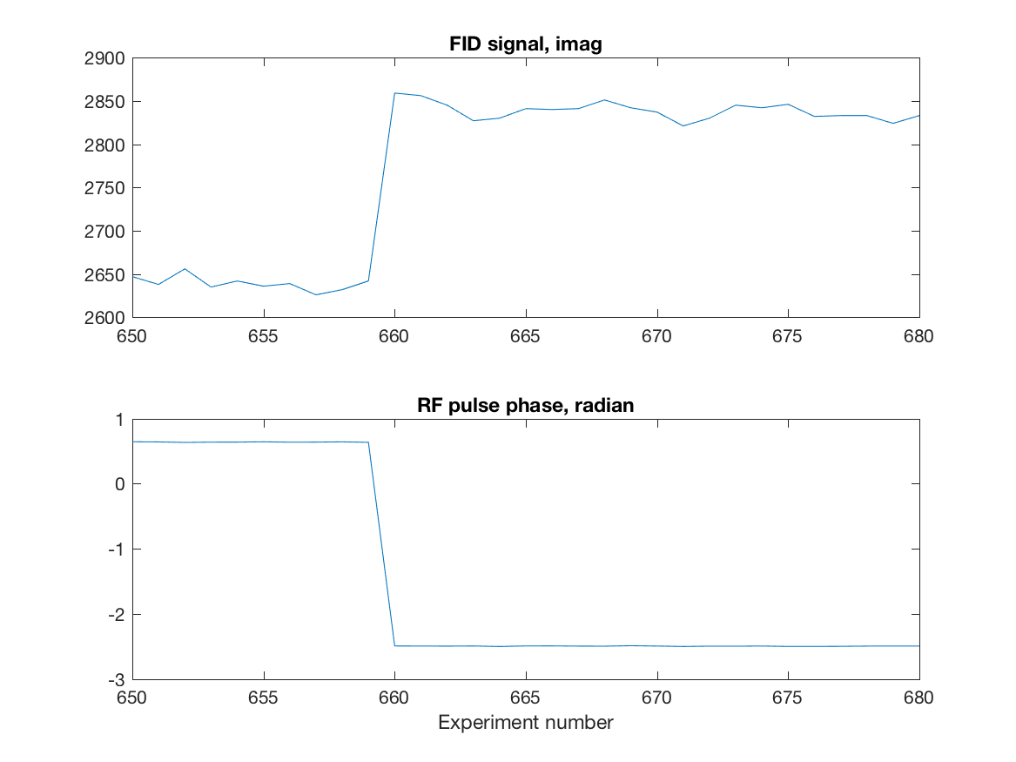
Phase Jump

