Slide 1
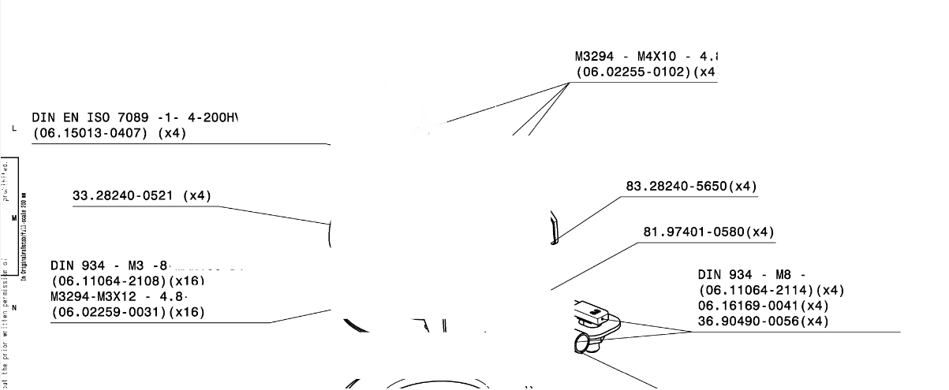
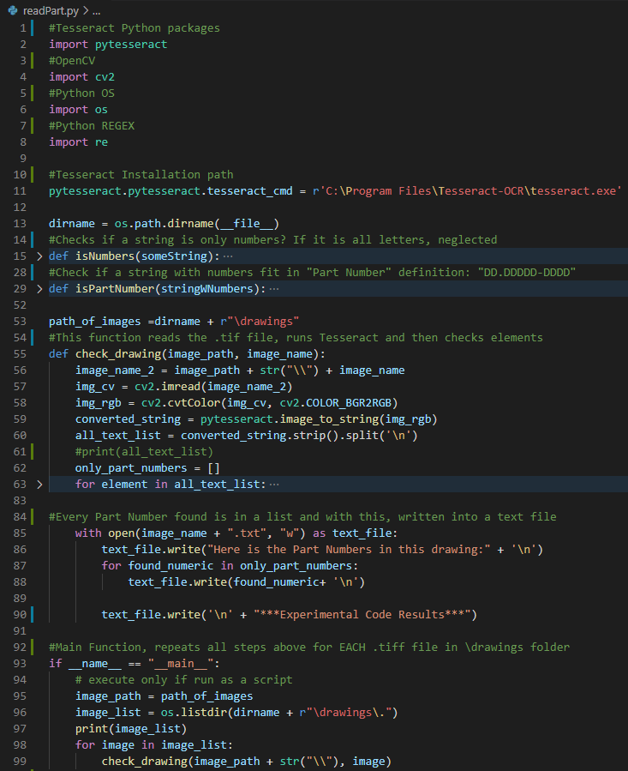
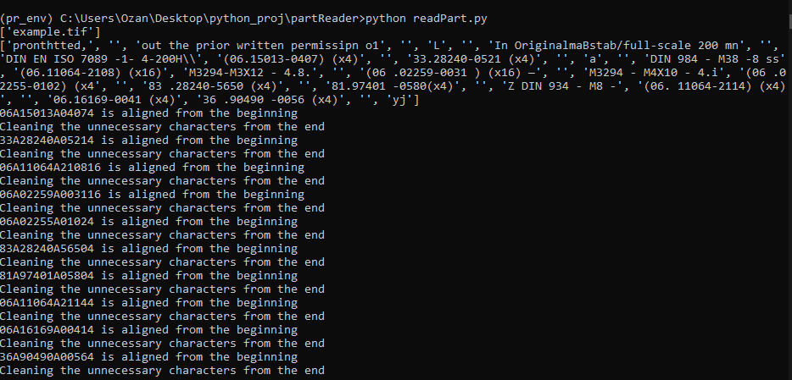
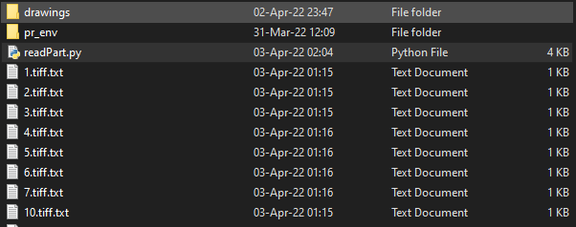
example.tif
Read #Comments
Technical drawing name(s) will be displayed in command line
Run Script readPart.py via command line
Raw Text Output of Tesseract
(This print out is for demonstration
Purposes only, commented out in the code)
Raw text is:
-Filtered & Seperated
-Aligned
According to part number’s format.
Filter Rules:
Part numbers does not contain alphabetical values.
Part Numbers only contain two special characters, «.» & «-»
Part Numbers only contain digits(D)
DD.DDDDD-DDDD
NOTE THAT, «.» & «-» are replaced with char «A».
This can be modified to re-insert «.» & «-» ilo «A»s
Part Number .txt files are placed into same directory with the script. Each .tiff will have its own .txt file

