Slide 1
GANs in action
AutoEncoder, GAN, DCGAN
한병찬

Slide 2
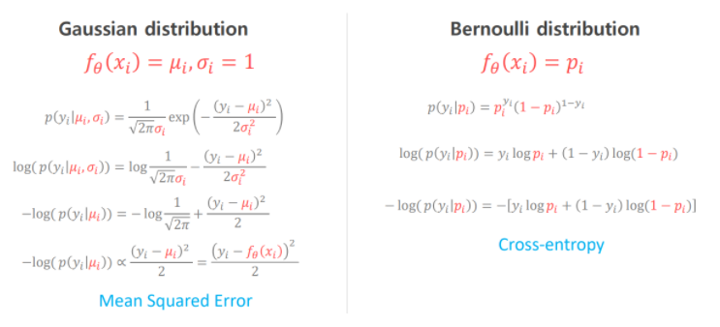
Generative model

Slide 3
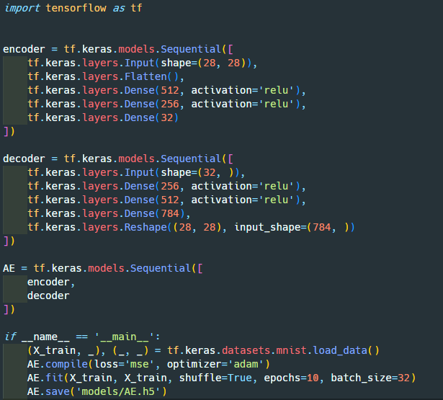
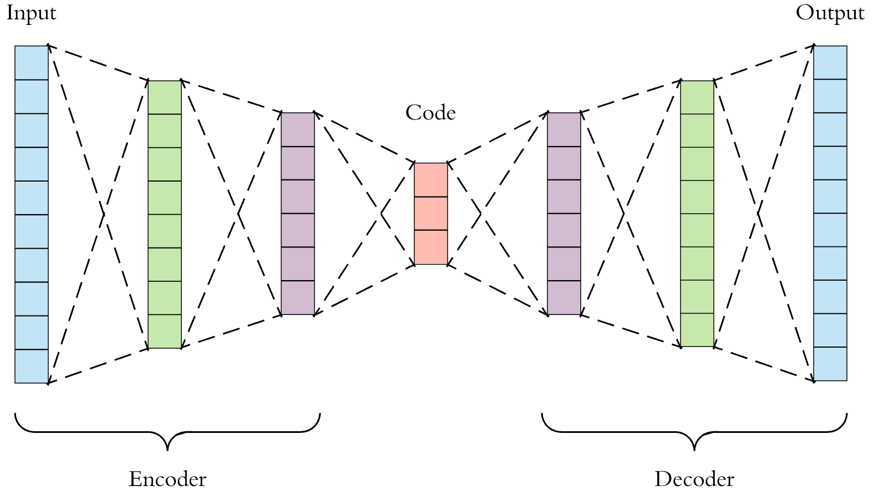
AE(AutoEncoder)

Slide 4
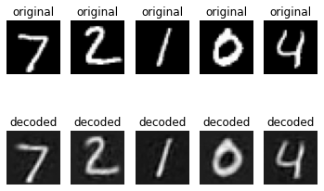
AE(AutoEncoder)

Slide 5
VAE(Variational AutoEncoder)

Slide 6
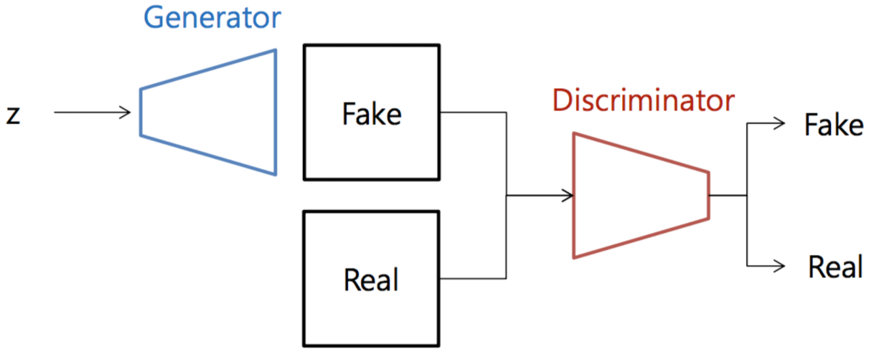
GAN(generative adversarial network)

Slide 7


GAN(generative adversarial network)
$$Objective Function$$
$$Discriminator: D\left(x\right) → 1, D\left(G\left(z\right)\right)→ 0$$
$$Generator: D\left(G\left(z\right)\right) → 1$$

Slide 8
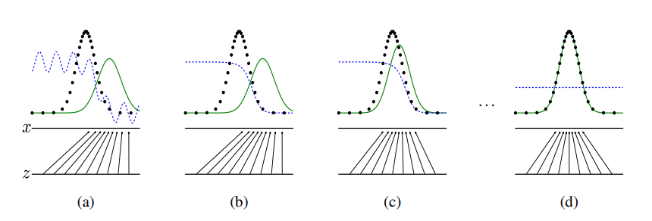
GAN(generative adversarial network)

Slide 9
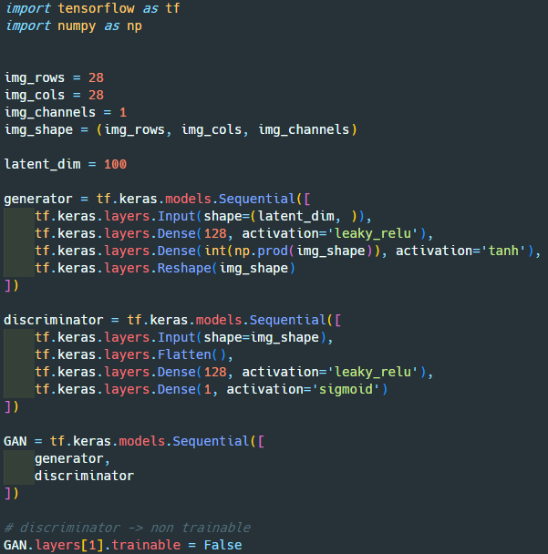
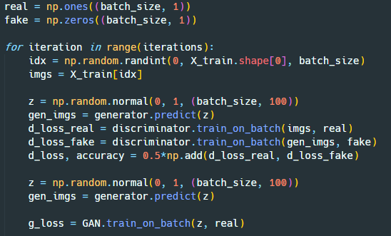
GAN(generative adversarial network)

Slide 10
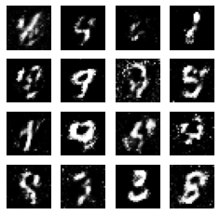
GAN(generative adversarial network)

Slide 11
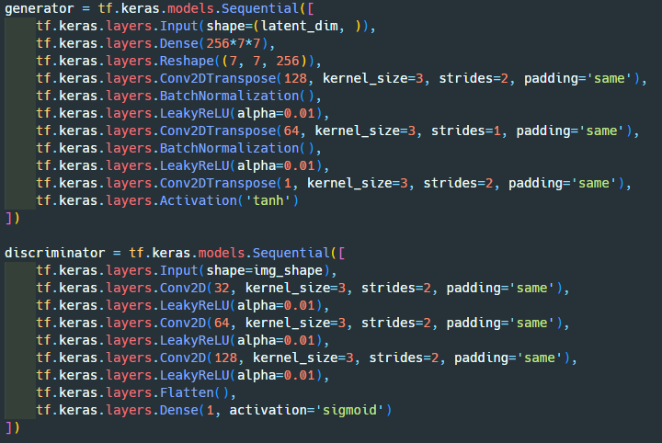
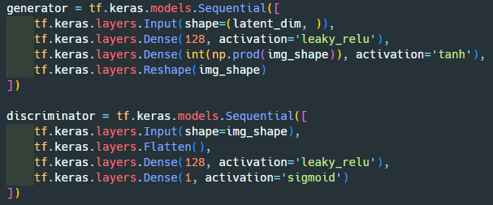
DCGAN(Deep Convolutional GAN)

Slide 12
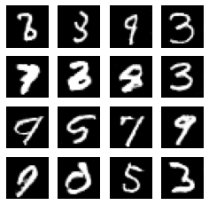
DCGAN(Deep Convolutional GAN)

Slide 13
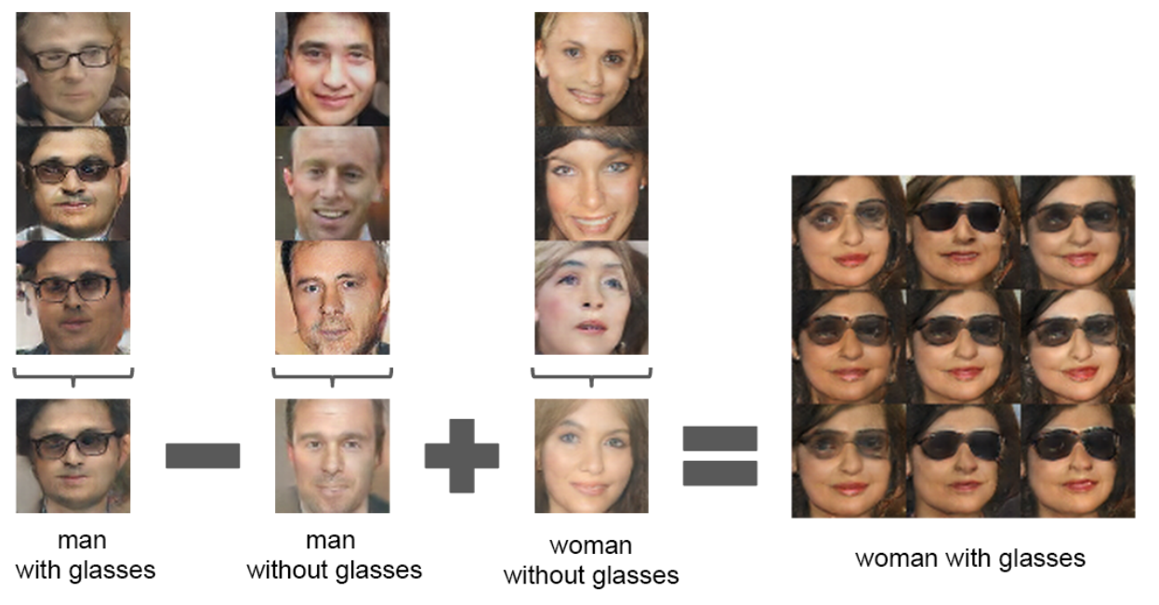
DCGAN(Deep Convolutional GAN)

