Slide 1
Top-Down Approach
Cre: Mike Zalo: Mèo Già

Slide 2
Top-Down Appoach
01
Introduction.
Overview of Top-down approach.
02
Why should you use Top-down approach?
Top-down approach will help you in your work.
03
Steps to implement.
Top-down approach will help you in your work.
04
Attention
Summary of items to attention when applying Top-down.

Slide 3
Introduction.
Overview of Top-down approach.
“
Top-Down Approach is a management and development methodology that begins with an overarching view of the system or project and progressively breaks it down into smaller, more detailed components. It involves starting with high-level strategic decisions and then incrementally adding specific elements in a step-by-step fashion. This method is commonly used in project management and software development to establish a clear overall picture before delving into specific details, promoting organized and systematic work.
“

Slide 4
Why should you use Top-down approach?
Top-down approach will help you in your work.
Clarity and Vision
01
Provides a clear overall vision of the project or system before delving into details.
Helps stakeholders and team members understand the big picture and overarching goals.
Effective Planning
02
Facilitates effective planning by breaking down complex tasks into manageable and organized components.
Enables the creation of a structured roadmap for project execution.
Strategic Decision-Making
03
Allows for strategic decision-making at the beginning of a project.
Helps in defining high-level goals and objectives before focusing on specific tasks.
Progress Monitoring
04
Facilitates easier monitoring of progress as tasks are completed step by step.
Provides opportunities to evaluate achievements and make adjustments as needed.

Slide 5
Why should you use Top-down approach?
Top-down approach will help you in your work.
Resource Allocation
05
Aids in the efficient allocation of resources by identifying critical tasks and priorities.
Allows for better management of time, budget, and personnel.
Risk Management
06
Helps in identifying potential risks and challenges early in the project.
Enables proactive risk management and mitigation strategies.
Communication
07
Enhances communication among team members and stakeholders by providing a common understanding of project goals.
Facilitates effective communication of project status and updates.

Slide 6
Why should you use Top-down approach?
Top-down approach will help you in your work.
Organized Development
08
Particularly beneficial in software development for creating well-structured and modular programs.
Allows for the systematic development of software components from high-level functionality to detailed implementation.
Alignment with Goals
09
Ensures that every task and component aligns with the overall objectives of the project.
Reduces the risk of diverging from the project's primary goals.
Adaptability
10
Permits adjustments and refinements to the plan based on changing circumstances or new information.
Enhances adaptability to evolving project requirements.

Slide 7
Steps to implement.
Top-down approach will help you in your work.
Set Overall Goals
Execute Tasks
01
Identify the main goal or outcome you want to achieve.
Ask yourself: "What do I want?"
04
Begin implementing the tasks according to the planned sequence.
Focus on each step individually.
Analyze and Define Specific Steps
Evaluate and Adjust
02
Break down the overarching goal into smaller and more specific components.
Ask the question: "How can I achieve the main goal?"
05
Assess progress and results after each step.
Adjust the plan if necessary based on experience and new information.
Prioritize and Plan
Continuous Improvement and Maintain Cohesion
03
Prioritize steps based on importance and sequence.
Plan the execution of tasks in the established order.
06
Learn from experience and improve your approach.
Ensure that each step continues to align with the overall goal.

Slide 8
Attention
Mind Map
Summary of items to attention when applying Top-down.
Clear Objective
Define the main goal or outcome you aim to achieve clearly.
Comprehensive Analysis
Strategic Decision-Making
Conduct a thorough analysis to break down the main goal into manageable components.
Make strategic decisions at the beginning to set the project's direction.
Effective Planning
Regular Evaluation
Prioritize tasks and plan their execution based on importance and logical sequence.
Periodically assess progress and results after completing each step or task.

Slide 9
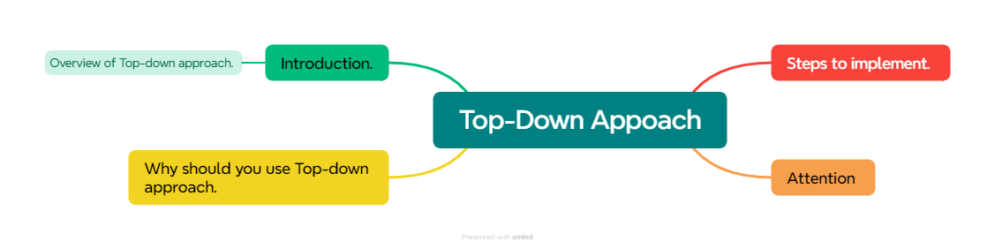
Introduction
Mind Map

Slide 10
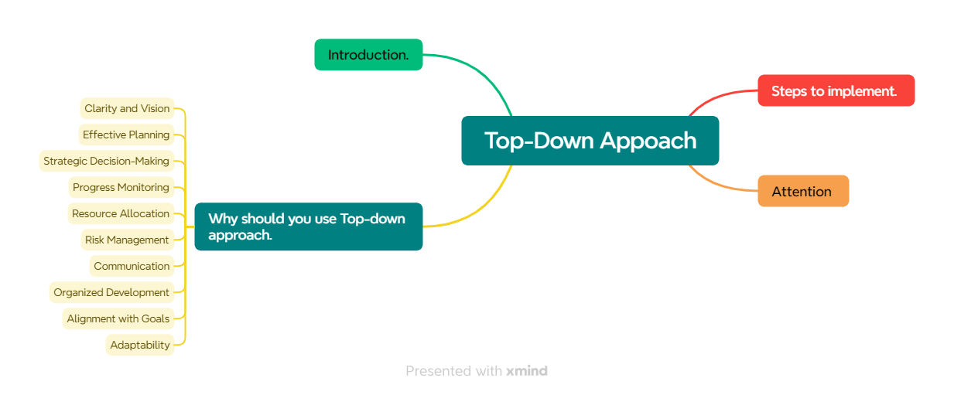
Why should you use Top-down approach?
Mind Map

Slide 11
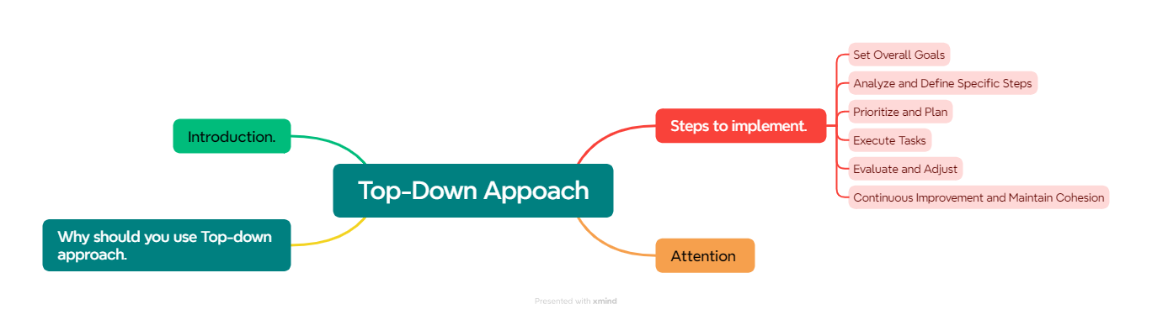
Steps to implement
Mind Map

Slide 12
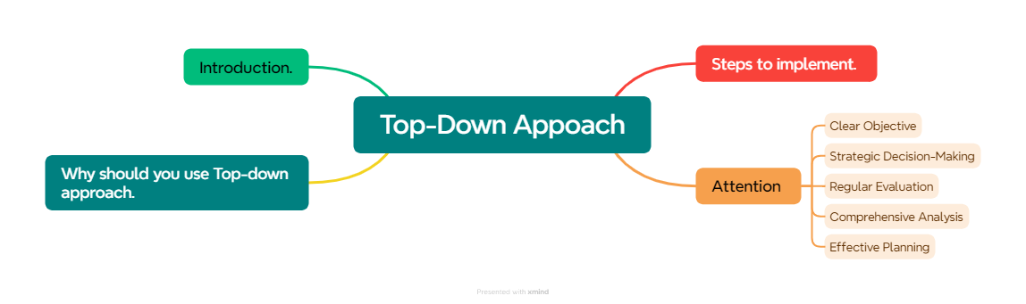
Attention
Mind Map

Slide 13
Thank you

