Slide 1

SMART INDIA HACKATHON 2026
TITLE PAGE
Problem Statement ID – SIH26099
Problem Statement Title-Student
Theme- Smart Automation
PS Category- Software
Team ID - 176653
Team Name – Access_Innovators

Slide 2
AI-DRIVEN STANDARDIZATION AND HARMONIZATION
OF MATERIAL CODES ACROSS CPSEs
Access_
innovators
AI-BASED STANDARDIZATION: Standardizes material codes across different CPSEs using AI.
DUPLICATE DETECTION: Identifies duplicate, similar, and inconsistent material codes automatically.
SMART MATERIAL MATCHING: Matches similar materials using, descriptions, and specifications.
CENTRALIZED DATABASE: Creates a unified material master database accessible across CPSEs.
IMPROVED EFFICIENCY: Enhances procurement, inventory, data accuracy, and cost efficiency
PROPOSED SOLUTION:

Slide 3
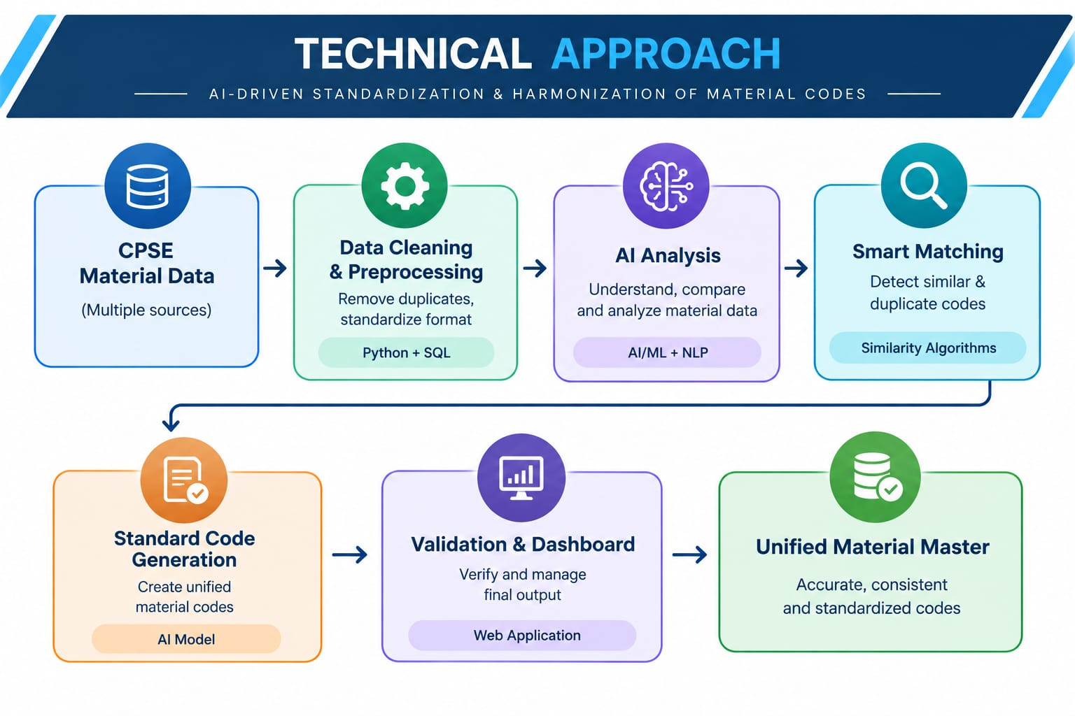

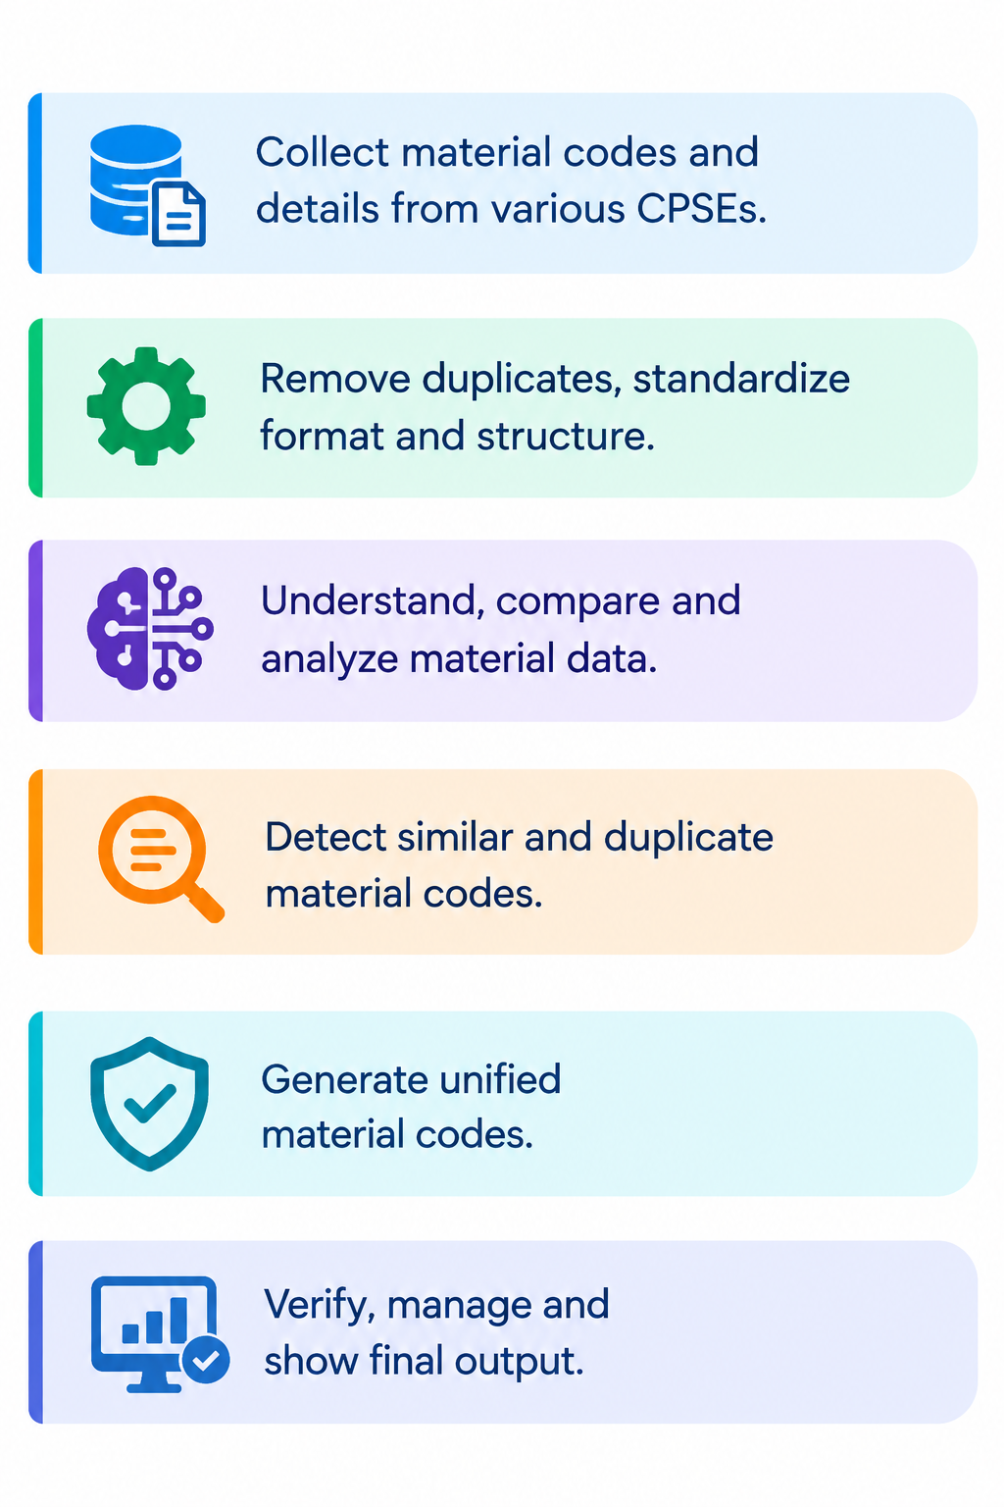
TECHNICAL APPROACH
Access_
innovators

Slide 4
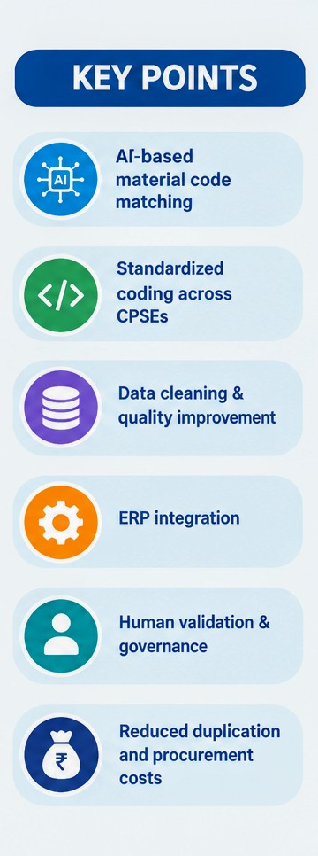
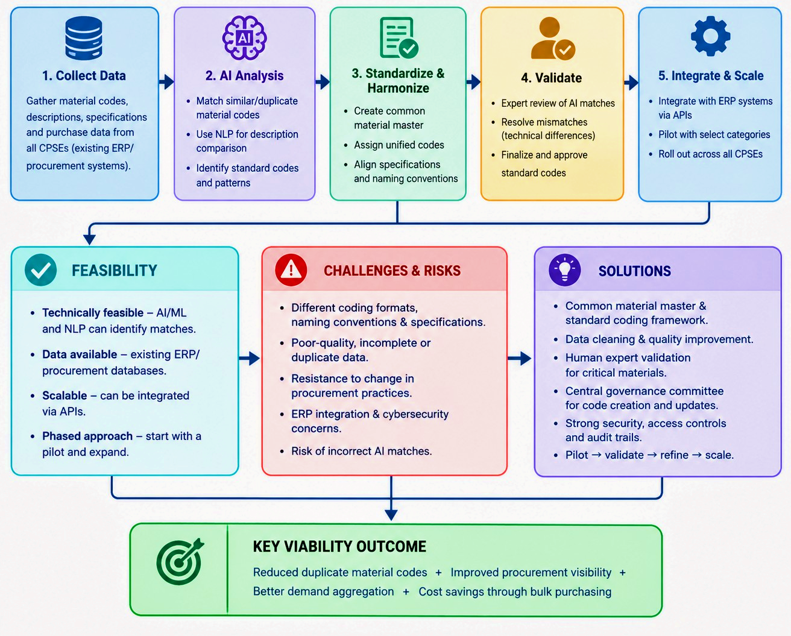
FEASIBILITY AND VIABILITY
Access_
innovators

Slide 5
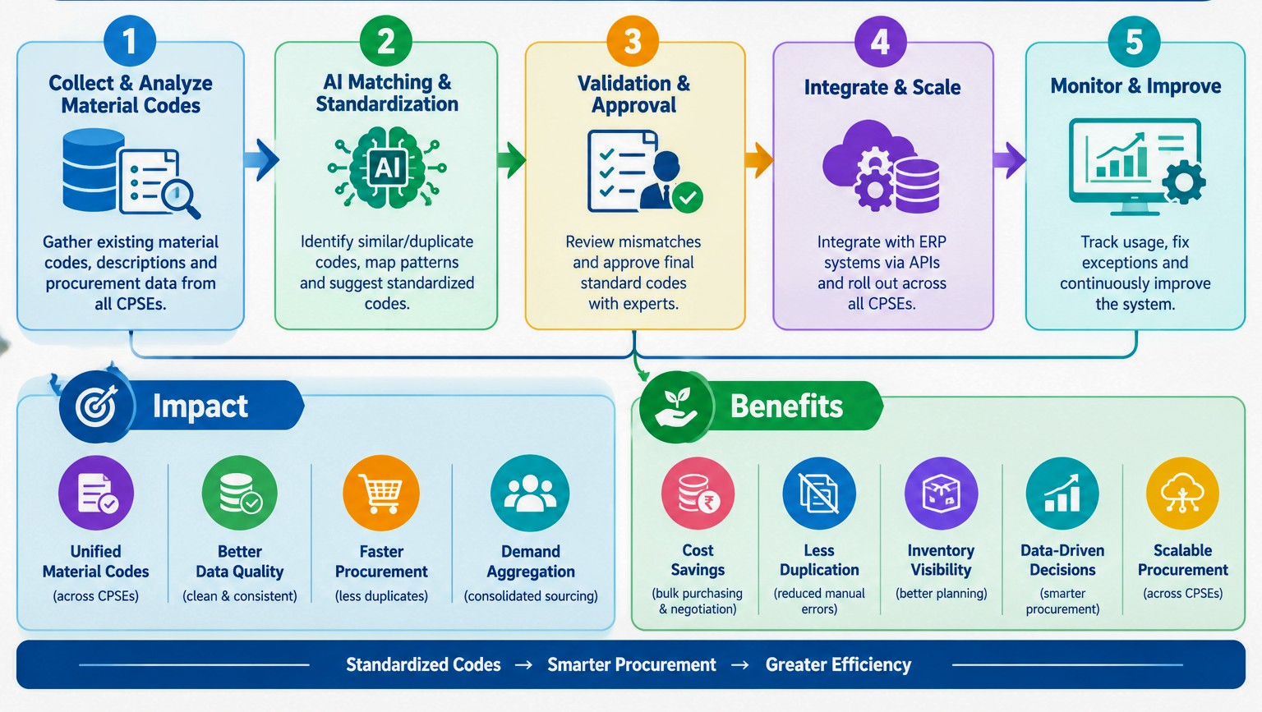
IMPACT AND BENEFITS
Access_
innovators

Slide 6
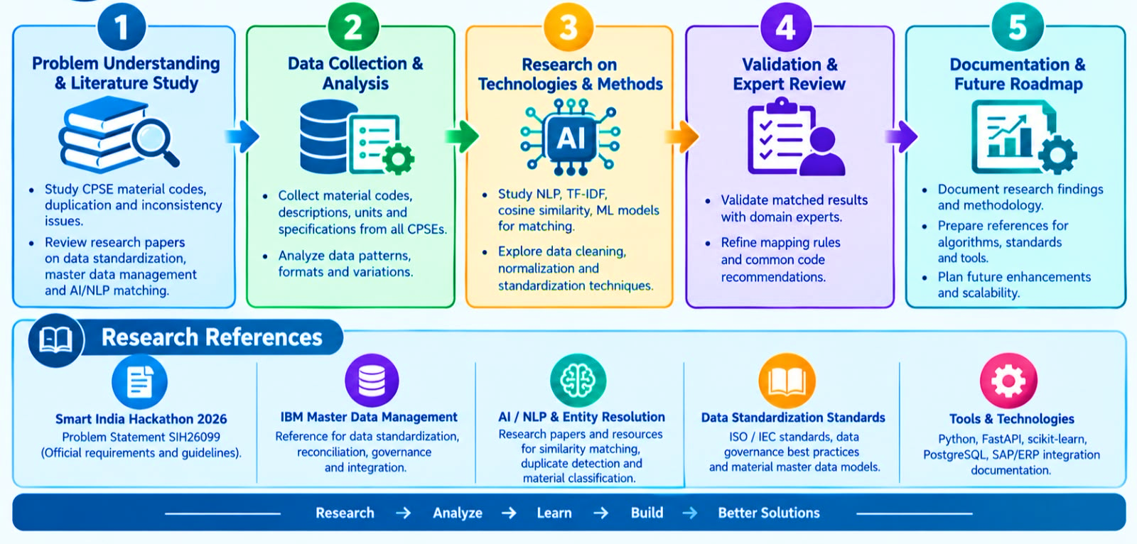
RESEARCH AND REFERENCES
Access_
innovators

Slide 7
IMPORTANT INSTRUCTIONS
Please ensure below pointers are met while submitting the Idea PPT:
Kindly keep the maximum slides limit up to six (6). ( Including the title slide)
Try to avoid paragraphs and post your idea in points /diagrams / Infographics /pictures
Keep your explanation precise and easy to understand
Idea should be unique and novel.
You can only use provided template for making the PPT without changing the idea details pointers (mentioned in previous slides).
You need to save the file in PDF and upload the same on portal. No PPT, Word Doc or any other format will be supported.
Note - You can delete this slide (Important Pointers) when you upload the details of your idea on SIH portal.

