Slide 1
What is Machine Learning?
Machine learning is programming computers to optimize a performance criterion using example data or past experience.
[-- Ethem Alpaydin]
The goal of machine learning is to develop methods that can automatically detect patterns in data, and then to use the uncovered patters to predict future data or other outcomes of interest.
[-- Kevin P. Murphy]
Based on slide by David Kauchak

Slide 2
Traditional Programming
Machine Learning
Data
Computer
Output
Program
Data
Computer
Program
Output
Slide credit: Pedro Domingos

Slide 3
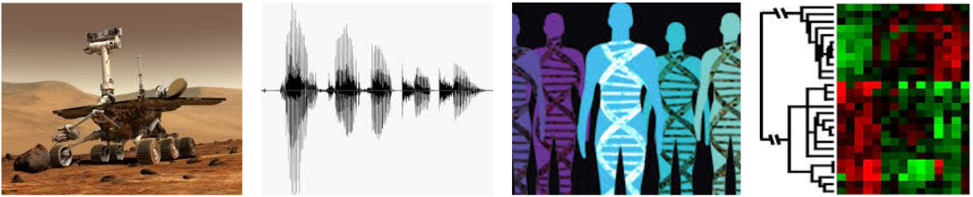
When Do We Use Machine Learning?
ML is useful when:
Human expertise does not exist (navigating on Mars)
Humans can’t explain their expertise (speech recognition)
Models must be customized (personalized medicine)
Models are based on huge amounts of data (genomics)
Based on slide by Eric Eaton

Slide 4
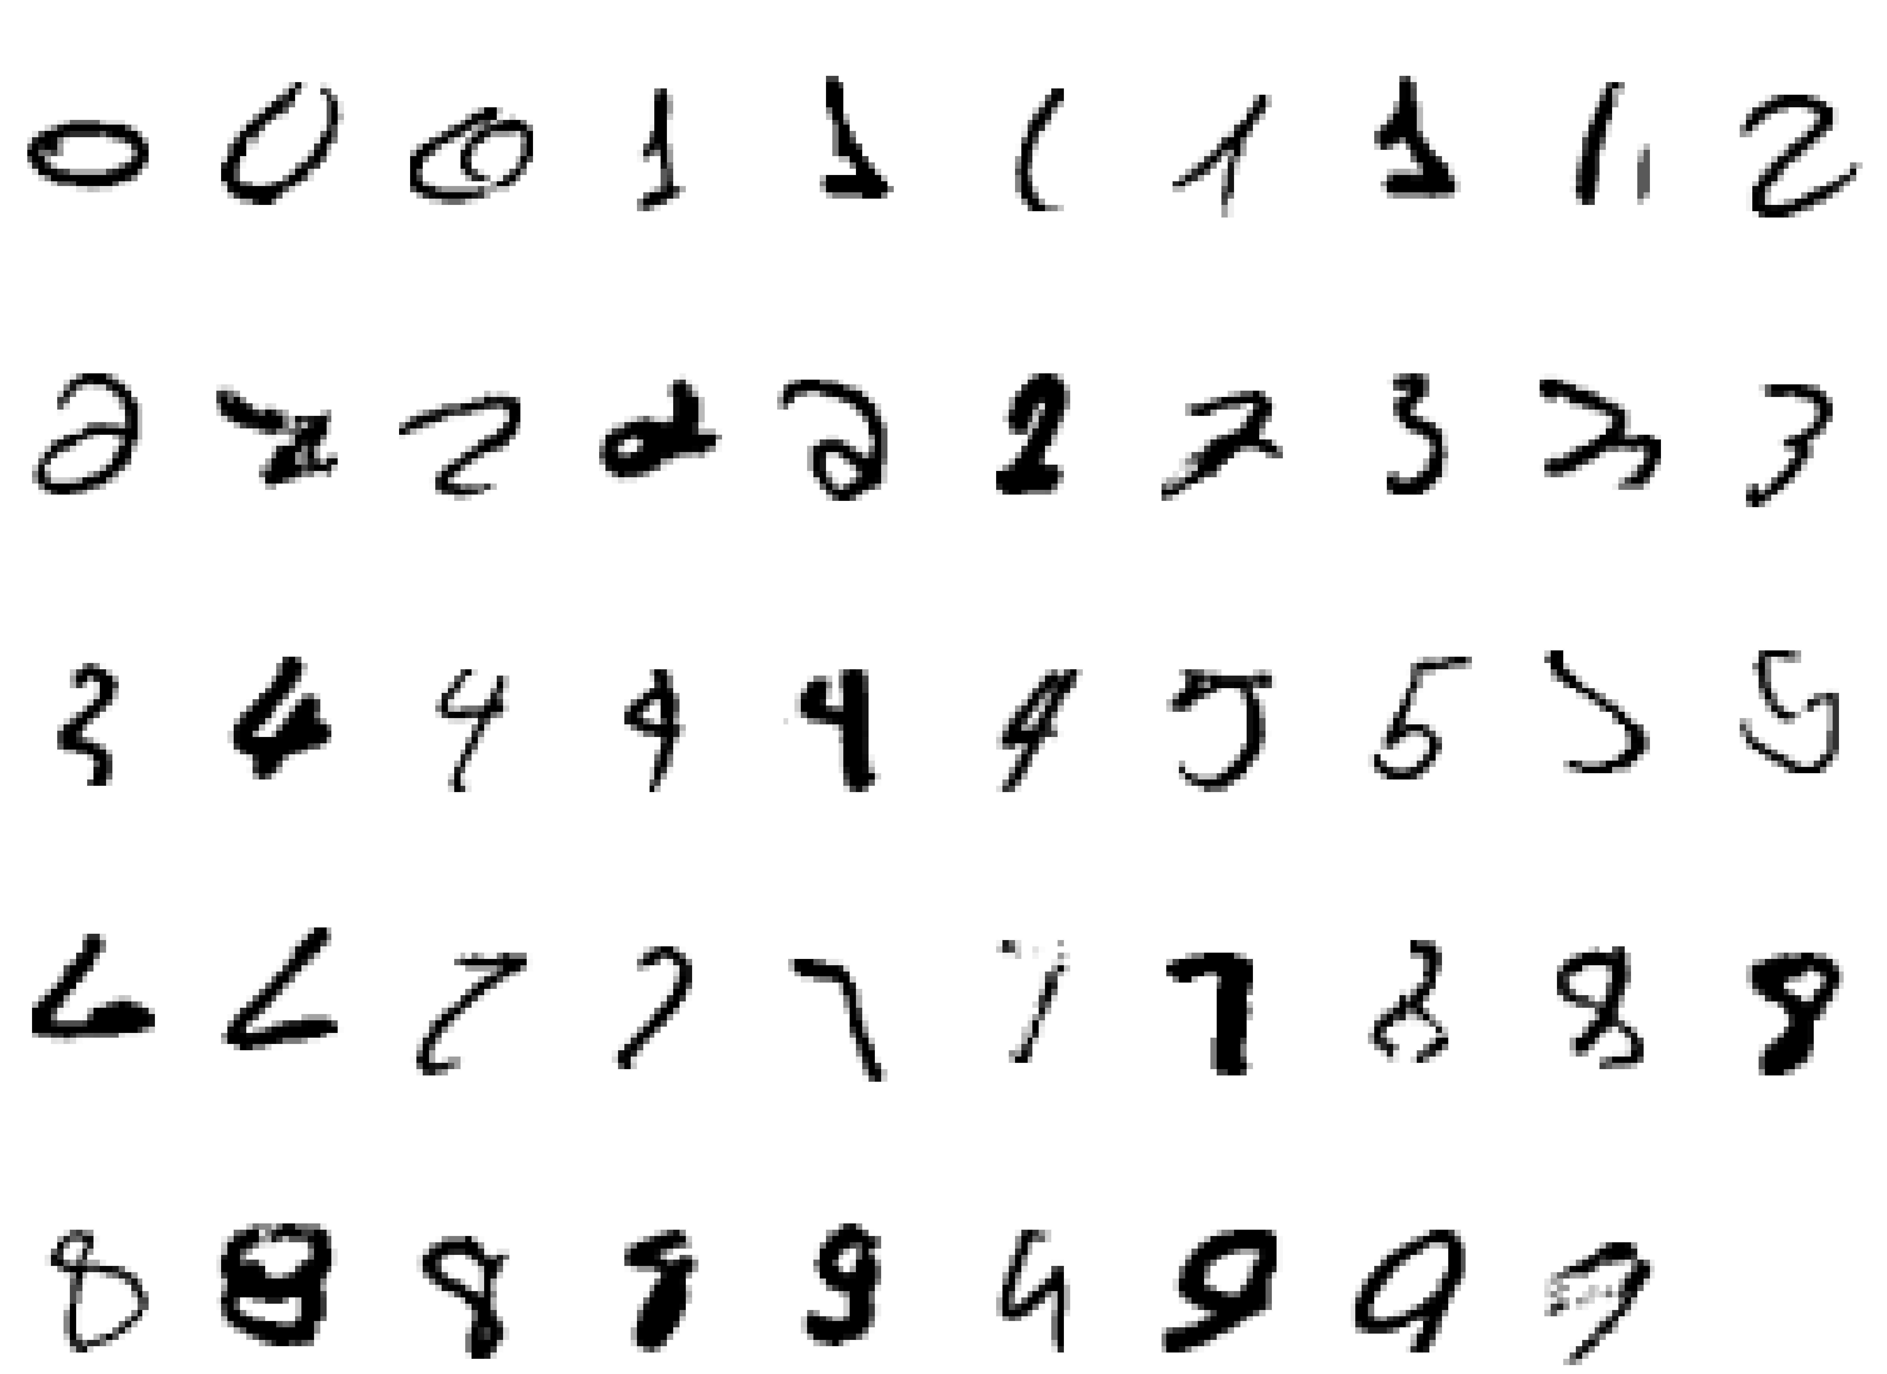
Classic Example:
It is hard to say what makes a 2
Slide Credit: Geoffrey Hinton

Slide 5
Other examples of tasks best solved by machine learning
Recognizing patterns:
  Objects in real scenes
  Facial identities or facial expressions
  Spoken words
Recognizing anomalies:
  Unusual sequences of credit card transactions
  Unusual patterns of sensor readings in a nuclear power plant
Prediction:
  Future stock prices or currency exchange rates
  Which movies will a person like?
Slide Credit: Geoffrey Hinton

Slide 6

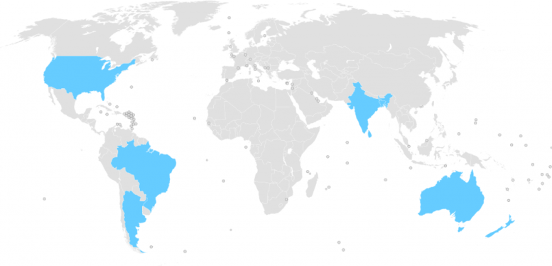
This Year’s WiDS Datathon
Focused on patient health data from MIT’s GOSSIS (Global Open Source Severity of Illness Score) initiative
130,000 hospital Intensive Care Unit (ICU) visits from GOSSIS consortium

Slide 7
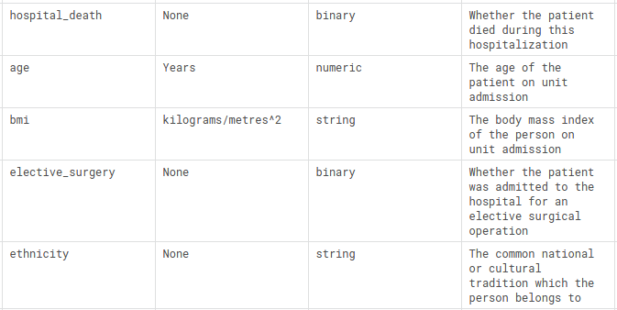
This Year’s WiDS Datathon
Goal is to predict patient survival using data from the first 24 hours of intensive care

Slide 8
Goals for the workshop
Develop intuition for working with patient data
  Data exploration and preprocessing
Understand and apply ML algorithms to data
  Model representations: logistic regression, decision trees, neural networks, etc.
  Evaluation metrics and optimization
Appreciate what makes healthcare different
  Need to consider fairness and accountability
  Small number of samples
  Lots of missing data
  etc.

Slide 9
What makes healthcare different?
Life or death decisions
  Consider fairness and accountability of algorithms
Many of the questions we want to answer are causal
  Naive use of supervised machine learning is insufficient
Sometimes a small number of samples
  Majority of patients are healthy people, survivors, etc.
Lots of missing data
Based on slides by David Sontag

