Slide 1

Wireless display of Apple / iOS devices
AirPlay is Apple's wireless audio and video technology. It allows most iOS devices (iPhone, iPad, iPod) and recent MAC computers the ability to mirror screens and stream content to AirPlay receivers typically connected to TVs or projectors. In an educational context, this can allow faculty to present on the lecture screen and not be restricted to the podium area. It gives the faculty member the freedom to circulate throughout the class and engage with students while retaining control of what is being projected. This also allows for active participation from students who can contribute and share their own work on screen via student's own iOS device.
In this session we will look at various options available from Apple and 3rd party developers. Restrictions and limitations of each will also be explored as well as price points ranging from $0*, $15, $100 and $200+.
* $0 – assuming previously purchased hardware.

Slide 2
iPad / MacBook wireless display demo
We will look at 6 different options today
Our standard, tested, reliable “Apple TV kit” (~$300):
AppleTV
VGA adapter
Airport Extreme router
3 laptop software solutions ($0-$13) + laptop + router:
Any router will work – from a $200 airport extreme to a $15 tigerdirect special to a 3G cellular hotspot, etc.
MAC or PC laptop (hardware spec requirement vary)
3rd party (not Apple) Airplay ‘receiver’ software
Air Server
Reflector
XBMC
Non router option
Bluetooth connection to transmit AirPlay
Quality issues
AppleTV utilizing UofT WiFi network
Limited hardware options
Notes:
Will look at various different methods to stream content via AirPlay.
If we have time at the end, maybe we can stress test with audience participation.
Apple devices can’t discovers each other over UofT WiFi (needs Bonjour)
Separate wifi router is recommended. In a few years, hopefully this won’t be necessary.

Slide 3
iOS - AirPlay
Use AirPlay to stream music, photos, and video wirelessly to Apple TV and other AirPlay-enabled devices that are on the same Wi-Fi network as your iPhone, iPad, or iPod touch.
Requirements:
iPhone 4 (or later), iPad, iPad mini, or iPod touch (4th generation or later)
For videos or photos: Apple TV (2nd or 3rd generation)
For music: Apple TV (2nd or 3rd generation), AirPort Express, or AirPlay-enabled speakers or receivers
You can also use AirPlay with iTunes.
http://support.apple.com/kb/ht4437
Notes:
Straight from the Apple website

Slide 4
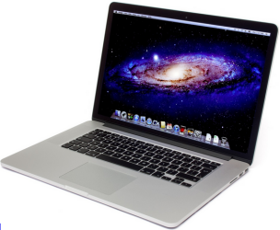
AirPlay Mirroring in OS X
Stream MAC desktop the same as an iOS devices
AirPlay Mirroring in OS X takes advantage of the hardware capabilities of recent Macs to deliver high frame rates while maintaining optimal system performance.
The following Mac models support AirPlay Mirroring when using OS X Mountain Lion or later:
iMac (Mid 2011 or newer)
Mac mini (Mid 2011 or newer)
MacBook Air (Mid 2011 or newer)
MacBook Pro (Early 2011 or newer)
Mac Pro (Late 2013 or newer)
http://support.apple.com/kb/ht5404
Notes:
Straight from the apple website

Slide 5
Our “Apple TV kit”
Reliable. Same ‘plug-and-play’ kit has been used at OISE for almost 3 years.
Simple to use (one time wifi configuration required). Instructor connects the same way they would a laptop – plug in power, network , VGA & sound.
Apple Canada’s education trainer brought a similar kit when delivering workshops at OISE.
Currently using an Airport Extreme router, but kit has been used with a 3G wireless hotspot at remote site.
Built $200 kits for other departments at OISE (AppleTV, Airport Express, cheaper VGA adapter)
Notes:
Departments are choosing this option over a ‘cheaper’ software option because this does not tie up a computer/laptop to use.
Compared to purchasing a laptop, this is the cheapest option.
Faculty can use it out of the box, simplest method for students to connect as well
BUT an open LAN network connection is required

Slide 6
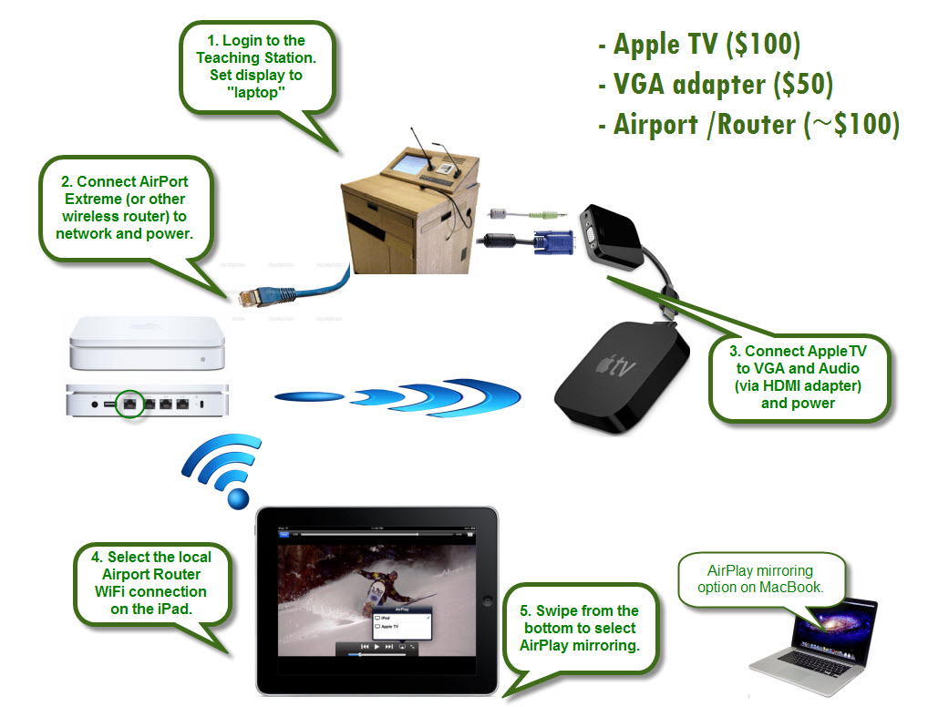
Notes:
DEMO – plug in kit
Demo apps:
,youtube, stage (& camera app), remote desktop into PC, slideshark
ALLcast on android

Slide 7
Air Server
Your laptop does what the Apple TV does
Laptop is an AirPlay Reciever
MAC or PC laptop
Has “ad-hoc” network support (for both PC and MAC), works so long as you don’t need internet
ie – not a solution for Teaching Station Jr LAN connection
Can record / screen capture
Shows multiple devices at once
Hardware requirements:
iPad 2 or newer
iPad mini
iPhone 4S or newer
iPod Touch 5+
Notes:
- Still requires a router.
- Teaching station

Slide 8
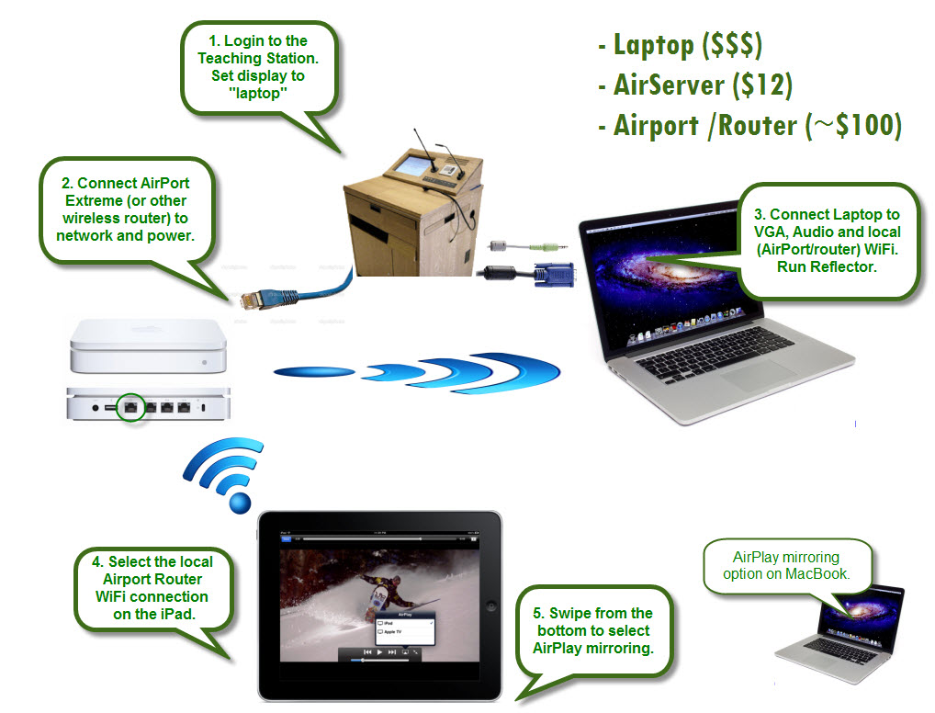
Notes:
DEMO-
Multiple screens, Auto layout
windows can rezised / moved, and be minimized to choose who is shown full screen
Screen recording (.mov)
DEMO – ad hoc network (no router)?

Slide 9
Reflector
Uses a laptop as a AirPlay Reciever
Same as AirServer
MAC or PC laptop
Shows multiple devices at once
Has more multiple display options than AirServer
Same hardware requirements as AirServer:
iPad 2 or newer
iPad mini
iPhone 4S or newer
iPod Touch 5+
Company also sells “Air Parrot” which does the reverse, makes your laptop an AirPlay transmitter - send your desktop to an AirPlay reciever (AppleTV)
Newer MacBooks have this feature built-in
Notes:
Pretty much the same as airserver
Pretty much same features as Air Server
- recording, etc.
Most teachers did purchase reflector for the multi-display options, but airserver has those now.

Slide 10

Notes:
DEMO – multiple ipads, iphone and MacBook desktop on 2nd screen
Show ‘skins’

Slide 11
XBMC
Free*
Other similar products (PLEX, etc.)
Many home theater systems are “Air Play compatible”, but just for audio.
Very limited in what can be streamed. Typically just audio for most free AirPlay systems.
Some (like XBMC) can also show pictures and video from compatible apps only.
Desktop / mirroring not available.
* also the least reliable
Notes:
- No mirror capabilities
Limited to audio and video capable apps
Photos, youtube
Depends on your hardware (iPad)
Free – you get what you pay for, can be buggy

Slide 12
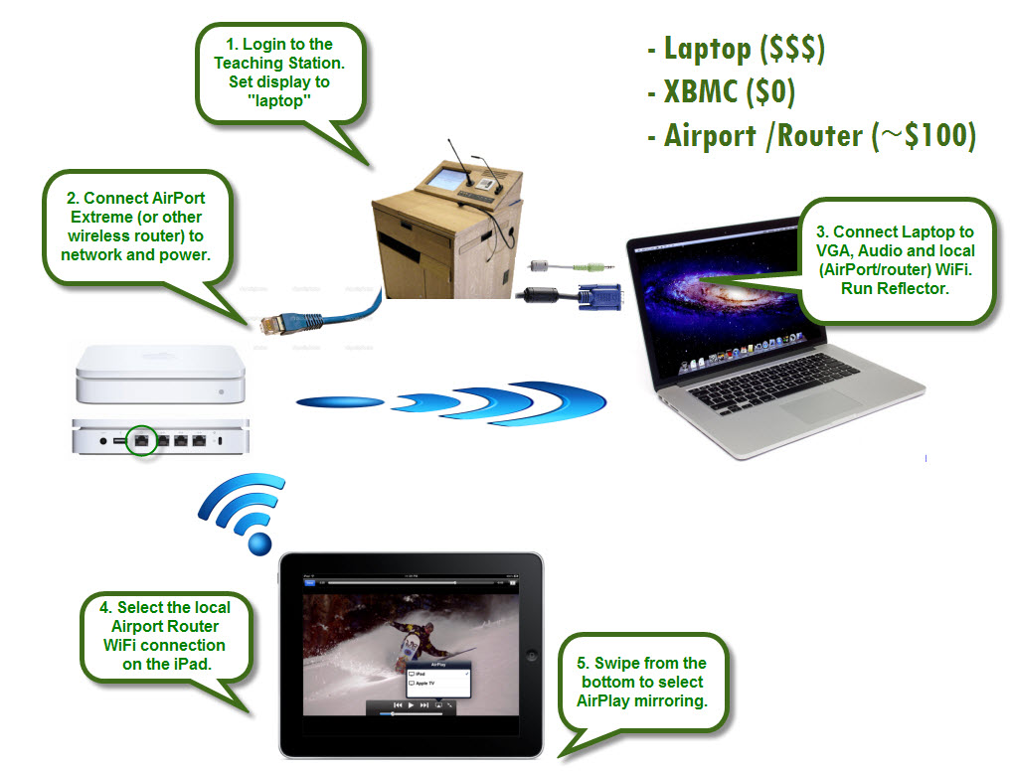
Notes:
DEMO – change MacBook screen to “Mirror”
In XBMC go to System - Services – Settings
Some apps have separate airplay buttons for full screen streaming (DEMO with Apple TV).
Older generations of AirPlay, this was the only option before desktop mirroring.

Slide 13
Bluetooth (no router)
Previous examples all require a LAN connection and separate router to give the iPad internet access.
Previous examples will not work with Teaching Station jr.
BT 4.0 allows streaming over bluetooth, not wifi.
Cheapest option
(assuming hardware has already been purchased)
Speeds can be too slow for most applications
Paring issues
Notes:
This example will work with Teaching Station jr.
Will do desktop mirroring, but very slow
Videos won’t sync, but ok for powerpoint, pictures, etc.
Can loose Bluetooth connection

Slide 14
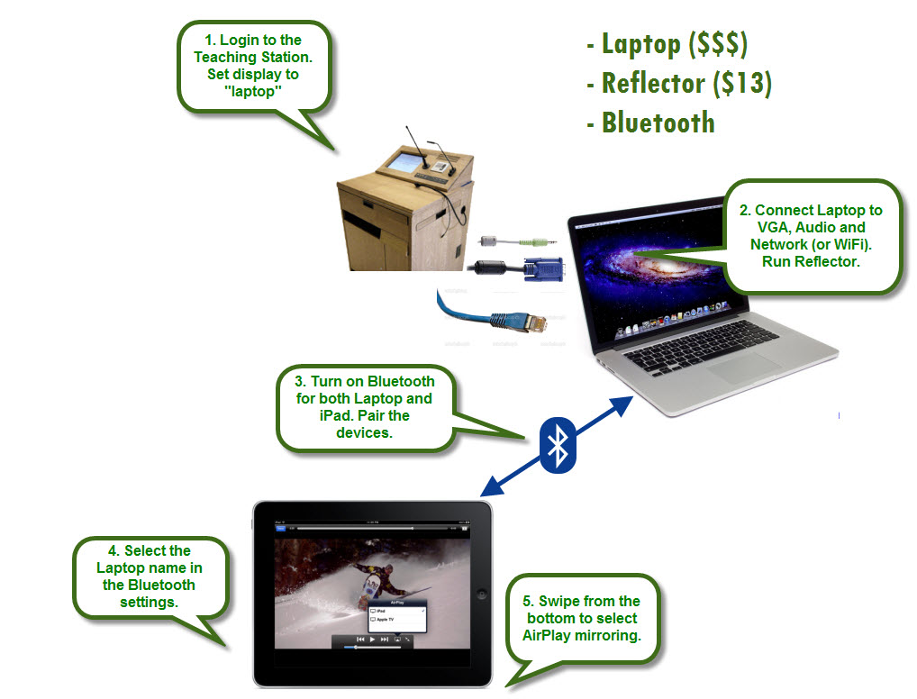
Notes:
DEMO –
MACbook – setup bluetooth devices (top menu), Run Reflector
iPad – settings, bluetooth (Derek’s MacBook there)
DEMO – youtube, then slideshare

Slide 15
Bluetooth / UofT Wi-Fi
AirPlay normally needs bonjour over UDP for AirPlay discovery.
Uses Bluetooth to discover IP addresses.
Once IPs have been determined, streaming occurs over WiFi.
Apple TV needs to be managed via Apple Configurator to connect to UofT enterprise WiFi
http://support.apple.com/kb/HT5437
Requirements:
Apple TV 3rd gen or higher with version 6.1 (released 3/10/14)
iOS device with version 7.1 (released 3/10/14)
IP connectivity between the two devices
Bluetooth 4.0 devices (iPad 3rd gen+, iPad mini, iPhone 4S+, touch 5th gen+)
Thanks to Michael Spears (UofT MADLab) for the heads up of this feature - afp548.com
Notes:
Needs newer iPad devices with Bluetooth 4.0
Ipads need to be managed to connect to UofT wifi
Inconsistent finding devices with bluetooth, reliable once connected.

Slide 16
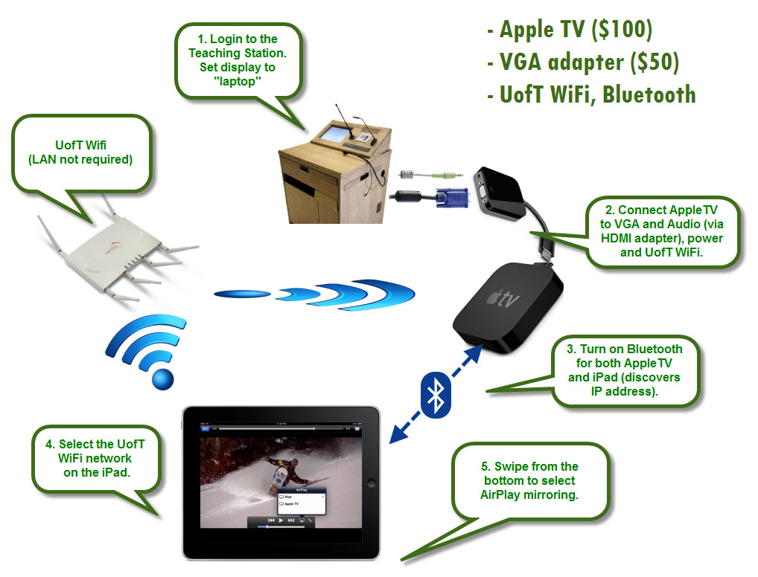
Notes:
DEMO – Apple TV, connect to UofT WiFi, reboot, connect VGA
My iPad, connect to UofT WiFi
DEMO – youtube.
DEMO – ask if anyone else in the audience with BT4.0 device can see / airplay to the apple tv?

Slide 17
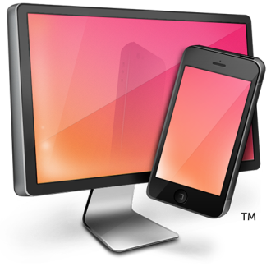
Questions / stress test
Get out your Apple devices and lets all connect to Reflector and watch the sparks fly ☺
Contact:
Derek Hunt
derek.hunt@utoronto.ca
@HuntDerek

