Slide 1

Be Prepared: IT as Scouts and Guides in Business Continuity Planning
Information Technology Services
Robert Cook, Chief Information Officer
CANHEIT - PEI, June 2, 2014

Slide 2
Agenda
What is business continuity planning?
Why IT?
Continuity planning at U of T
Kuali Ready SaaS
Brief Demo
Discussion

Slide 3
Qualifications on this presentation and full disclosure
No expert in risk management
COBIT/ITIL-free
Case in progress … with lots of warts
I’m on the project board of Kuali Ready

Slide 4
What is business continuity planning?
A rose by any other name …
An aspect of risk management
Not risk prevention
Not emergency response
Not DR, not IT specific
“All hazards” insurance

Slide 5
What is business continuity planning?
“No matter what happens today,
we want to be able to do tomorrow
what we were doing yesterday.”
Kuali Ready

Slide 6
What is business continuity planning?
Put in place NOW the things that will enable us
to continue serving our constituents
to maintain our viability following a catastrophic event of any size or type

Slide 7
Why IT?
Our vantage point at nexus of many university services
Analogous experience regarding other pan-university requirements
Project management
Business Process Reengineering

Slide 8
Why IT?
US situation – vice presidents of risk management
Canadian institutions
U of T
Risk Management & Insurance
Incident Response
High Risk students
Information Security
Internal Audit

Slide 9
University of Toronto – Who We Are
83,000 Students
12,700 Faculty and 6,100 Staff
$2B operating annually plus $1.2B research (with hospital partners)
3 campuses across 50 km
20th worldwide in 2013 Times Higher Ed Rankings
BIG RISK PROFILE!

Slide 10
Development of institutionally coordinated BCP at U of T
Pre 2008 – mostly ad hoc, best developed in physical plant and finance
2009 - H1N1 pandemic threat and potential labour disruption motivates intensification across most lines of business
2010-2013 – “uneven” maintenance
2014 - two stage renewal initiative

Slide 11
Development of institutionally coordinated BCP at U of T
Tools
2008 - Berkeley Continuity Planning Tool
2010 – UTOR Continuity Planning
Canadian instance of Kuali Ready SaaS (hosted by U of T & UBC)
U of T becomes a paying KR client

Slide 12
UTOR Ready Features
step by step process (QuickTax-like)
local administration
App specific or Shibboleth authentication (Kuali is a CAF member)
hardcopies and redundant cloud access

Slide 13
UTOR Ready Features
Prompts reflection to identify functions and rate their criticality

Slide 14
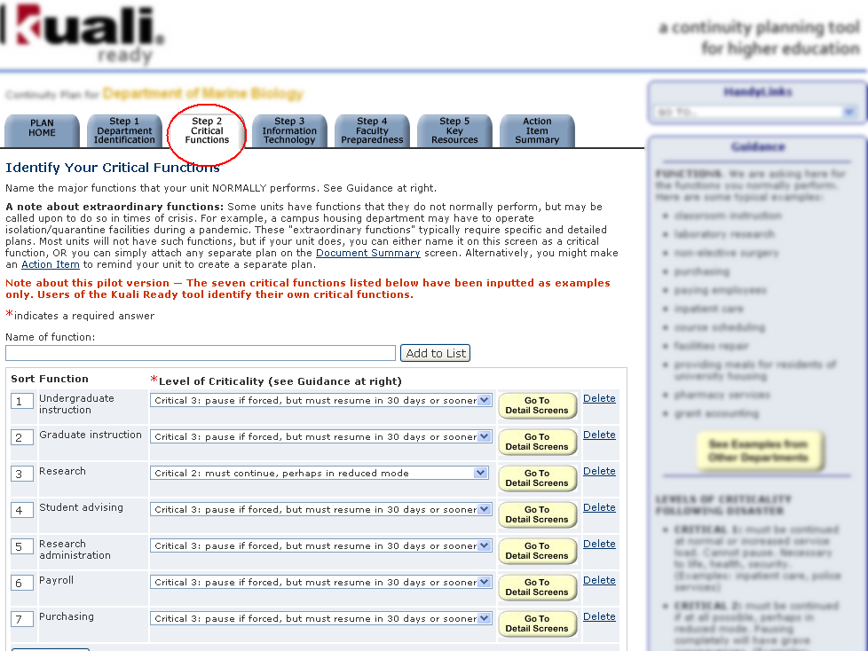

Slide 15
UTOR Ready Features
Prompts reflection to identify functions and rate their criticality
Causes collection & documentation of key information

Slide 16
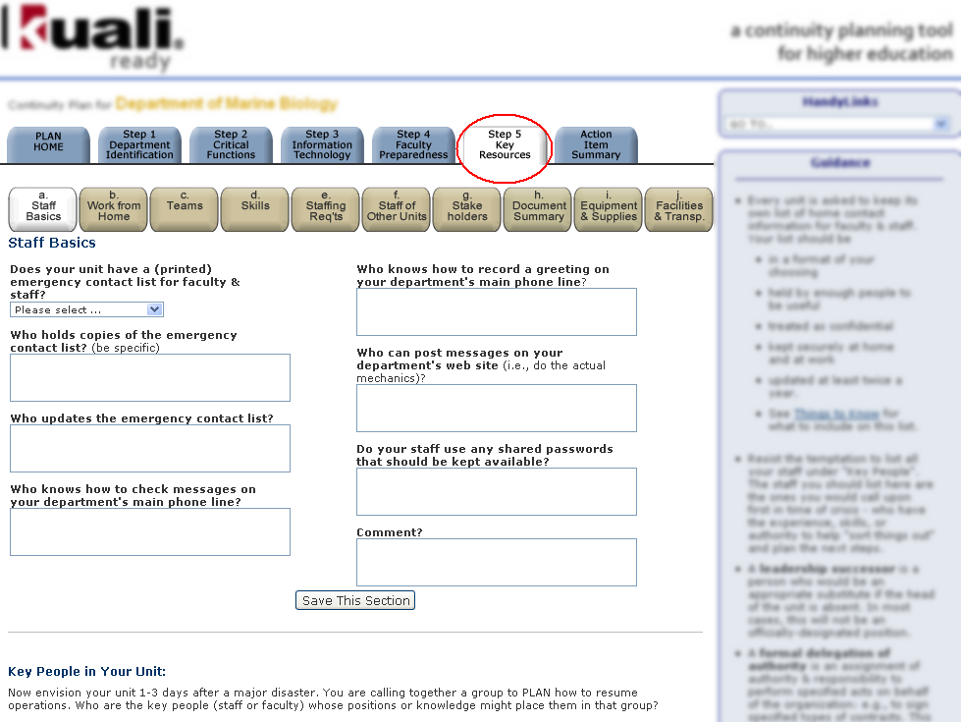

Slide 17
UTOR Ready Features
Prompts reflection to identify functions and rate their criticality
Causes collection & documentation of key information
Prompts development of coping responses

Slide 19
UTOR Ready Features
Prompts reflection to identify functions and rate their criticality
Causes collection & documentation of key information
Prompts development of coping responses
Stimulates identification of actions to take now to be prepared

Slide 20
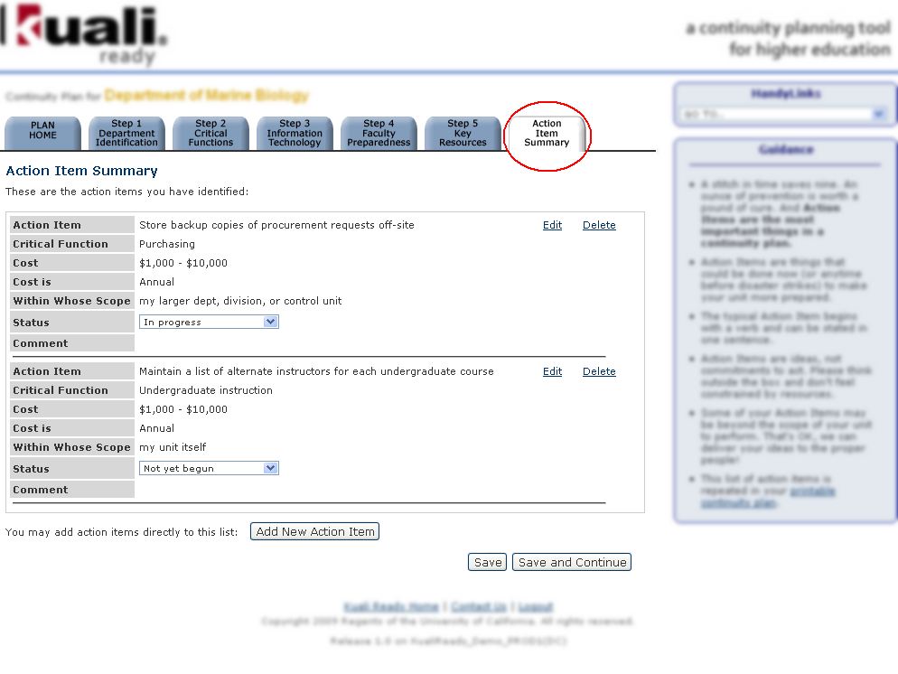

Slide 21
UTOR Ready Features
Prompts reflection to identify functions and rate their criticality
Causes collection & documentation of key information
Prompts development of coping responses
Stimulates identification of actions to take now to be prepared

Slide 22
Implementation Insights
Lean, useable content
Directed toward action vs artifacts
Report formats and consolidation
Good administrative control, customizable (picklists, messaging, common priorities)

Slide 23
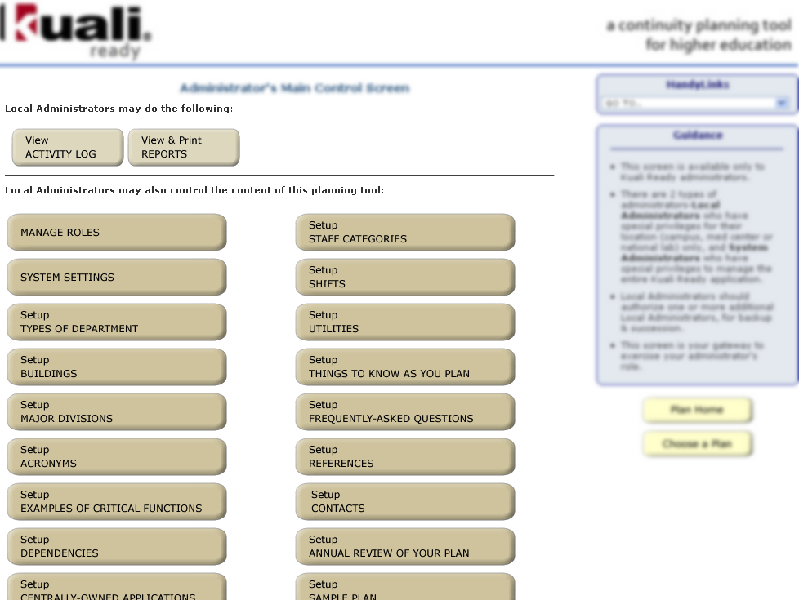

Slide 24
Implementation Insights
Supports continuous evolution and refinement
Easy interface, good templates … but it’s still alien activity to most users
Needs local ownership/encouragement/compliance

Slide 25
More information
http://www.kuali.org/ready
Product description
Test Drive
Subscription information
cio@utoronto.ca

Slide 26
Demo and Discussion

Slide 27
Be Prepared: IT as Scouts and Guides in Business Continuity Planning
Information Technology Services
Robert Cook, Chief Information Officer
CANHEIT - PEI, June 2, 2014

